Slide 1



Around the World
Unit 8 Lesson 10

Slide 2


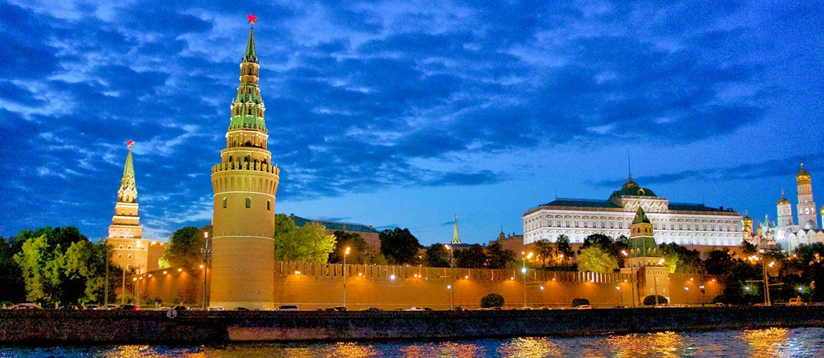
What will we be learning this class?
A look into a new country
Adding endings to words (suffixes)

Slide 3


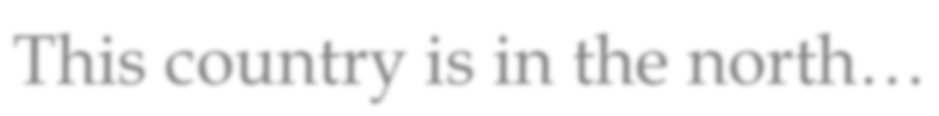
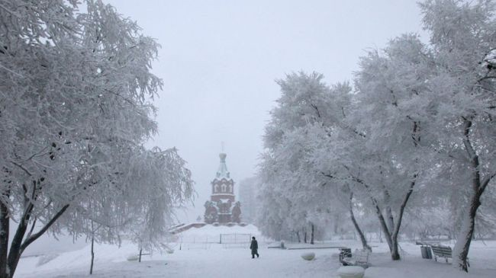
Today we will be learning about another country.
This country is in the north…

Slide 4


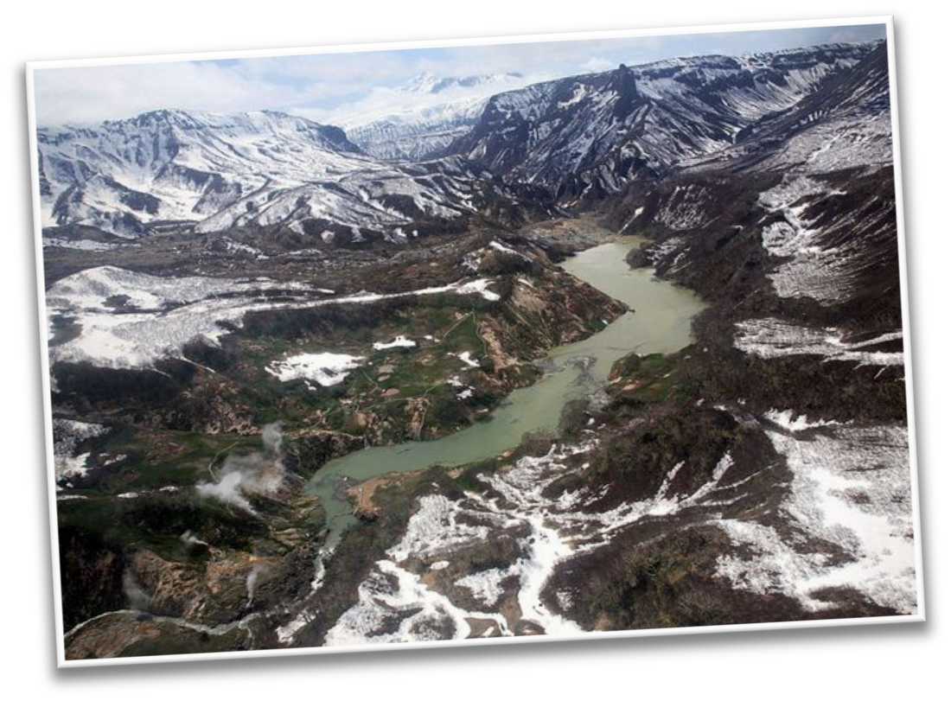


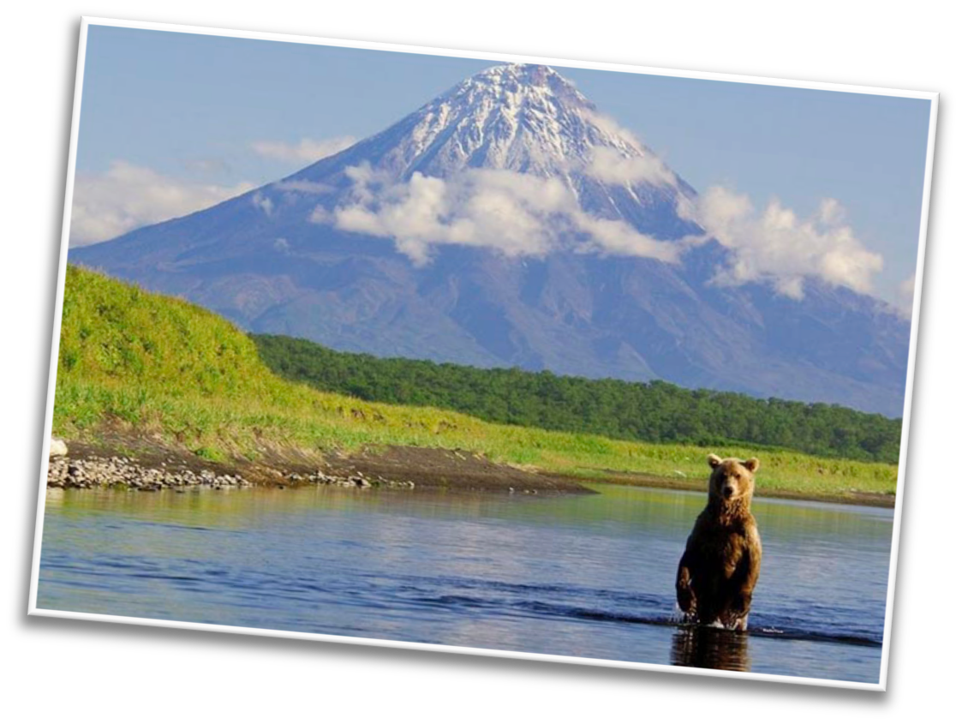


It is the largest country in the world…
And is part of TWO continents!

Slide 5
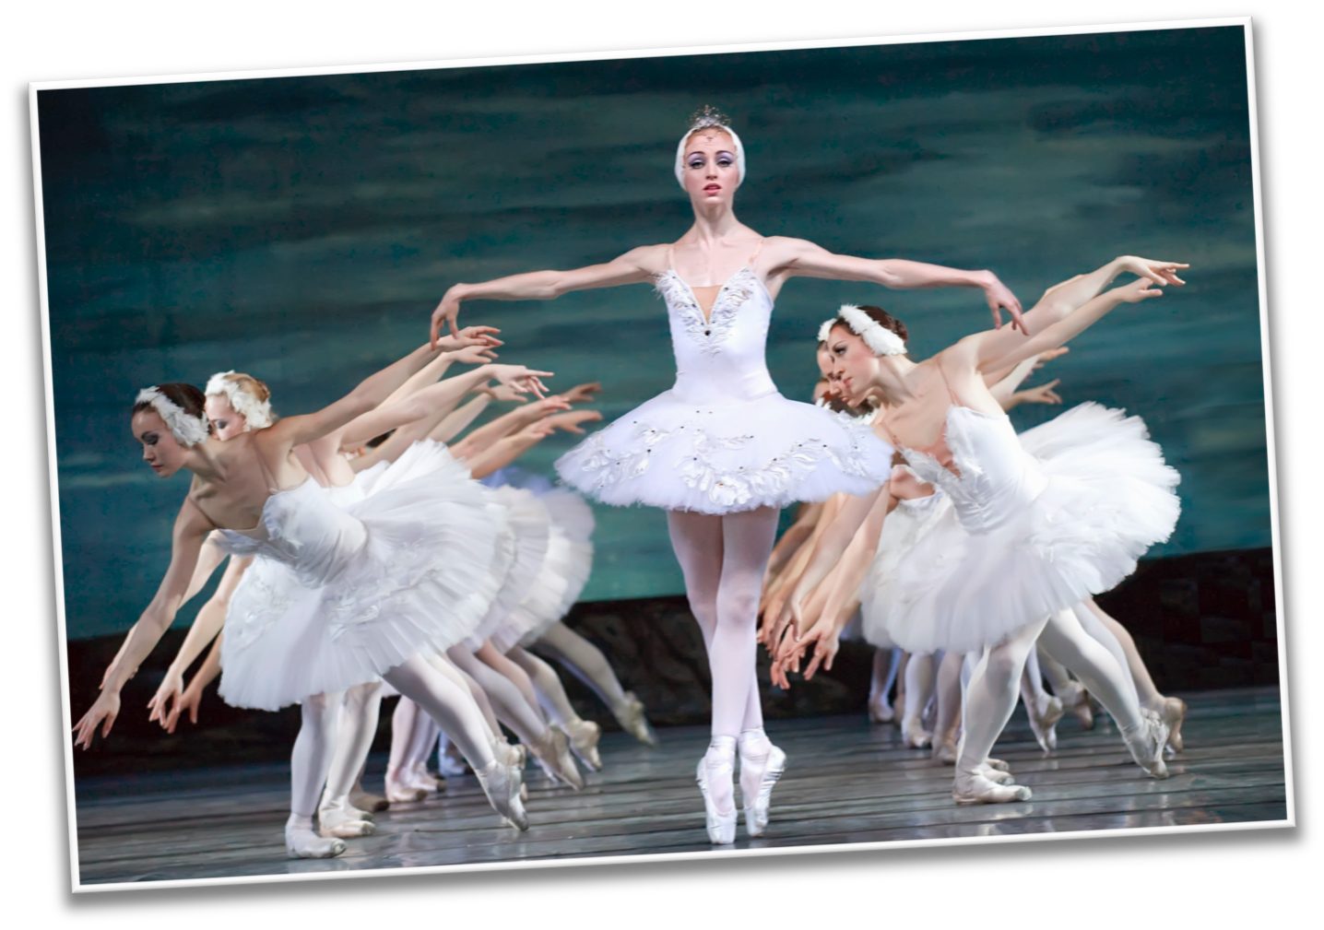
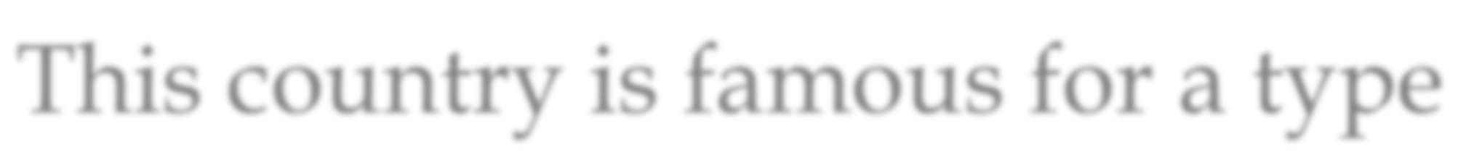
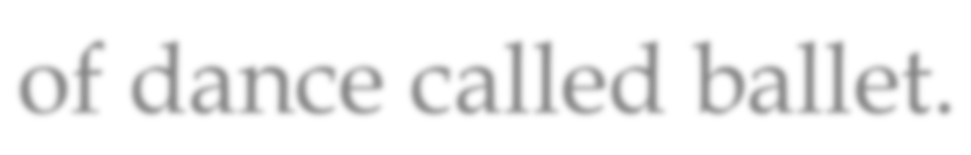
This country is famous for a type of dance called ballet.

Slide 6
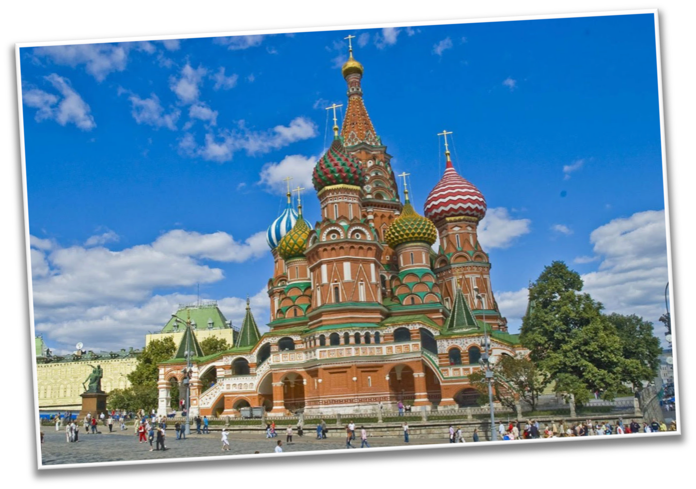
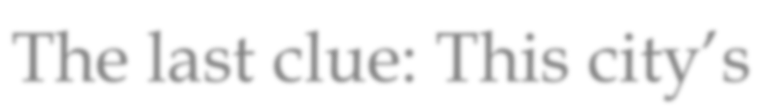
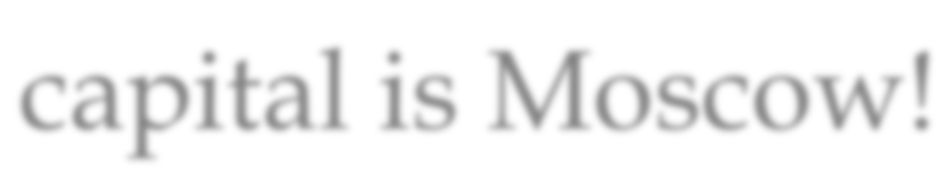
The last clue: This city’s capital is Moscow!

Slide 7
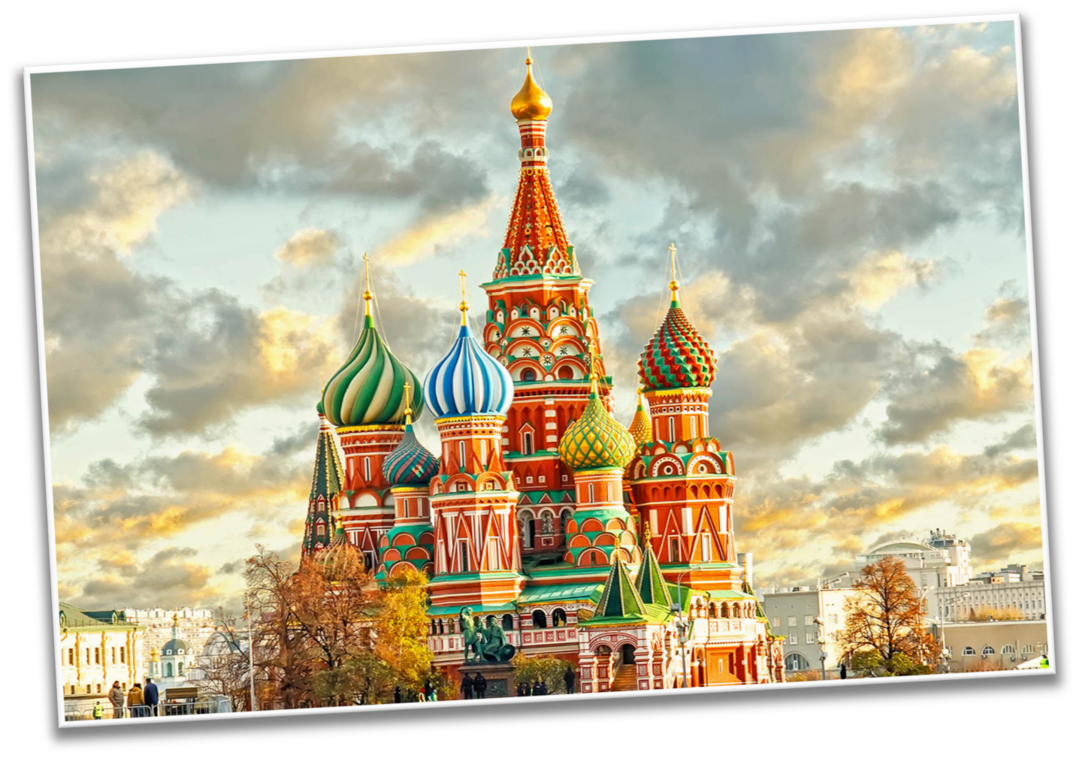
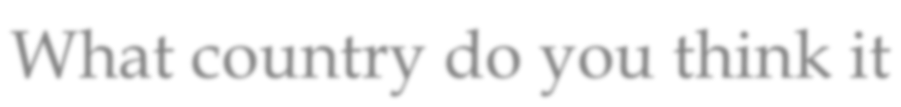
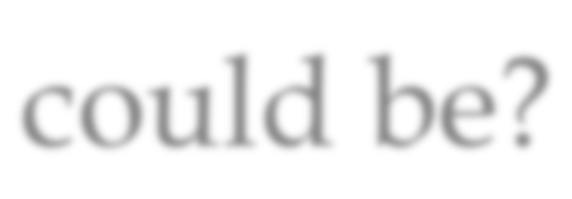
What country do you think it could be?

Slide 8


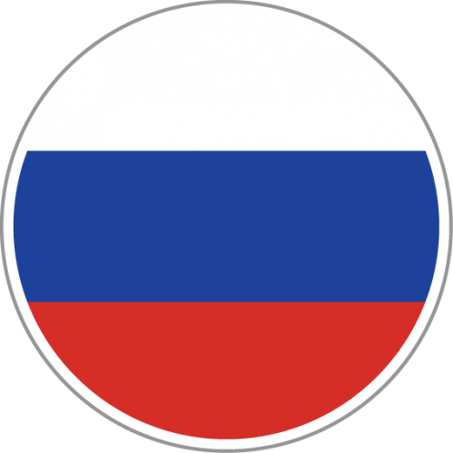
What do you know about Russia? Write it below

Slide 9








We learned that this country is in the north.
Describe what you think the land might look like.

Slide 10
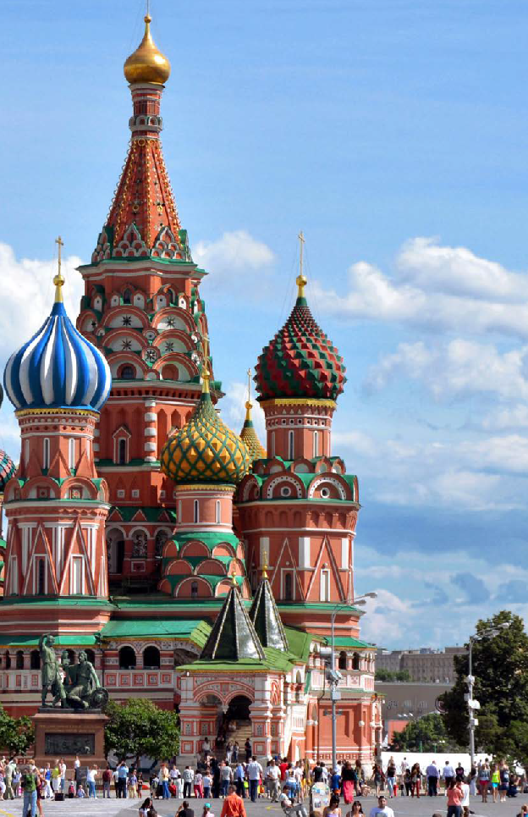

Let’s learn more about the country!
LEVELED BOOK • K
Russia
We will now read a book about Japan!
Written by Eleanor Frost
www.readinga-z.com

Slide 11


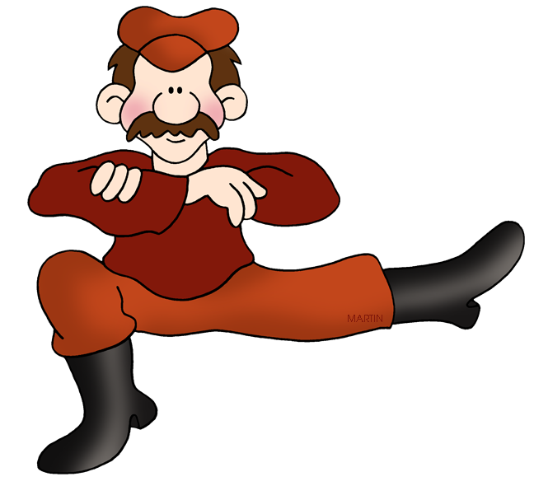
What did you like about Russia?

Slide 12


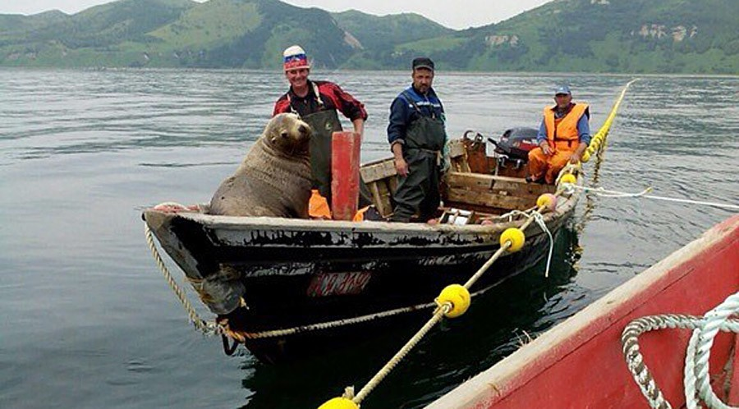
Do you remember? What do people in Russia do for work?

Slide 13

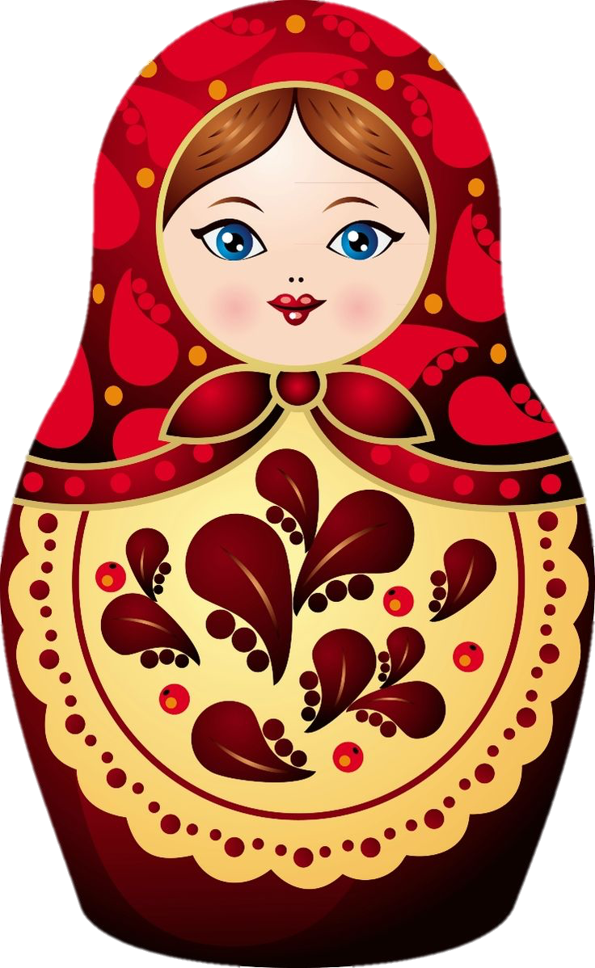
Great work!
Now we will review endings to words!

Slide 14




Often, we will see the letter “S” at the end of words.
What does the letter “S” mean at the end of a word?

Slide 15


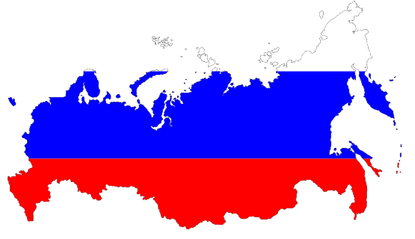
What about when we see “ED” at the end of a word?
What does that mean?

Slide 16


What about when we see “ING” at the end of a word?
What does that mean?

Slide 17



Write a word using the “ED” suffix.

Slide 18



Write a word using the “S” suffix.

Slide 19


Write a word using the “ING” suffix.

Slide 20


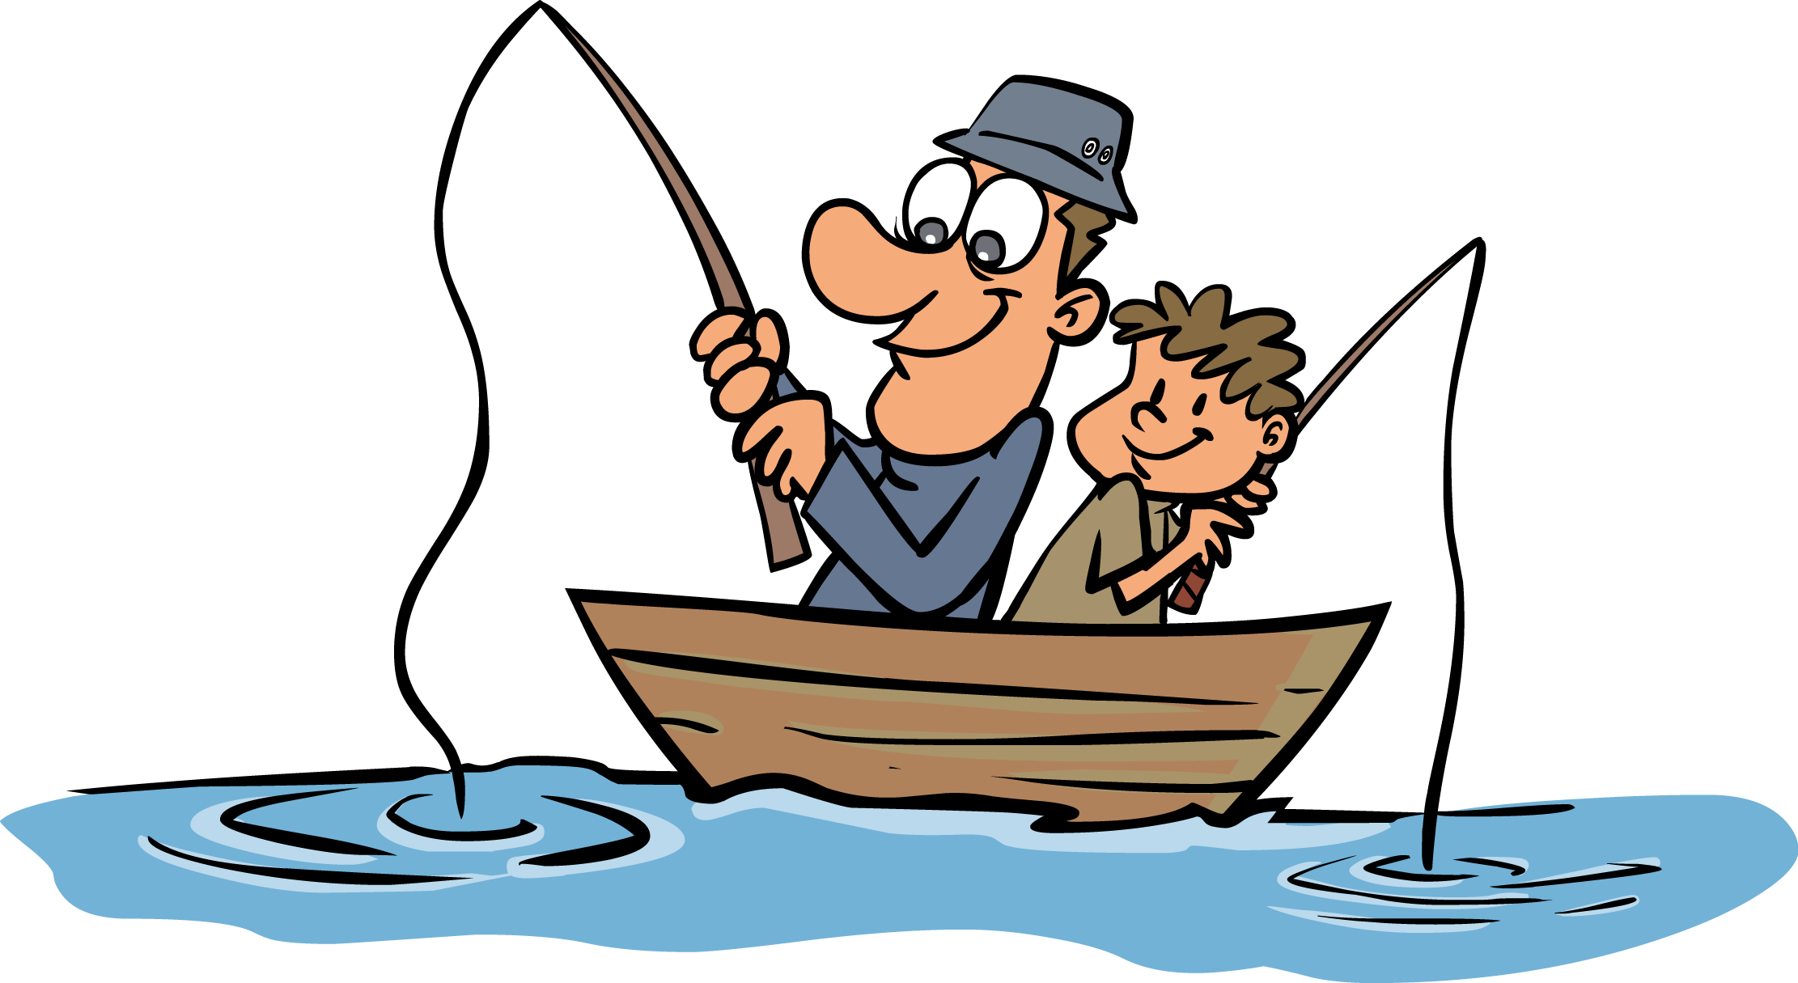
Use the “ING” suffix in a sentence.

Slide 21


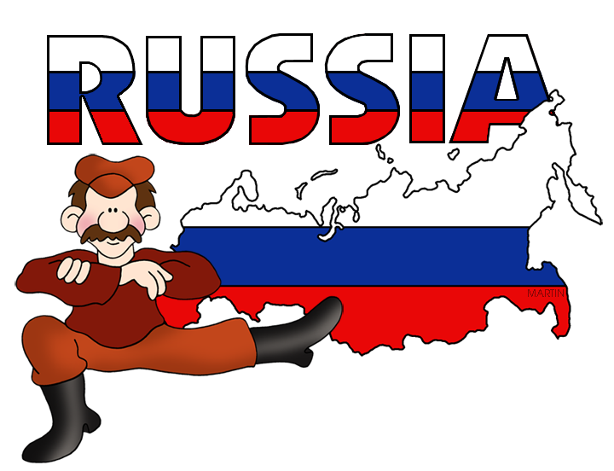
Very good job! What did we learn today?
A look into Russia
Suffixes

Slide 22

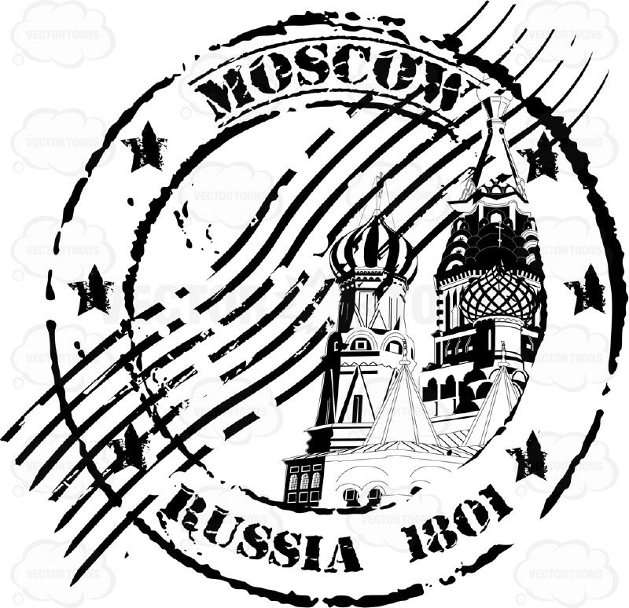
Let’s look at the homework now.
Do you have any questions?

