Slide 1
Around the World
Unit 8 Lesson 10

Slide 2
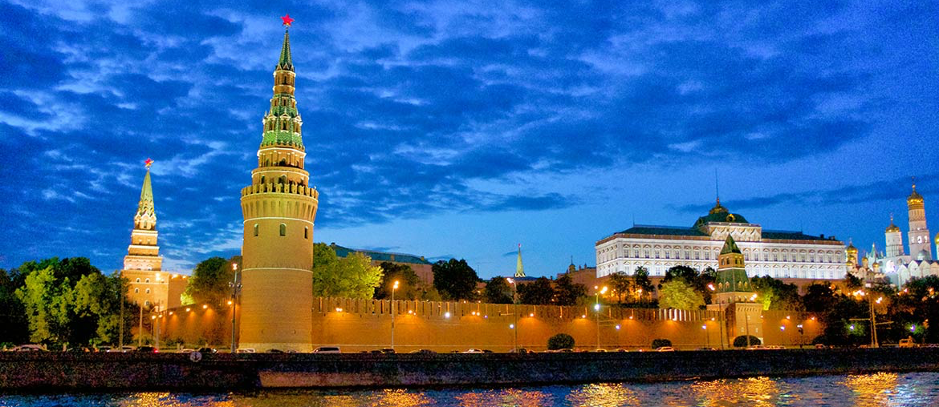
What will we be learning this class?
A look into a new country
Adding endings to words (suffixes)

Slide 3
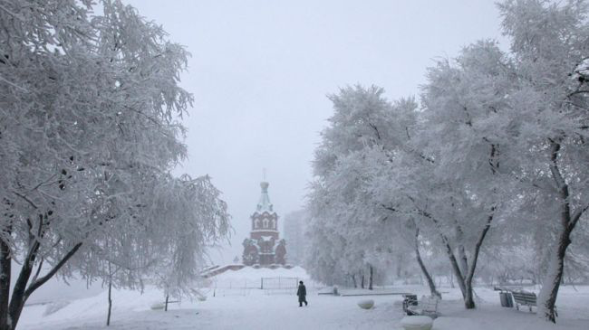
Today we will be learning about another country.
This country is in the north…

Slide 4
It is the largest country in the world…
And is part of TWO continents!

Slide 5
This country is famous for a type of dance called ballet.

Slide 6
The last clue: This city’s capital is Moscow!

Slide 7
What country do you think it could be?

Slide 8
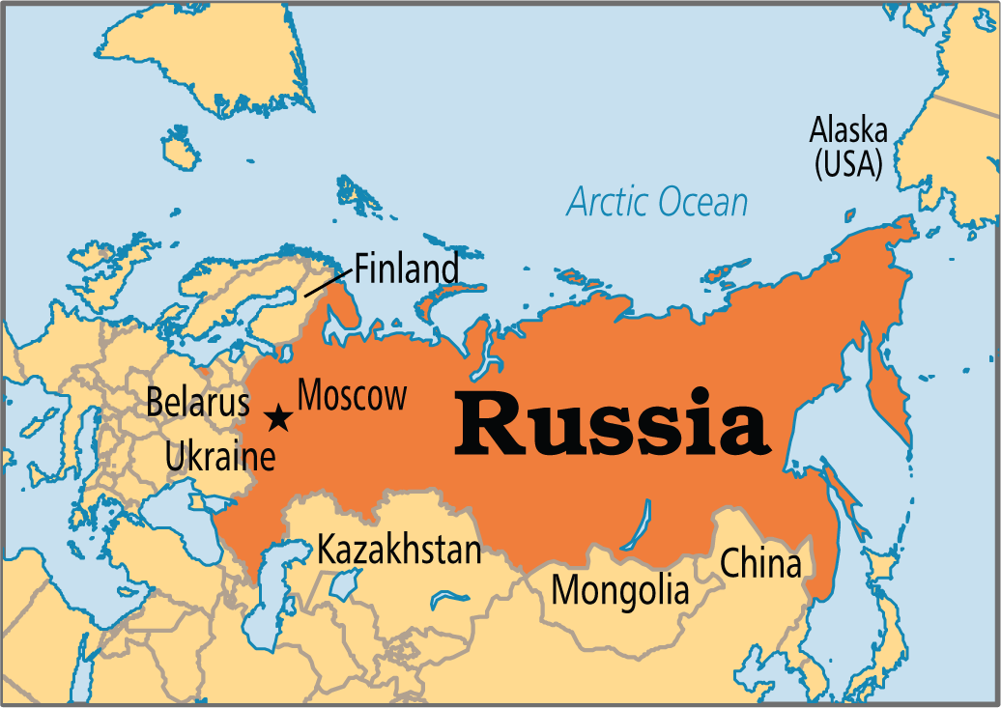
It is Russia! We will be learning about this country today.

Slide 9
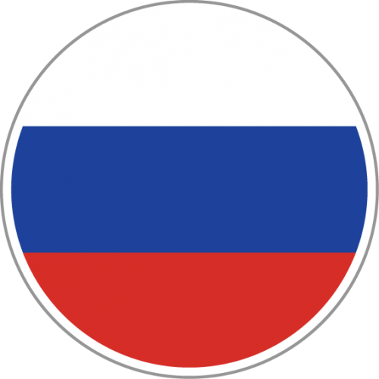
What do you know about Russia? Write it below

Slide 10
We learned that this country is in the north.
Describe what you think the land might look like.

Slide 11
Let’s learn more about the country!
We will now read a book about Japan!

Slide 19
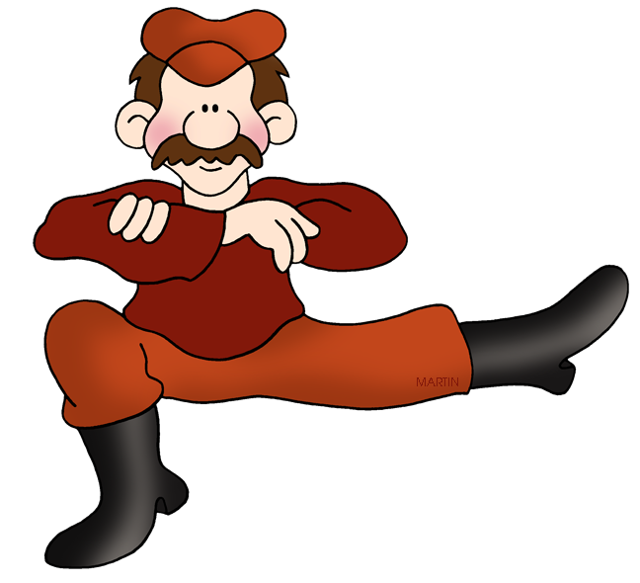
What did you like about Russia?

Slide 20
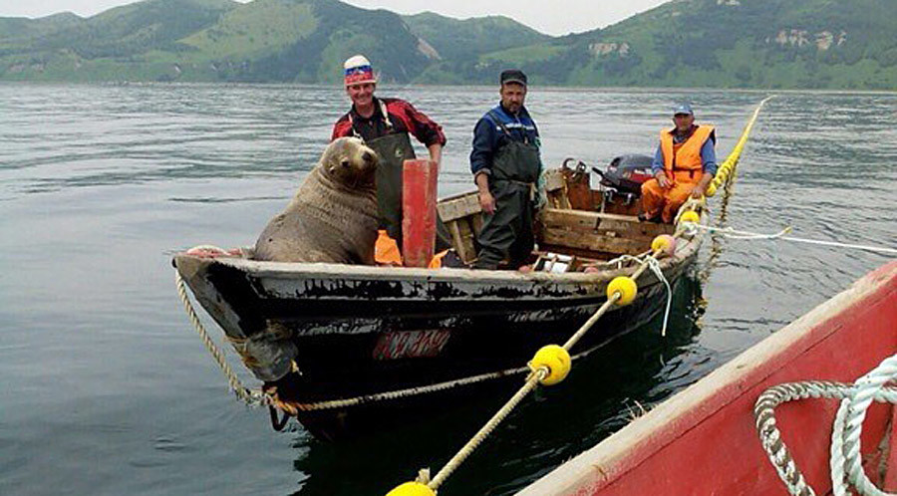
Do you remember? What do people in Russia do for work?

Slide 21
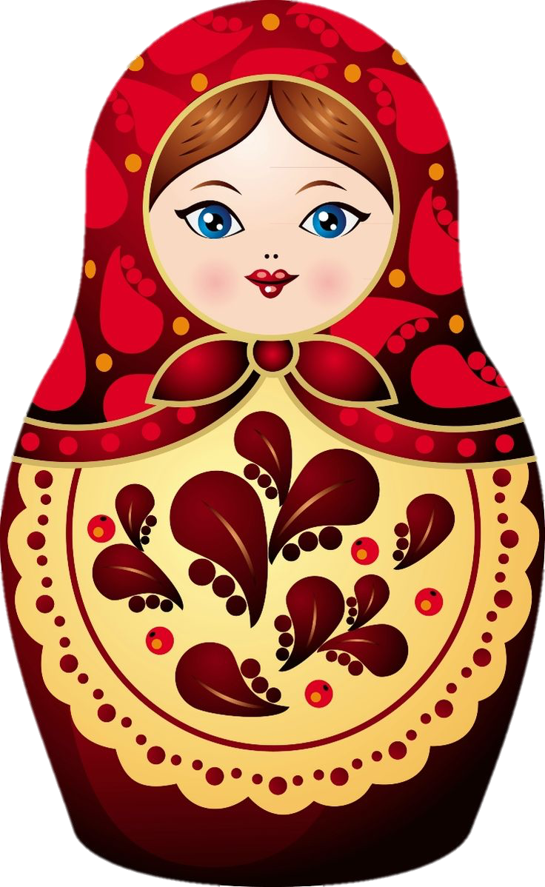
Great work!
Now we will review endings to words!

Slide 22
Often, we will see the letter “S” at the end of words.
What does the letter “S” mean at the end of a word?

Slide 23
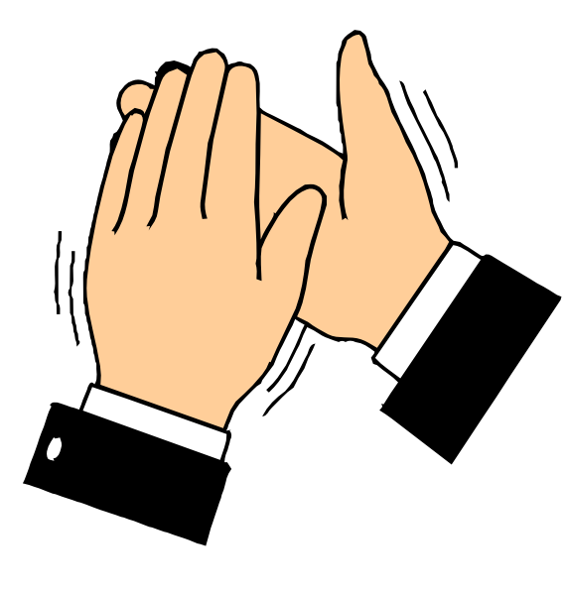
Correct, it means the word is plural! There are more than one.

Slide 24
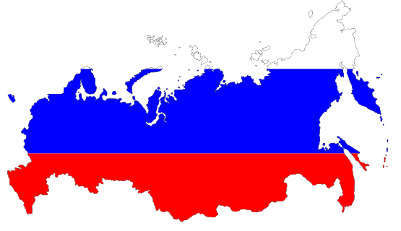
What about when we see “ED” at the end of a word?
What does that mean?

Slide 25
Correct, it means the word is in the past tense! We often use “ED” with verbs.

Slide 26
What about when we see “ING” at the end of a word?
What does that mean?

Slide 27
Correct, it is a suffix that is used at the end of a verb. This means the word is continuous, active, or is ongoing.

Slide 28
Write a word using the “ED” suffix.

Slide 29
Write a word using the “S” suffix.

Slide 30
Write a word using the “ING” suffix.

Slide 31
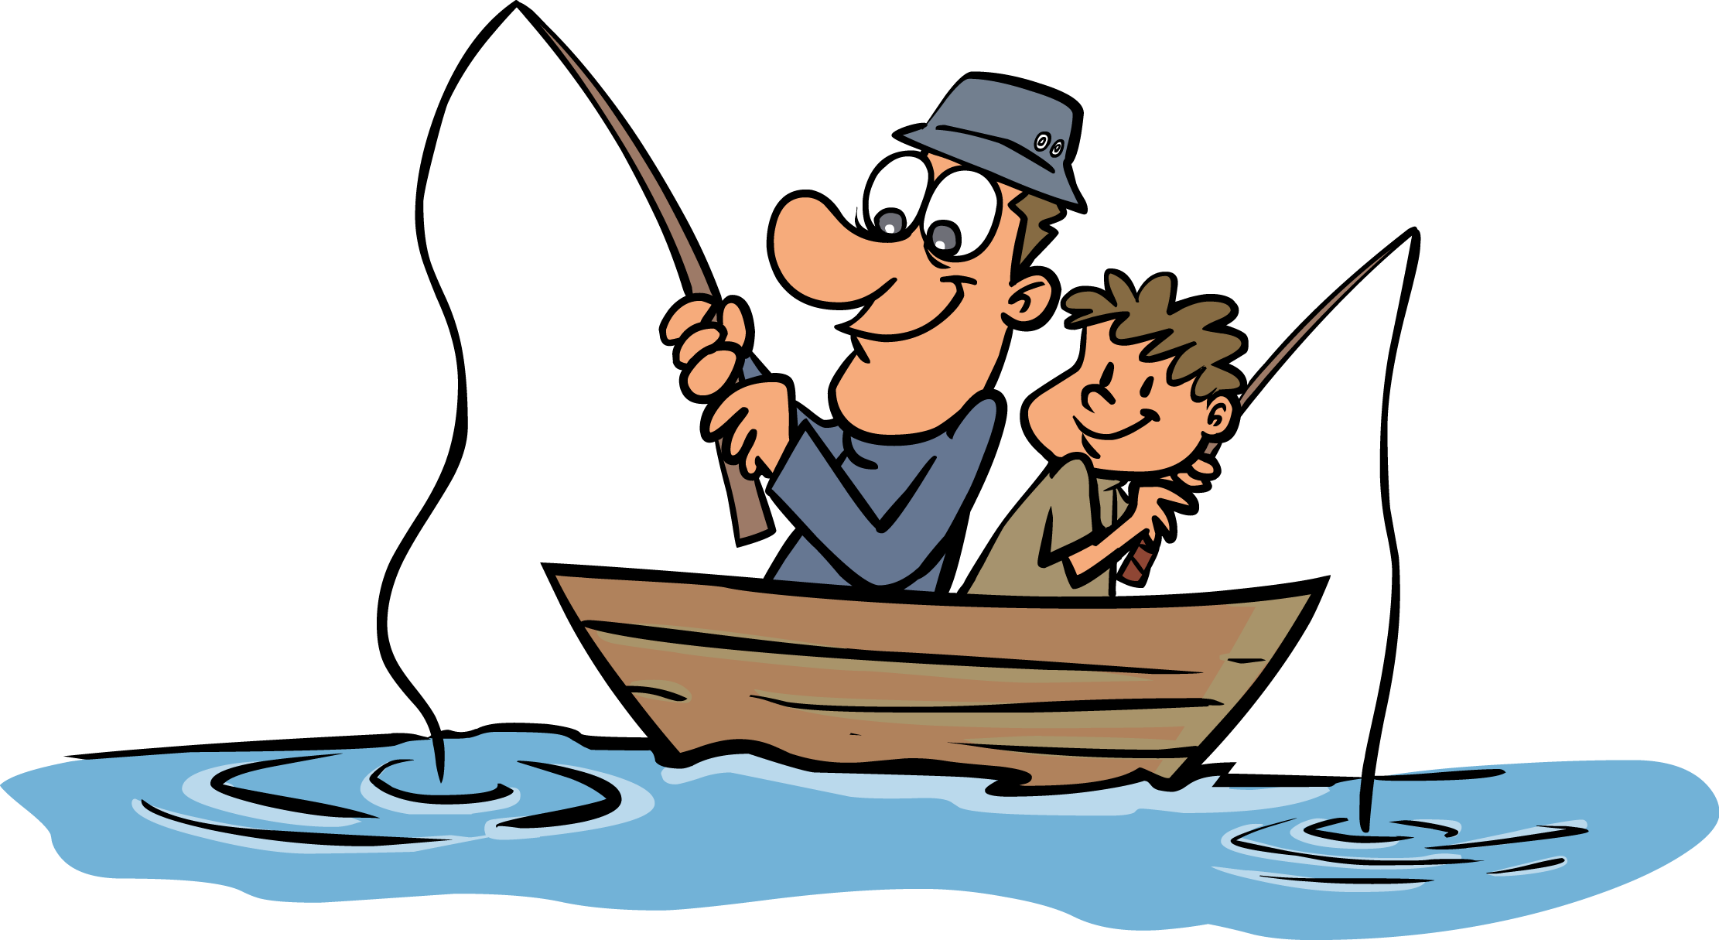
Use the “ING” suffix in a sentence.

Slide 32
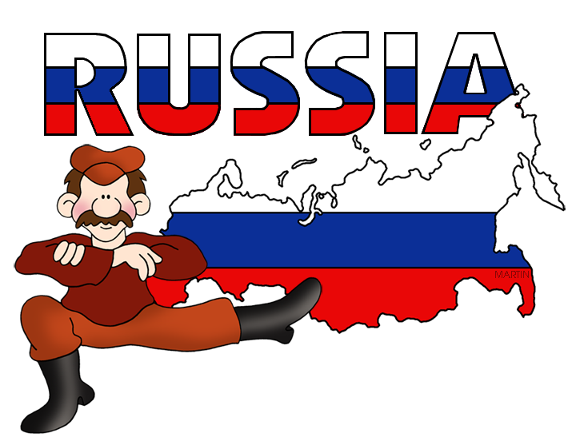
Very good job! What did we learn today?
A look into Russia
Suffixes

Slide 33
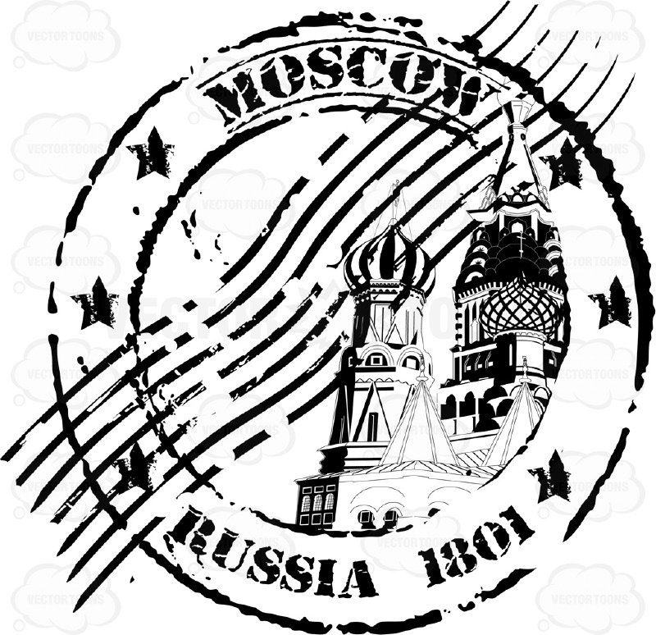
Let’s look at the homework now.
Do you have any questions?

