Slide 1



Around the World
Unit 8 Lesson 11

Slide 2


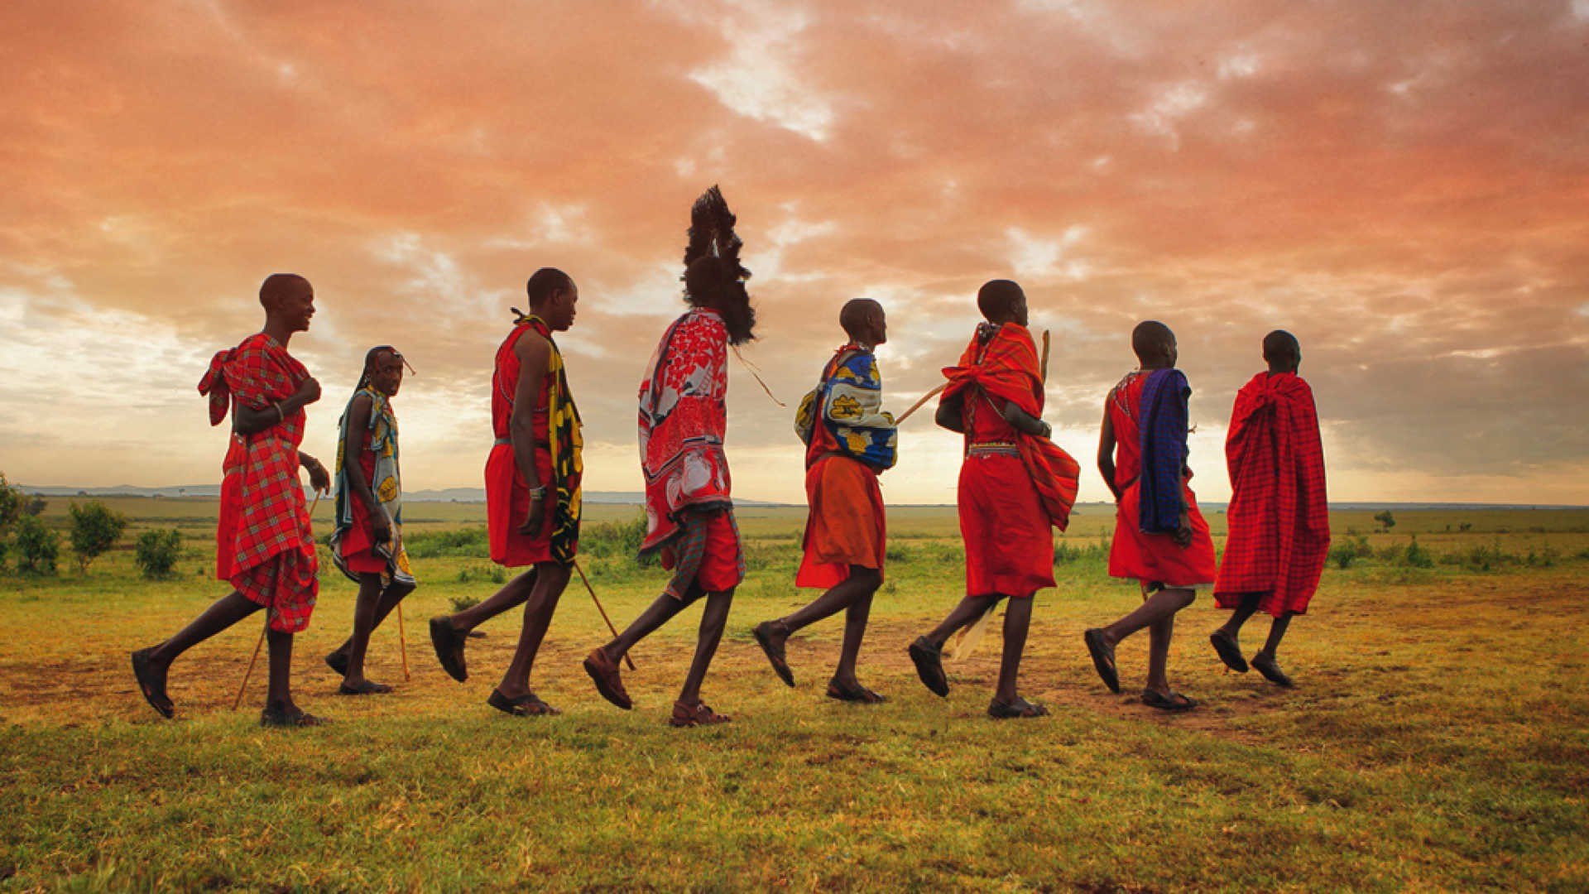
What will we be learning this class?
A look into a new country
A review of punctuation

Slide 3



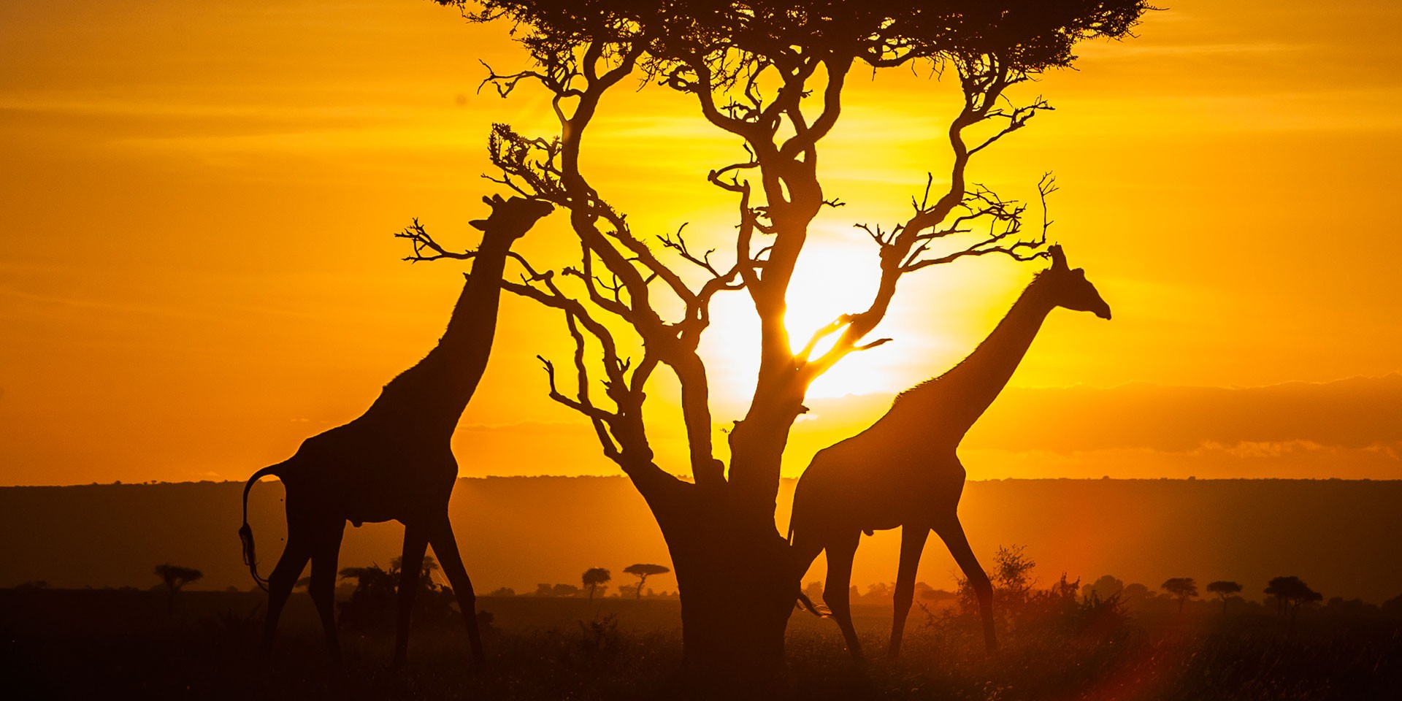
Today we will be looking into another country.
Can you guess which country it is?

Slide 4

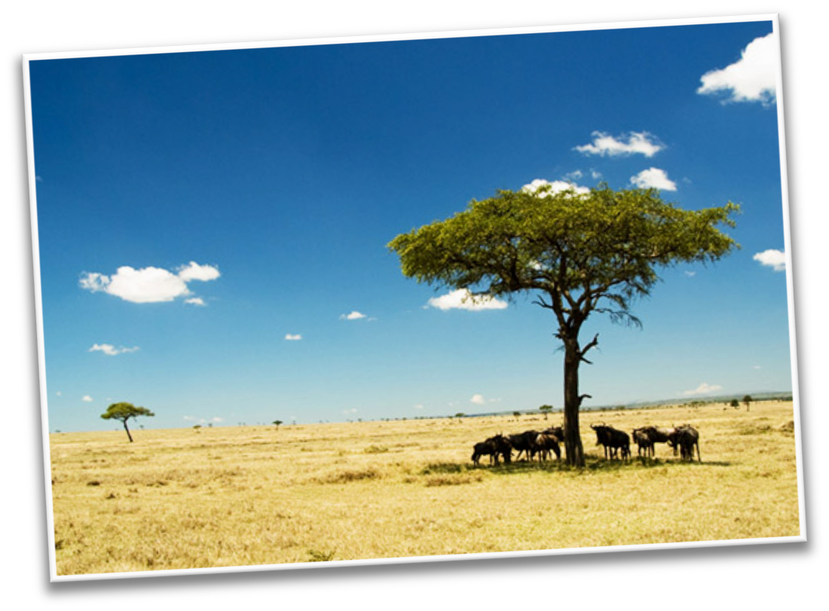




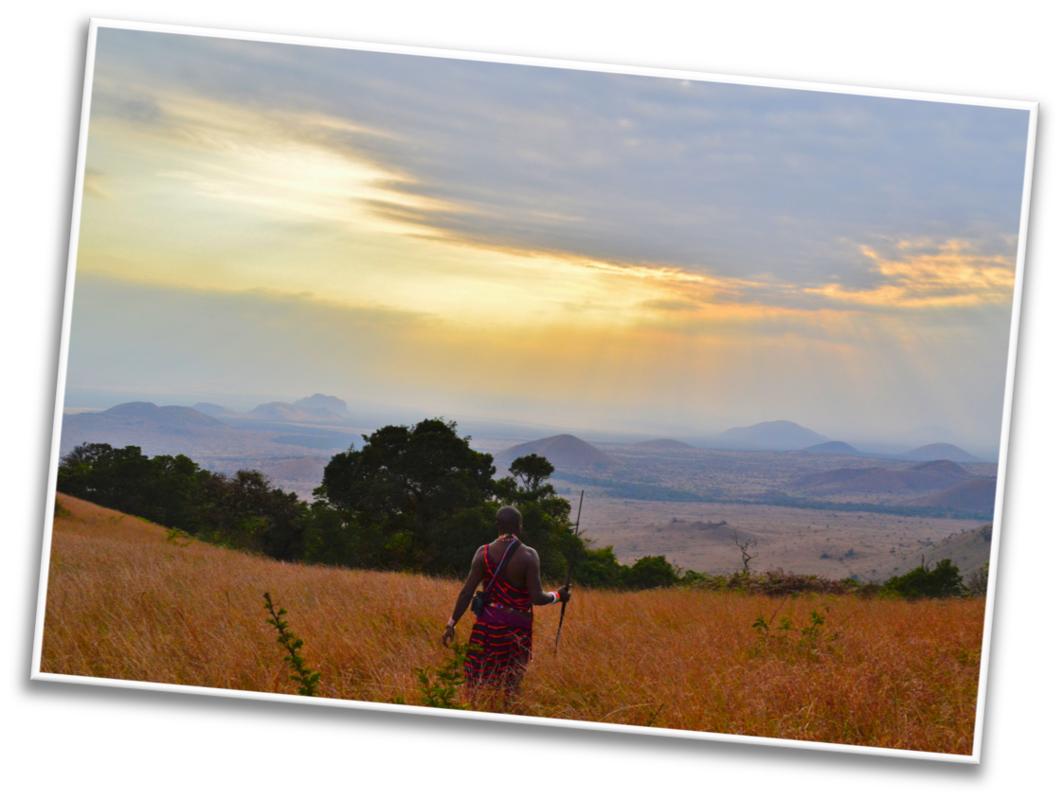

Here are some hints:
This country is in the warm continent of Africa!

Slide 5
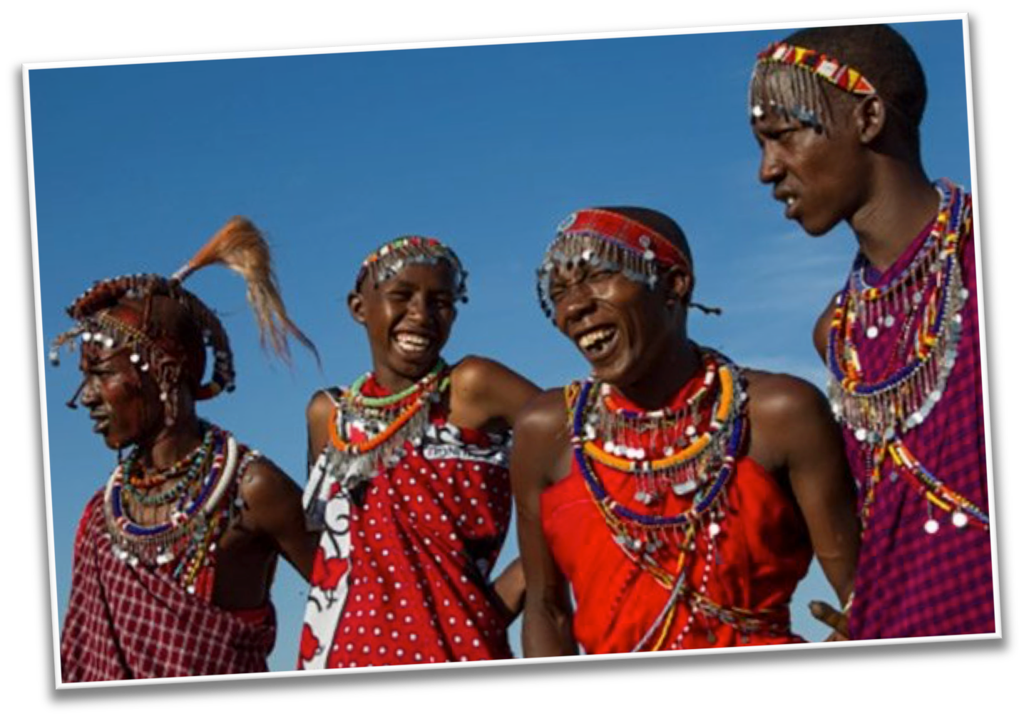


Most people who live here speak English or Swahili

Slide 6
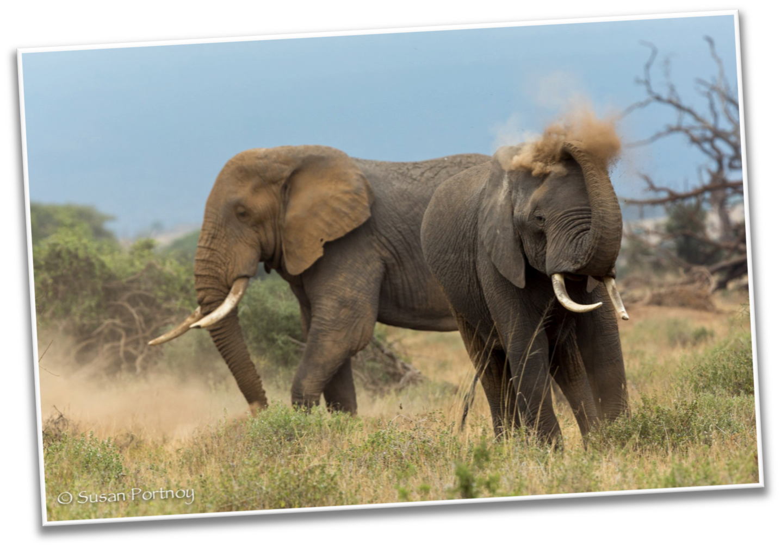
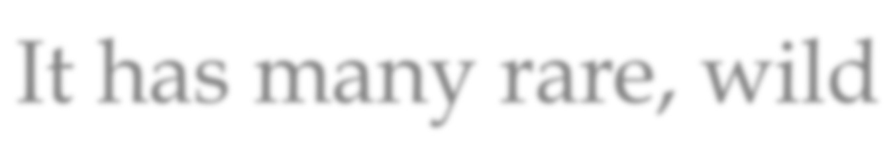
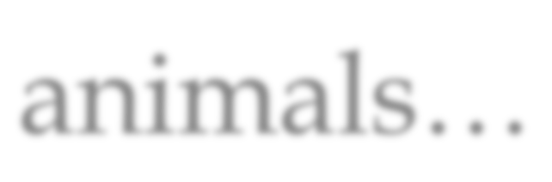
It has many rare, wild animals…

Slide 7
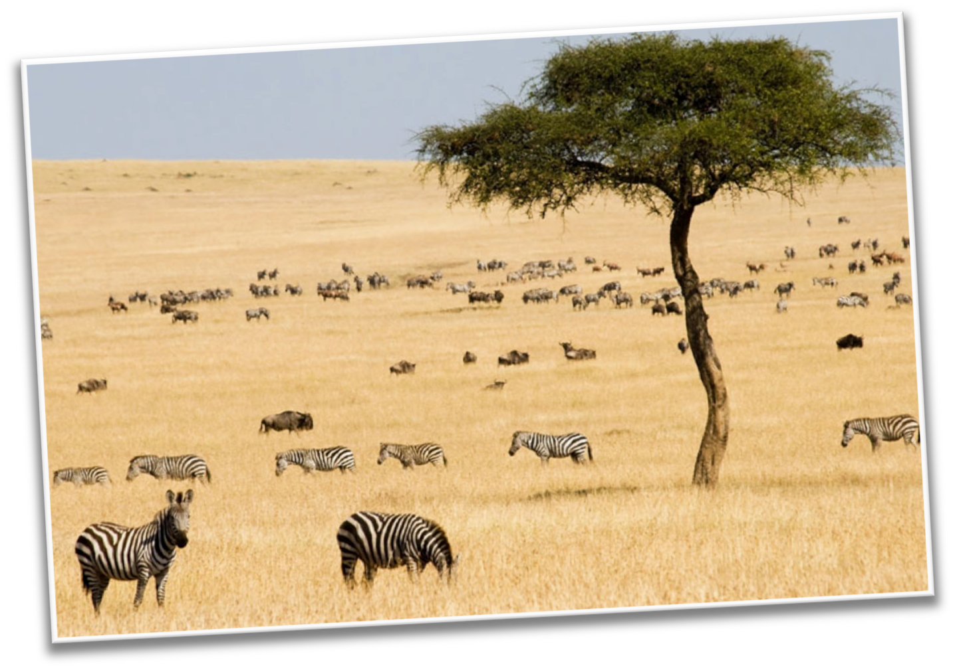
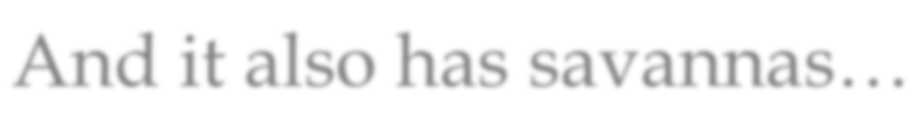
And it also has savannas…

Slide 8
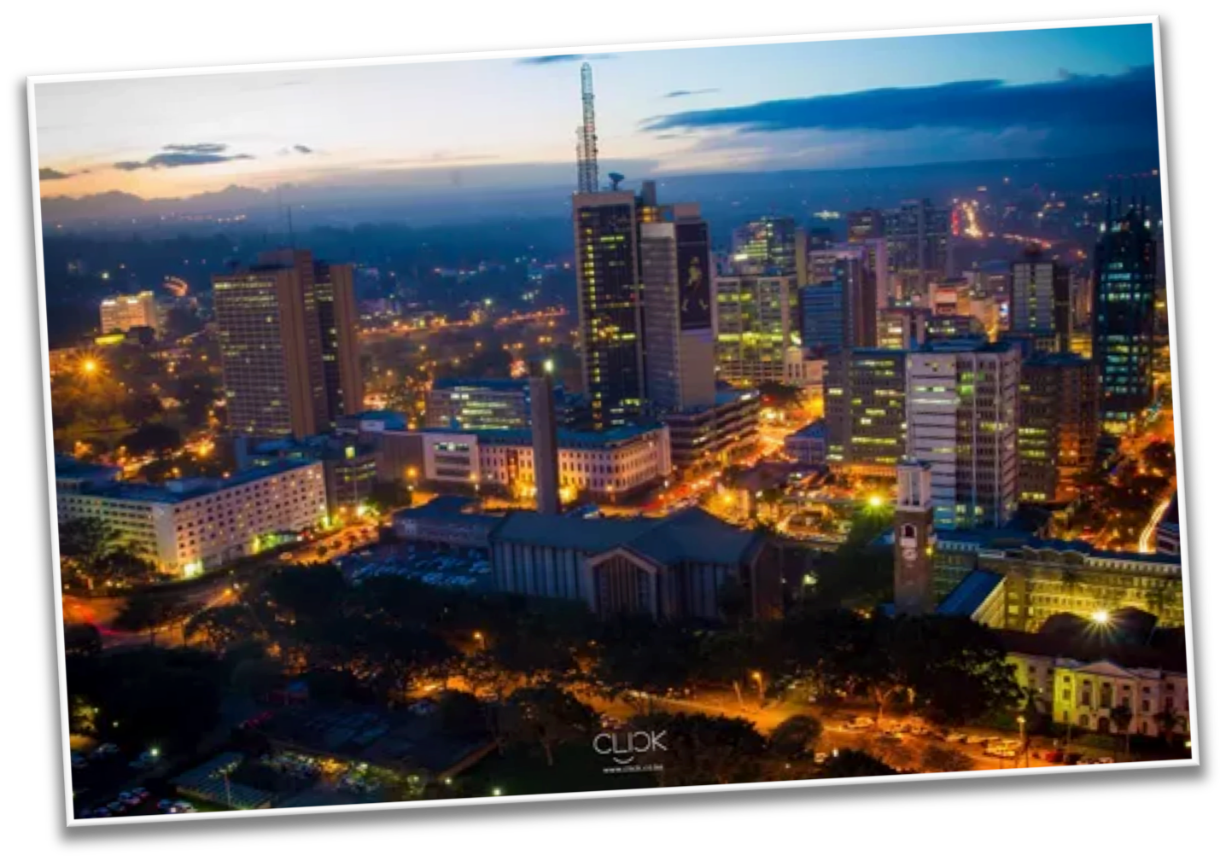

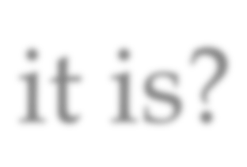
Can you guess what country it is?

Slide 9


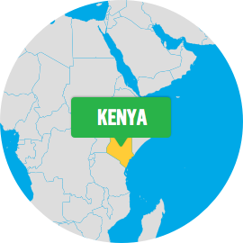
What do you know about Kenya? Write it below

Slide 10



Let’s make some predictions…
What sorts of animals do you think live in Kenya?

Slide 11


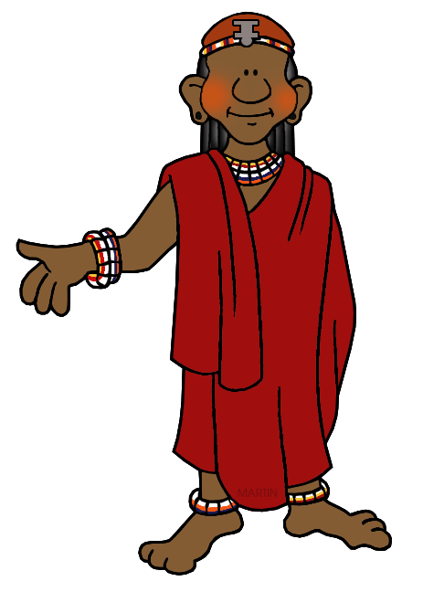
Do you think there could be mountains in Kenya?
Yes
or
No

Slide 12

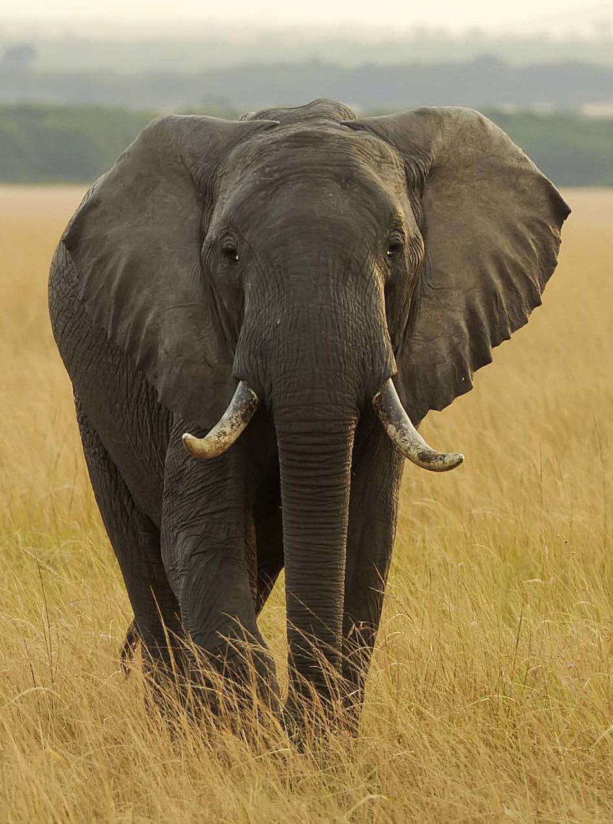








Let’s find out!
LEVELED BOOK • L
Kenya
We will now read a book about Kenya!
Written by Lou Duncan
www.readinga-z.com

Slide 13


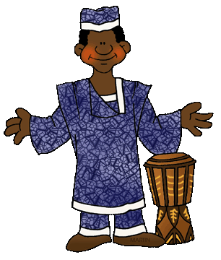
What did you like about Kenya?

Slide 14

Review
Now that you have read the book…
What animals live in Kenya?
Are there mountains in Kenya?

Slide 15

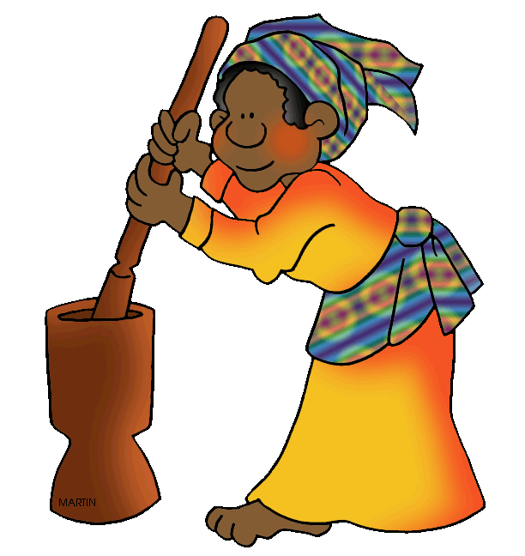
Great work!
Now we will review punctuation!

Slide 16


This is an exclamation mark
!
When would we use an exclamation mark?

Slide 17


This is a question mark
?
When would we use a question mark?

Slide 18

This is a comma
,
When would we use a comma?

Slide 19


Let’s practice using some in a sentence.
Write a sentence using an exclamation mark!

Slide 20
Let’s practice using some in a sentence.
Write a sentence using a question mark!

Slide 21
Let’s practice using some in a sentence.
Write a sentence using a comma!

Slide 22


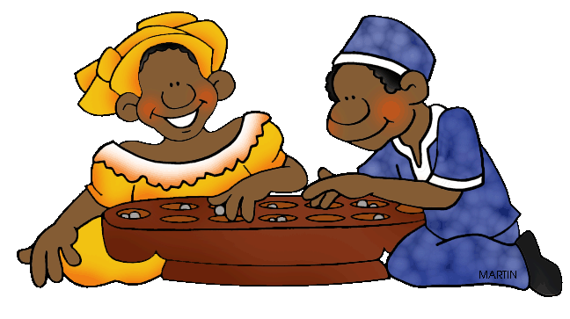
Very good job! What did we learn today?
A look into Kenya
Practicing punctuation

Slide 23

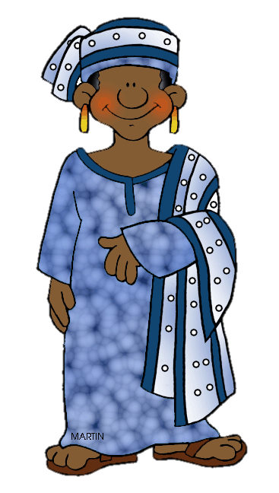
Let’s look at the homework now.
Do you have any questions?

Slide 24
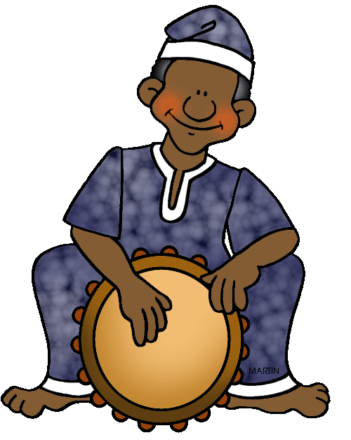
Thank you for a great class today. We’ll see you next time!

