Slide 1
Around the World
Unit 8 Lesson 11

Slide 2
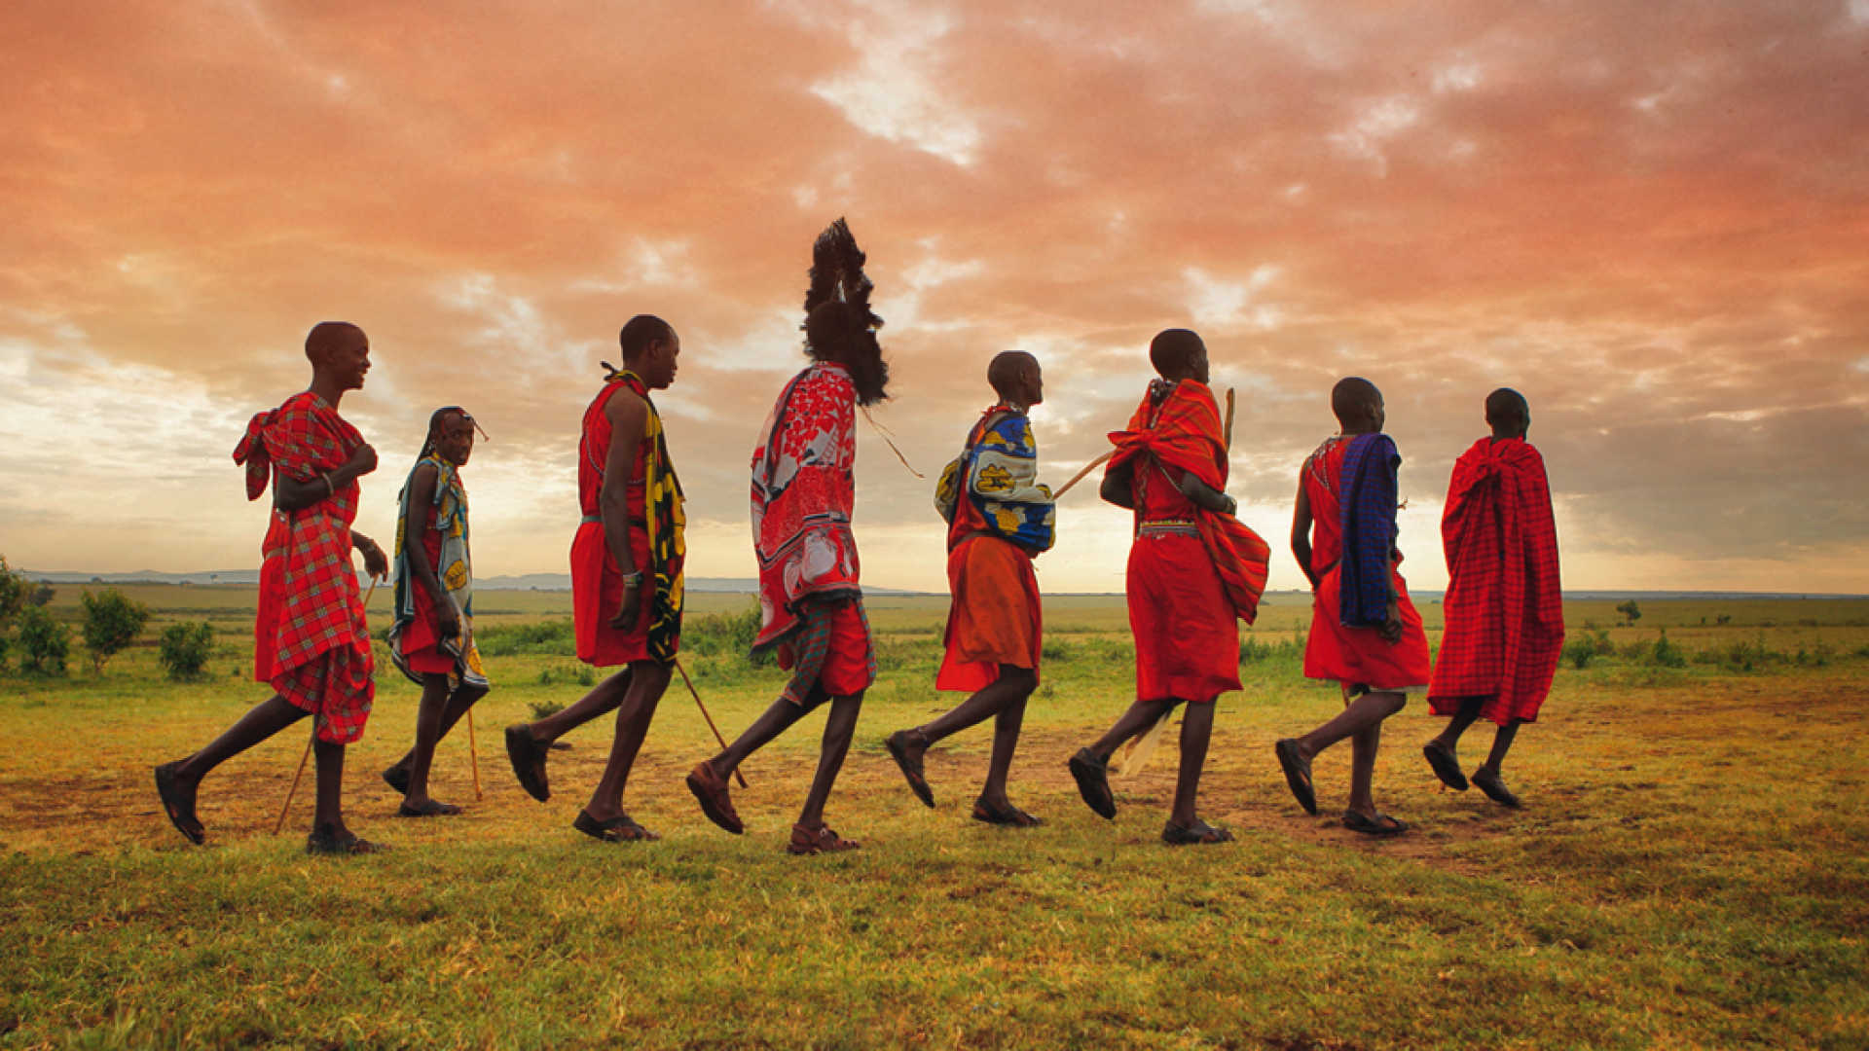
What will we be learning this class?
A look into a new country
A review of punctuation

Slide 3
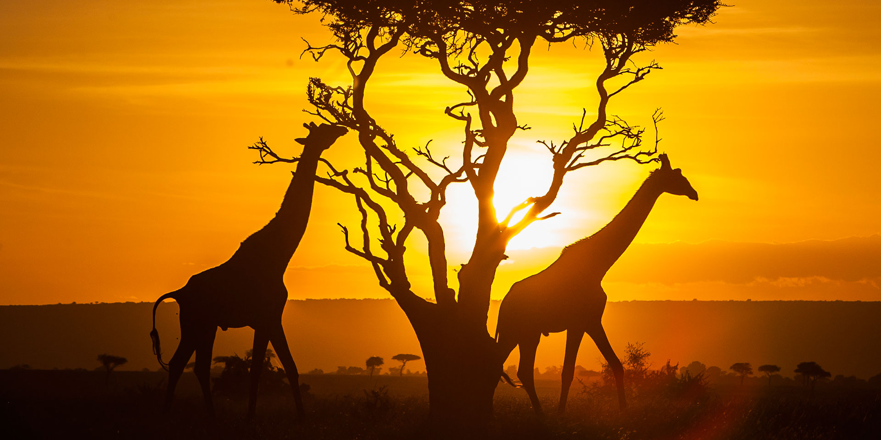
Today we will be looking into another country.
Can you guess which country it is?

Slide 4
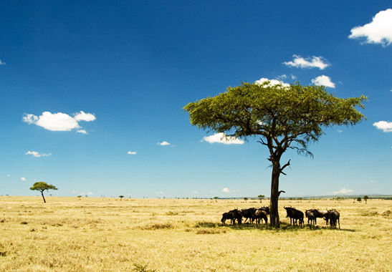
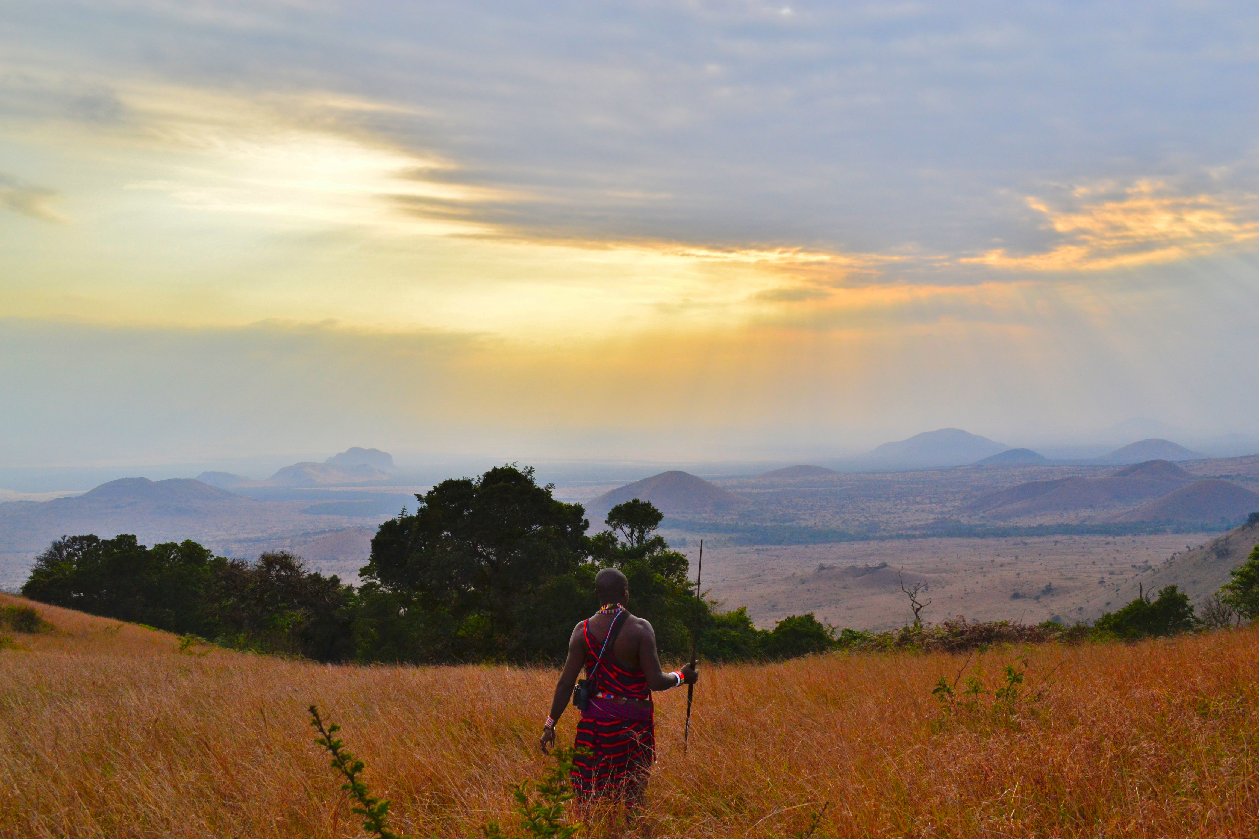
Here are some hints:
This country is in the warm continent of Africa!

Slide 5
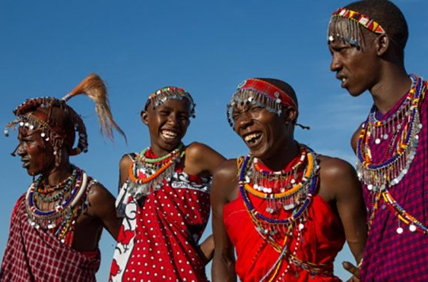
Most people who live here speak English or Swahili

Slide 6
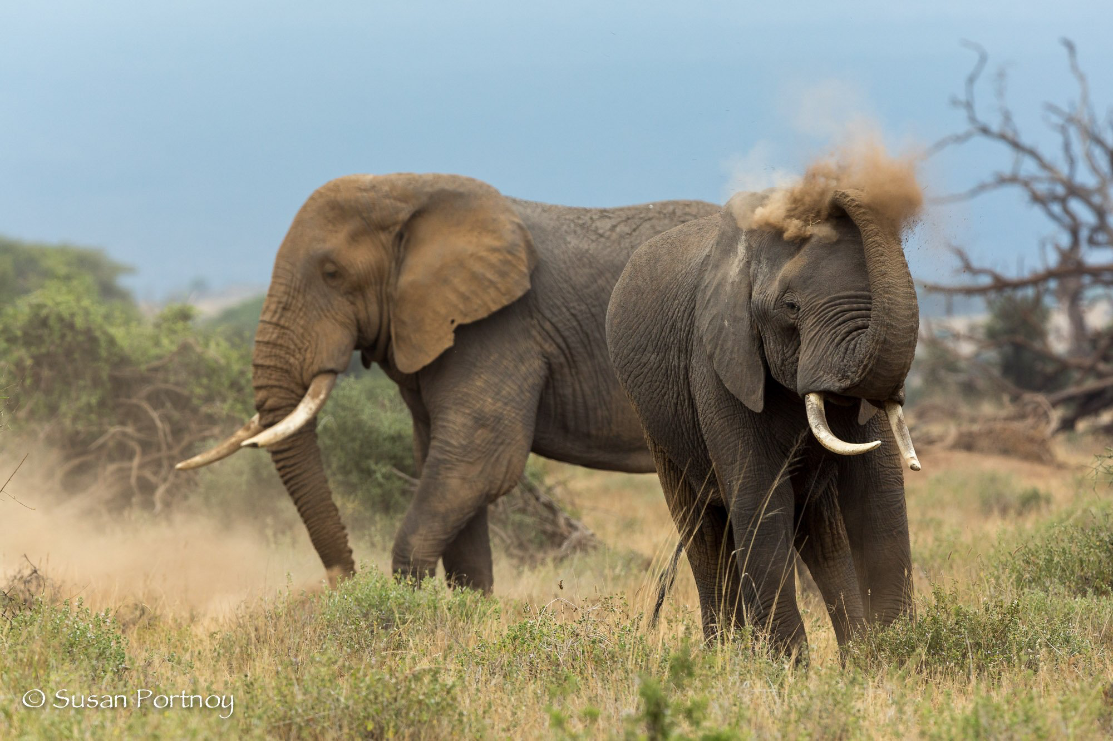
It has many rare, wild animals…

Slide 7
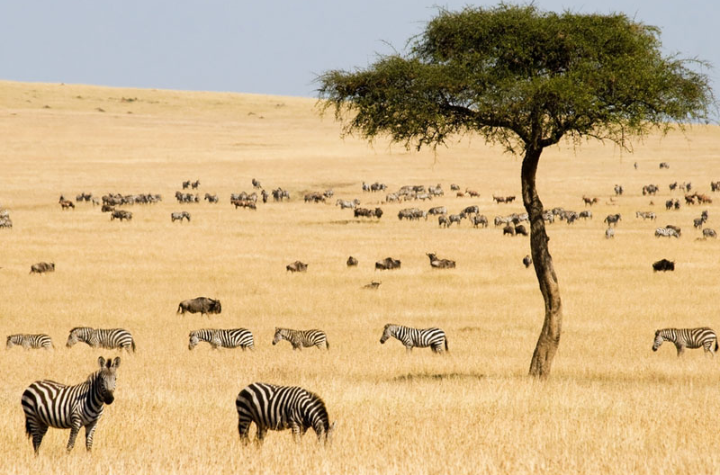
And it also has savannas…

Slide 8
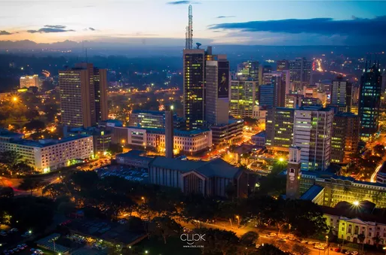
Can you guess what country it is?

Slide 9
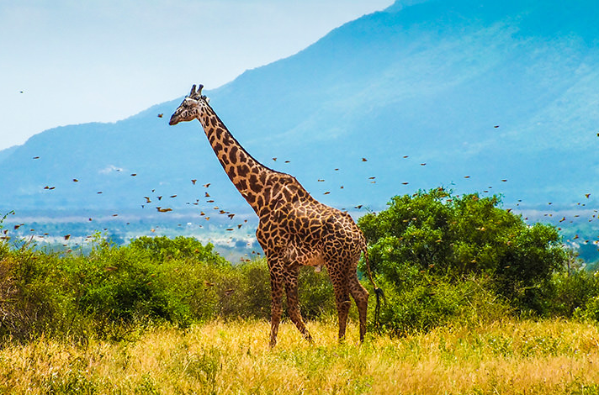
It is Kenya! We will be learning about this country today.

Slide 10
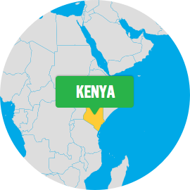
What do you know about Kenya? Write it below

Slide 11
Let’s make some predictions…
What sorts of animals do you think live in Kenya?

Slide 12
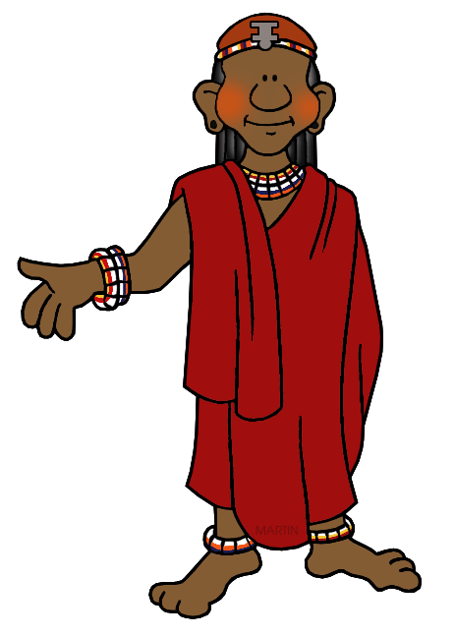
Do you think there could be mountains in Kenya?
Yes
or
No

Slide 13
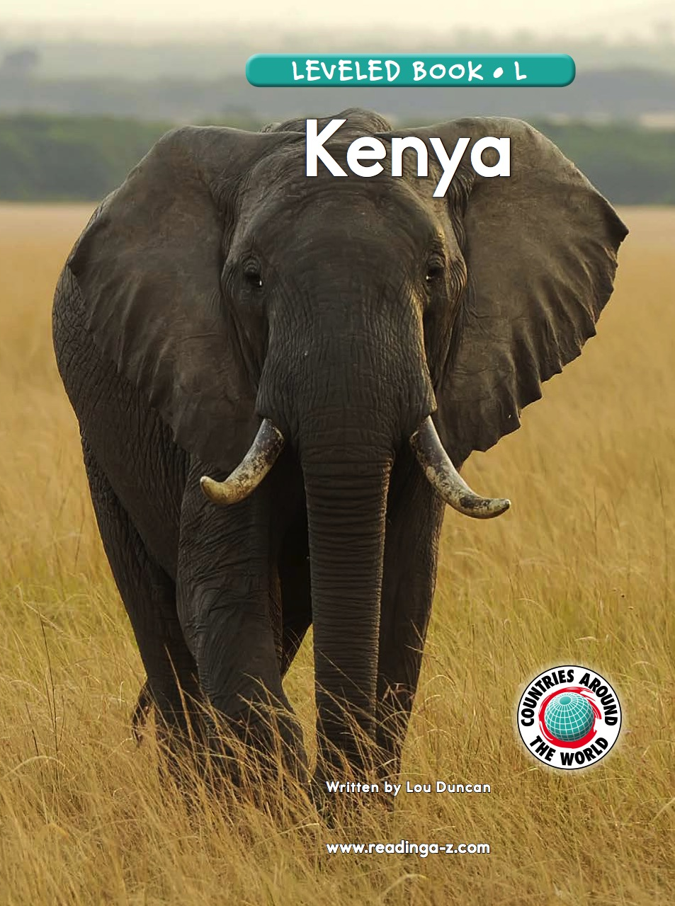
Let’s find out!
We will now read a book about Kenya!

Slide 14
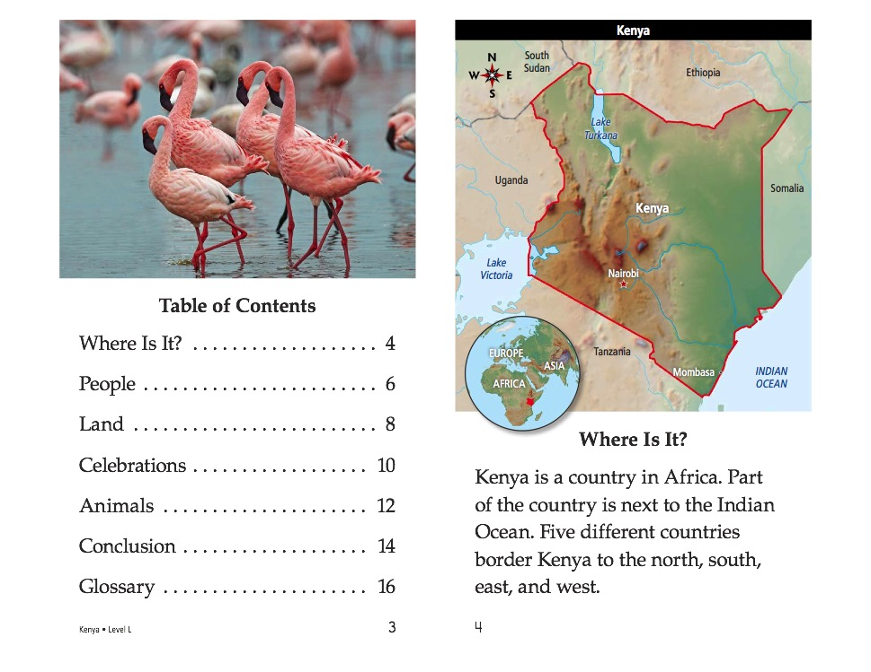

Slide 16
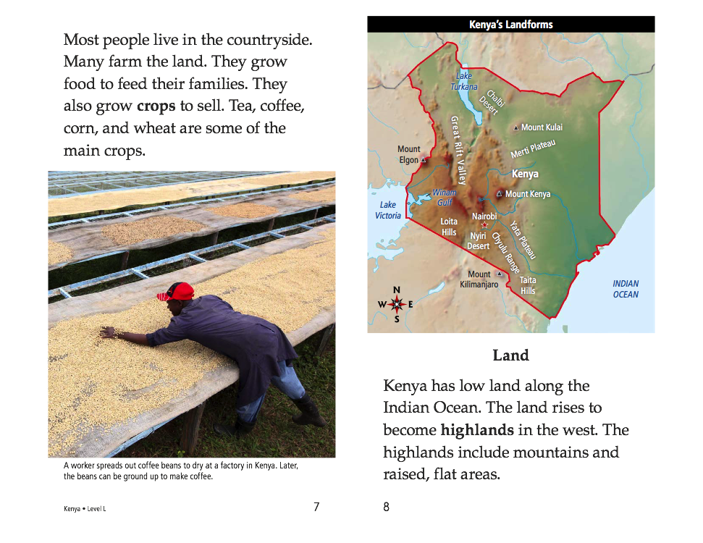

Slide 18
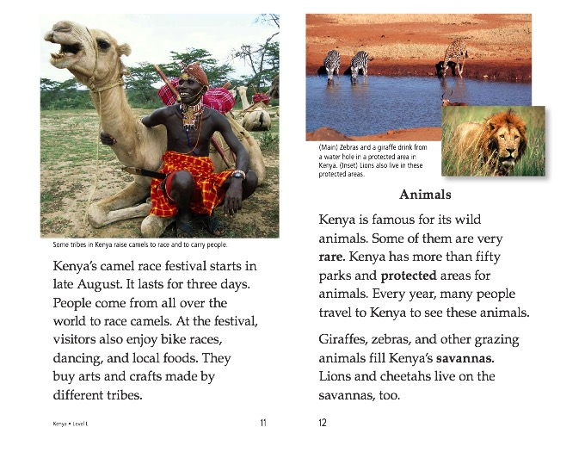

Slide 20
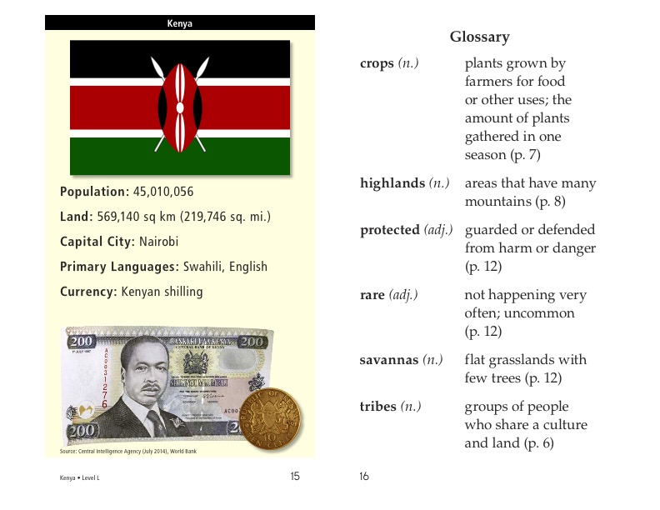

Slide 21
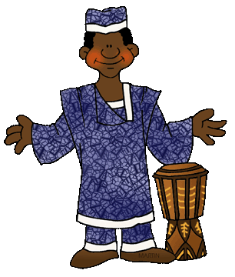
What did you like about Kenya?

Slide 22
Review
Now that you have read the book…
What animals live in Kenya?
Are there mountains in Kenya?

Slide 23
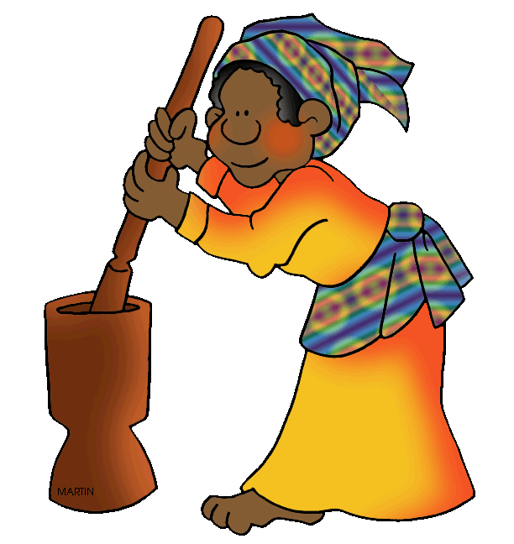
Great work!
Now we will review punctuation!

Slide 24
This is an exclamation mark
!
When would we use an exclamation mark?

Slide 25

When we are excited or are feeling a strong emotion.

Slide 26
This is a question mark
?
When would we use a question mark?

Slide 27
When we are asking a question.
Most sentences will begin with
Who?
What?
Where?
When?
Why?
or How?

Slide 28
This is a comma
,
When would we use a comma?

Slide 29
When we are making a list, or when we are using “connecting words” such as:
and, but, for, or, nor, so, yet
For example: I am going to Kenya, and I want to stay there.

Slide 30
Let’s practice using some in a sentence.
Write a sentence using an exclamation mark!

Slide 31
Let’s practice using some in a sentence.
Write a sentence using a question mark!

Slide 32
Let’s practice using some in a sentence.
Write a sentence using a comma!

Slide 33
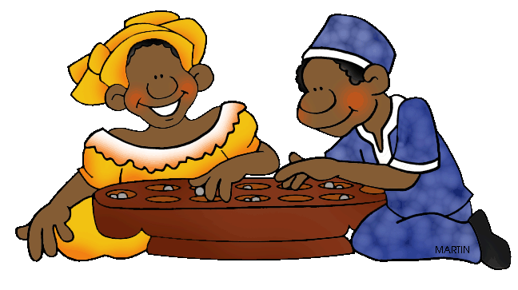
Very good job! What did we learn today?
A look into Kenya
Practicing punctuation

Slide 34
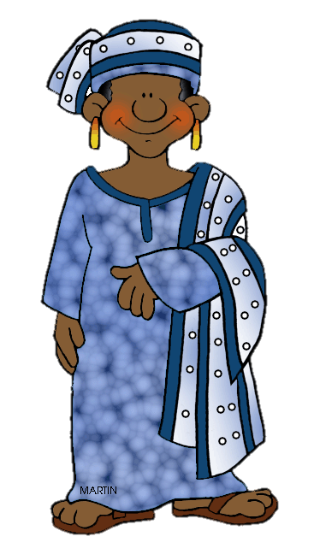
Let’s look at the homework now.
Do you have any questions?

Slide 35
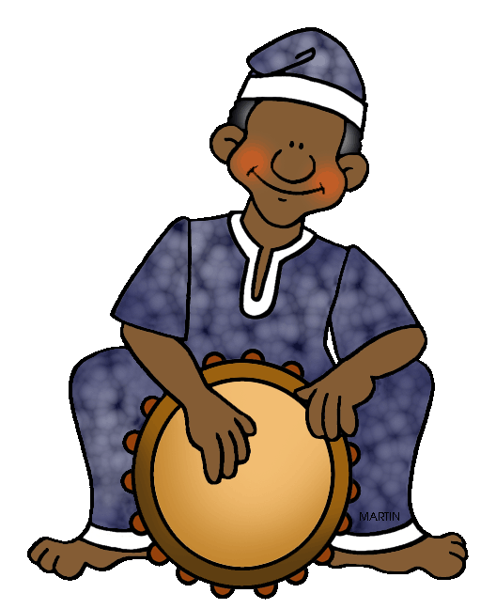
Thank you for a great class today.
We’ll see you next time!

