Slide 1



Around the World
Unit 8 Lesson 12

Slide 2

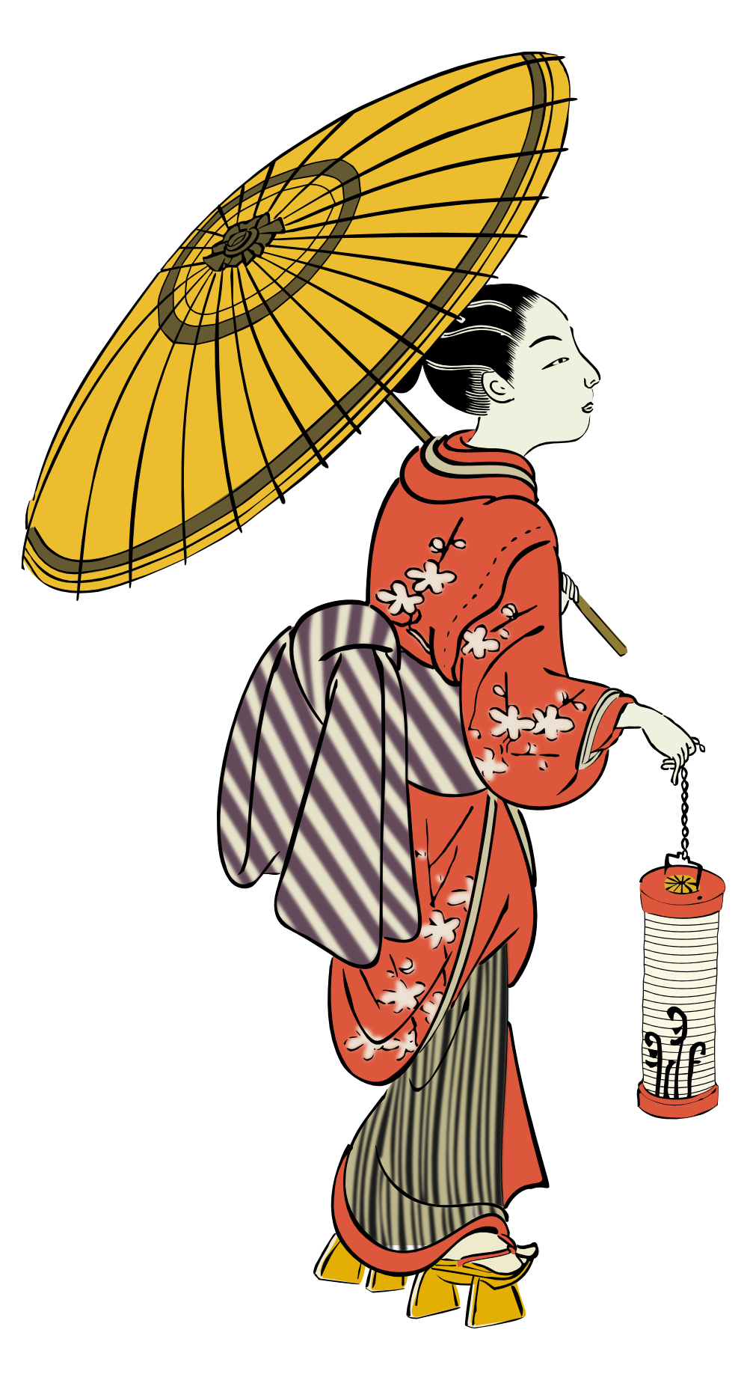

What will we be learning this class?
Comparing countries as a review
A review of suffixes, punctuation and the “o_e” sound

Slide 3


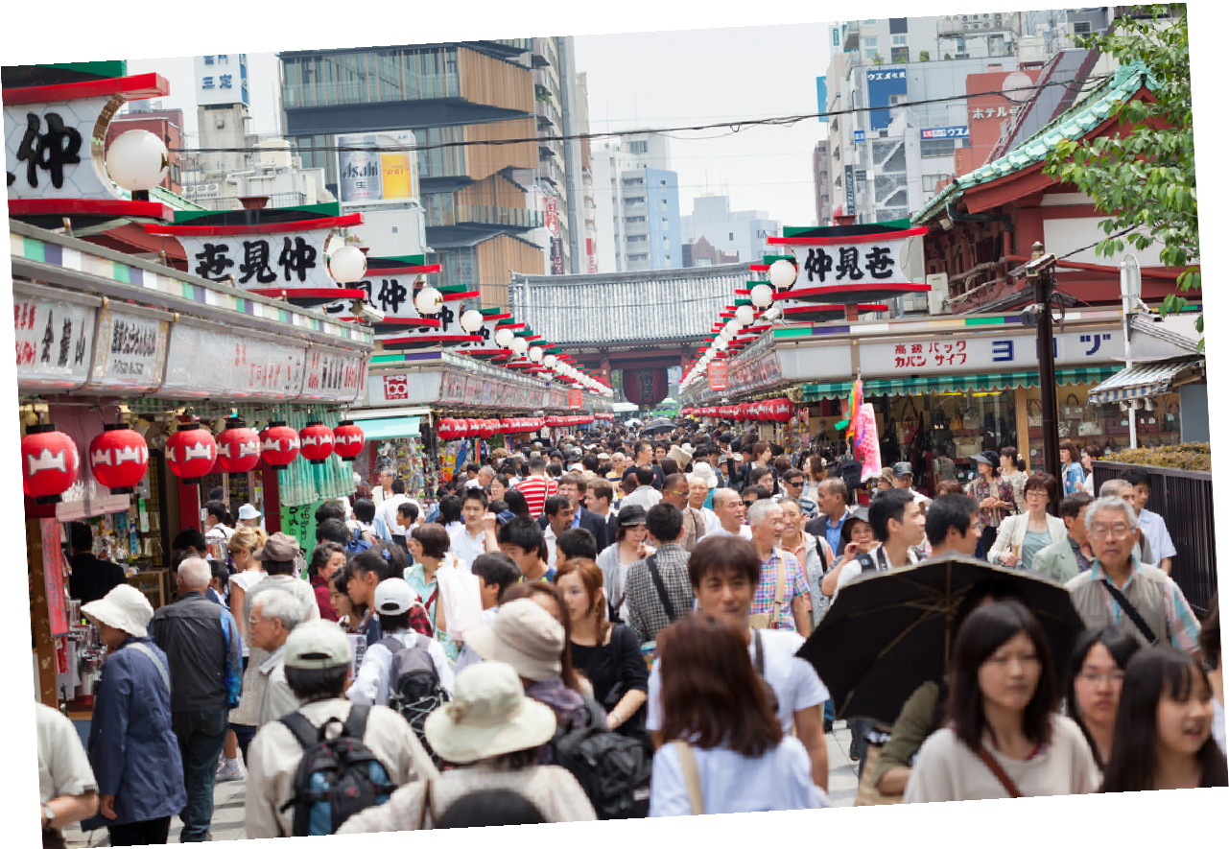
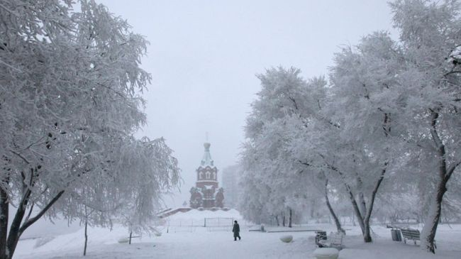
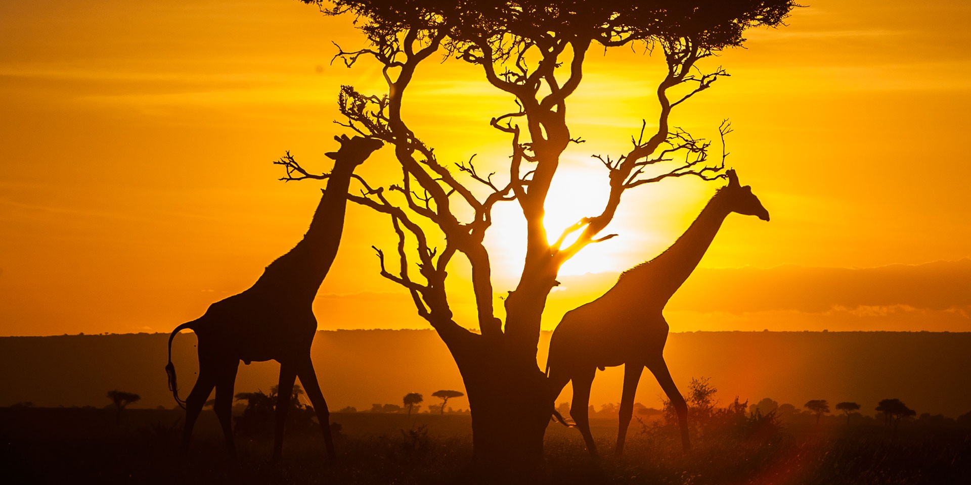
Do you remember? What countries have we learned about?

Slide 4

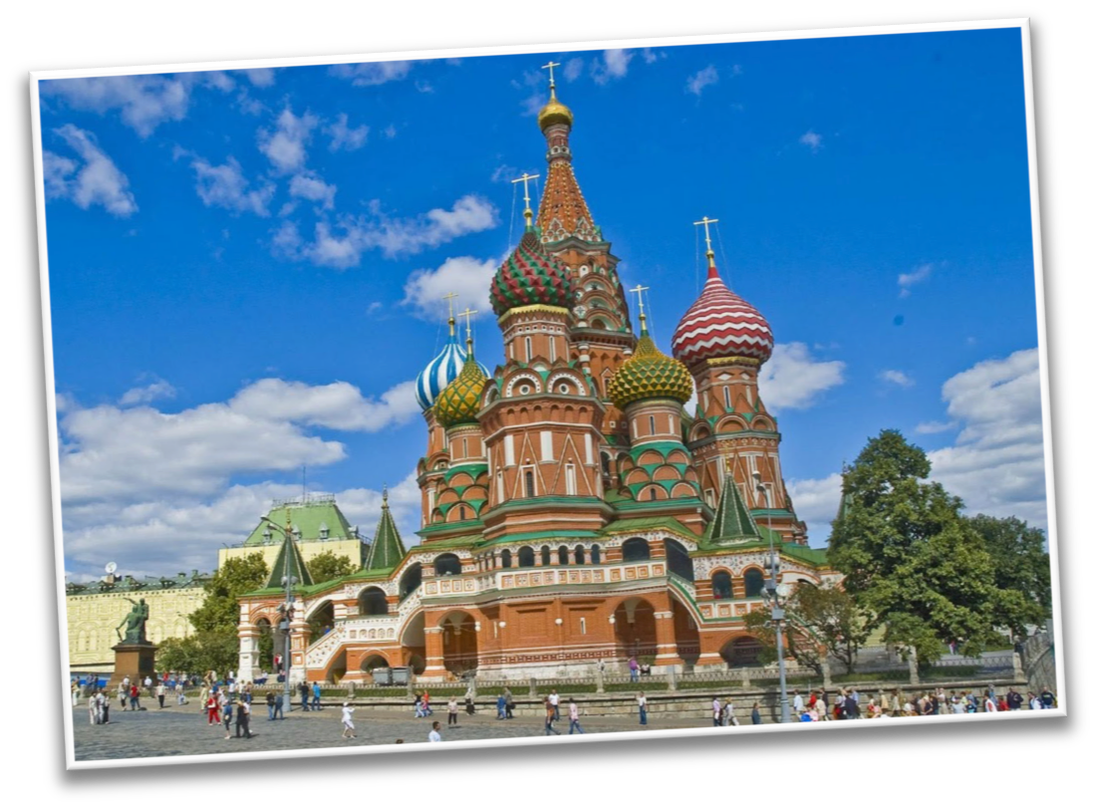



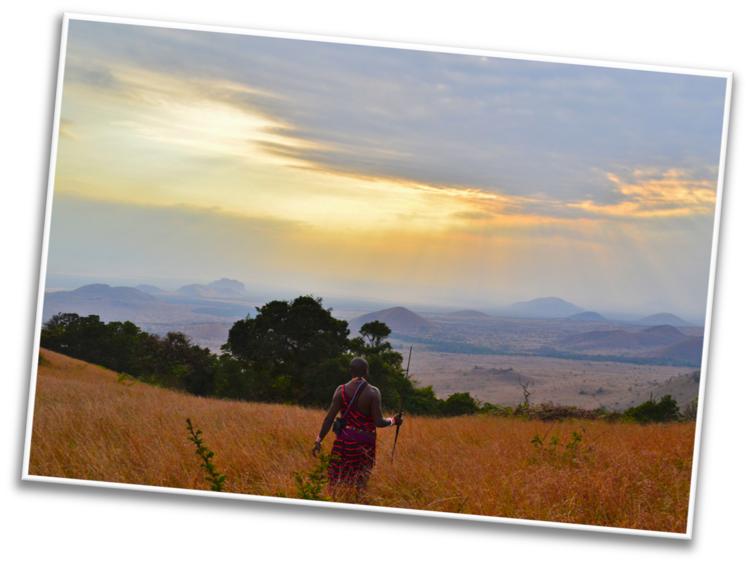



You are right! Japan, Russia and Kenya.
What country did you like the best?
Why?

Slide 5
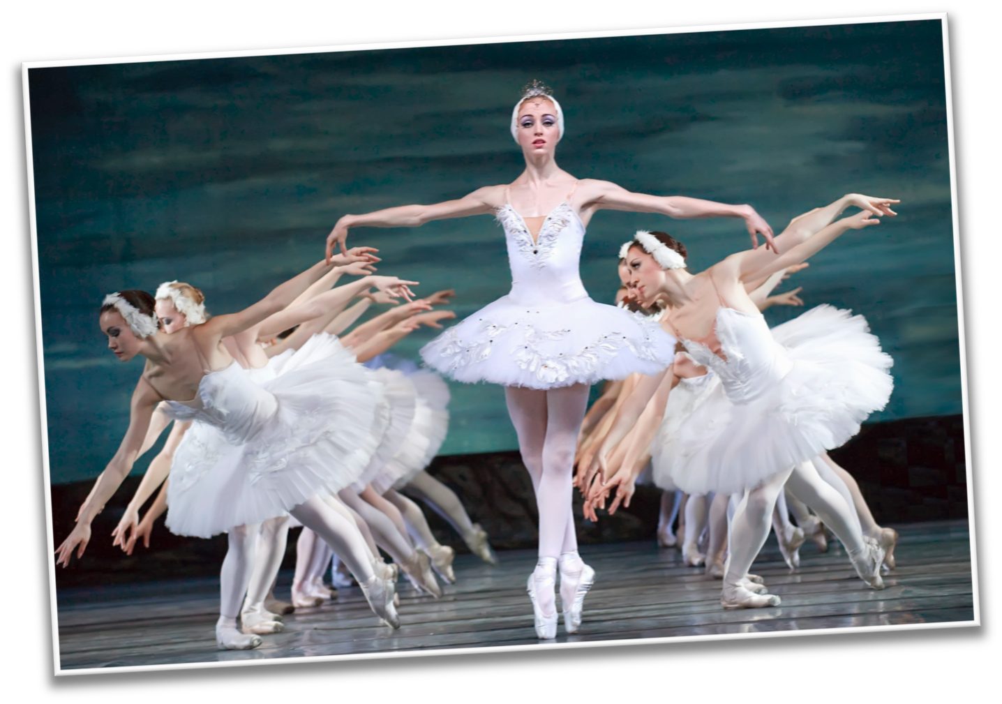
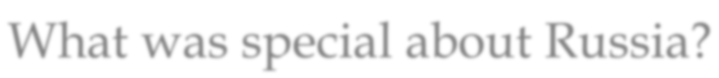
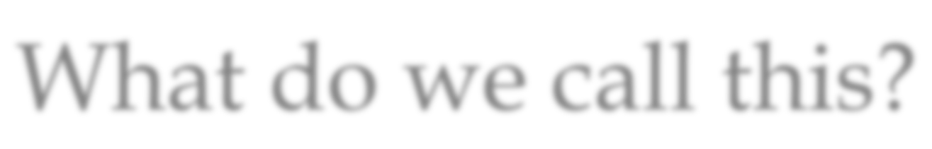
What was special about Russia?
What do we call this?

Slide 6
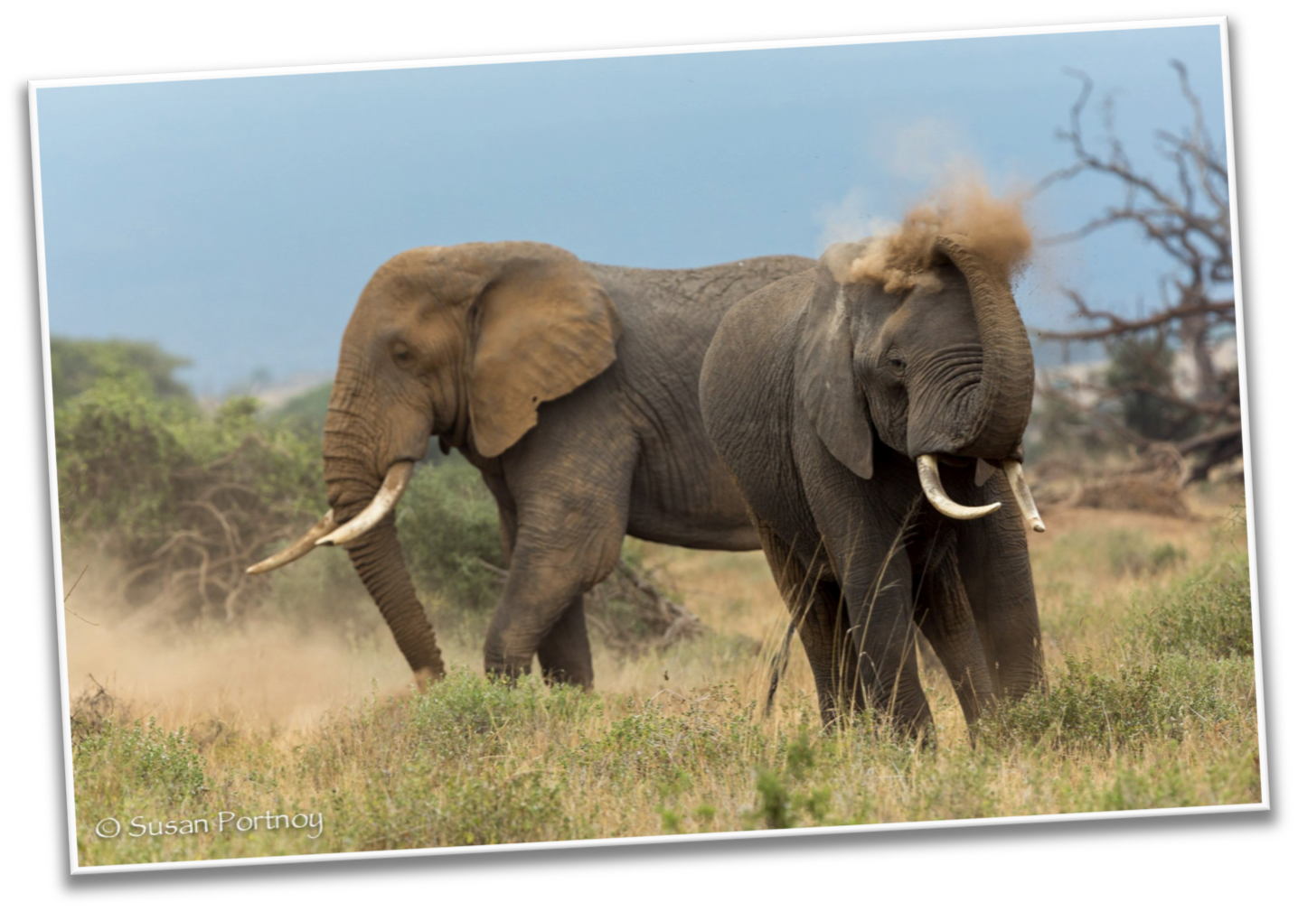
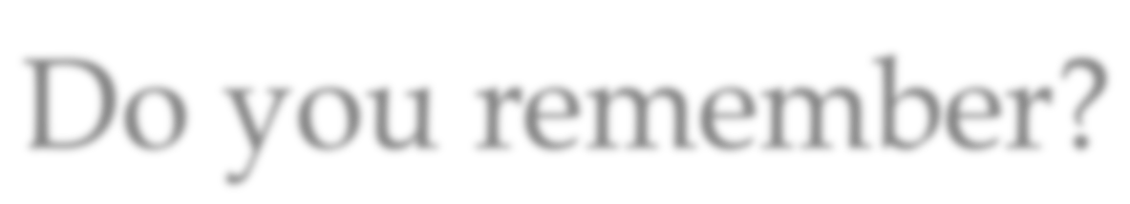
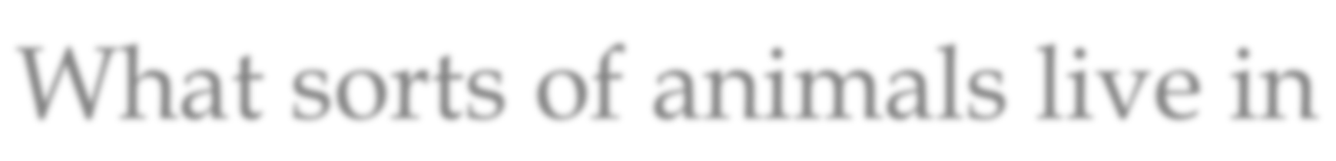
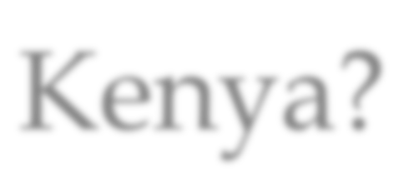
Do you remember?
What sorts of animals live in Kenya?

Slide 7
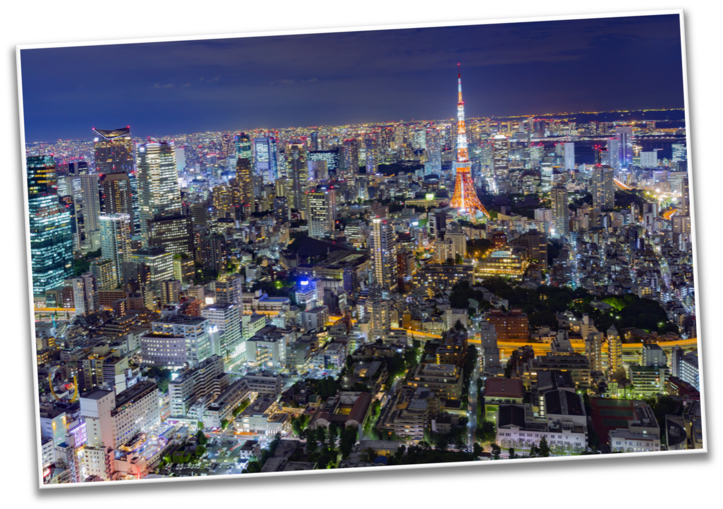
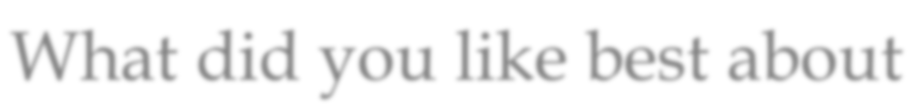
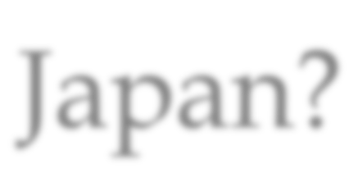

What did you like best about Japan?

Slide 8




Do you remember how to compare?
To compare is to see what is the same about two people, places, or things.

Slide 9



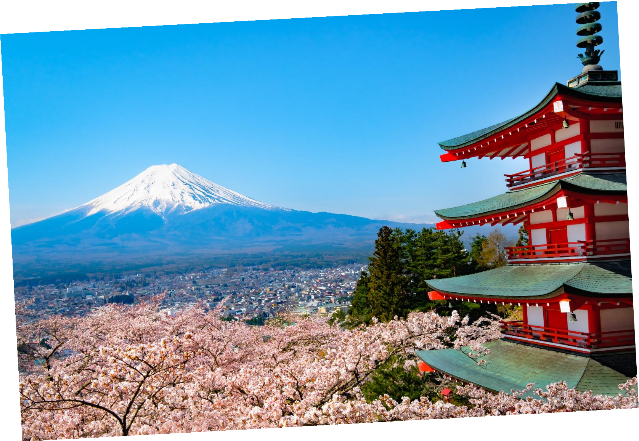
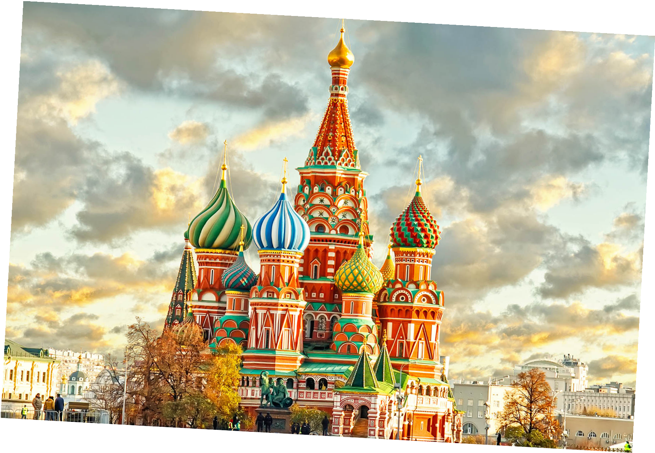
Can you compare the countries of Russia and Japan?
What is the same, or similar, between the two countries?

Slide 10



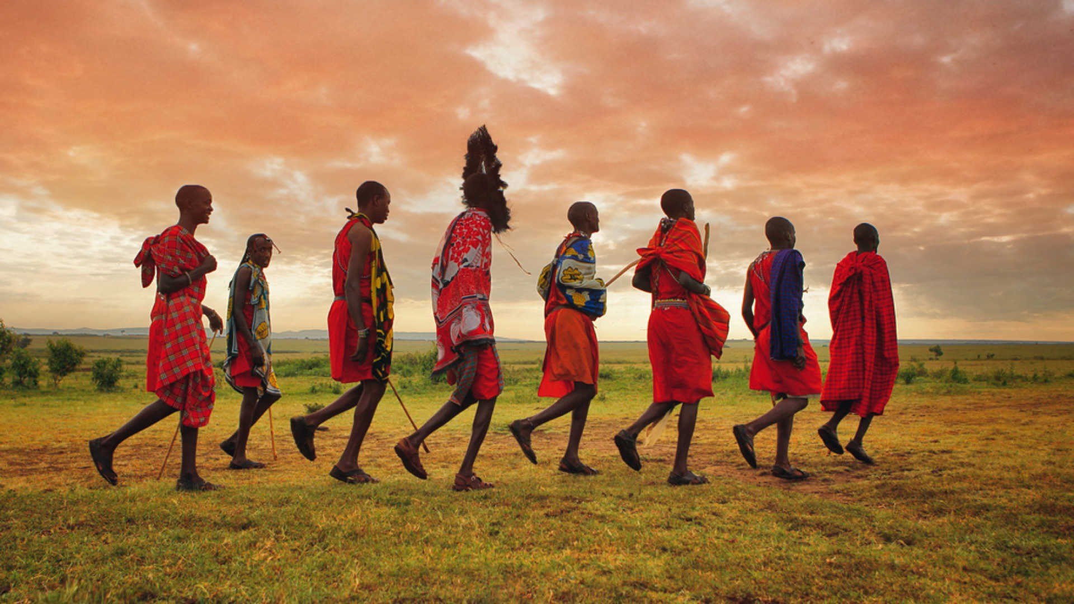
Great work! Let’s do it once more.
Compare the country of Japan with Kenya!

Slide 11


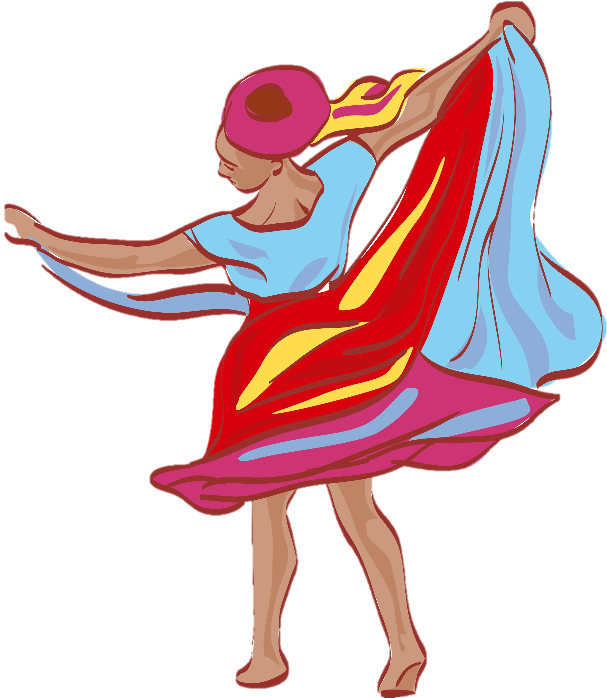
Great answers! You are great at comparing.

Slide 12



Where do you stay when you travel?
Do you stay in a home, in a hotel or in a motel?

Slide 13


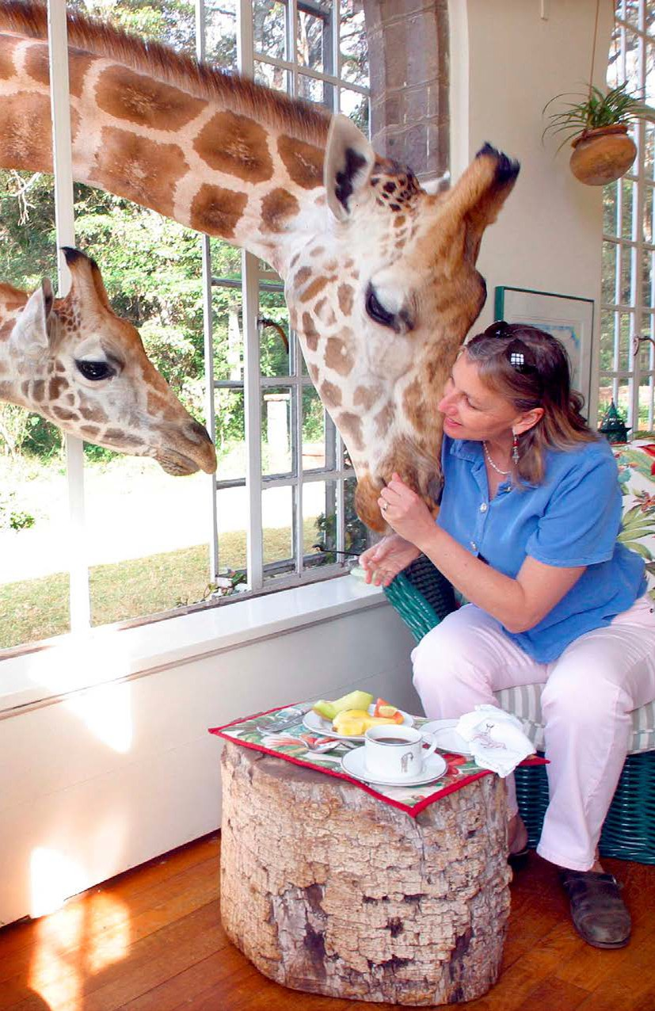


We are going to read a book about Hotels!
LEVELED BOOK • J
Incredible
Places to Stay
P
•
J
M
•
Written by Michael Bagnulo
www.readinga-z.com
www.readinga-z.com

Slide 14

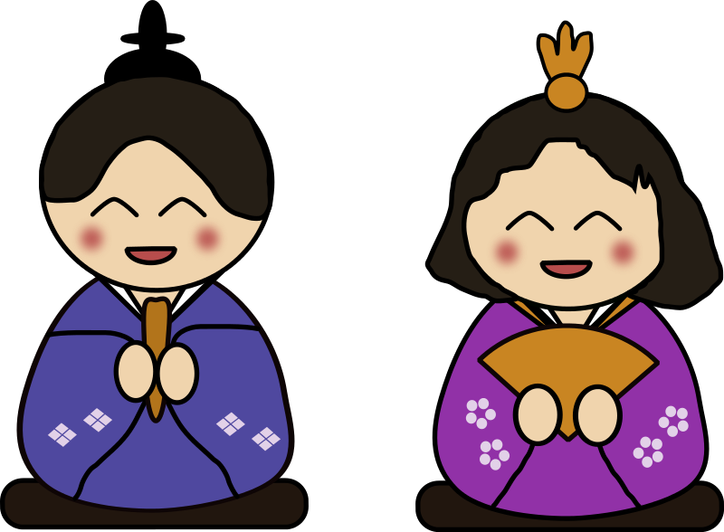
Nice reading!
Have you stayed at a hotel before?
What was it like?

Slide 15

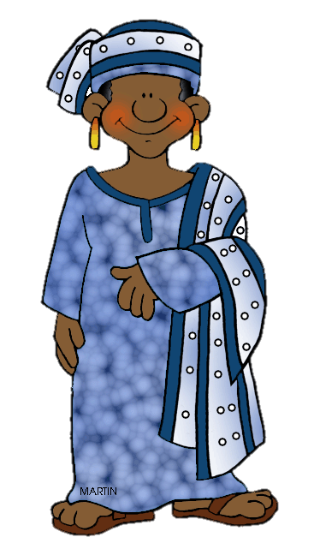
Review
Now we will review punctuation!
What is a question mark used
for?

Slide 16
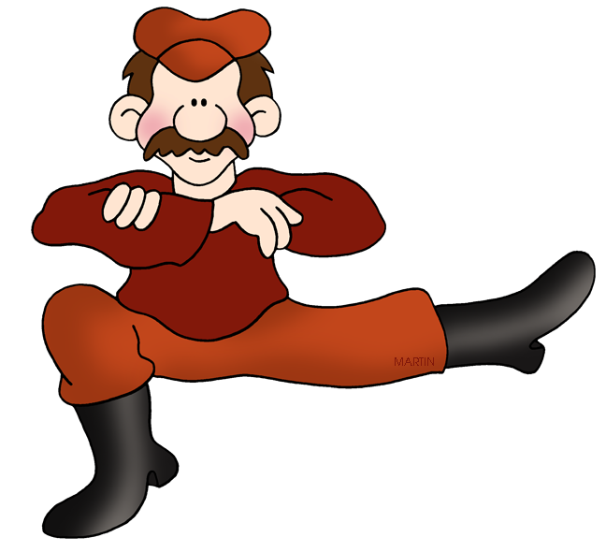
Great work! Now, what do we add to the end of a word to make it plural?

Slide 17

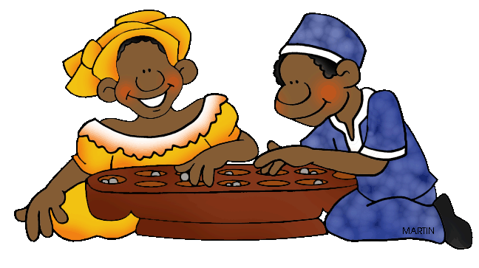
Correct, an “S”! Write a sentence using the “ing” suffix.

Slide 18

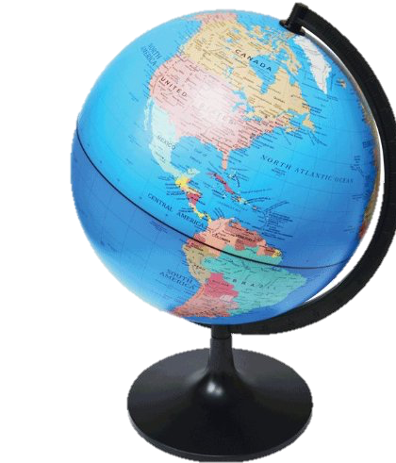

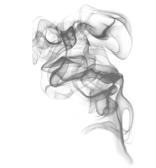
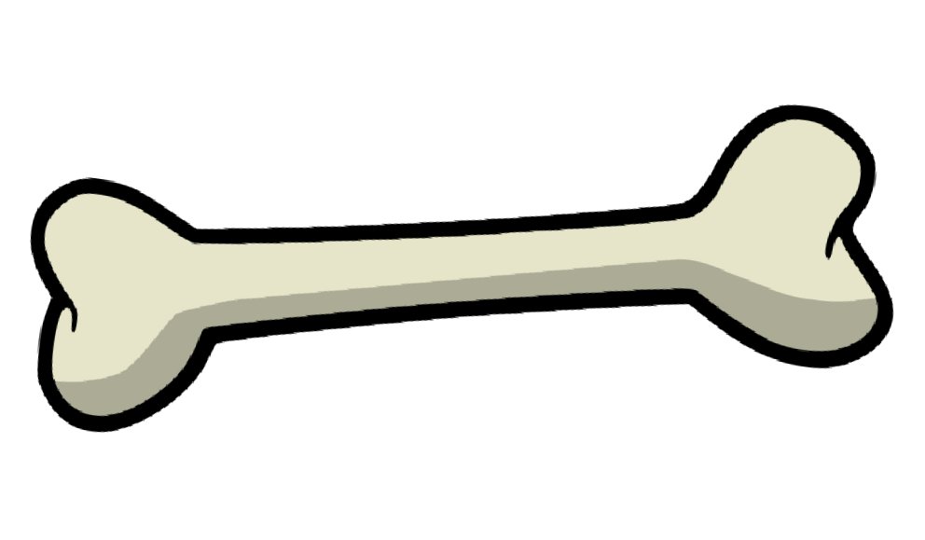
Fill in the blanks for the “o_e” words.
When I want to travel, I look at the .
When I visited Kenya, there was in the air.
I fed a dog a in Japan.

Slide 19


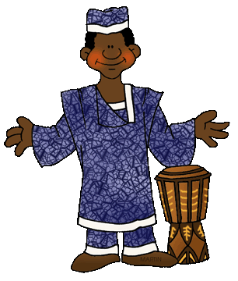
Great, that was fun. What did we learn today?
A review of Japan, Russia and Kenya.
Continuing to compare
Reading about Hotels
A review of “o_e”words, suffixes and punctuation.

Slide 20

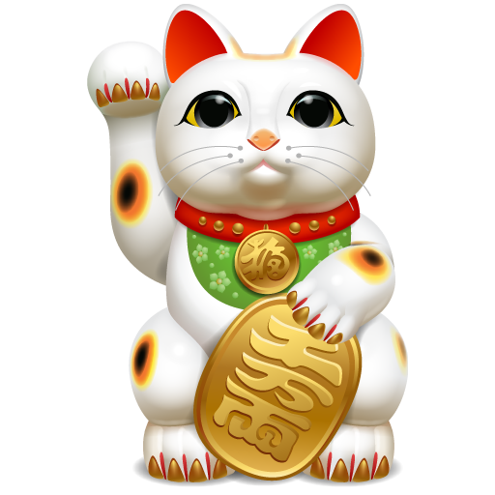
Let’s look at the homework now.
Do you have any questions?

Slide 21
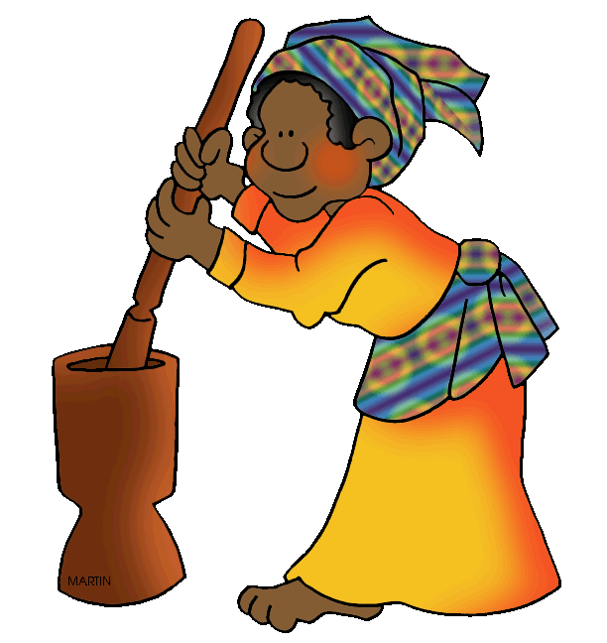
Thank you for a great class today.
We will see you next time!

