Slide 1
Around the World
Unit 8 Lesson 12

Slide 2
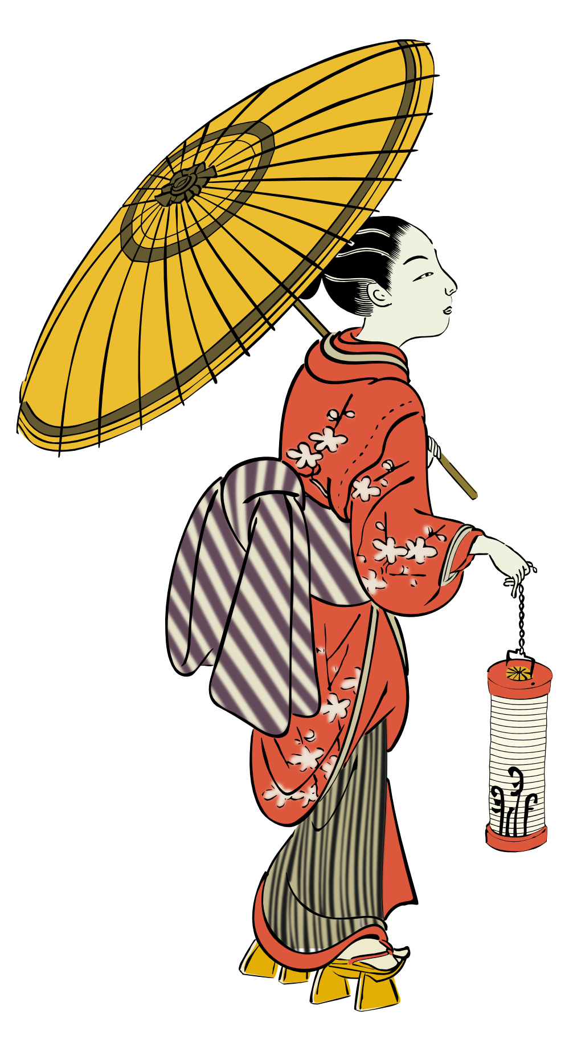
What will we be learning this class?
Comparing countries as a review
A review of suffixes, punctuation and the “o_e” sound

Slide 3
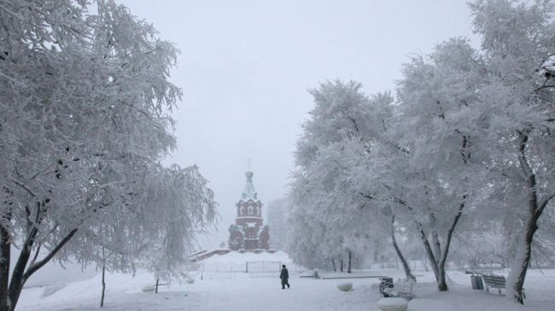
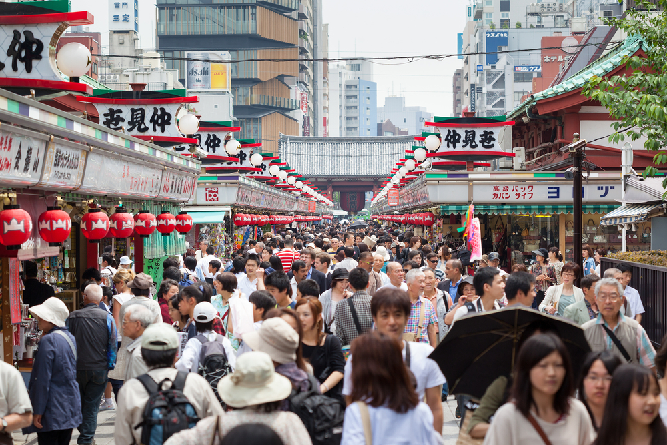
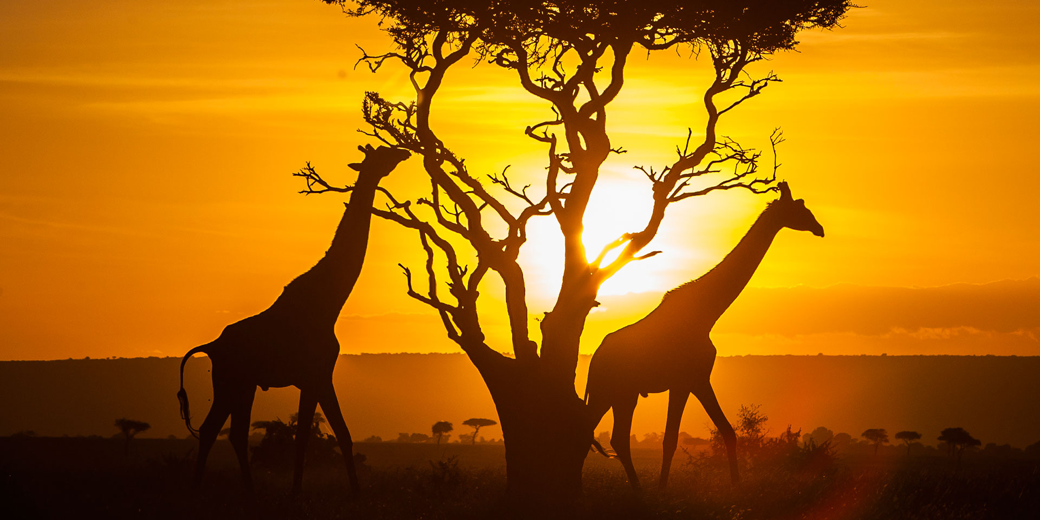
Do you remember? What countries have we learned about?

Slide 4
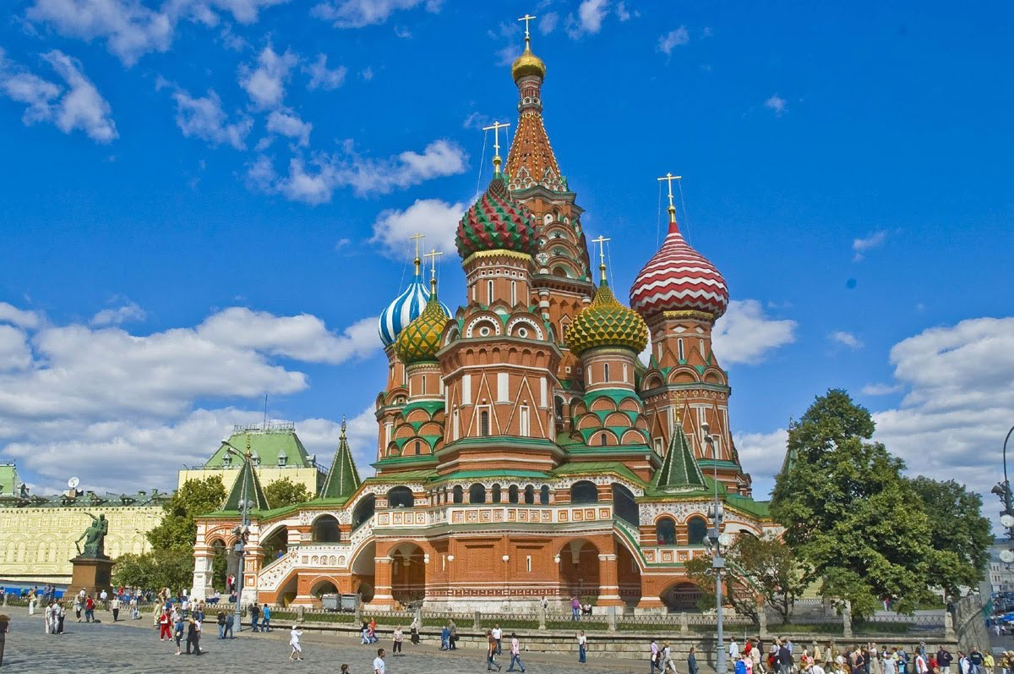
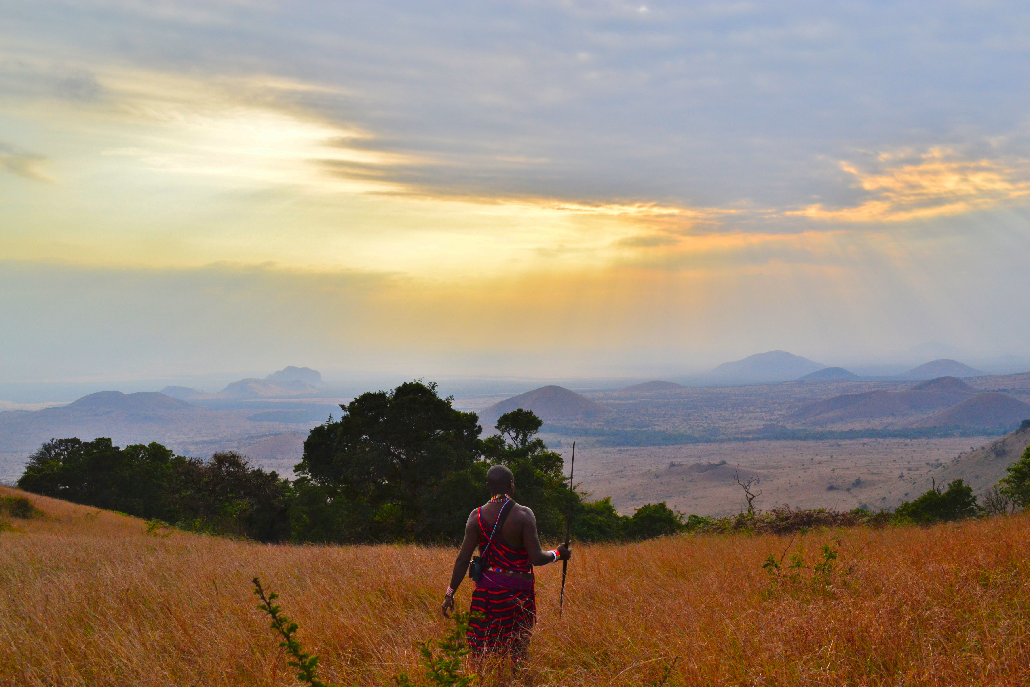
You are right!
Japan, Russia and Kenya.
What country did you like the best? Why?

Slide 5
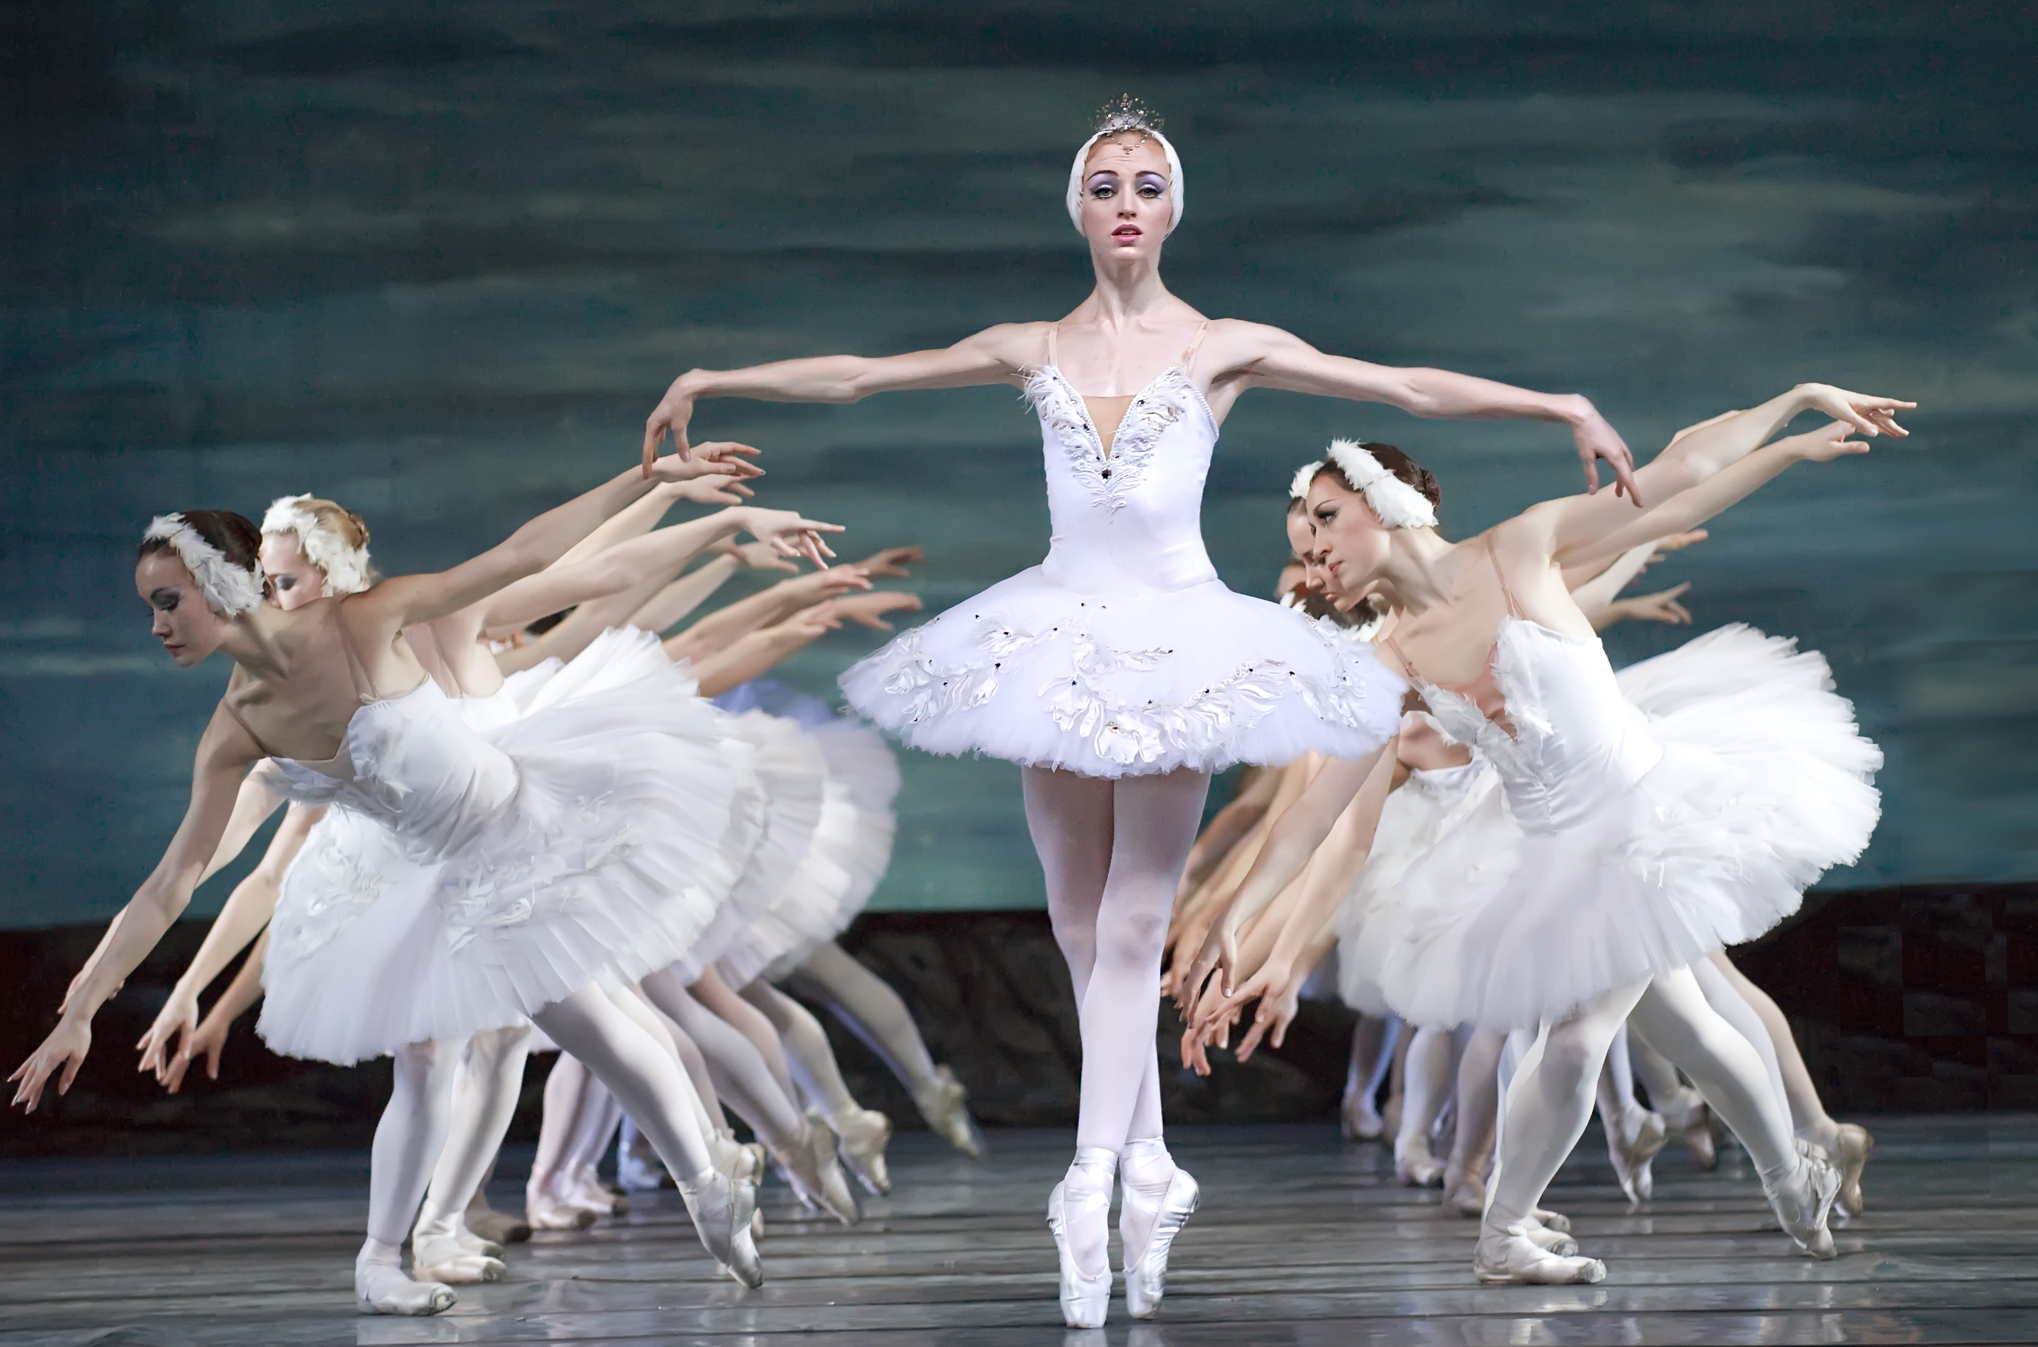
What was special about Russia? What do we call this?

Slide 6
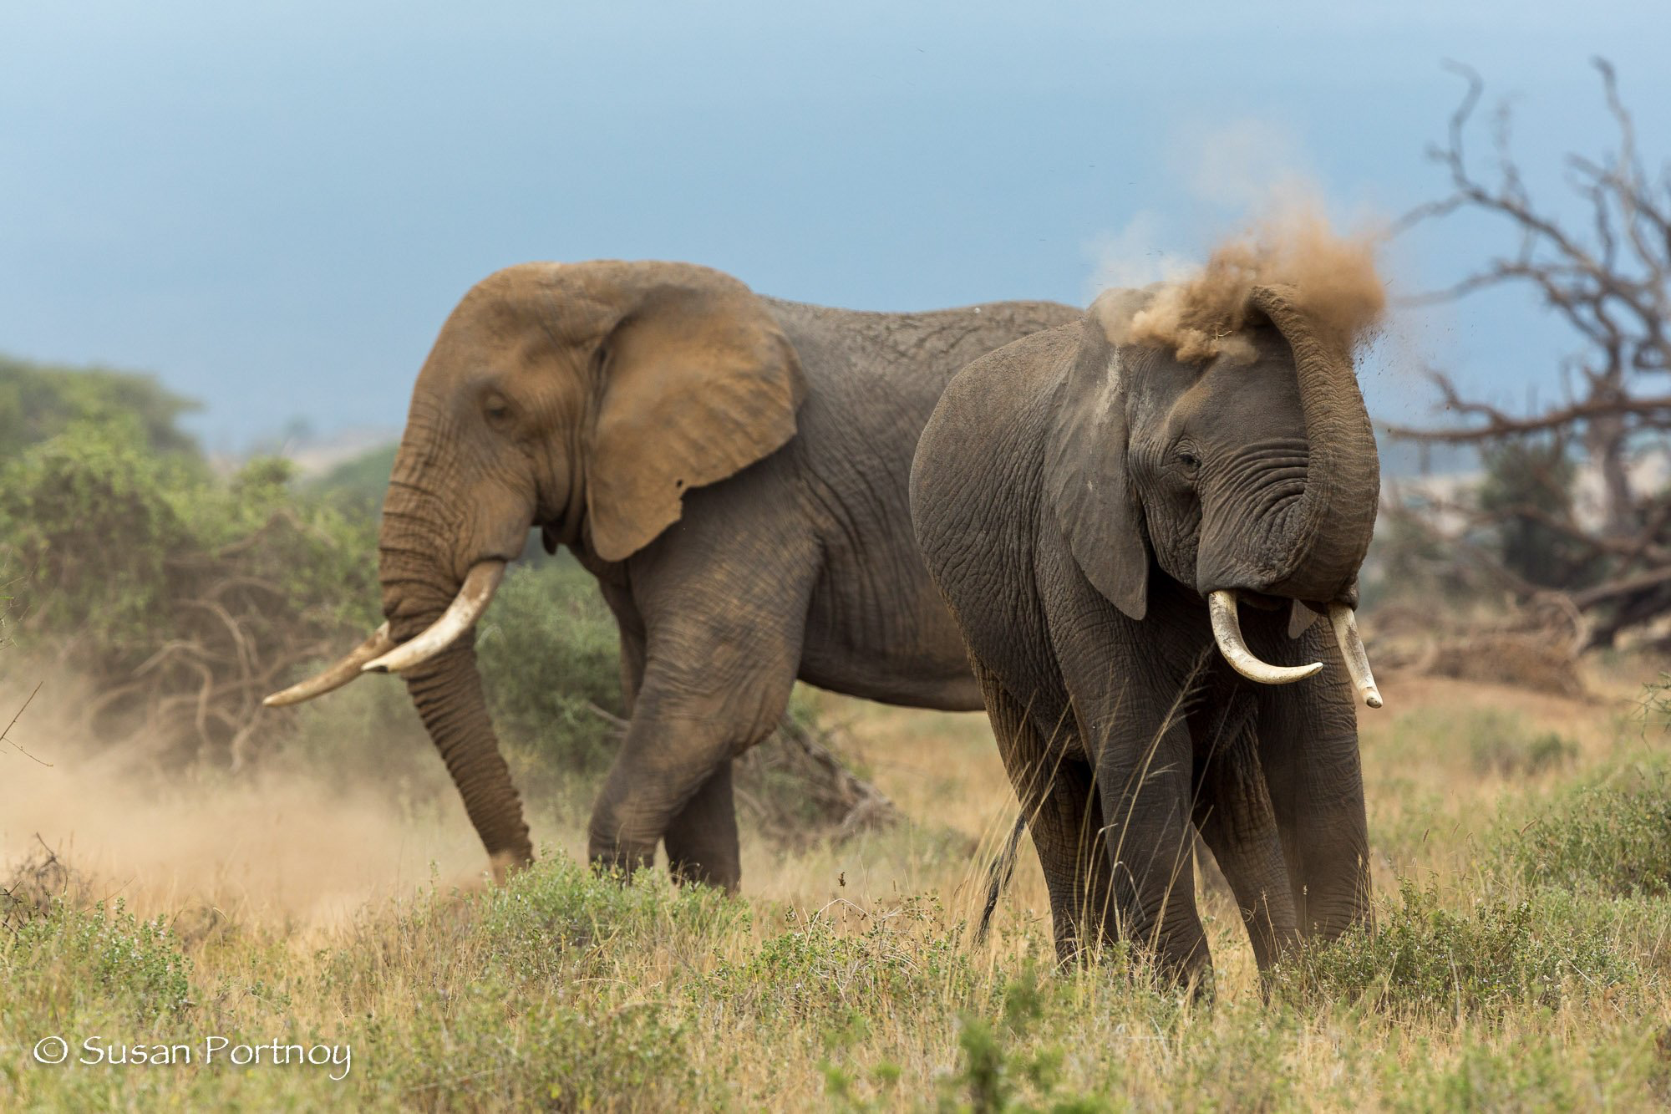
Do you remember?
What sorts of animals live in Kenya?

Slide 7
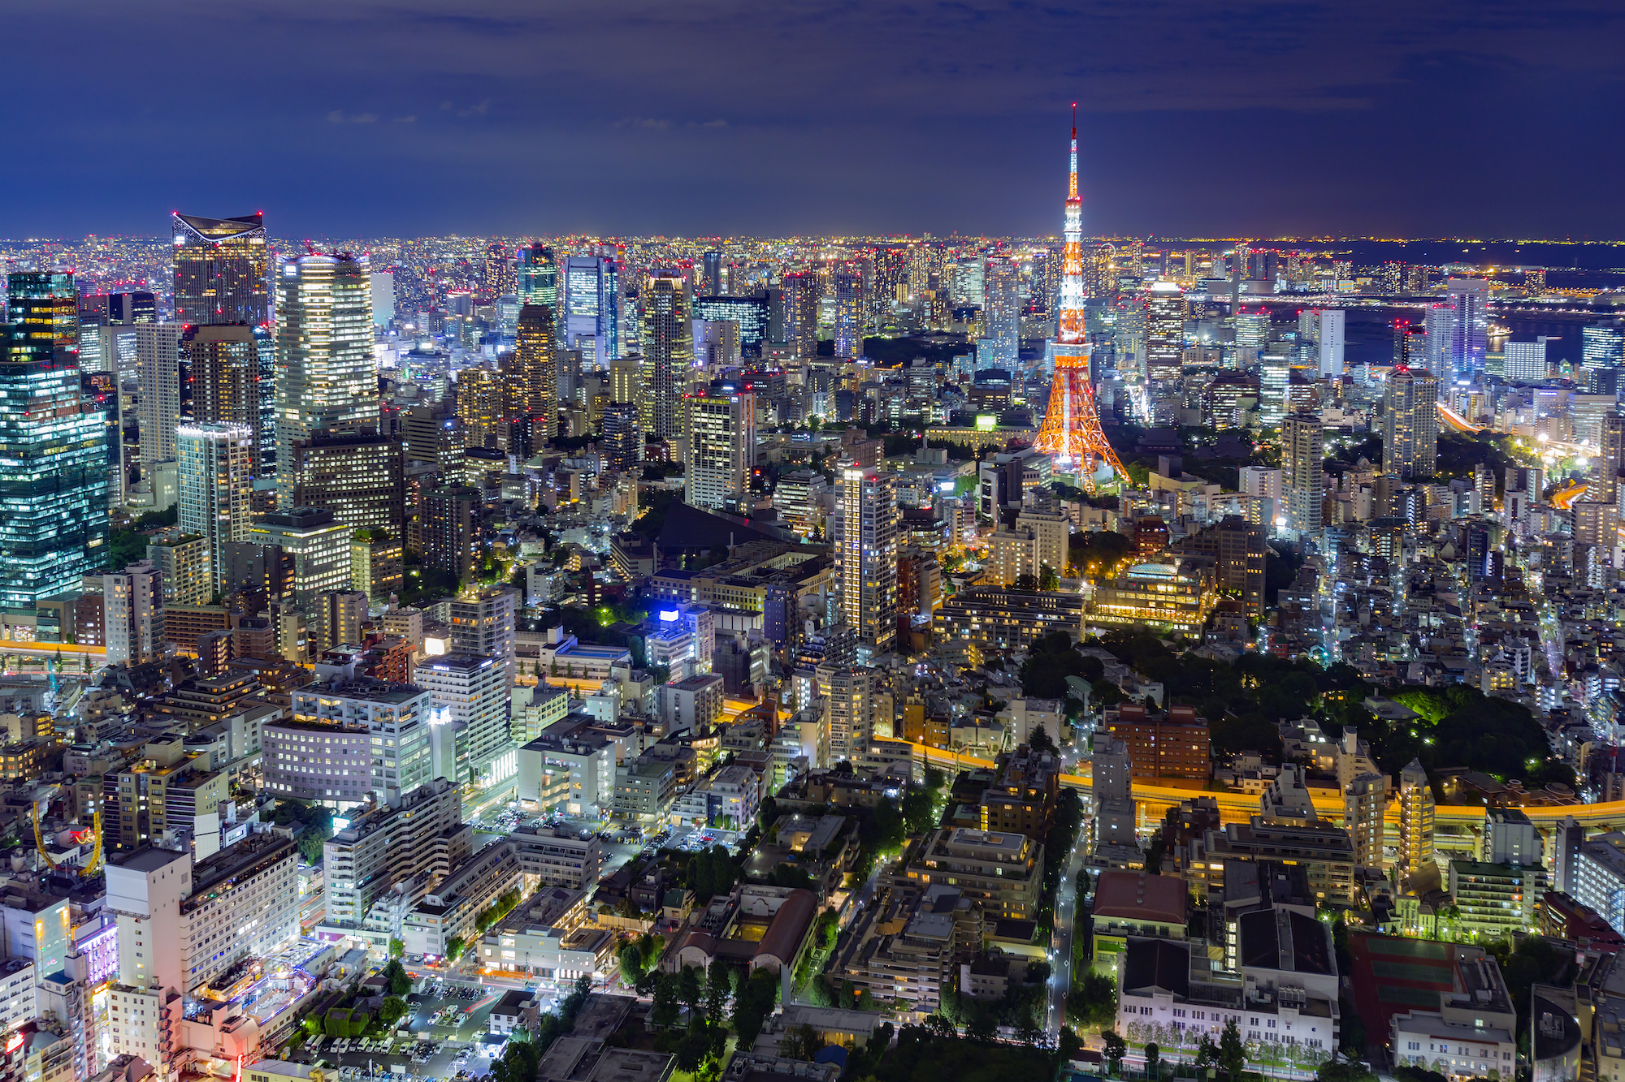
What did you like best about Japan?

Slide 8


Do you remember how to compare?
To compare is to see what is the same about two people, places, or things.

Slide 9
Compare these flowers.
Both are tall.
Both have green stems.

Slide 10
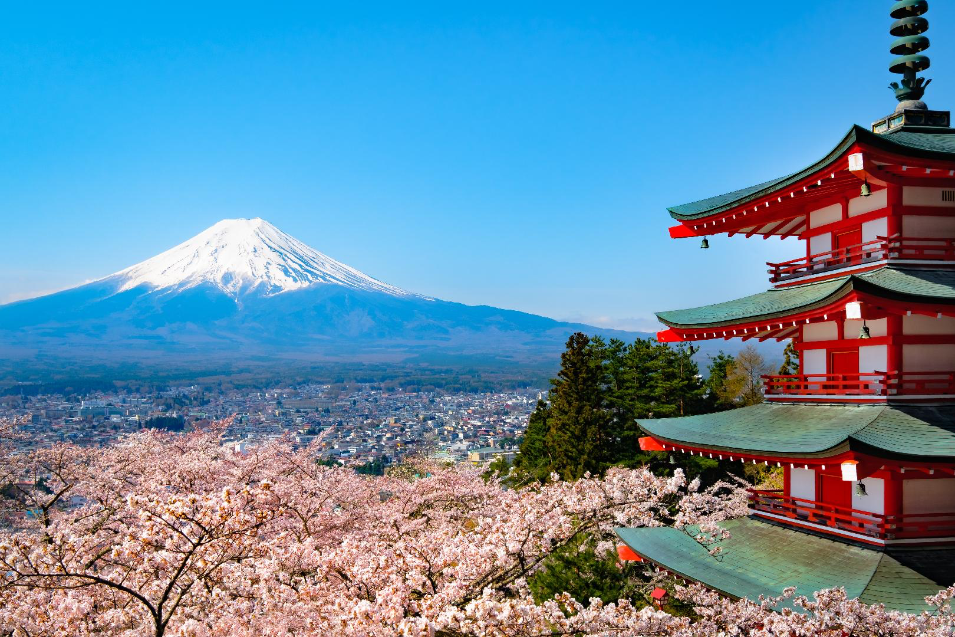
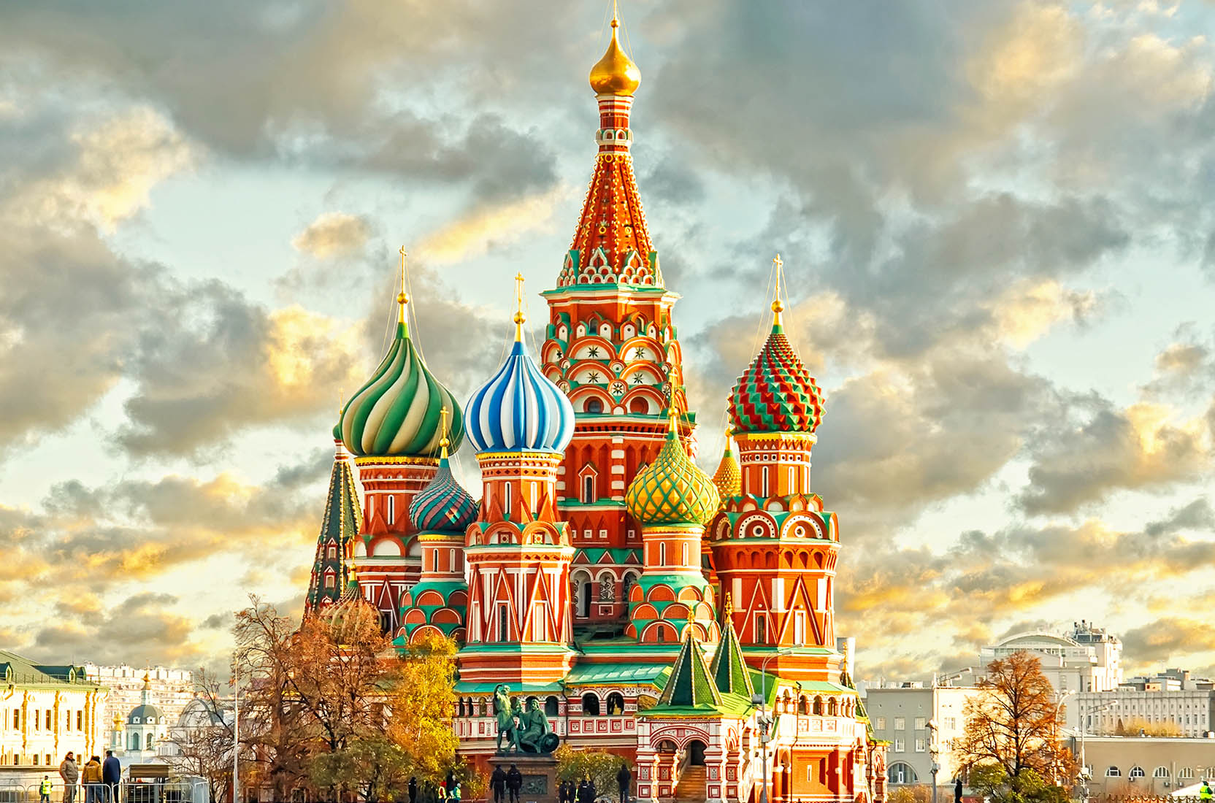
Can you compare the countries of Russia and Japan?
What is the same, or similar, between the two countries?

Slide 11
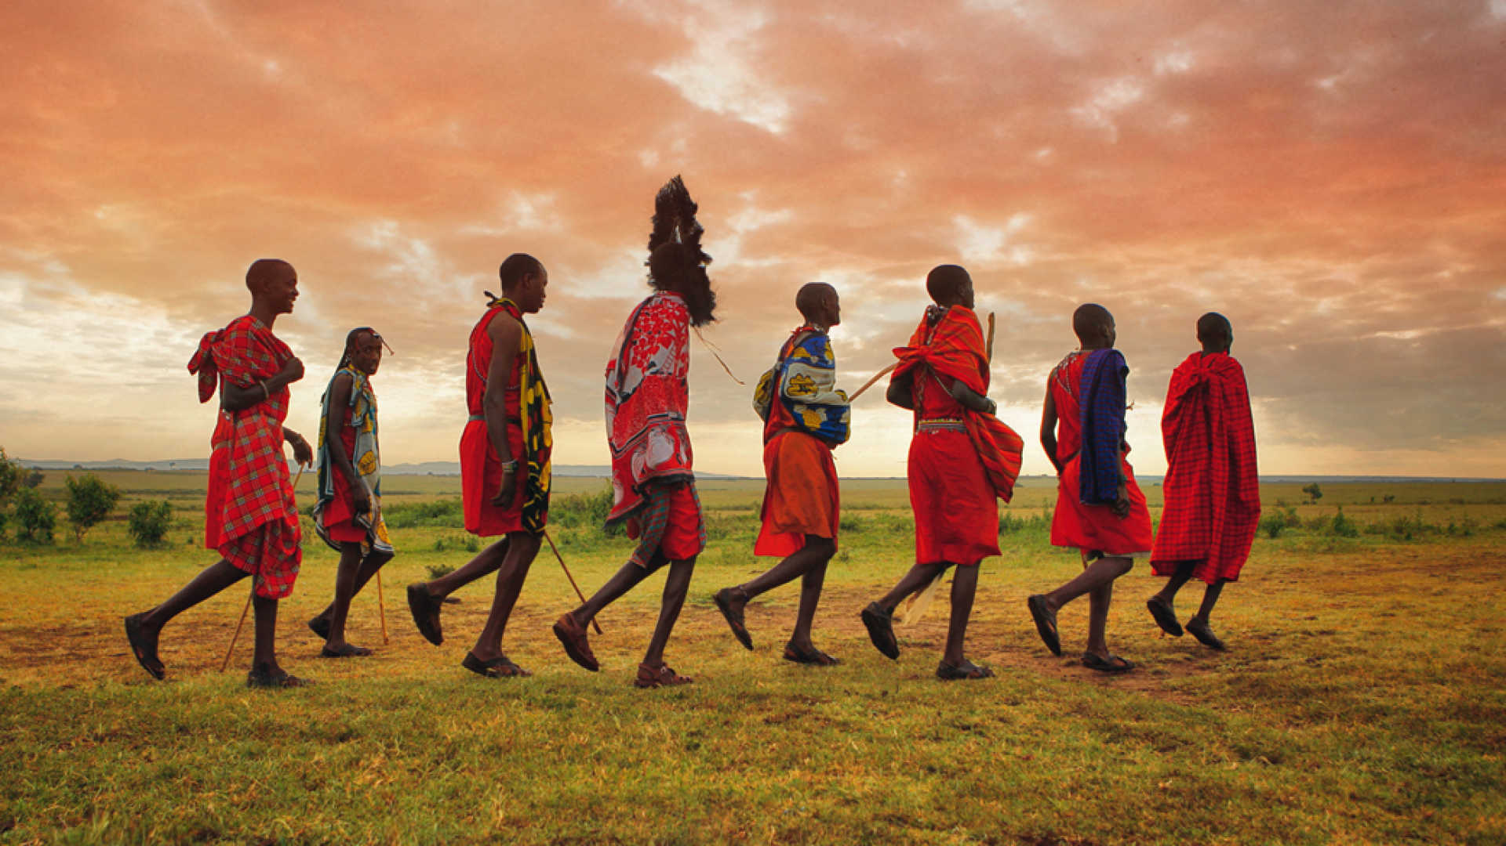
Great work! Let’s do it once more.
Compare the country of Japan with Kenya!

Slide 12
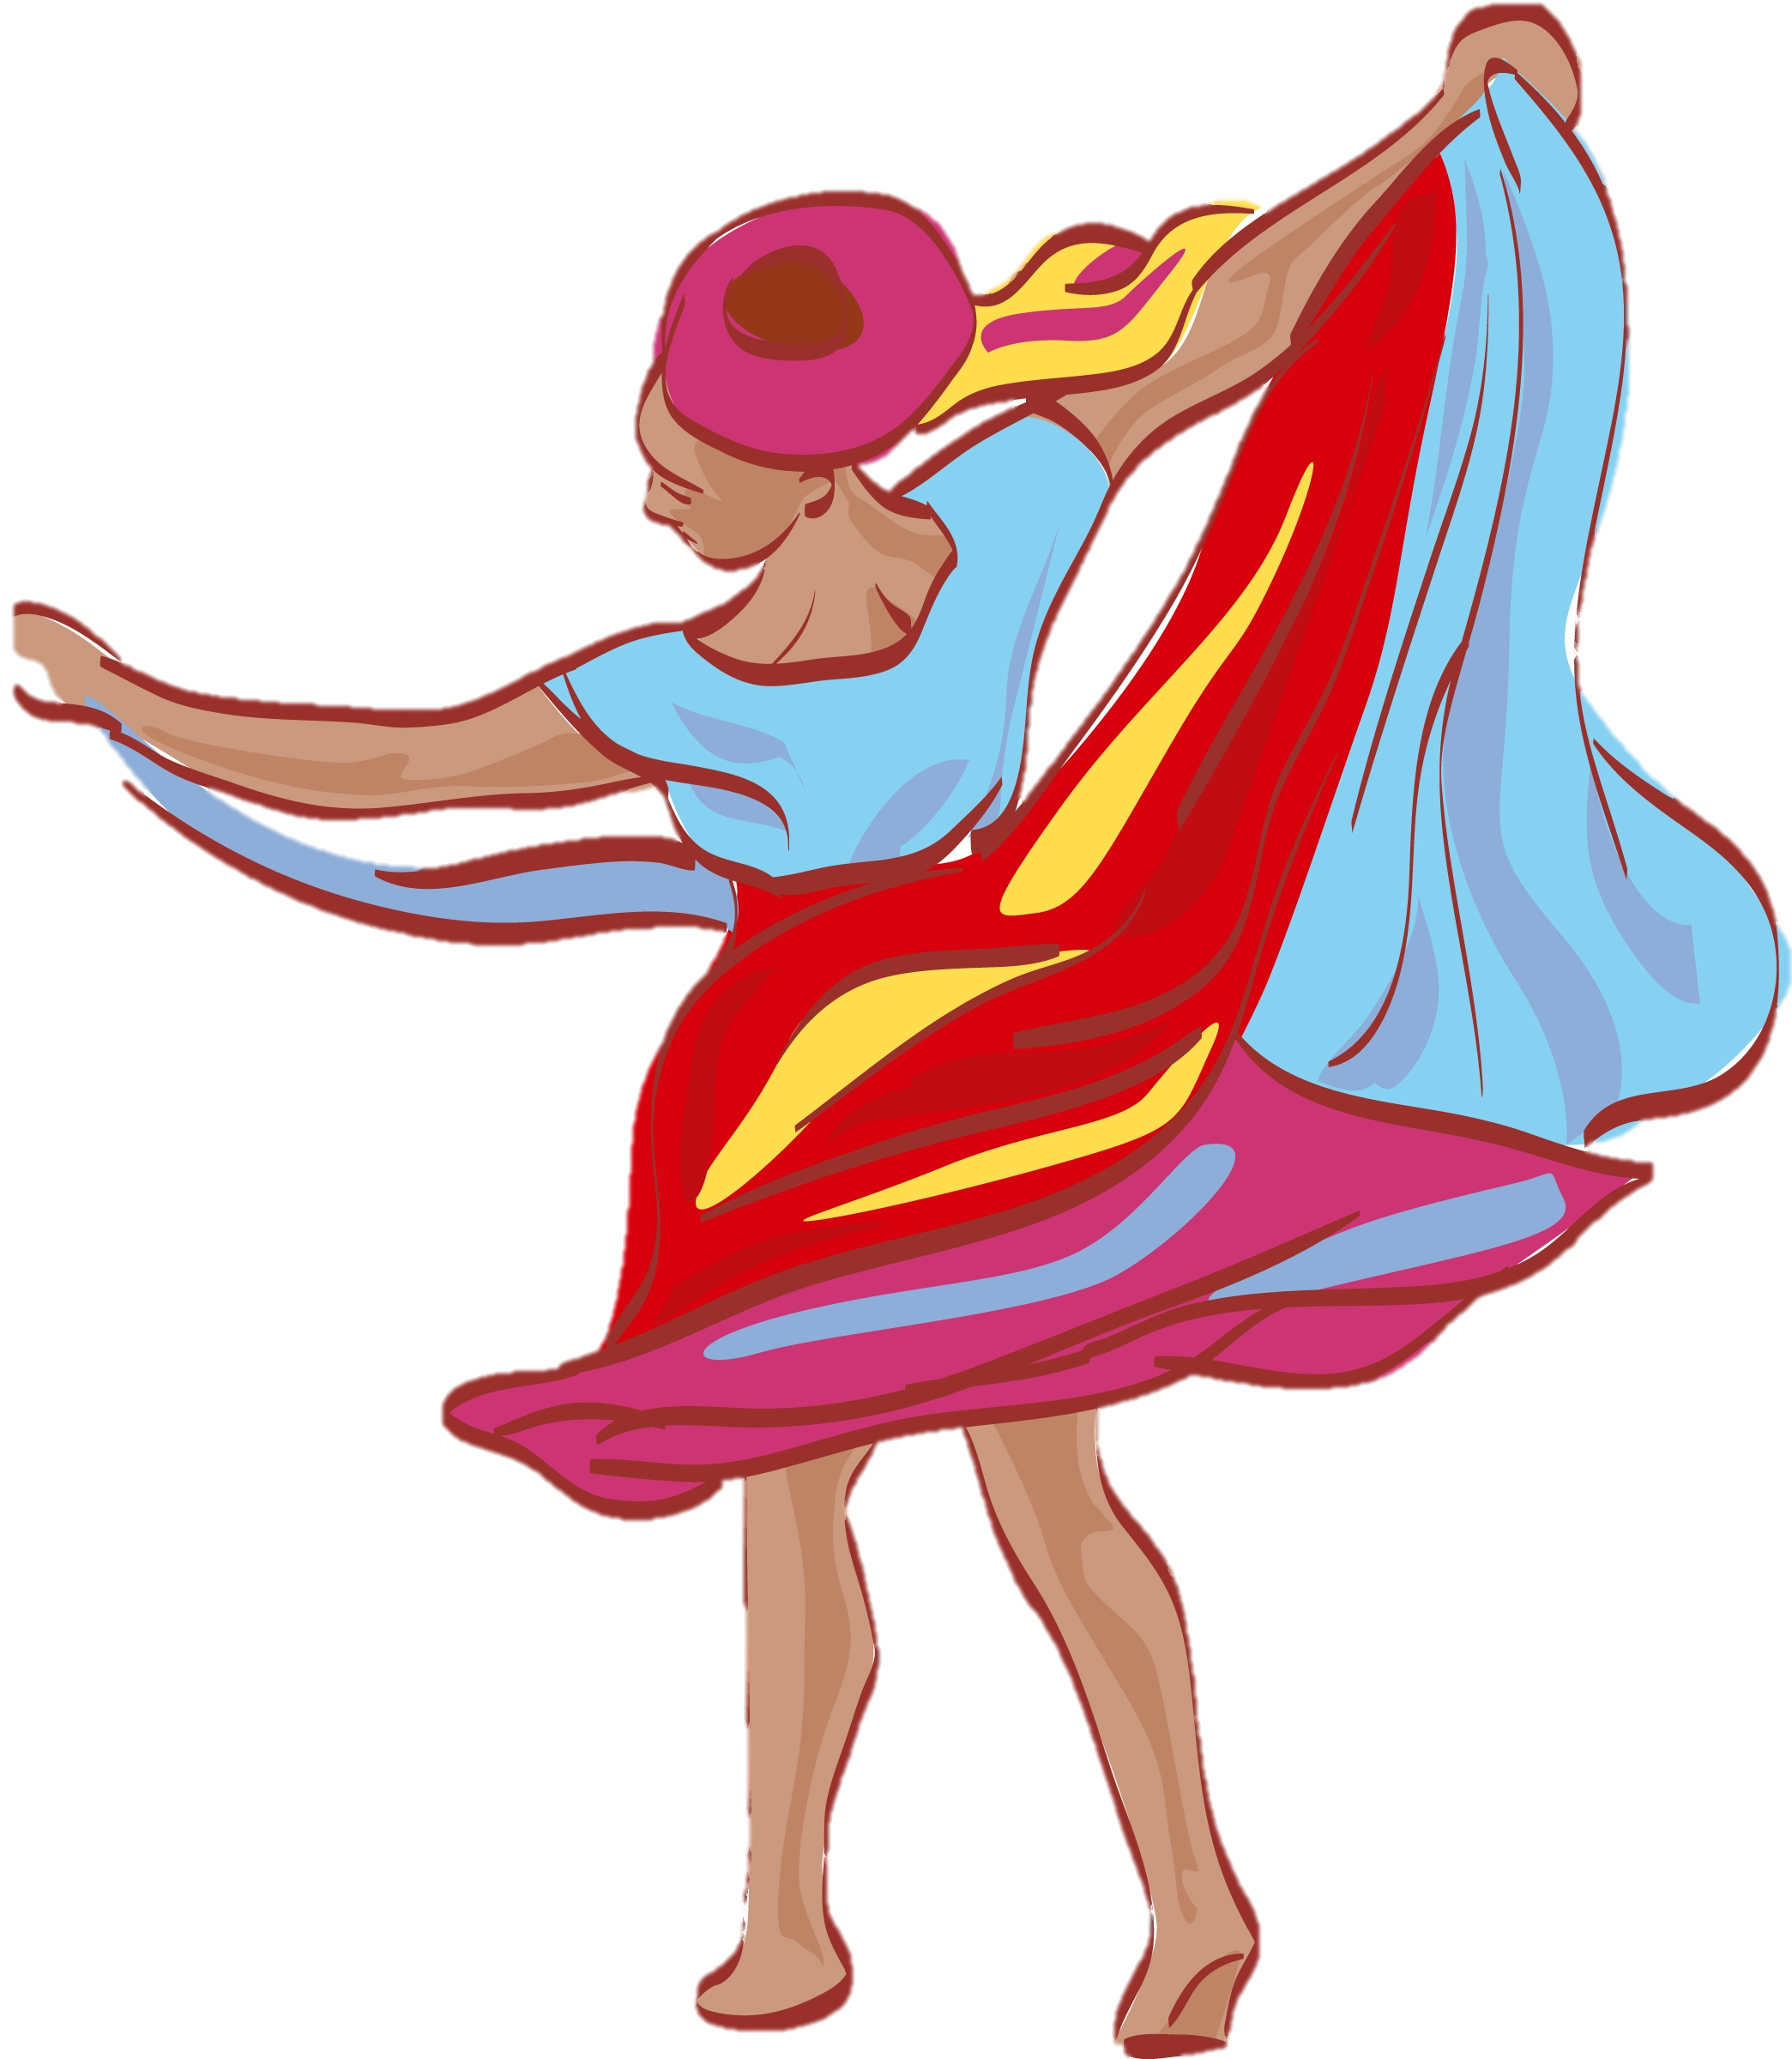
Great answers! You are great at comparing.

Slide 13

Where do you stay when you travel?
Do you stay in a home, in a hotel or in a motel?

Slide 14
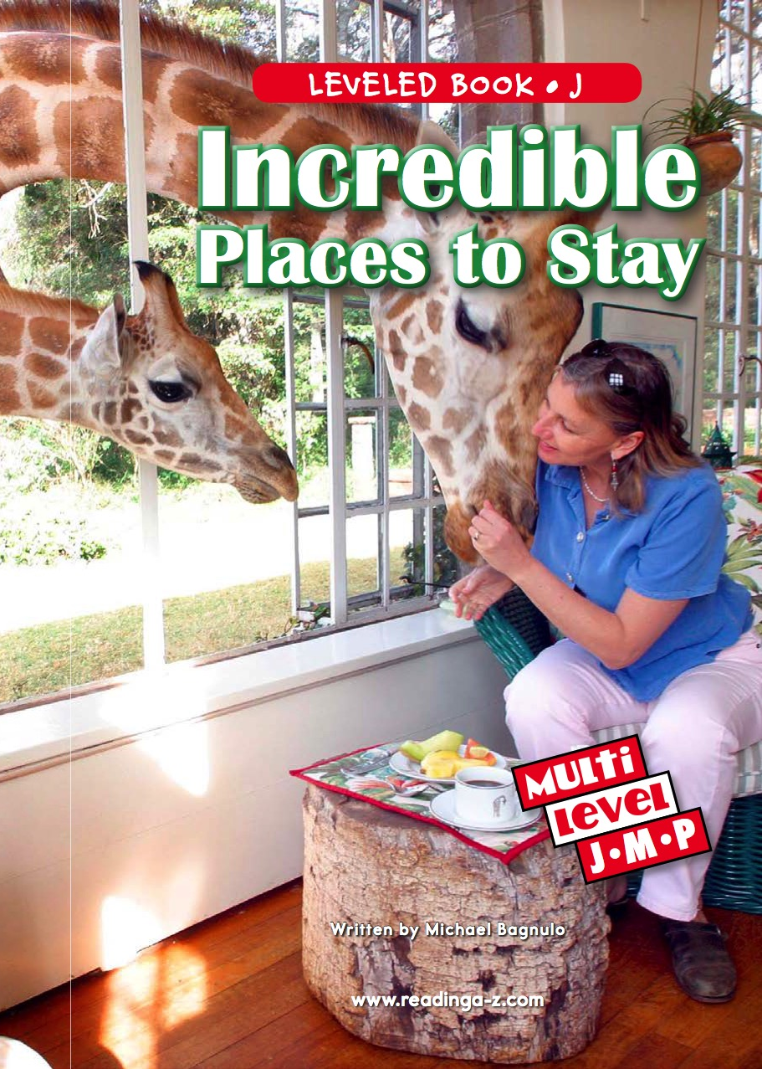
We are going to read a book about Hotels!

Slide 22
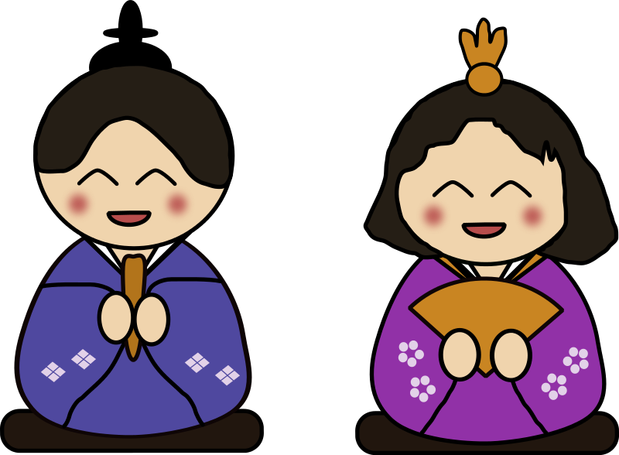
Nice reading!
Have you stayed at a hotel before?
What was it like?

Slide 23
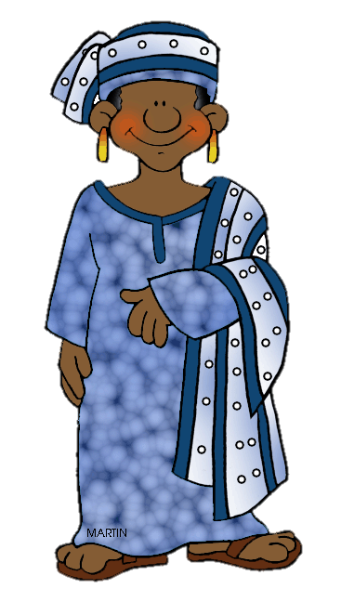
Review
Now we will review punctuation!
What is a question mark used for?

Slide 24
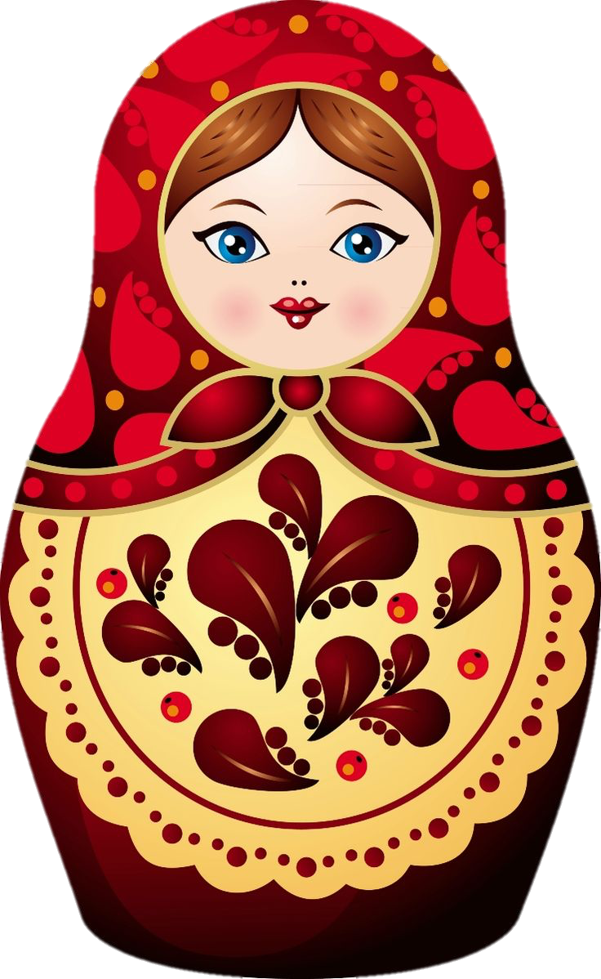
Correct! Now, write a sentence using a comma.

Slide 25
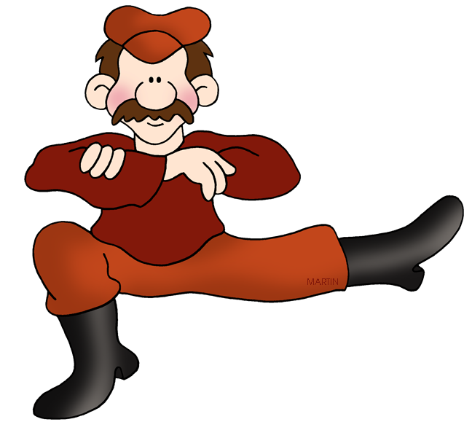
Great work! Now, what do we add to the end of a word to make it plural?

Slide 26
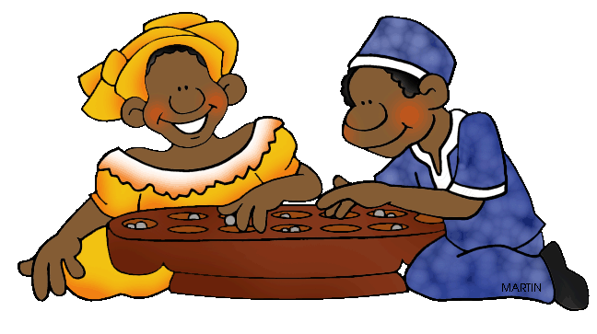
Correct, an “S”! Write a sentence using the “ing” suffix.

Slide 27
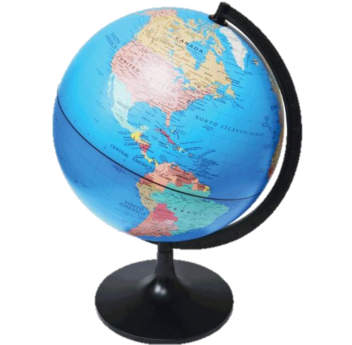
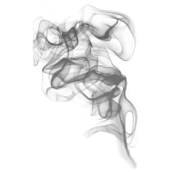

Fill in the blanks for the “o_e” words.
When I want to travel, I look at the _________.
When I visited Kenya, there was ___________
in the air.
I fed a dog a ______ in Japan.

Slide 28
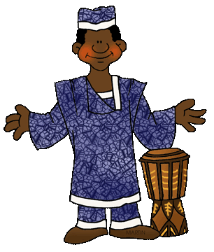
Great, that was fun. What did we learn today?
A review of Japan, Russia and Kenya.
Continuing to compare
Reading about Hotels
A review of “o_e”words, suffixes and punctuation.

Slide 29
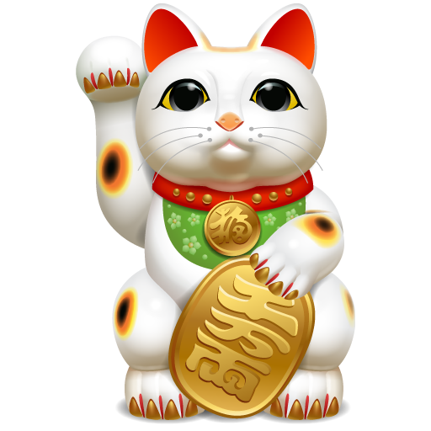
Let’s look at the homework now.
Do you have any questions?

Slide 30
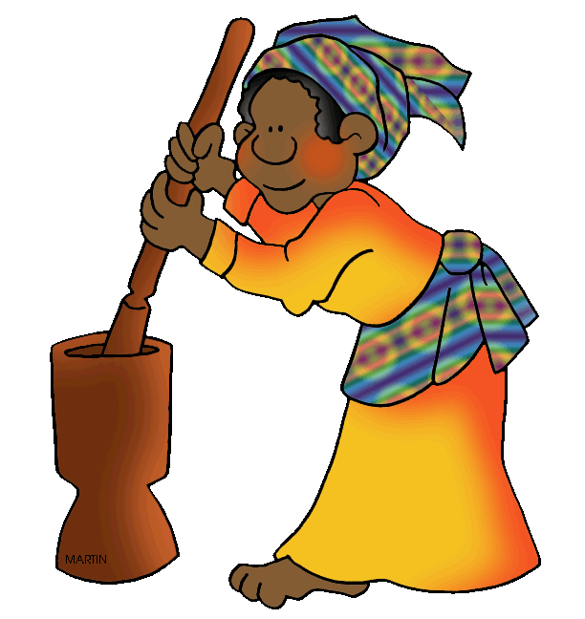
Thank you for a great class today.
We will see you next time!

