Slide 1



Around the World
Unit 8 Lesson 2

Slide 2



What will we be learning this class?
A look into a new country
A review of the “augh” sound

Slide 3

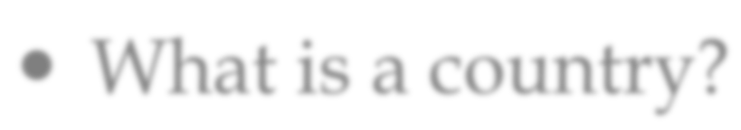
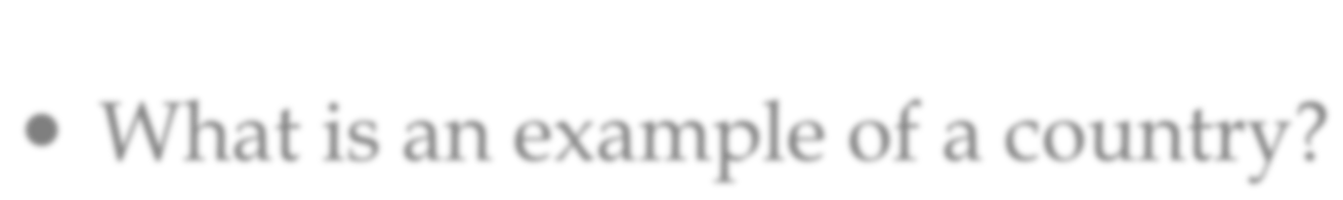
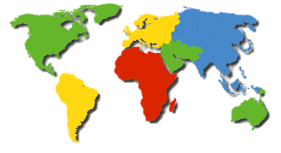
Do you remember?
What is a country?
What is an example of a country?

Slide 4


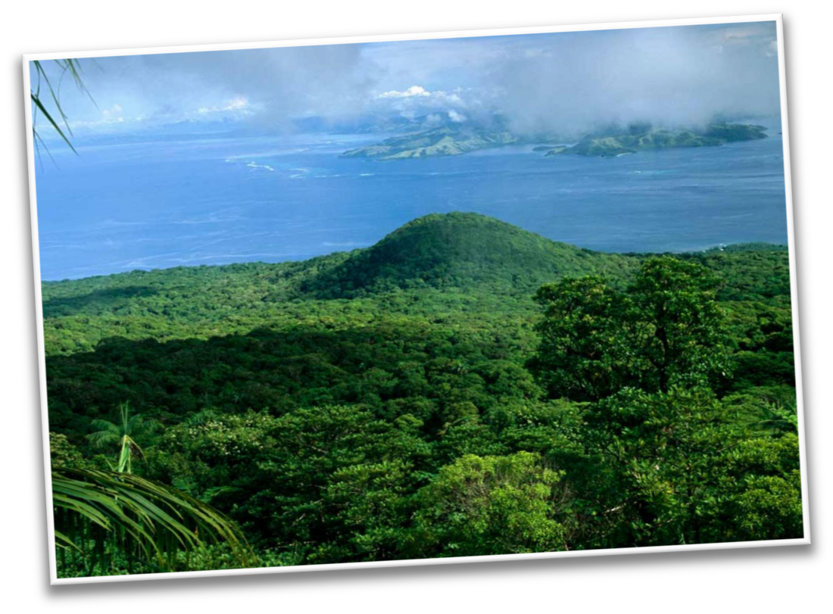




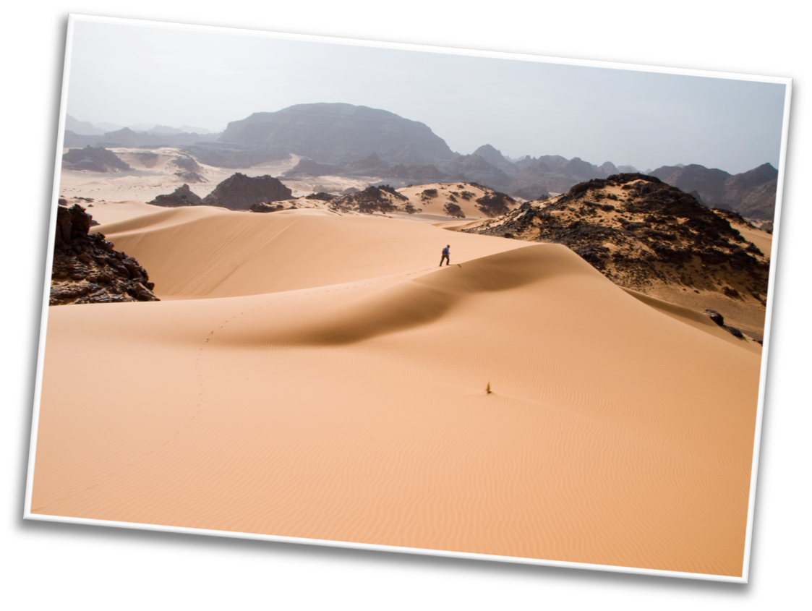



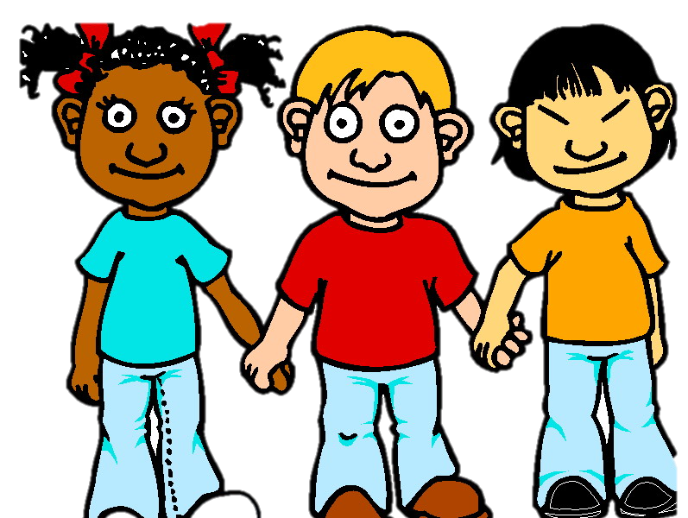
You have one minute
1:00
Write down as many countries as you can, then we will compare our lists!

Slide 5



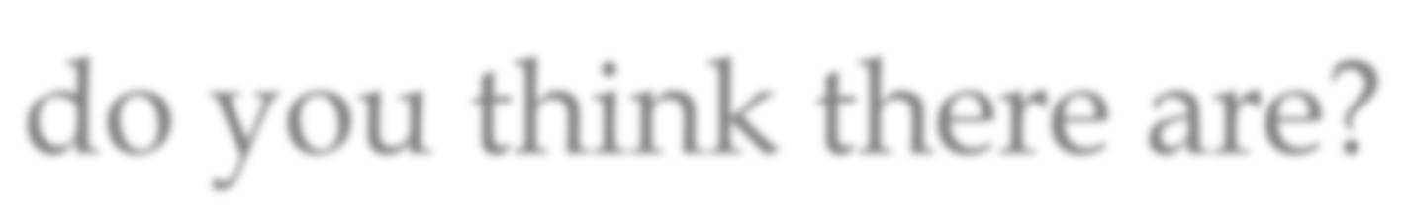
Nice work! There are so many countries! How many countries do you think there are?

Slide 6
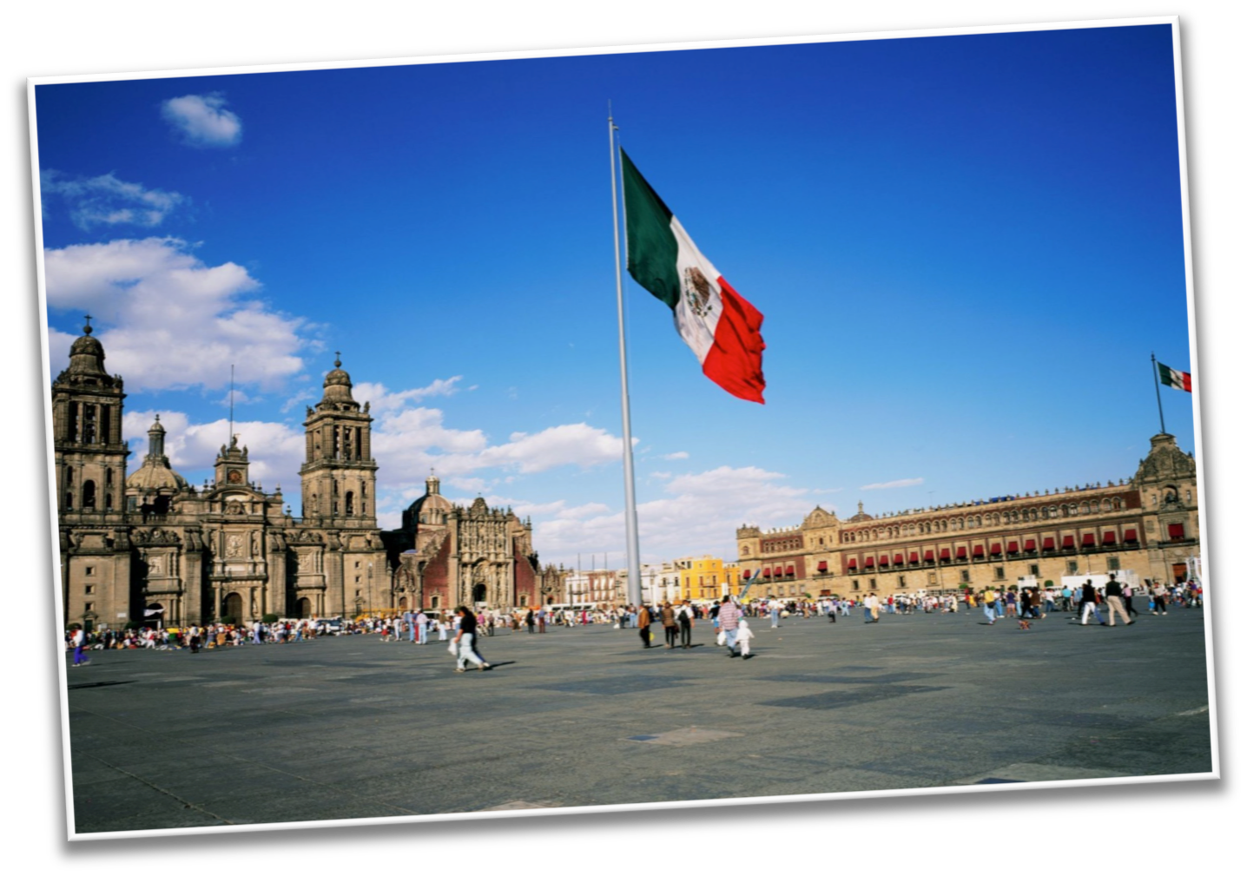
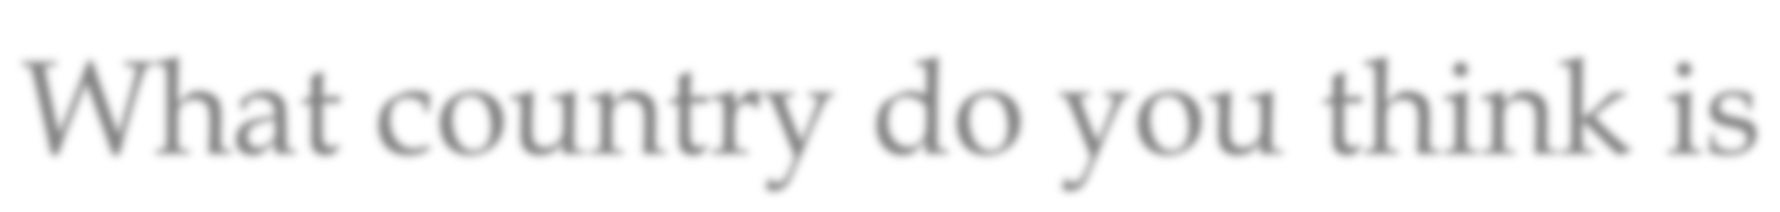
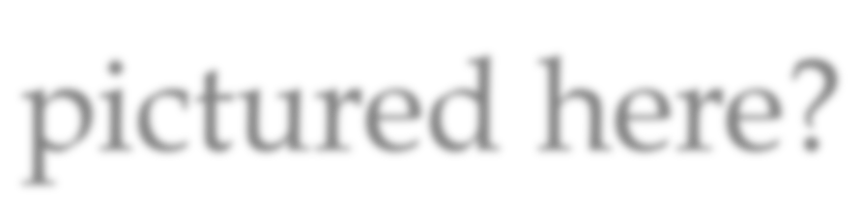
What country do you think is pictured here?

Slide 7
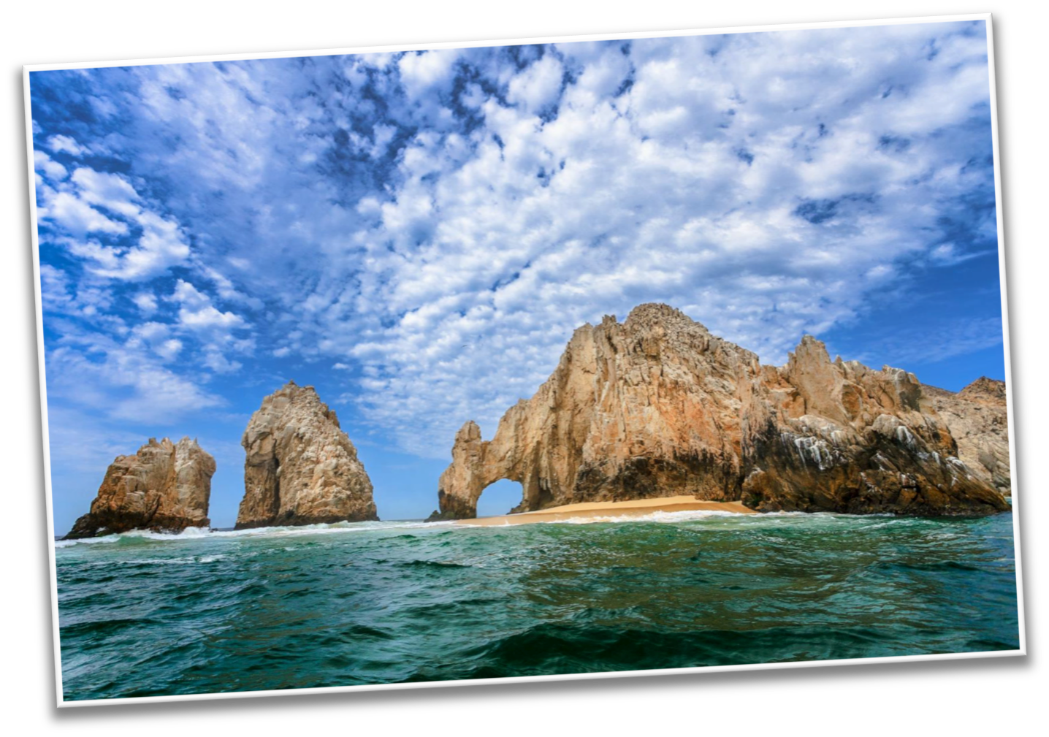
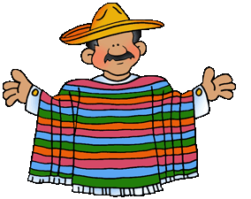
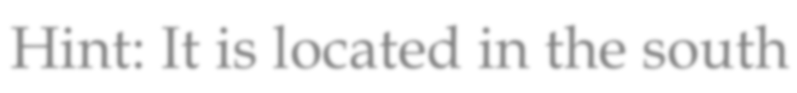

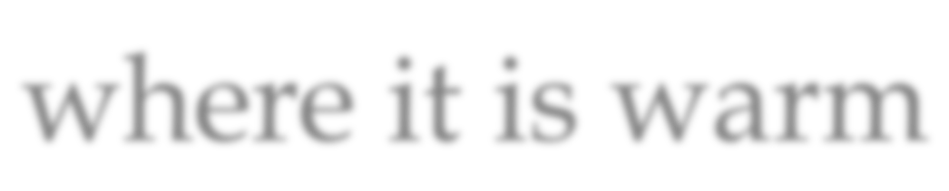


Hint: It is located in the south where it is warm

Slide 8



Review
What kinds of food do people in Mexico like to eat?

Slide 9

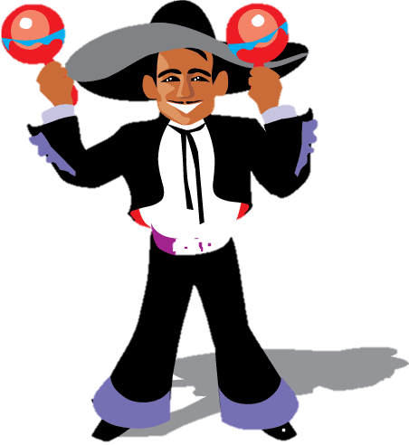
Great work!
Now we will review the “augh” sound!

Slide 10


Do you remember? What sound does “augh” make?

Slide 11


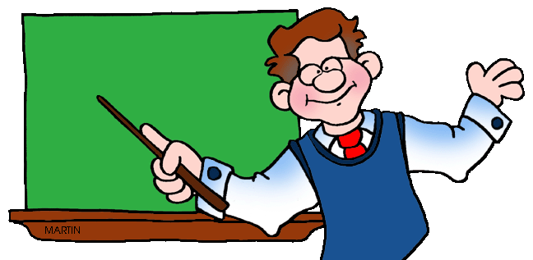
Let’s practice using some words in a sentence.
I was ______________ how to read.

Slide 12
Let’s practice using some words in a sentence.
My brother is funny, he makes me ____________.

Slide 13
Let’s practice using some words in a sentence.
She is her father’s ________________.

Slide 14

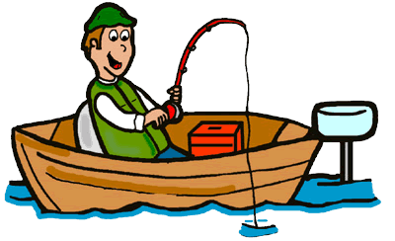
More practice!
We went fishing and _____________ a fish!

Slide 15


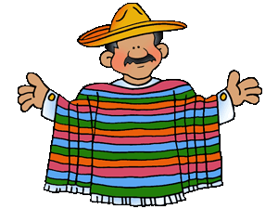
Now it is your turn, write a sentence using an “augh” word

Slide 16


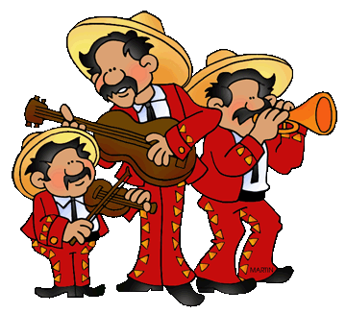
Great, that was fun. What did we learn today?
A look into the countries of the world
Learning about Mexico
A review of “augh” words

Slide 17

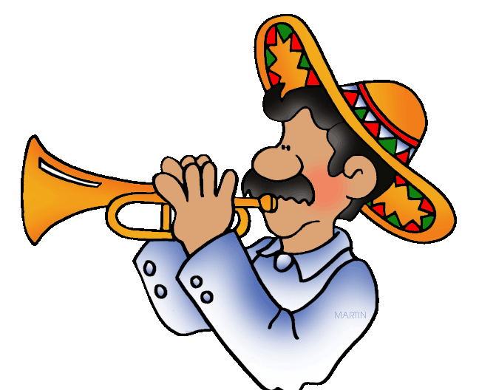
Let’s look at the homework now.
Do you have any questions?

Slide 18
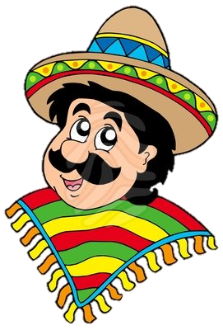
Thank you for a great class today.
As they say in Mexico, Adiós!

