Slide 1
Around the World
Unit 8 Lesson 2

Slide 2

What will we be learning this class?
A look into a new country
A review of the “augh” sound

Slide 3
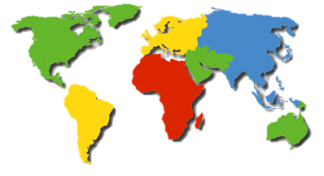
Do you remember?
What is a country?
What is an example of a country?

Slide 4
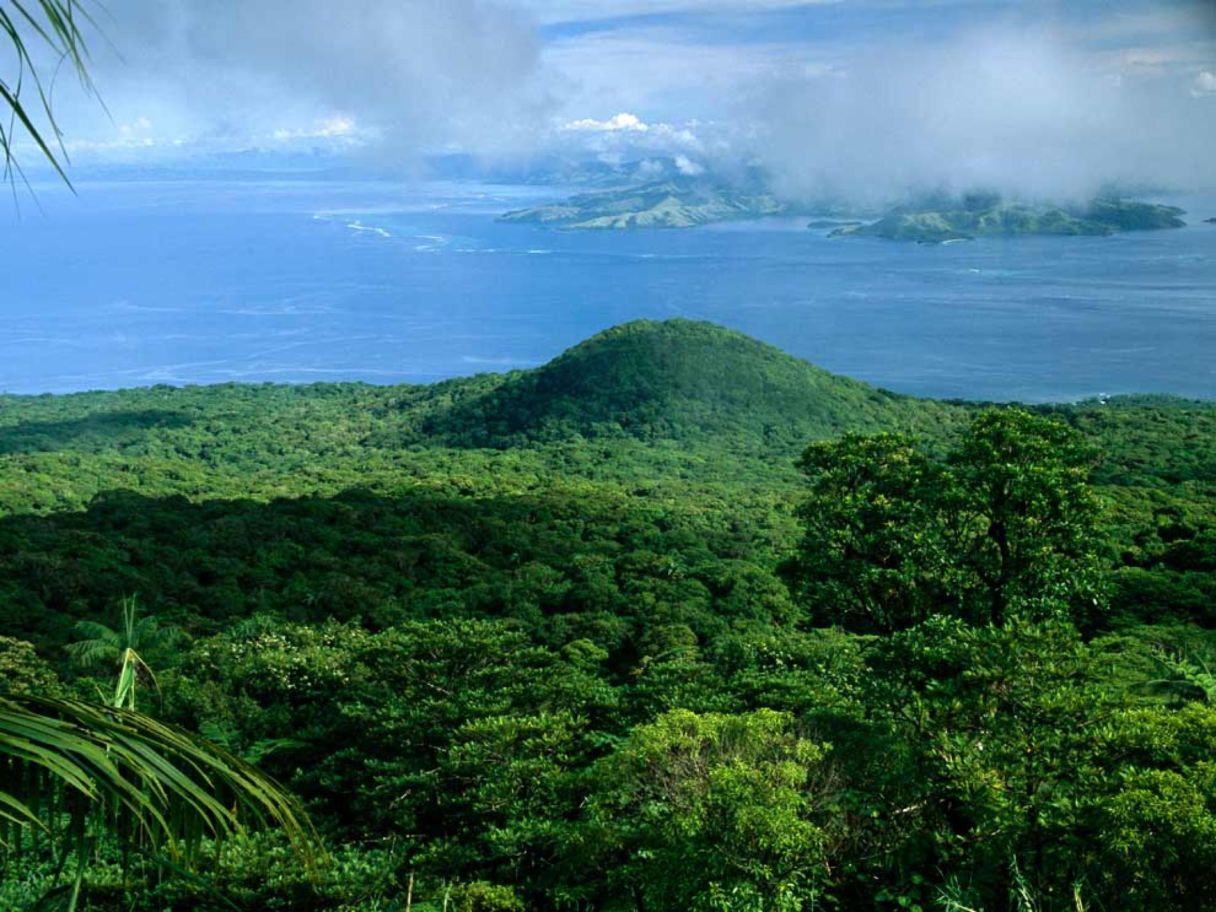
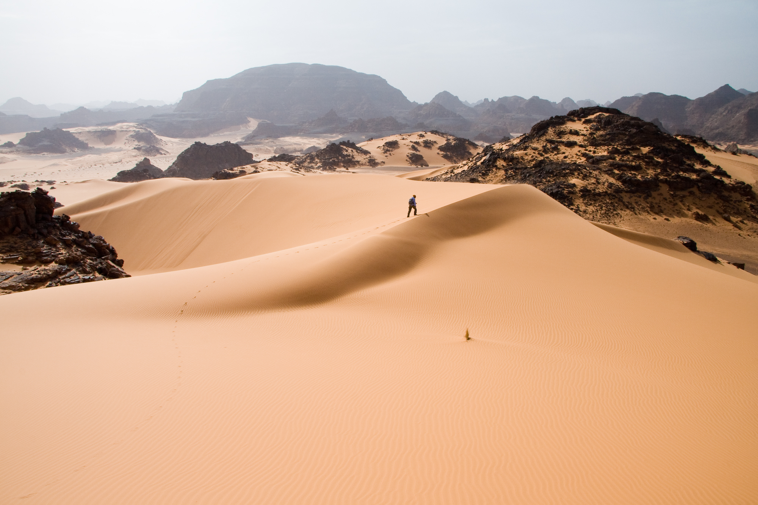
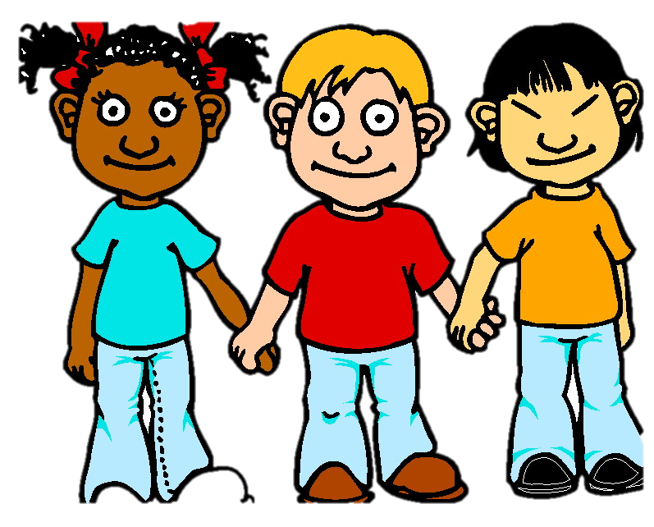
You have one minute
1:00
Write down as many countries as you can, then we will compare our lists!

Slide 5

Nice work! There are so many countries! How many countries do you think there are?

Slide 6
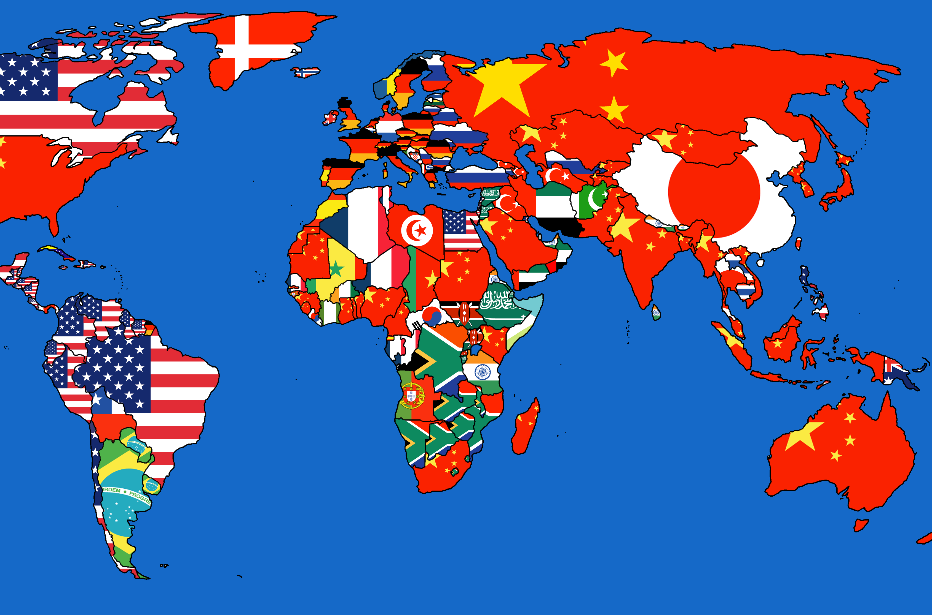
There are 196 countries in the world!

Slide 7
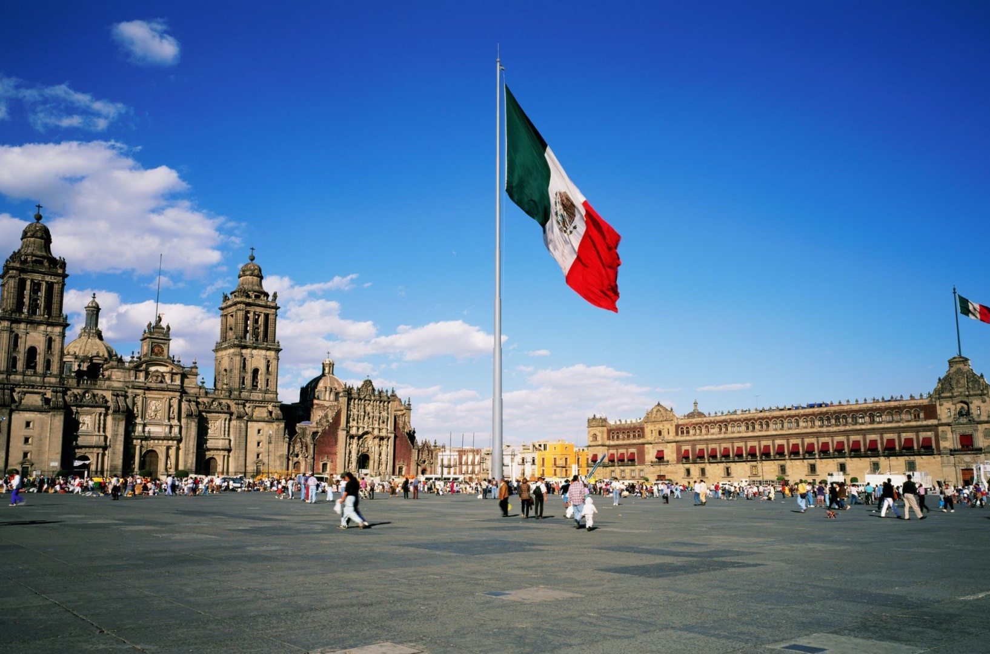
What country do you think is pictured here?

Slide 8
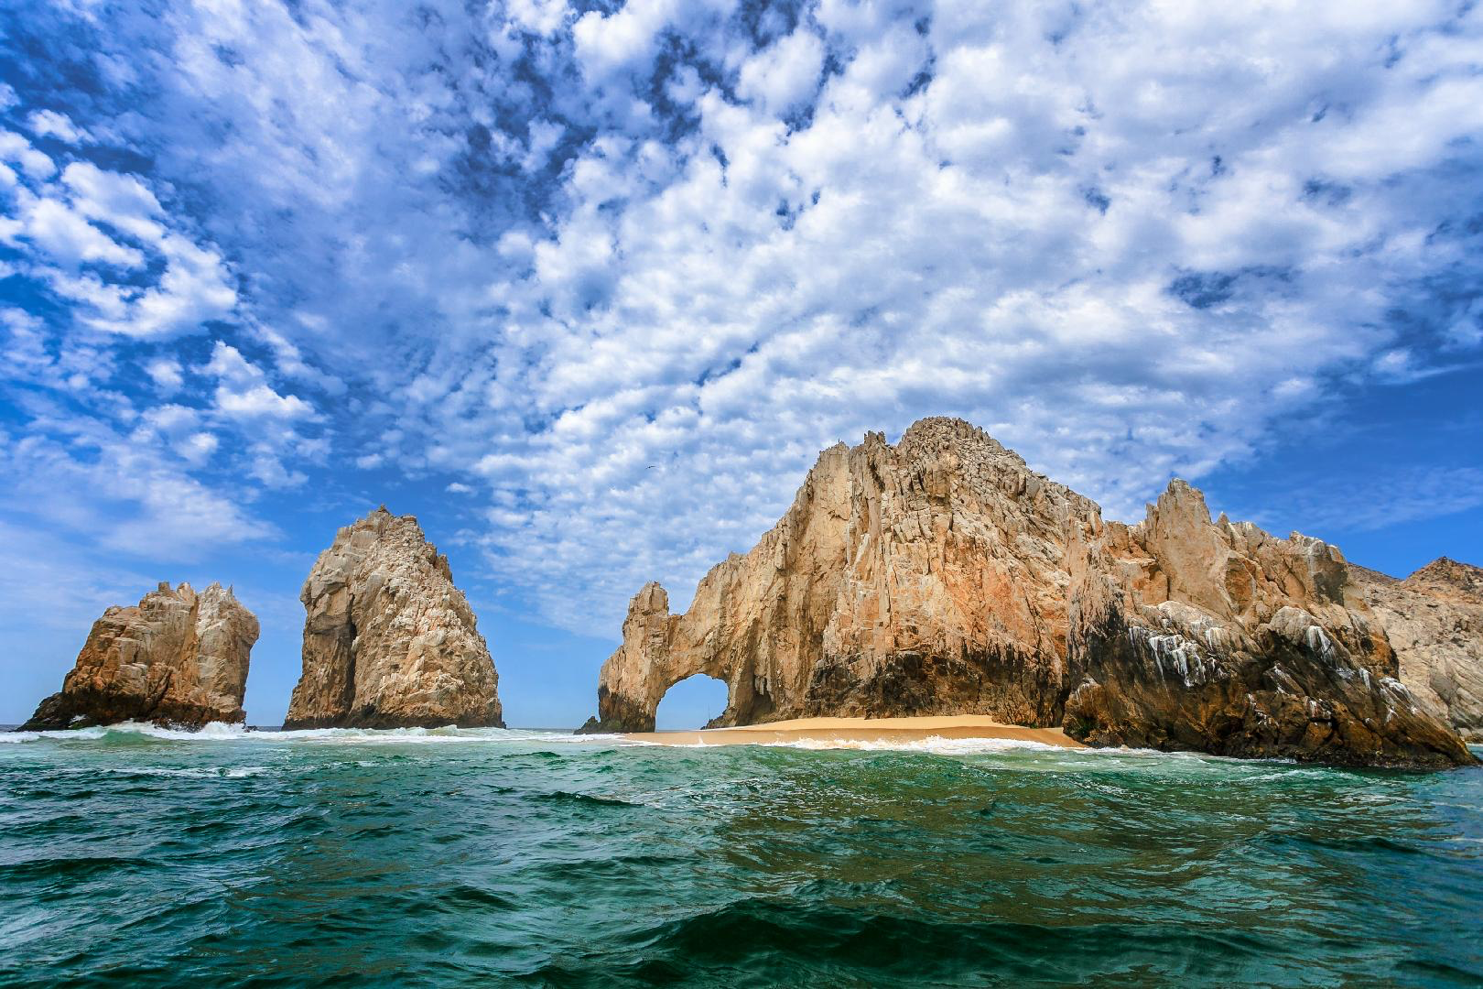
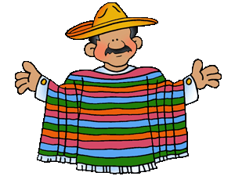
Hint: It is located in the south where it is warm

Slide 9
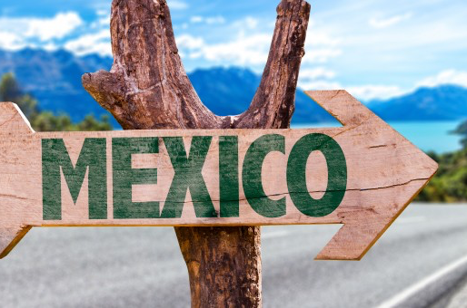
The country we will be learning about today is MEXICO

Slide 10
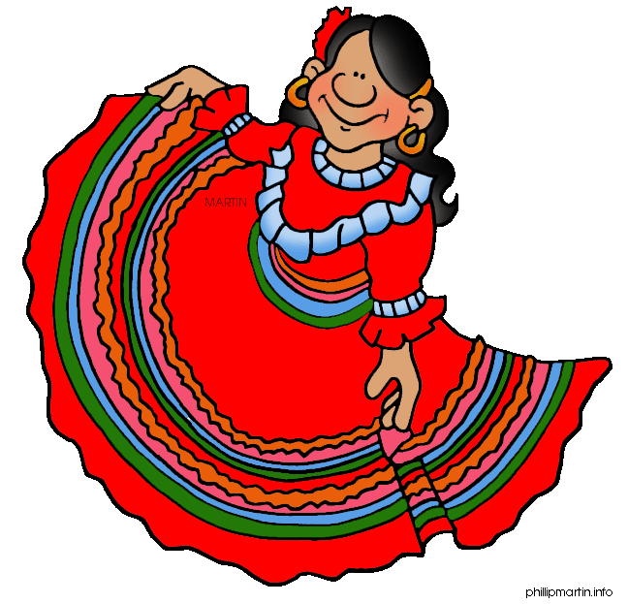
What do you know about Mexico? Write it below

Slide 11

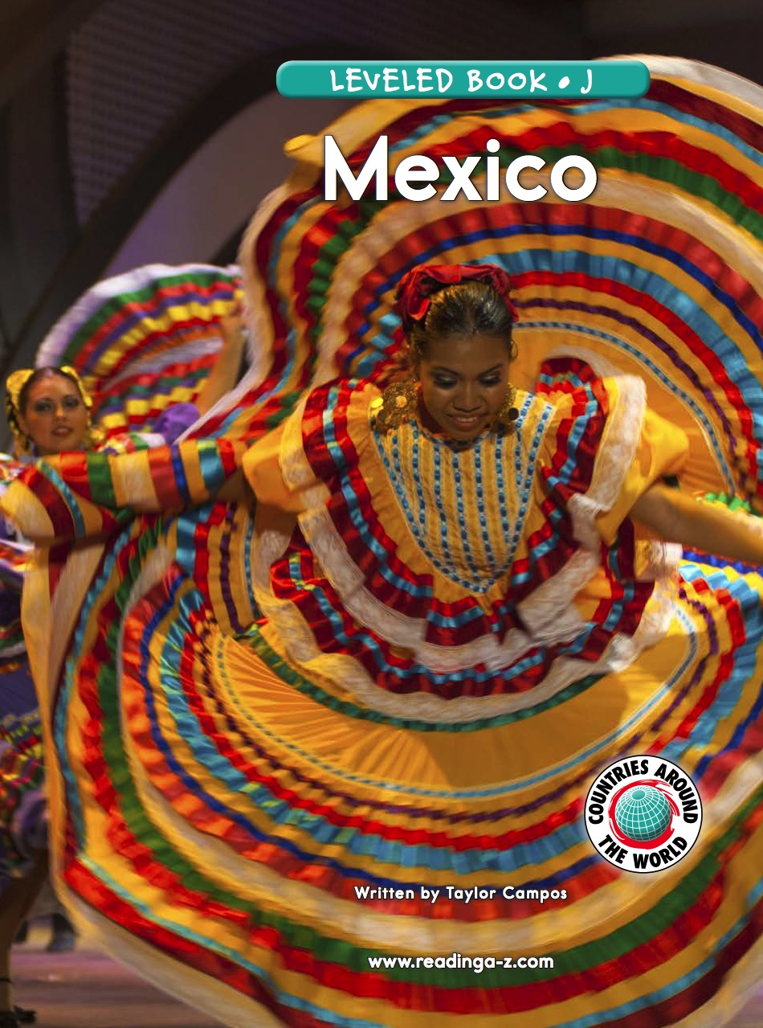
Let’s read a book about Mexico!

Slide 12
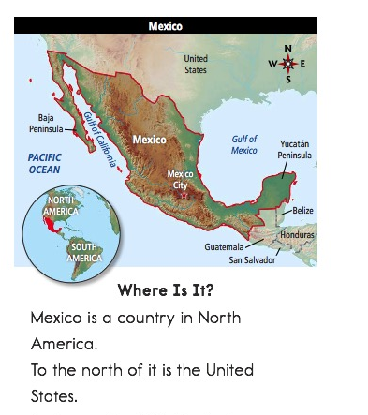

Slide 14
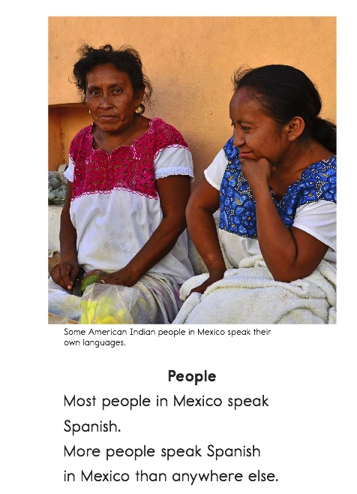

Slide 18
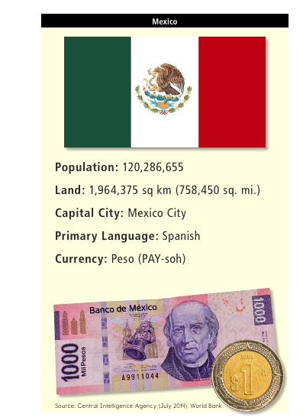

Slide 19

What did you like about Mexico?

Slide 20

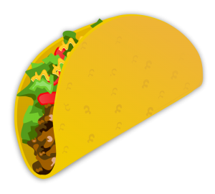
Review
What kinds of food do people in Mexico like to eat?

Slide 21
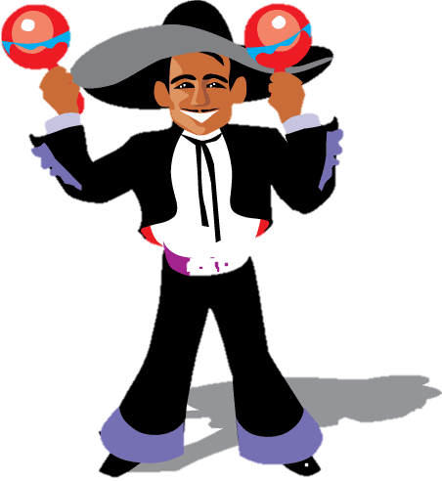
Great work!
Now we will review the “augh” sound!

Slide 22

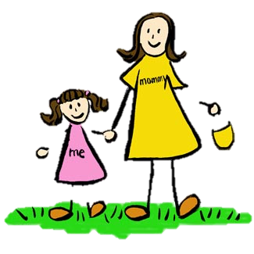
Do you remember? What sound does “augh” make?

Slide 23

Yes! It can make an
“ah” sound or an
“F” sound

Slide 24
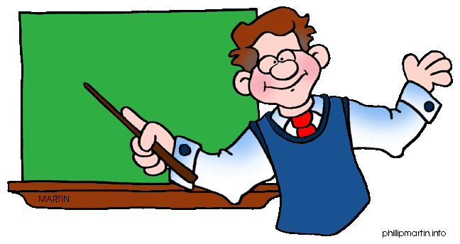
Let’s practice using some words in a sentence.
I was ______________ how to read.

Slide 25
Let’s practice using some words in a sentence.
My brother is funny, he makes me _____________

Slide 26
Let’s practice using some words in a sentence.
She is her father’s ________________.

Slide 27
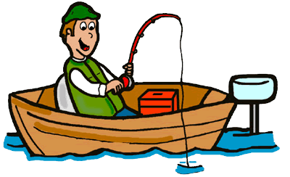
More practice!
We went fishing and _____________ a fish!

Slide 28
Now it is your turn, write a sentence using an “augh” word

Slide 29
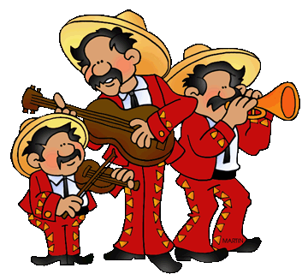
Great, that was fun. What did we learn today?
A look into the countries of the world
Learning about Mexico
A review of “augh” words

Slide 30
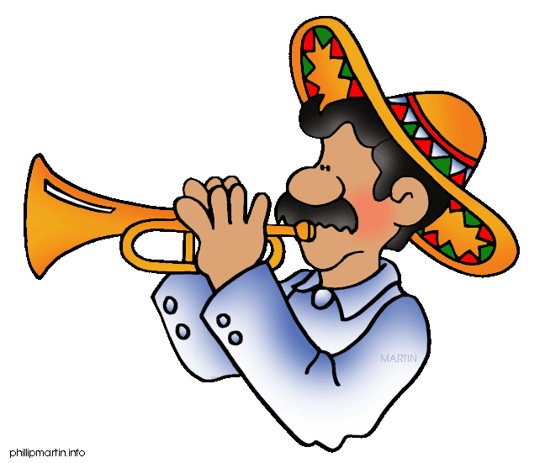
Let’s look at the homework now.
Do you have any questions?

Slide 31
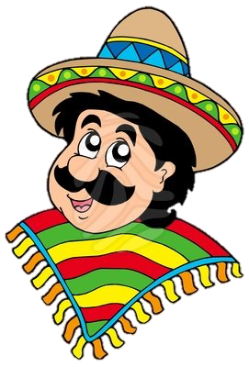
Thank you for a great class today.
As they say in Mexico,
Adiós!

