Slide 1



Around the World
Unit 8 Lesson 3

Slide 2


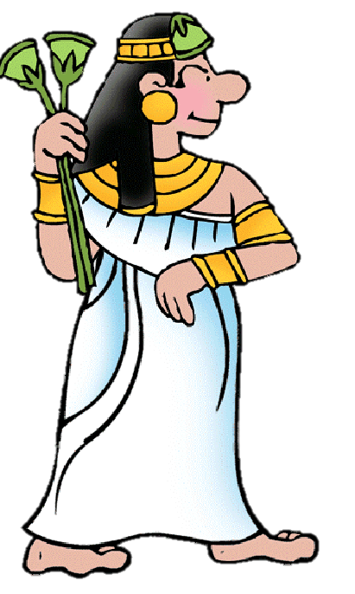
What will we be learning this class?
Wonders of the World
Learning about a new country
A review of the “u_e” sound

Slide 3
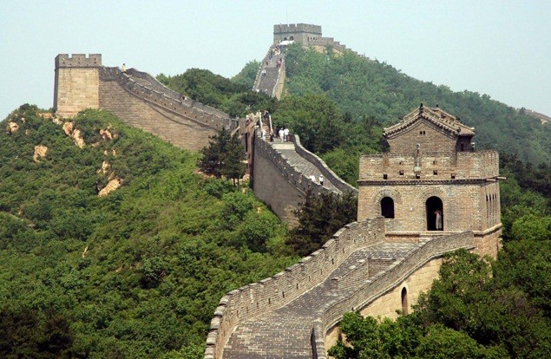
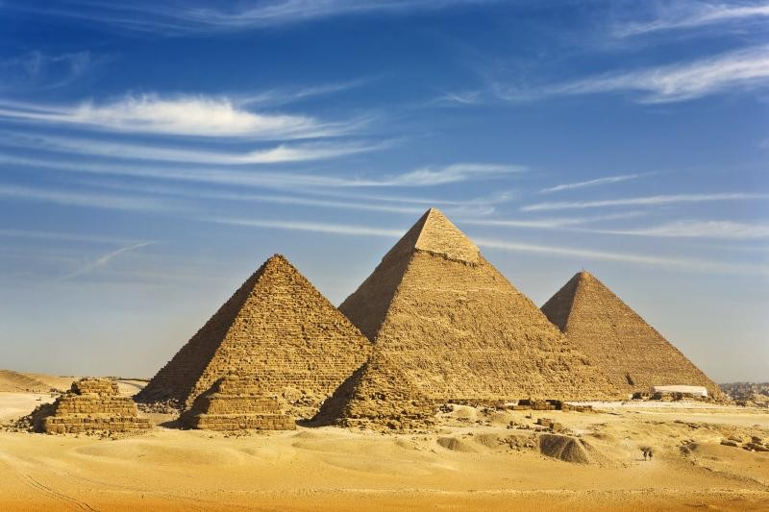
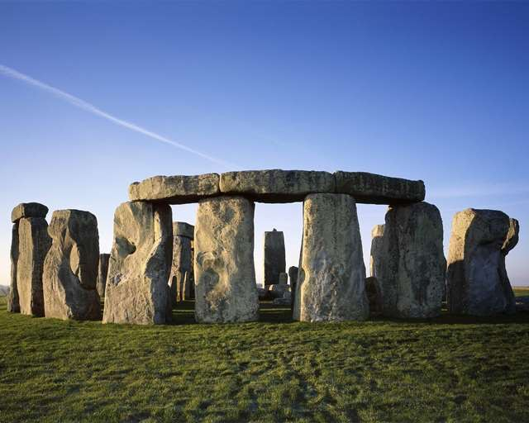
Many countries have large and beautiful attractions
Do you know what these are called?

Slide 4

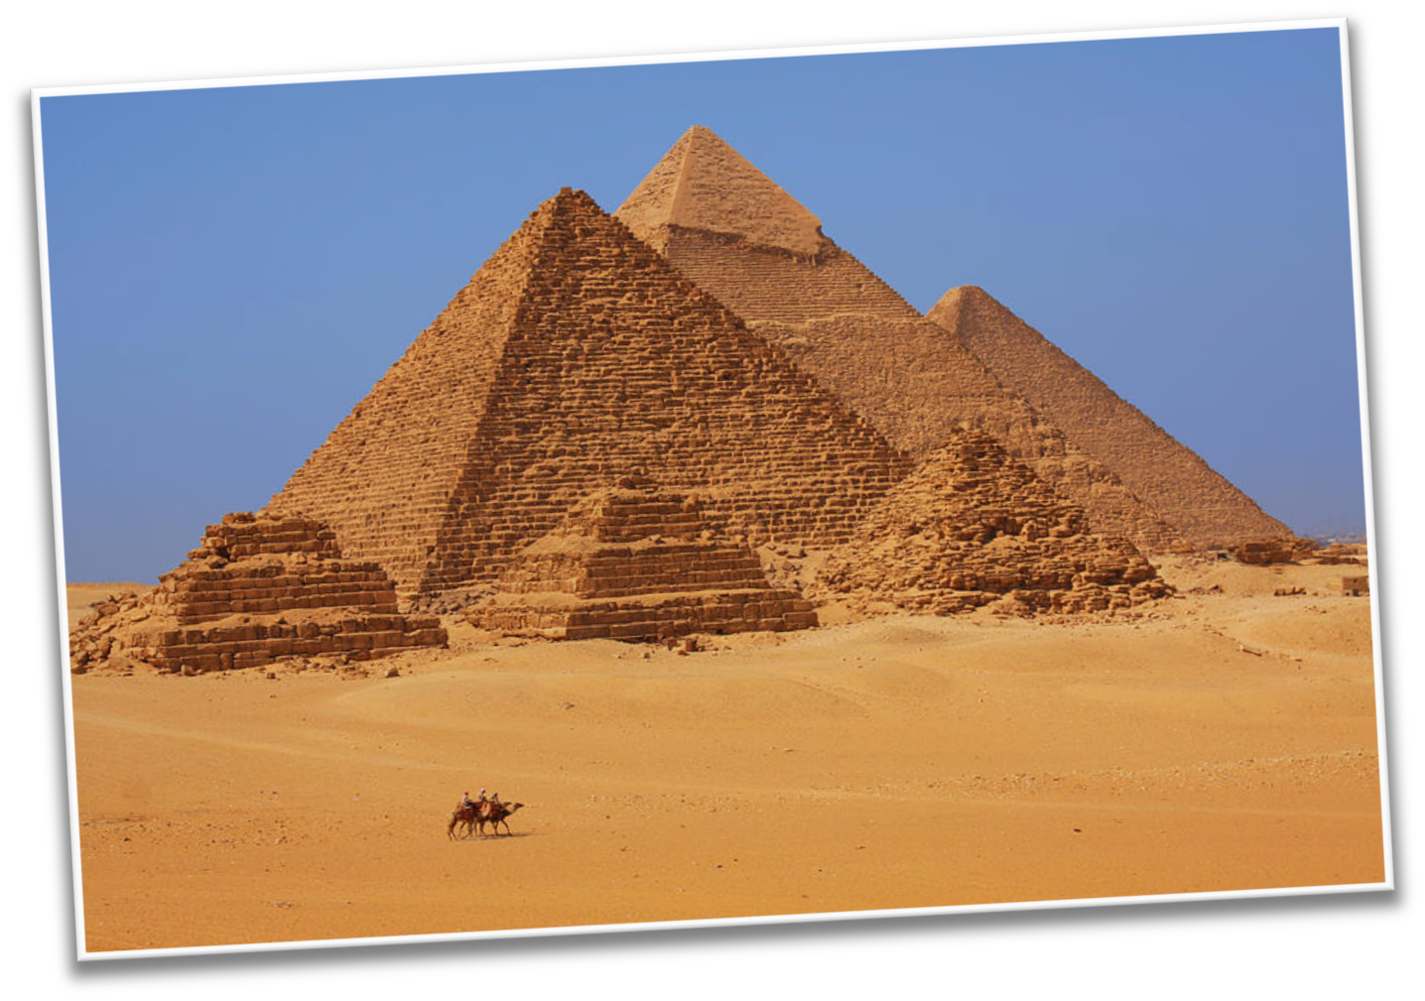

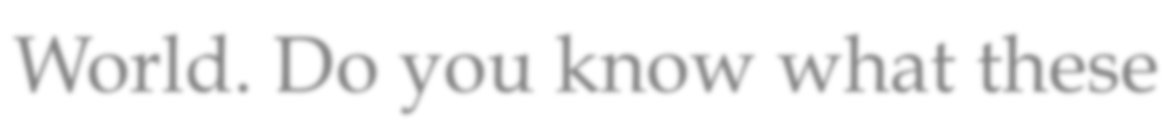
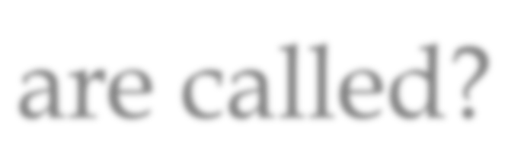
These are another Wonder of the World. Do you know what these are called?

Slide 5
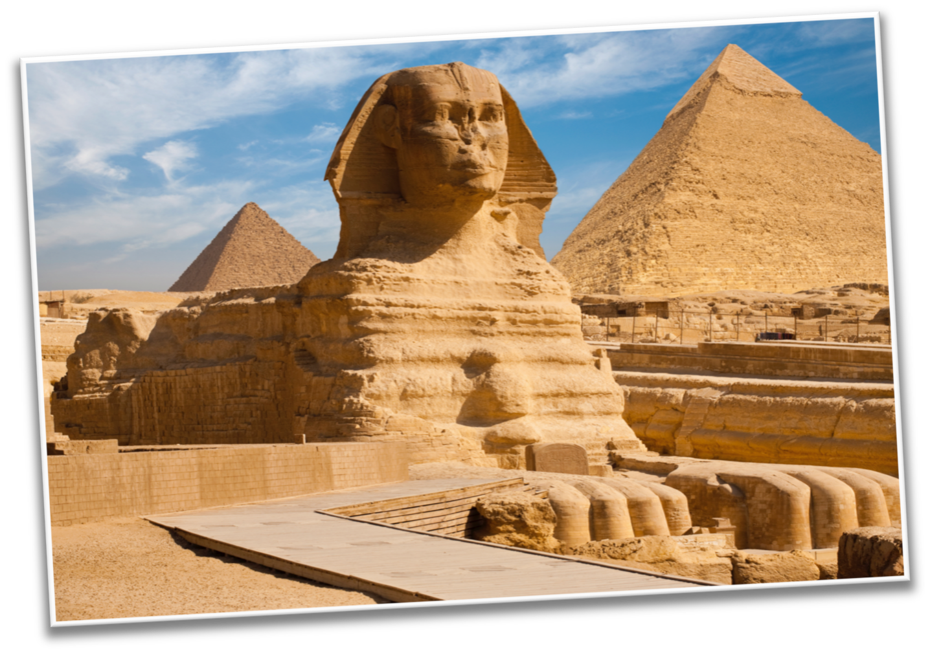
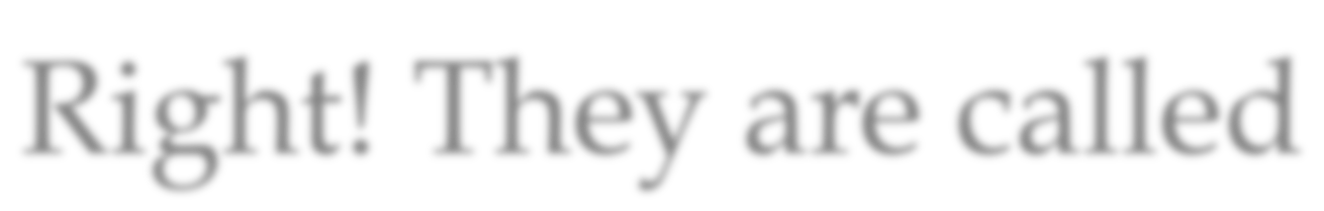
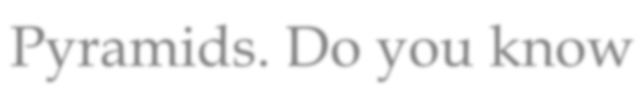
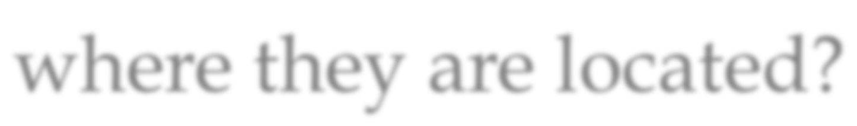
Right! They are called Pyramids. Do you know where they are located?

Slide 6


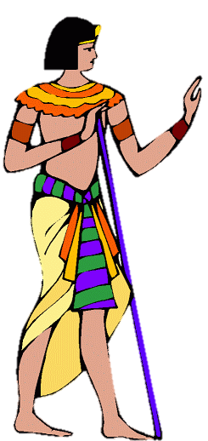
What do you know about Egypt? Write it below

Slide 7

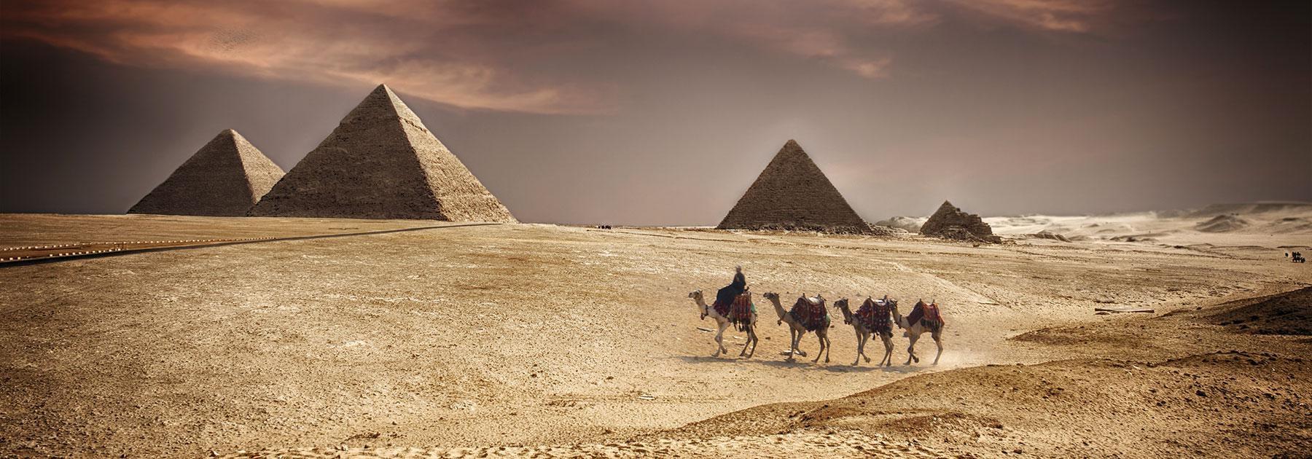
Before we read the book:
Do you think Egypt is mostly hot, or mostly cold?

Slide 8
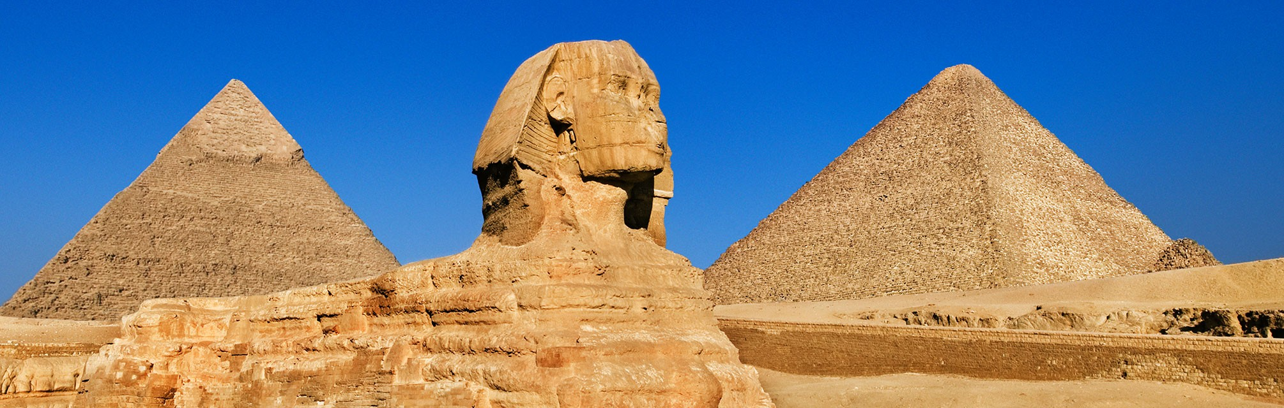
Before we read the book:
Why do you think there are pyramids in Egypt?

Slide 9
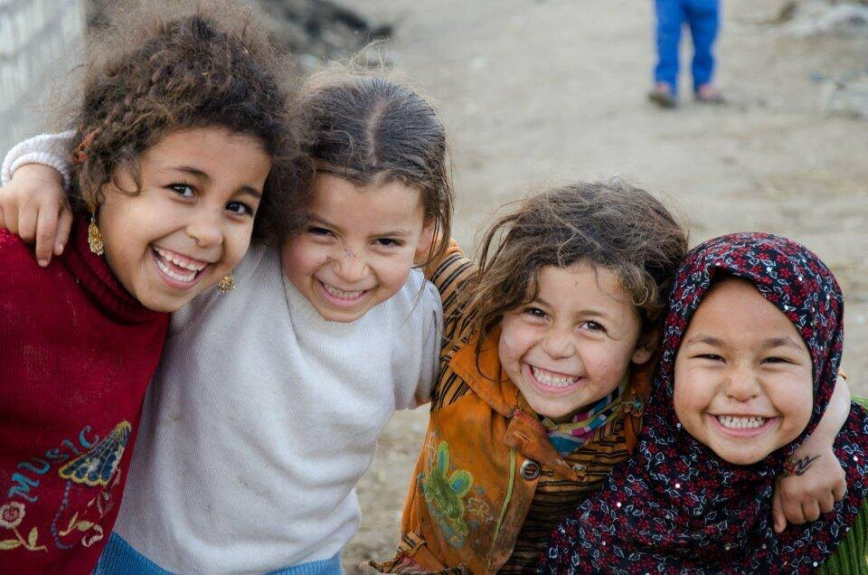
Before we read the book:
What do you think most Egyptians do for work?

Slide 10


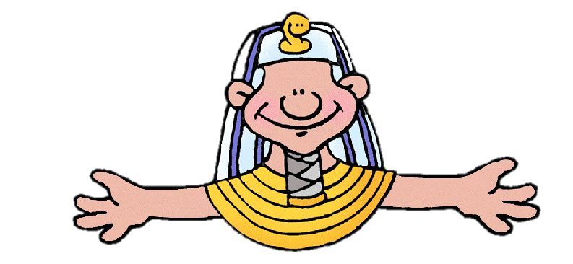
Great answers! By thinking about these questions before we read
We are predicting!

Slide 11


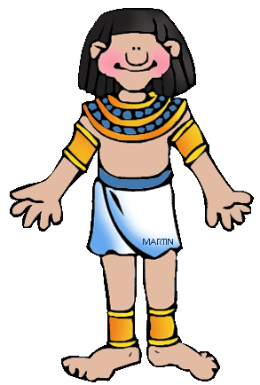
What did you like about Egypt?

Slide 12

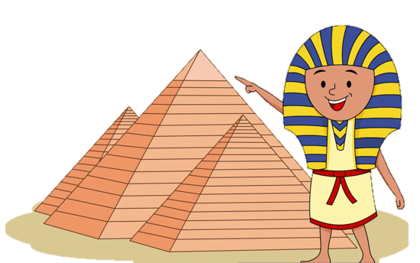
Review
Why does Egypt have pyramids?

Slide 13

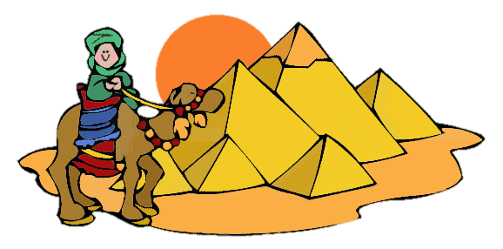
Great work!
Now we will review the “u_e” sound!

Slide 14


Do you remember? What words have “u_e” in them?
Write down as many as you can in 1:00! Go!

Slide 15


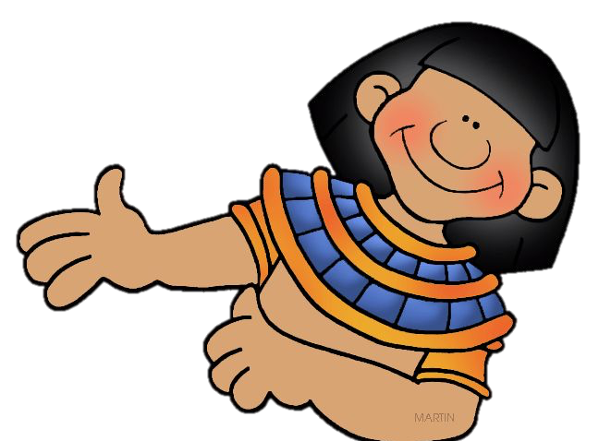
Read about the trip to Egypt.
Notice the u_e words.
The Egyptian pyramids are huge.
I went to go see them in June.
I rode a mule through the desert, and saw a man use a flute with a snake.

Slide 16


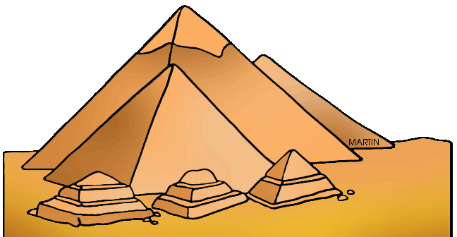
Let’s practice using some u_e words in a sentence.
The pyramids are ______________.
(What word can mean very large?)

Slide 17
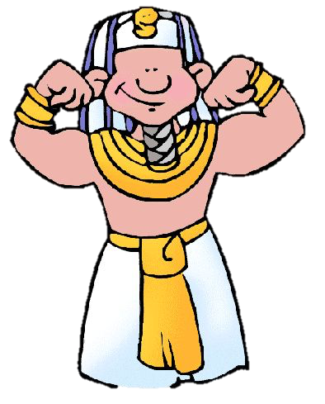
Let’s practice using some u_e words in a sentence.
I held a ___________ snake.

Slide 18
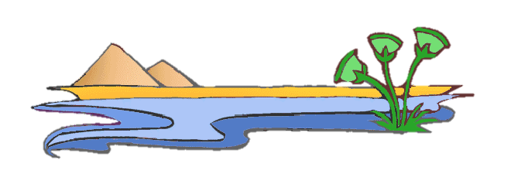
Let’s practice using some u_e words in a sentence.
Egyptians _______ the Nile River for farming.

Slide 19


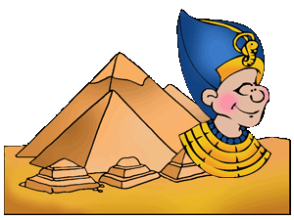
Now it is your turn, write a sentence using a “u_e” word

Slide 20

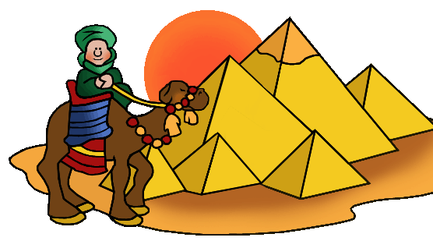
Now write a sentence using two “u_e” words!

Slide 21


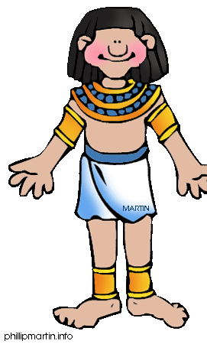
Great, that was fun. What did we learn today?
A look into the Wonders of the World
Learning about Egypt
A review of “u_e” words

Slide 22

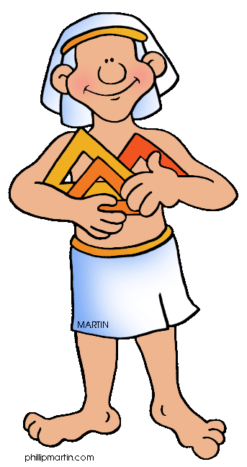
Let’s look at the homework now.
Do you have any questions?

Slide 23
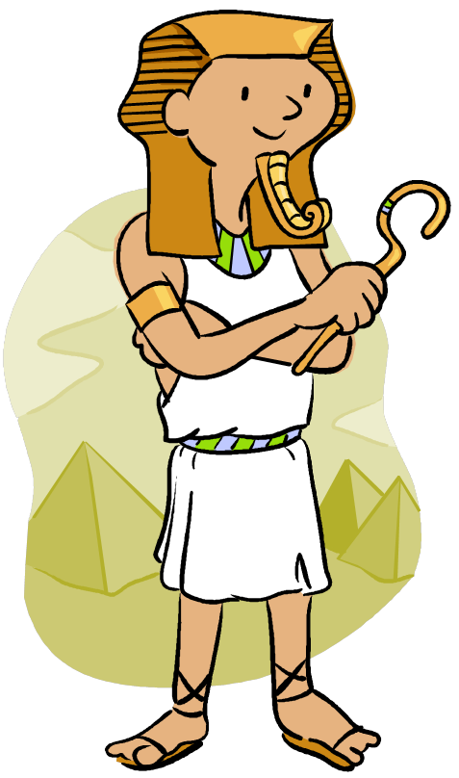
Thank you for a great class today.
As they say in Egypt, Mai-salama!

