Slide 1
Around the World
Unit 8 Lesson 3

Slide 2
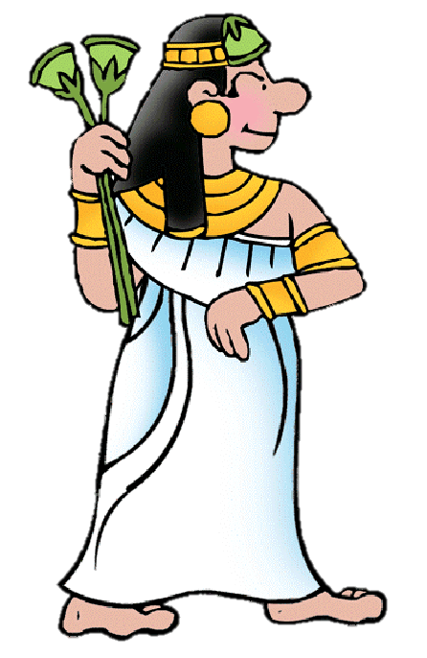
What will we be learning this class?
Wonders of the World
Learning about a new country
A review of the “u_e” sound

Slide 3
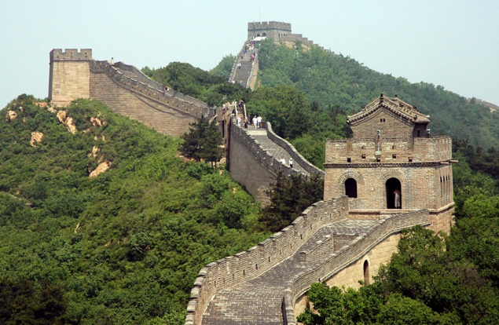
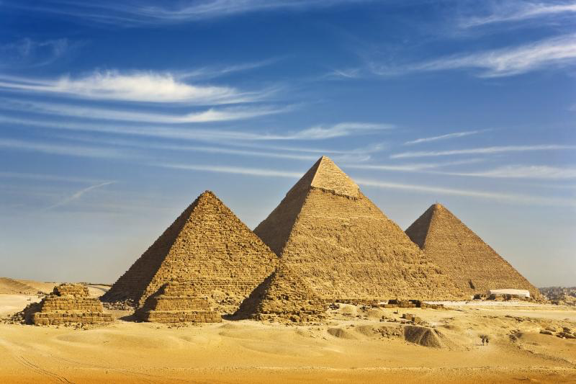
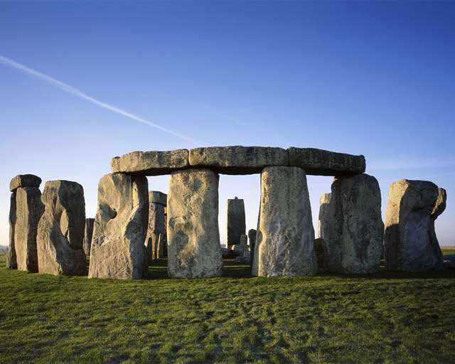
Many countries have large and beautiful attractions
Do you know what these are called?

Slide 4
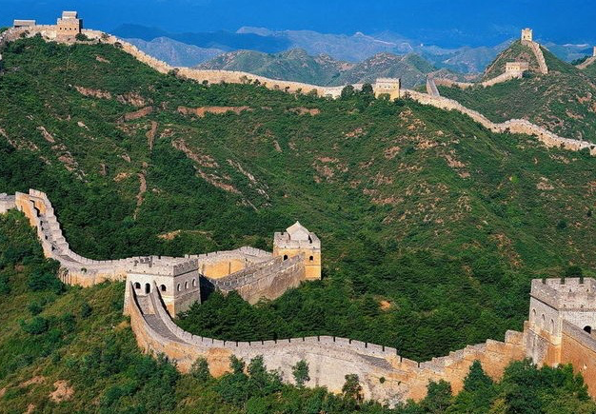
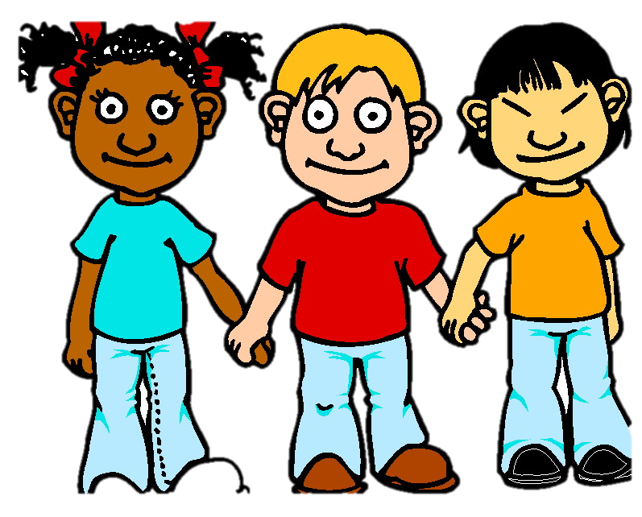
They are the “Wonders of the World”
What do you have in your country?

Slide 5
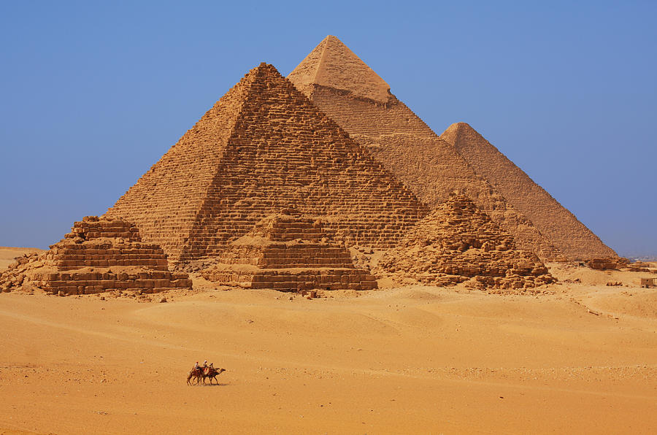
These are another Wonder of the World. Do you know what these are called?

Slide 6
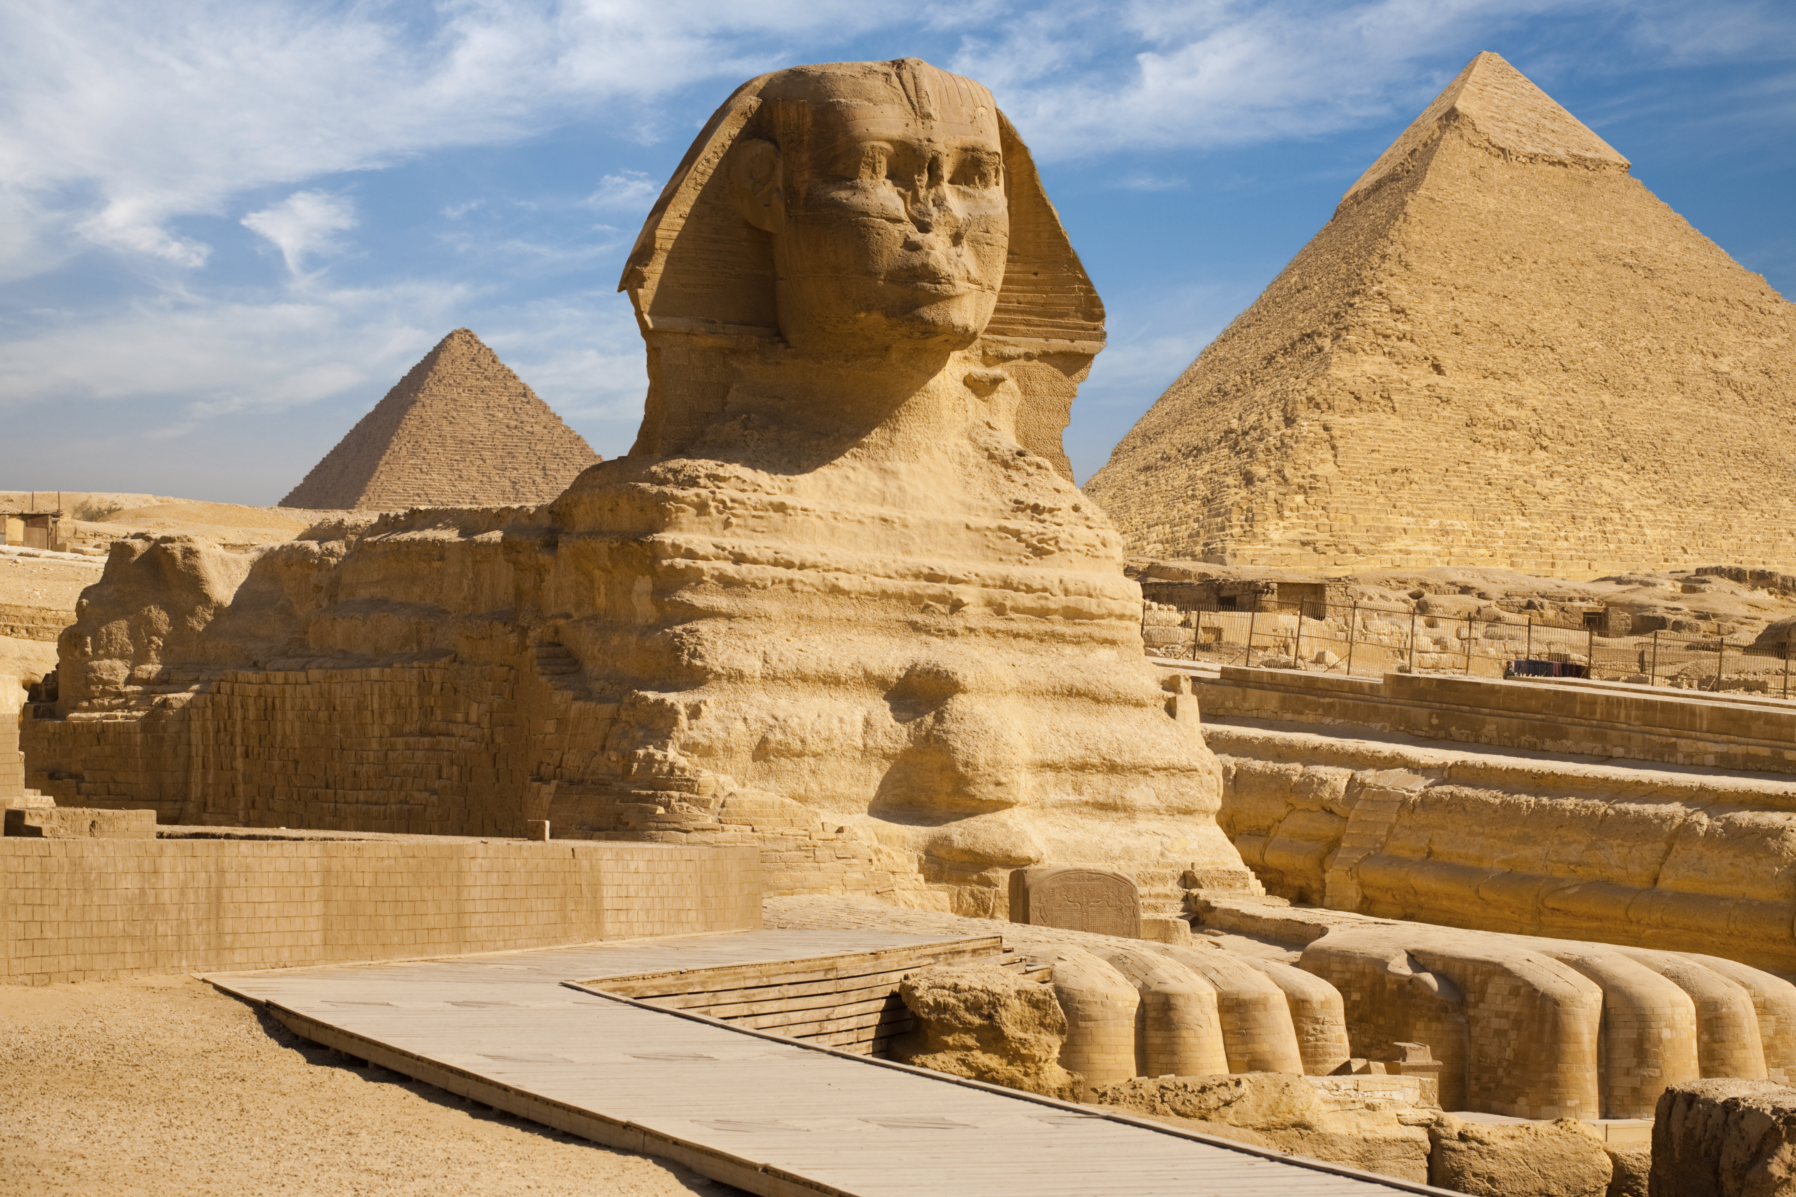
Right! They are called Pyramids. Do you know where they are located?

Slide 7
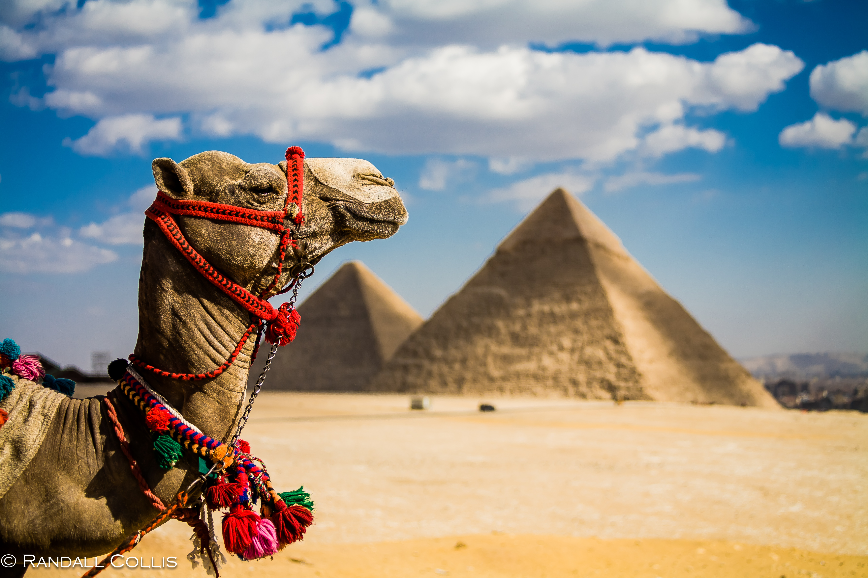
They are in the country of Egypt!

Slide 8
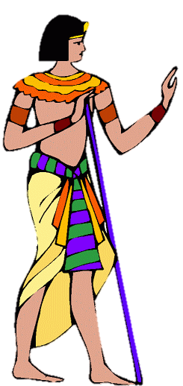
What do you know about Egypt? Write it below

Slide 9
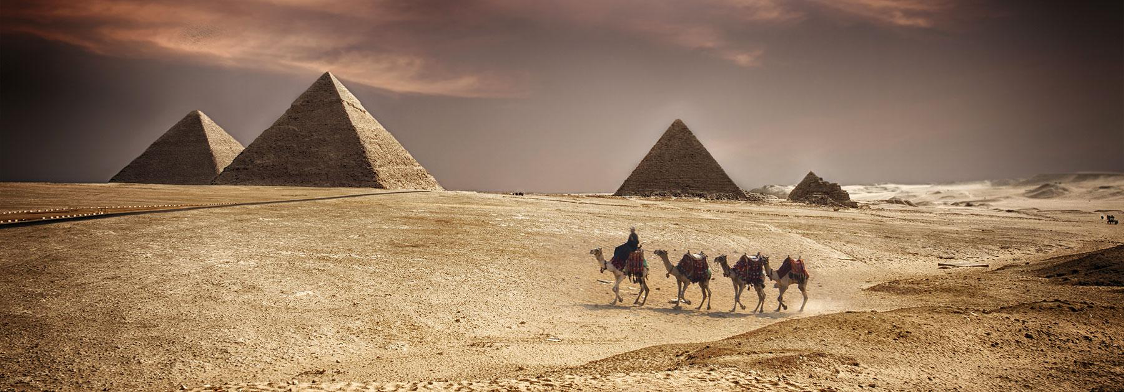
Before we read the book:
Do you think Egypt is mostly hot, or mostly cold?

Slide 10
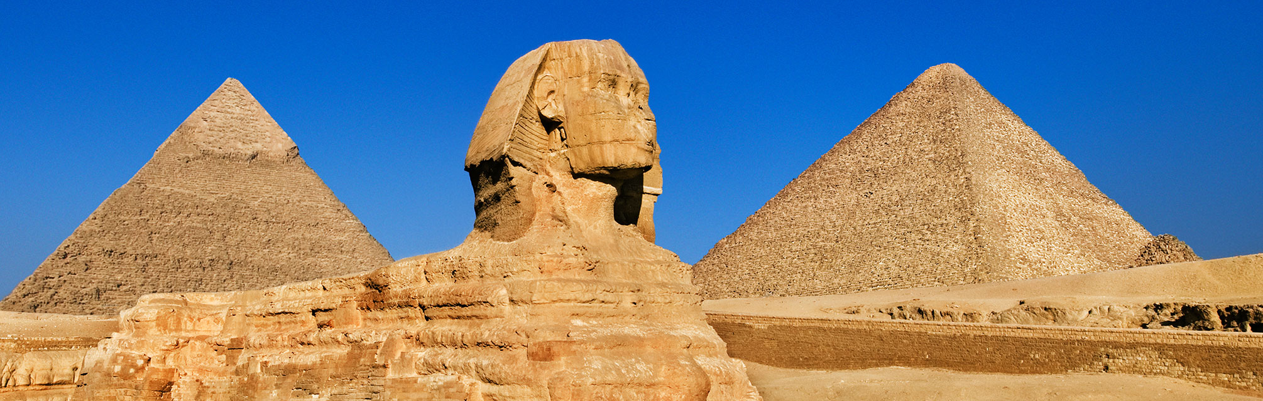
Before we read the book:
Why do you think there are pyramids in Egypt?

Slide 11
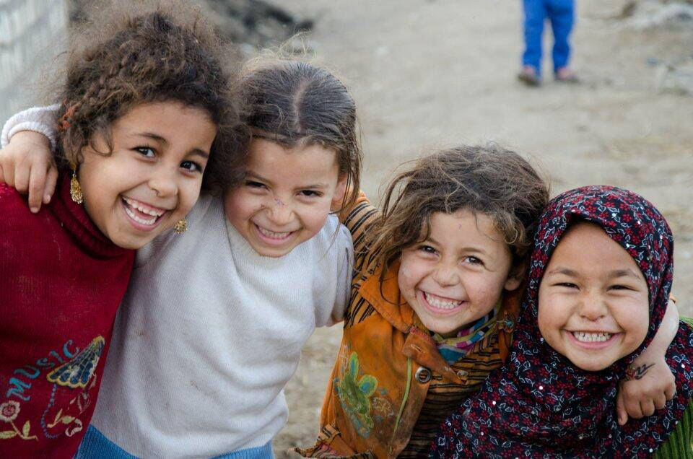
Before we read the book:
What do you think most Egyptians do for work?

Slide 12
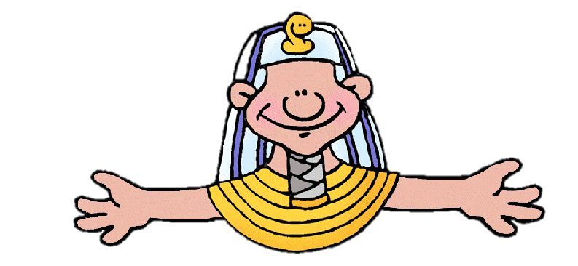
Great answers! By thinking about these questions before we read
We are predicting!

Slide 13
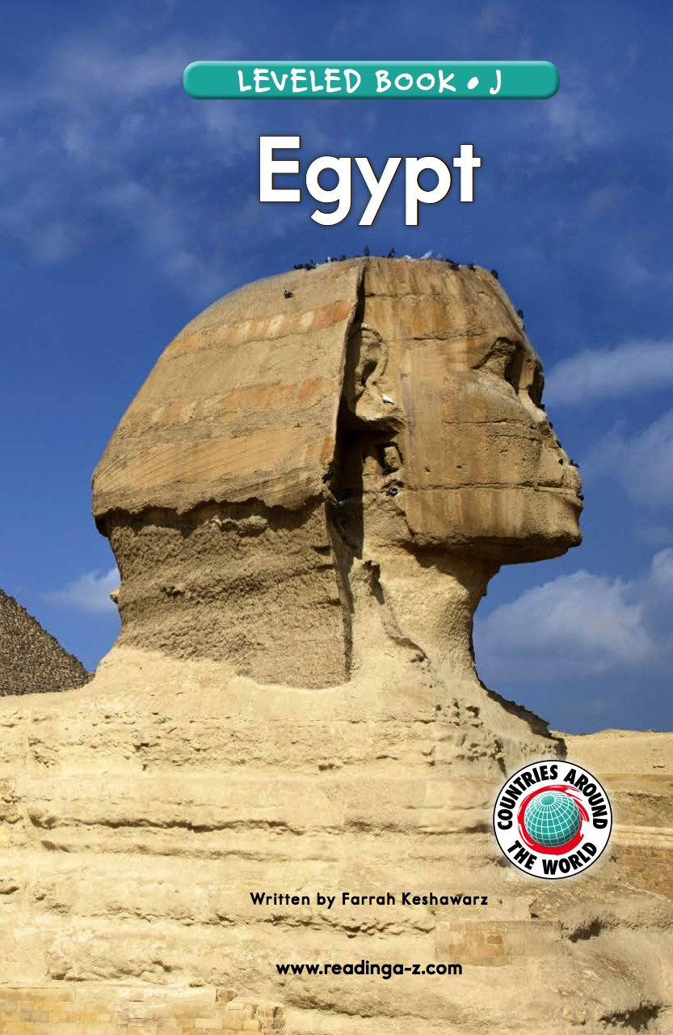
Let’s now read a book about Egypt!

Slide 14
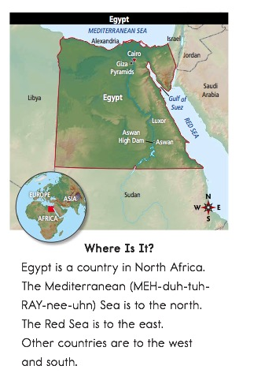

Slide 16
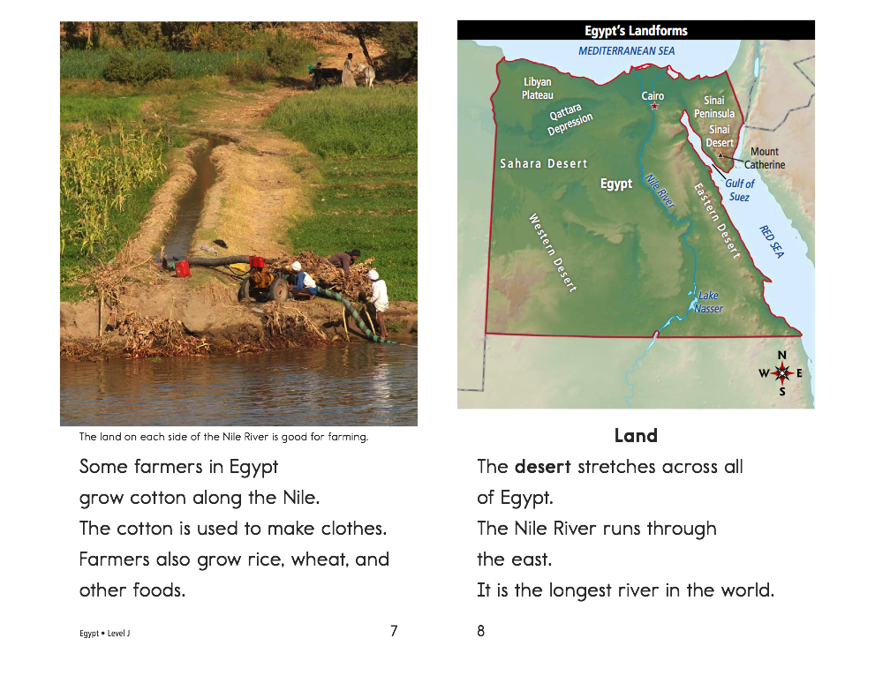

Slide 19
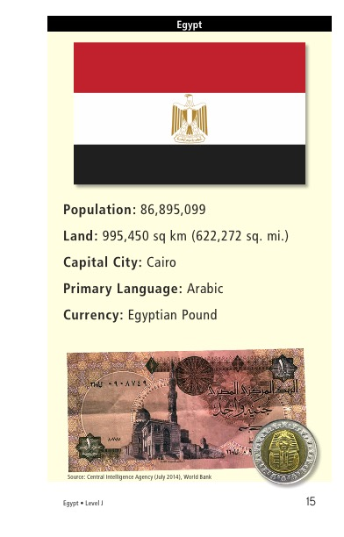

Slide 20
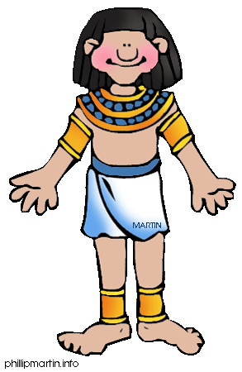
What did you like about Egypt?

Slide 21
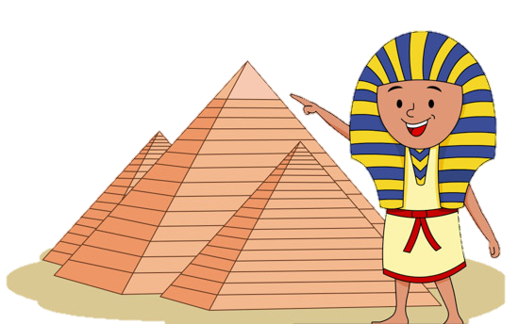
Review
Why does Egypt have pyramids?

Slide 22
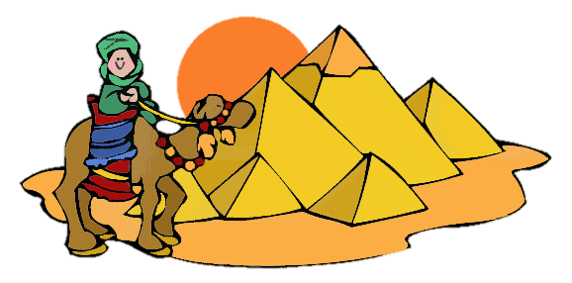
Great work!
Now we will review the “u_e” sound!

Slide 23
Do you remember? What words have “u_e” in them?
Write down as many as you can in 1:00! Go!

Slide 24
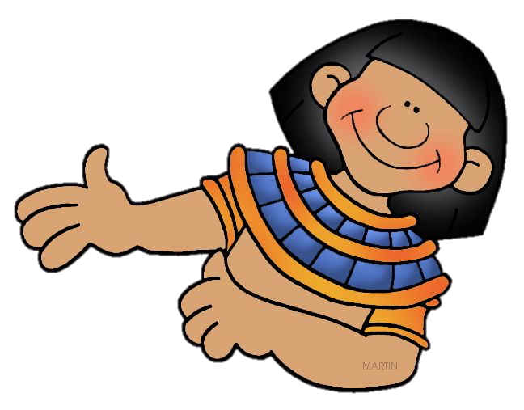
Read about the trip to Egypt. Notice the u_e words.
The Egyptian pyramids are huge.
I went to go see them in June.
I rode a mule through the desert, and
saw a man use a flute with a snake.

Slide 25
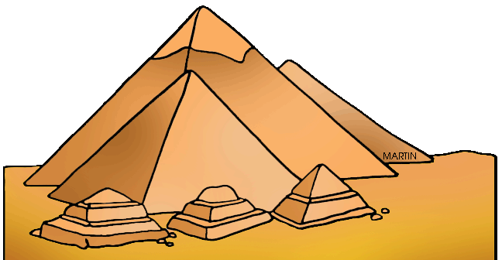
Let’s practice using some u_e words in a sentence.
The pyramids are ___________.
(What word can mean very large?)

Slide 26
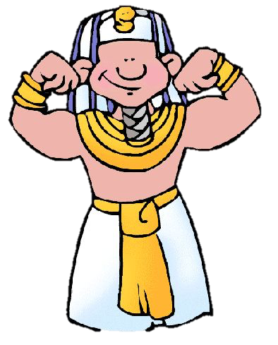
Let’s practice using some u_e words in a sentence.
I held a ___________ snake.

Slide 27

Let’s practice using some u_e words in a sentence.
Egyptians _______ the Nile River for farming.

Slide 28
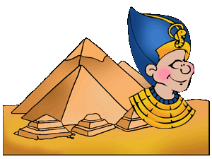
Now it is your turn, write a sentence using a “u_e” word

Slide 29
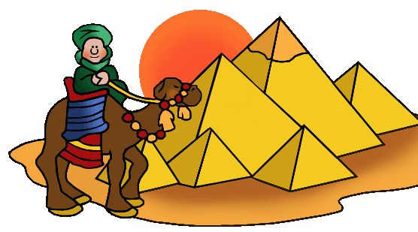
Now write a sentence using two “u_e” words!

Slide 30
Great, that was fun. What did we learn today?
A look into the Wonders of the World
Learning about Egypt
A review of “u_e” words

Slide 31
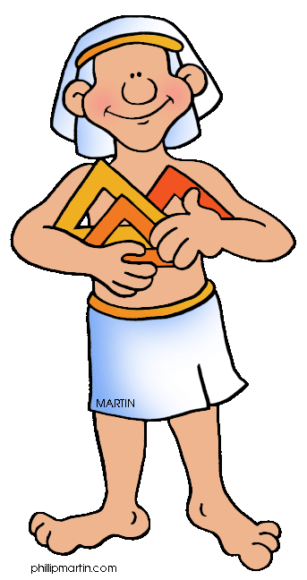
Let’s look at the homework now.
Do you have any questions?

Slide 32
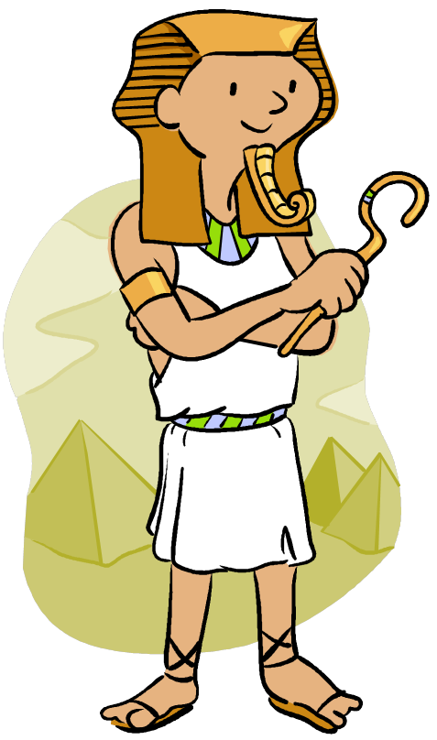
Thank you for a great class today.
As they say in Egypt,
Mai-salama!

