Slide 1



Around the World
Unit 8 Lesson 4

Slide 2



What will we be learning this class?
Comparing countries as a review
A review of the “ough” “augh” and “u_e” sounds
Reading about Travel!

Slide 3


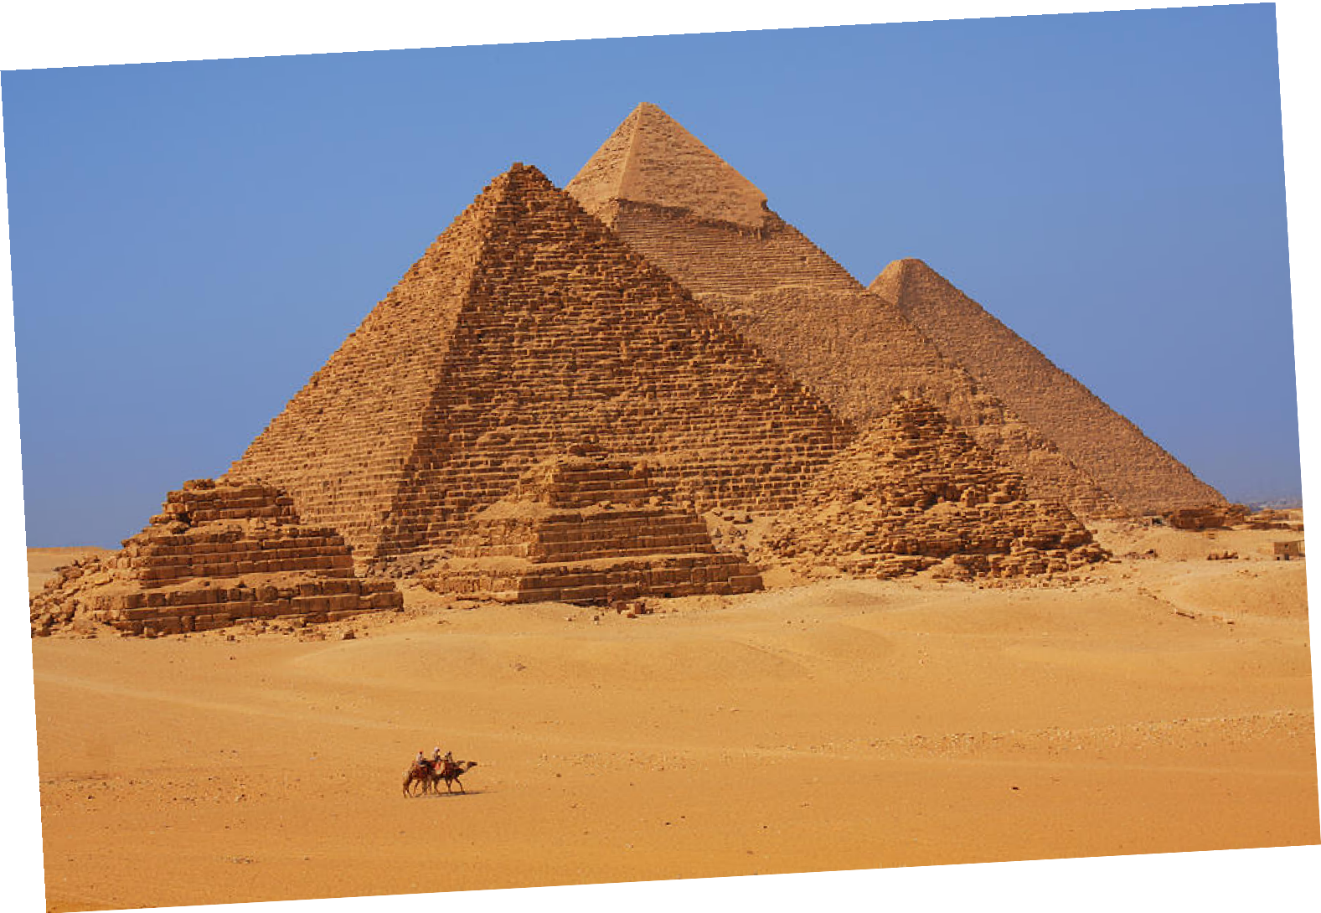
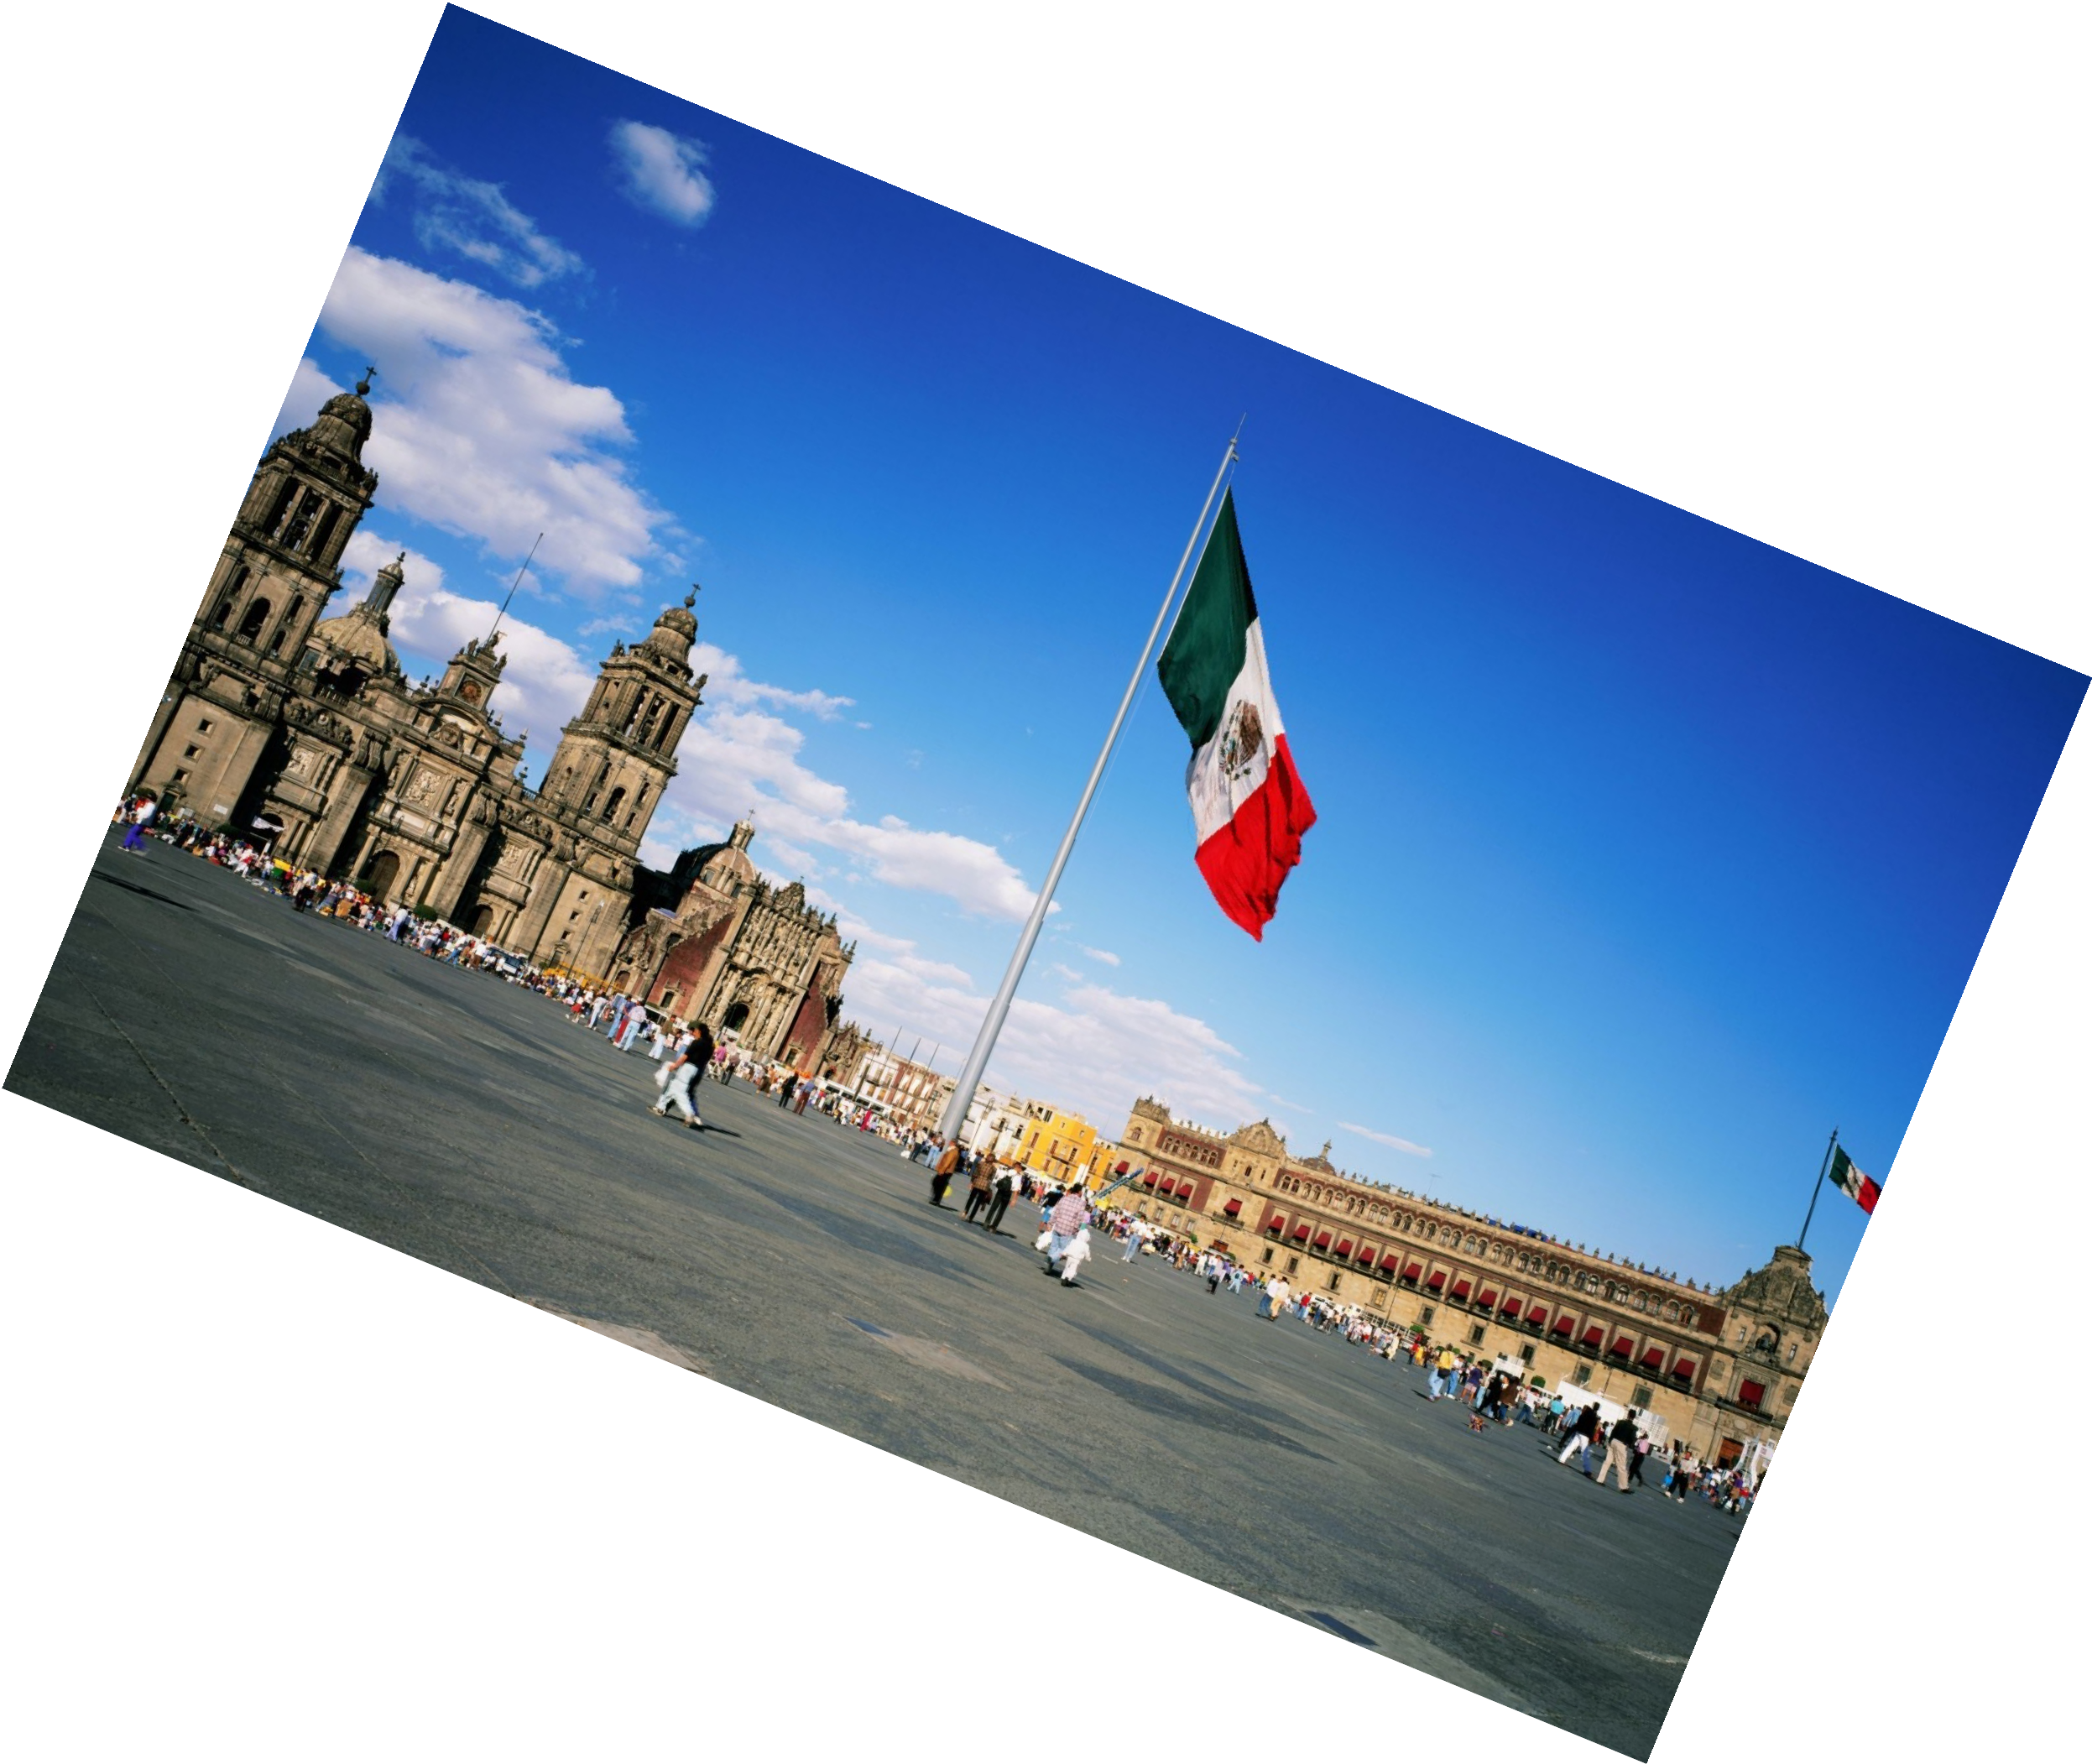
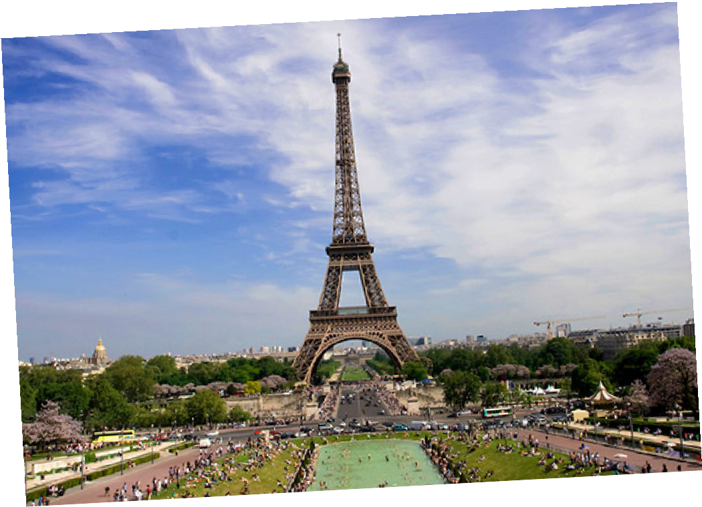
Do you remember? What countries have we learned about?

Slide 4
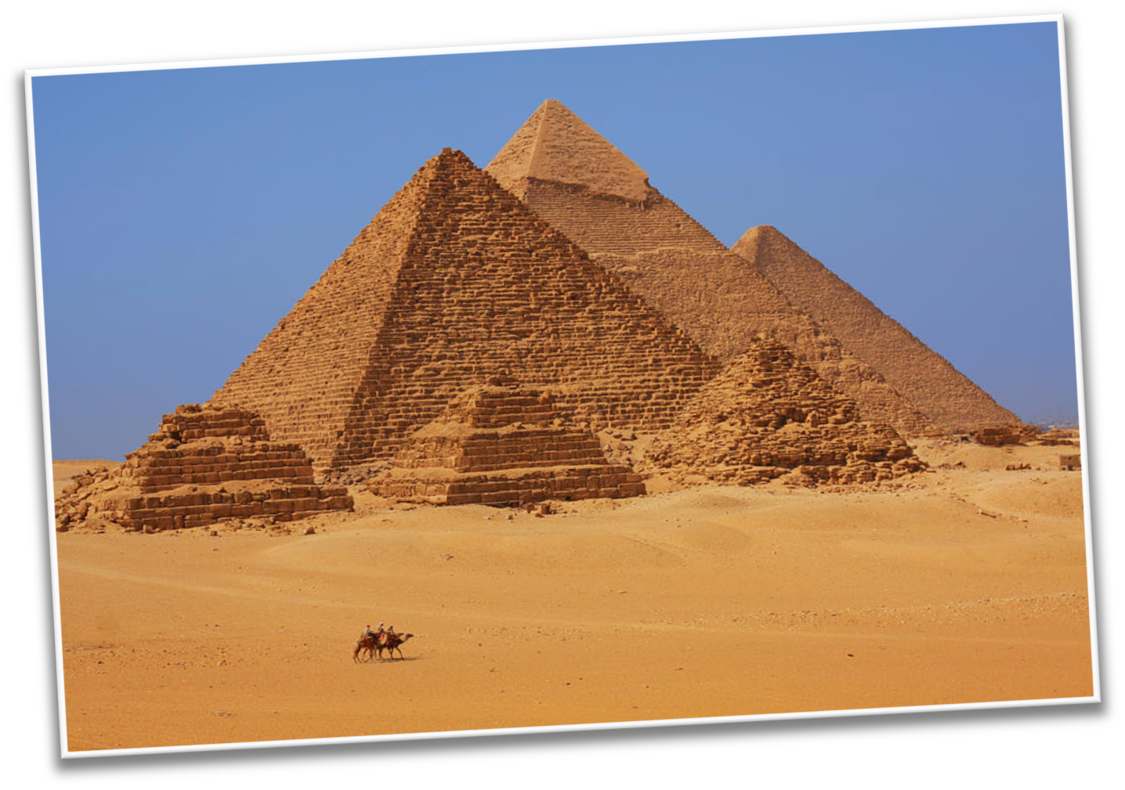
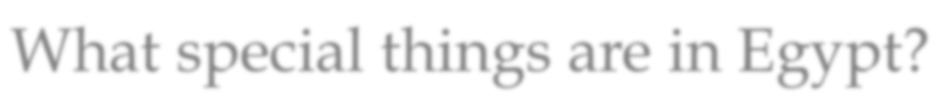
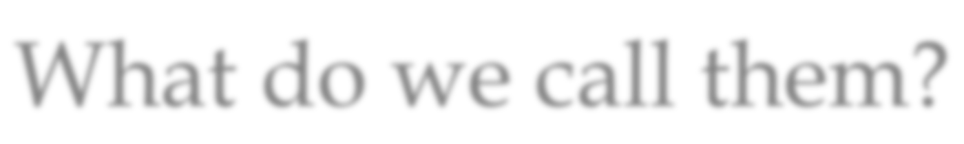
What special things are in Egypt?
What do we call them?

Slide 5
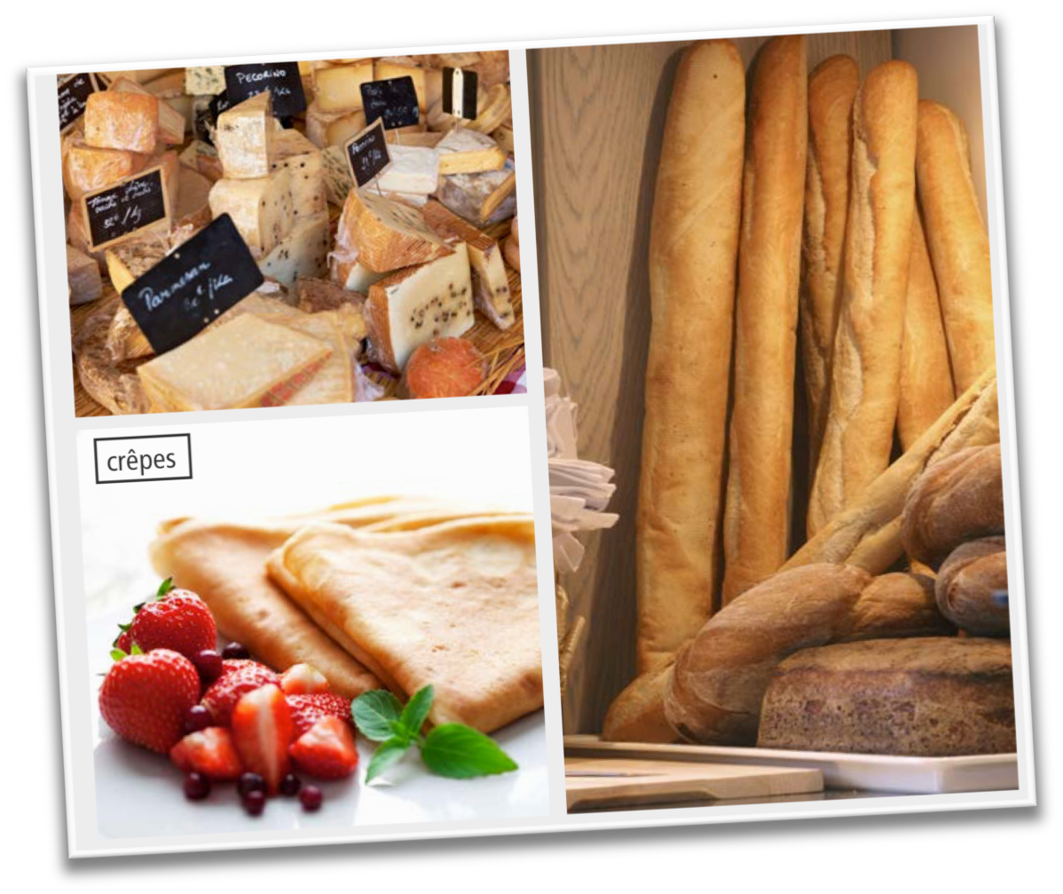


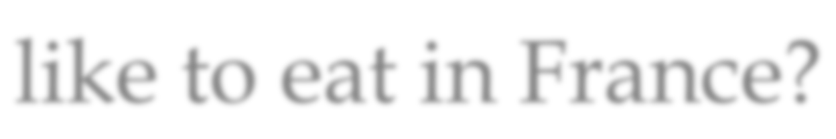
Do you remember?
What kinds of food do they like to eat in France?

Slide 6
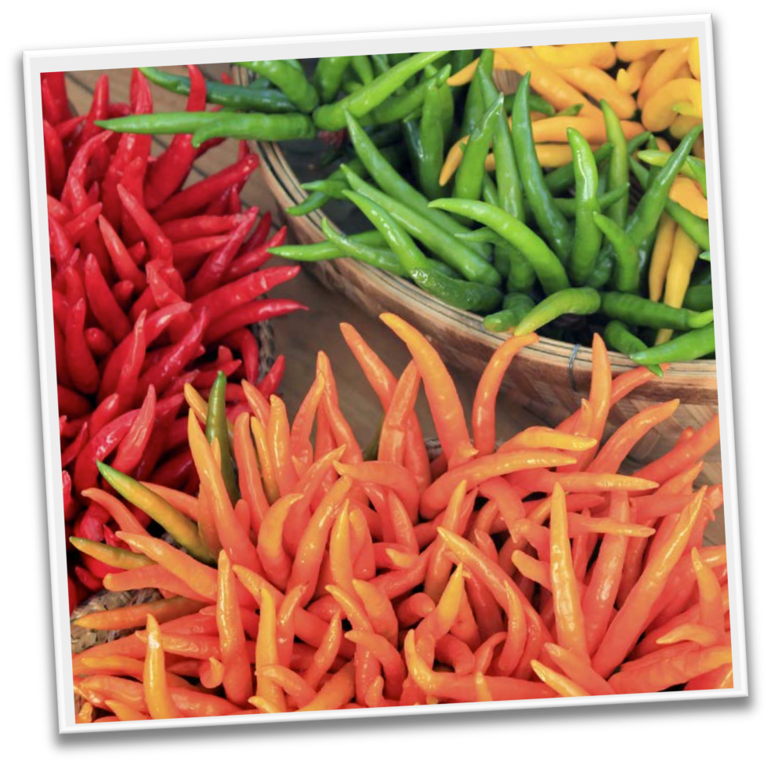

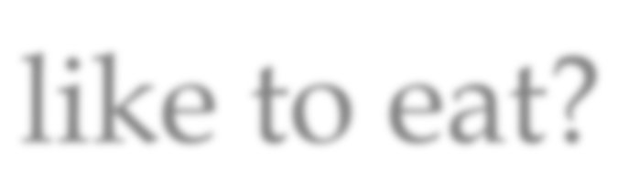

Do you remember?
What do people in Mexico like to eat?

Slide 7



Now we will compare.
To compare is to see what is the same about two people, places, or things.

Slide 8



For example, we will compare these flowers.
Both are tall.
Both have green stems.

Slide 9



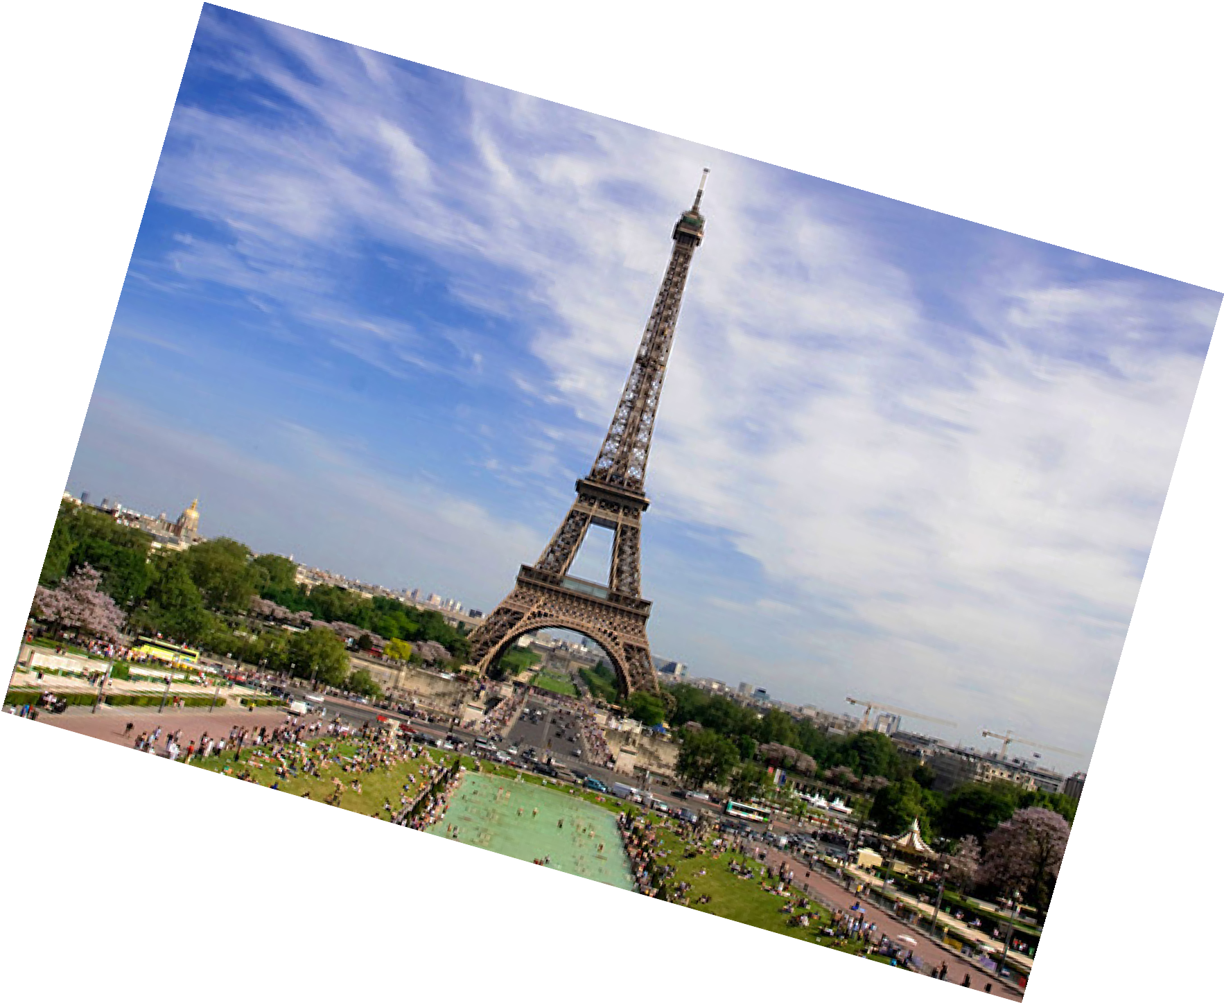
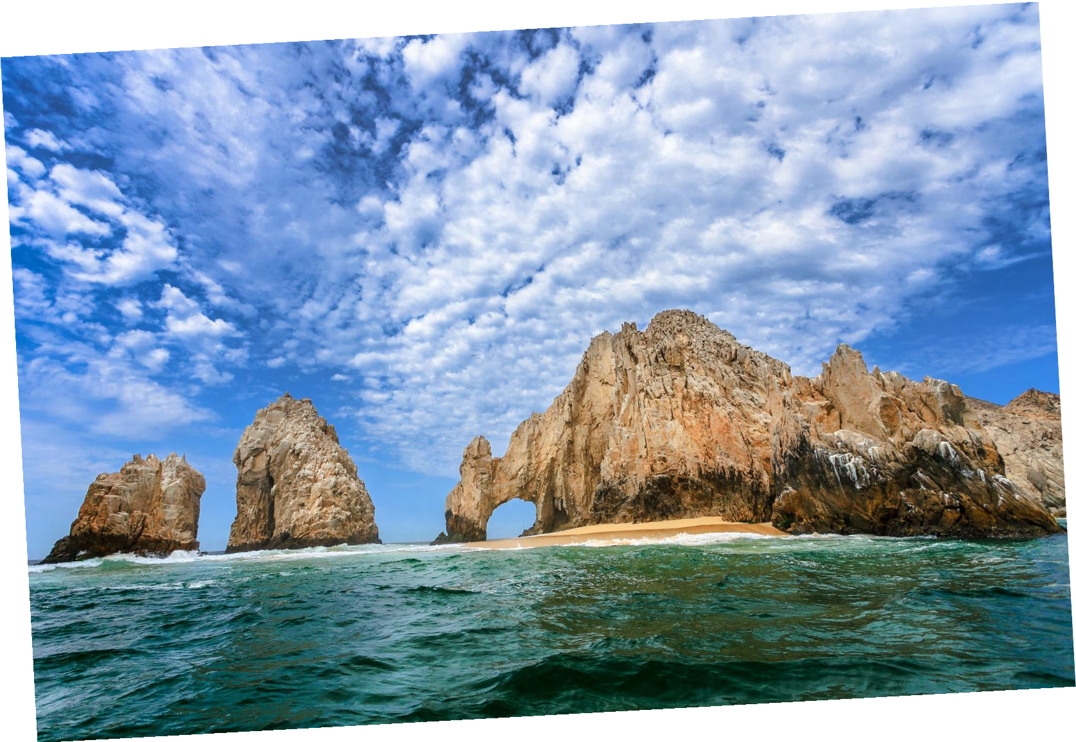
Can you compare the countries of Mexico and France?
What is the same, or similar, between the two countries?

Slide 10


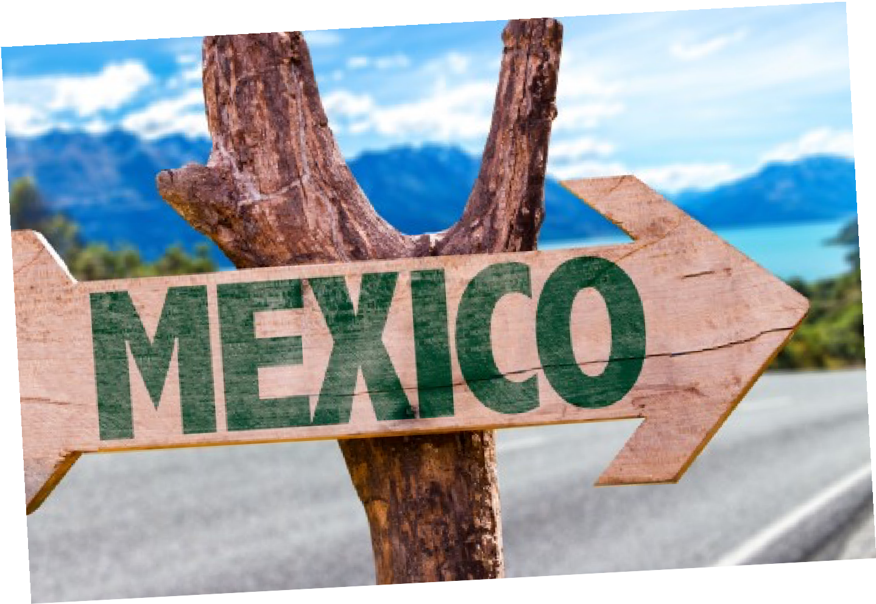
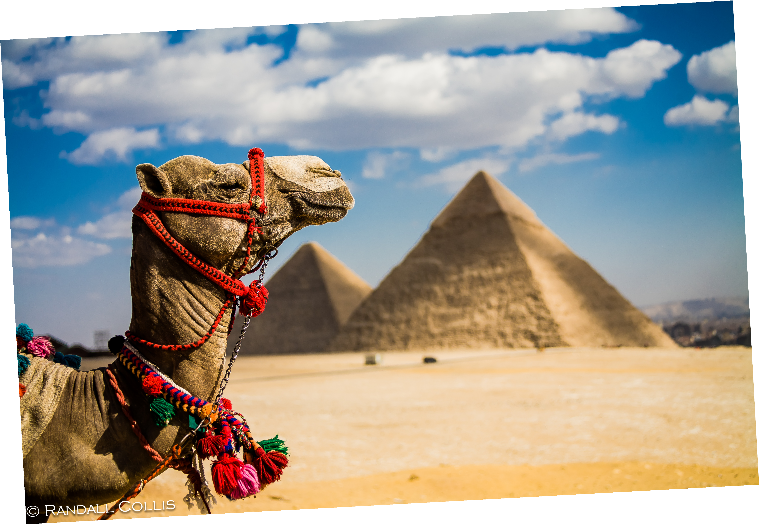
Great work! Let’s do it once more.
Compare the country of Egypt with Mexico!

Slide 11


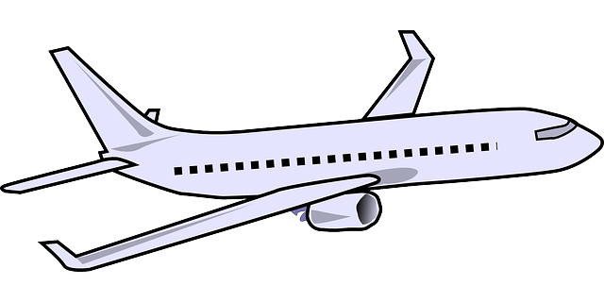

How do you travel to different countries?
Do you take a car, a plane, a train, or a bus?

Slide 12


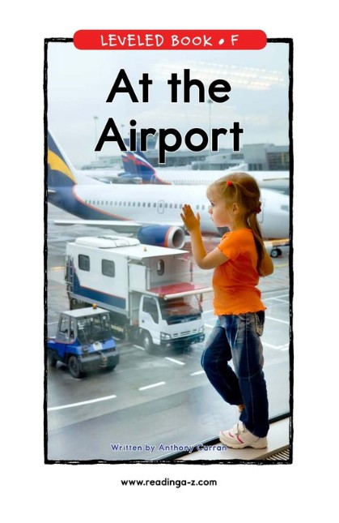
We are going to read a book about using the Airport!

Slide 13

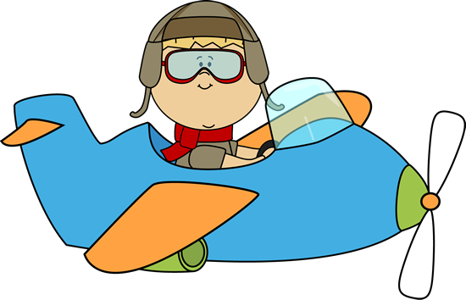
Nice reading!
Have you taken an airplane before?

Slide 14

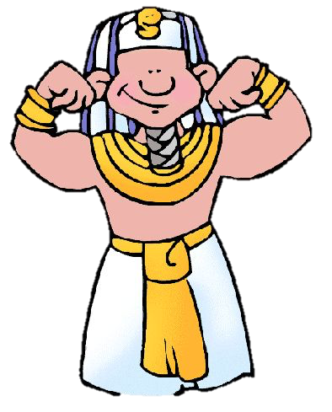
Review
Now we will review our sounds from this unit.
“Ough”
“Augh”
“U_e”

Slide 15


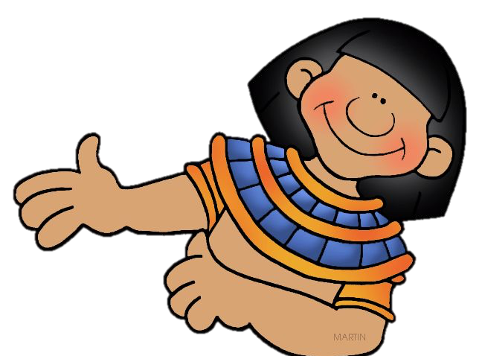
Fill in the blanks for the U_e words.
The Egyptian pyramids are _______
I rode a _______ through the desert.
.

Slide 16


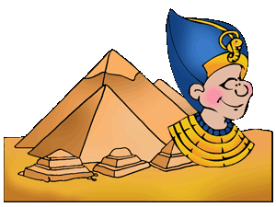
Write a sentence using a “u_e” word

Slide 17



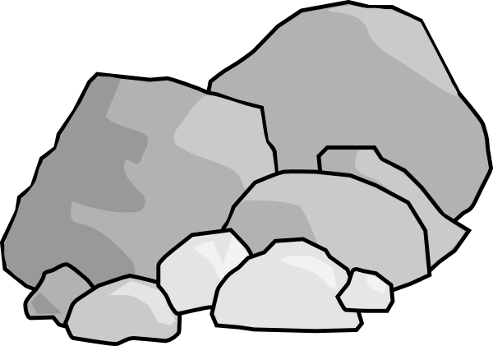
Fill in the blanks for the “ough” words.
Knead the ______________ to make the bread.
He kicked the ball _______________ the window.
The road was _________________ and rocky.

Slide 18


Fill in the blanks for the “augh” words.
My brother is funny, he makes me _____________
We went fishing and _______________ a fish!
She is her father’s __________________.

Slide 19


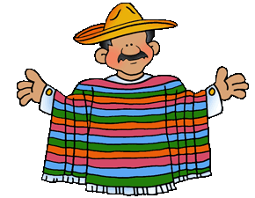
Great, that was fun. What did we learn today?
A review of France, Mexico and Egypt
Learning to compare
Reading about the Airport
A review of “ough”, “augh” and “u_e” words

Slide 20

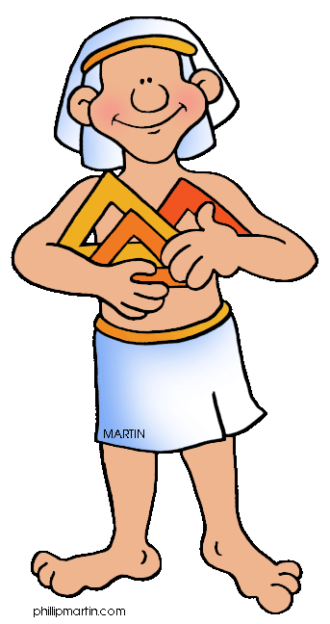
Let’s look at the homework now.
Do you have any questions?

Slide 21
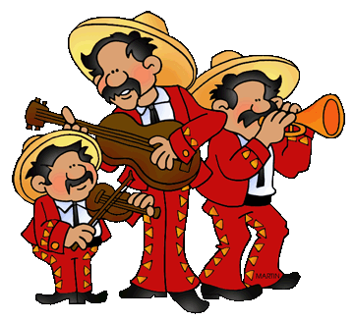
Thank you for a great class today.
We will see you next time!

