Slide 1
Around the World
Unit 8 Lesson 4

Slide 2
What will we be learning this class?
Comparing countries as a review
A review of the “ough” “augh” and “u_e” sounds
Reading about Travel!

Slide 3
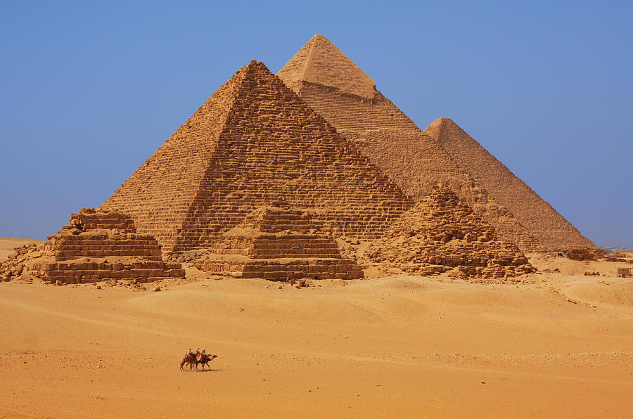
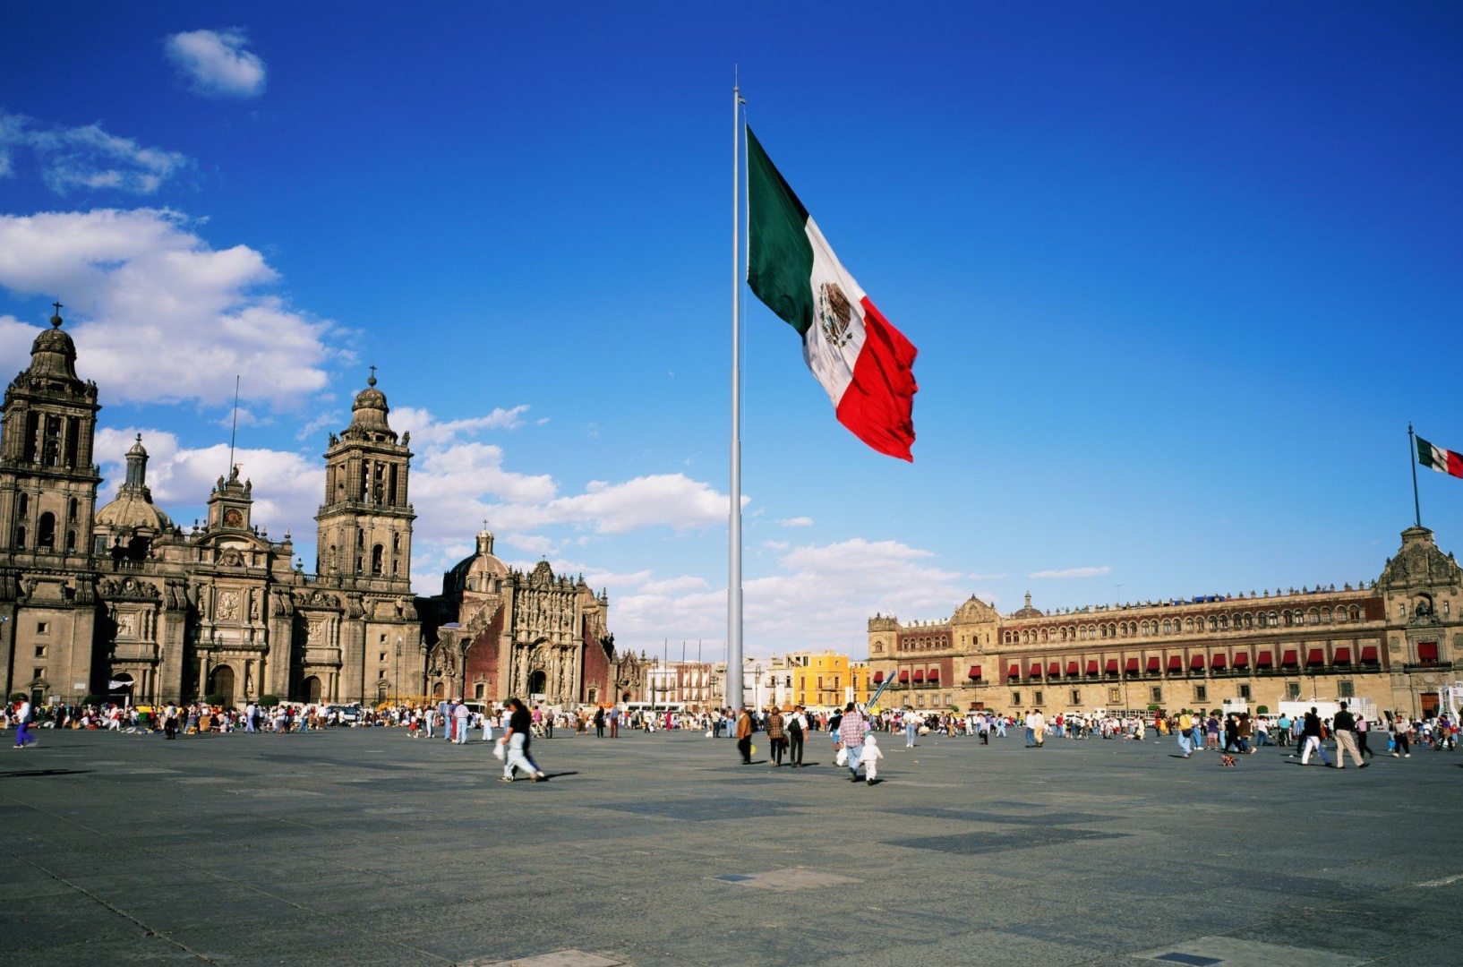
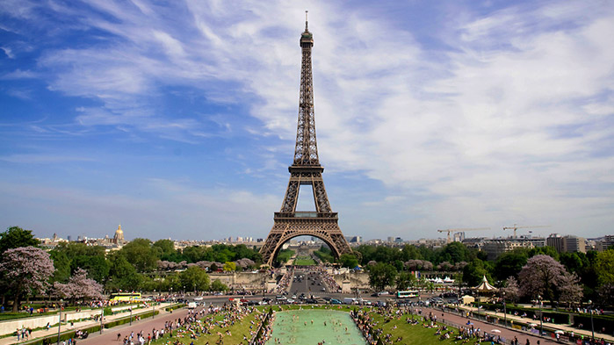
Do you remember? What countries have we learned about?

Slide 4
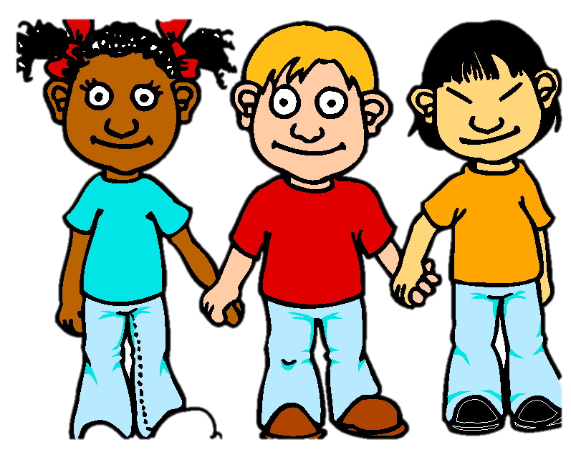
You are right! France, Mexico and Egypt.
What country did you like the best? Why?

Slide 5
What special things are in Egypt? What do we call them?

Slide 6
Do you remember? What kinds of food do they like to eat in France?

Slide 7
Do you remember? What do people in Mexico like to eat?

Slide 8
Now we will compare.
To compare is to see what is the same about two people, places, or things.

Slide 9
For example, we will compare these flowers.
Both are tall.
Both have green stems.

Slide 10
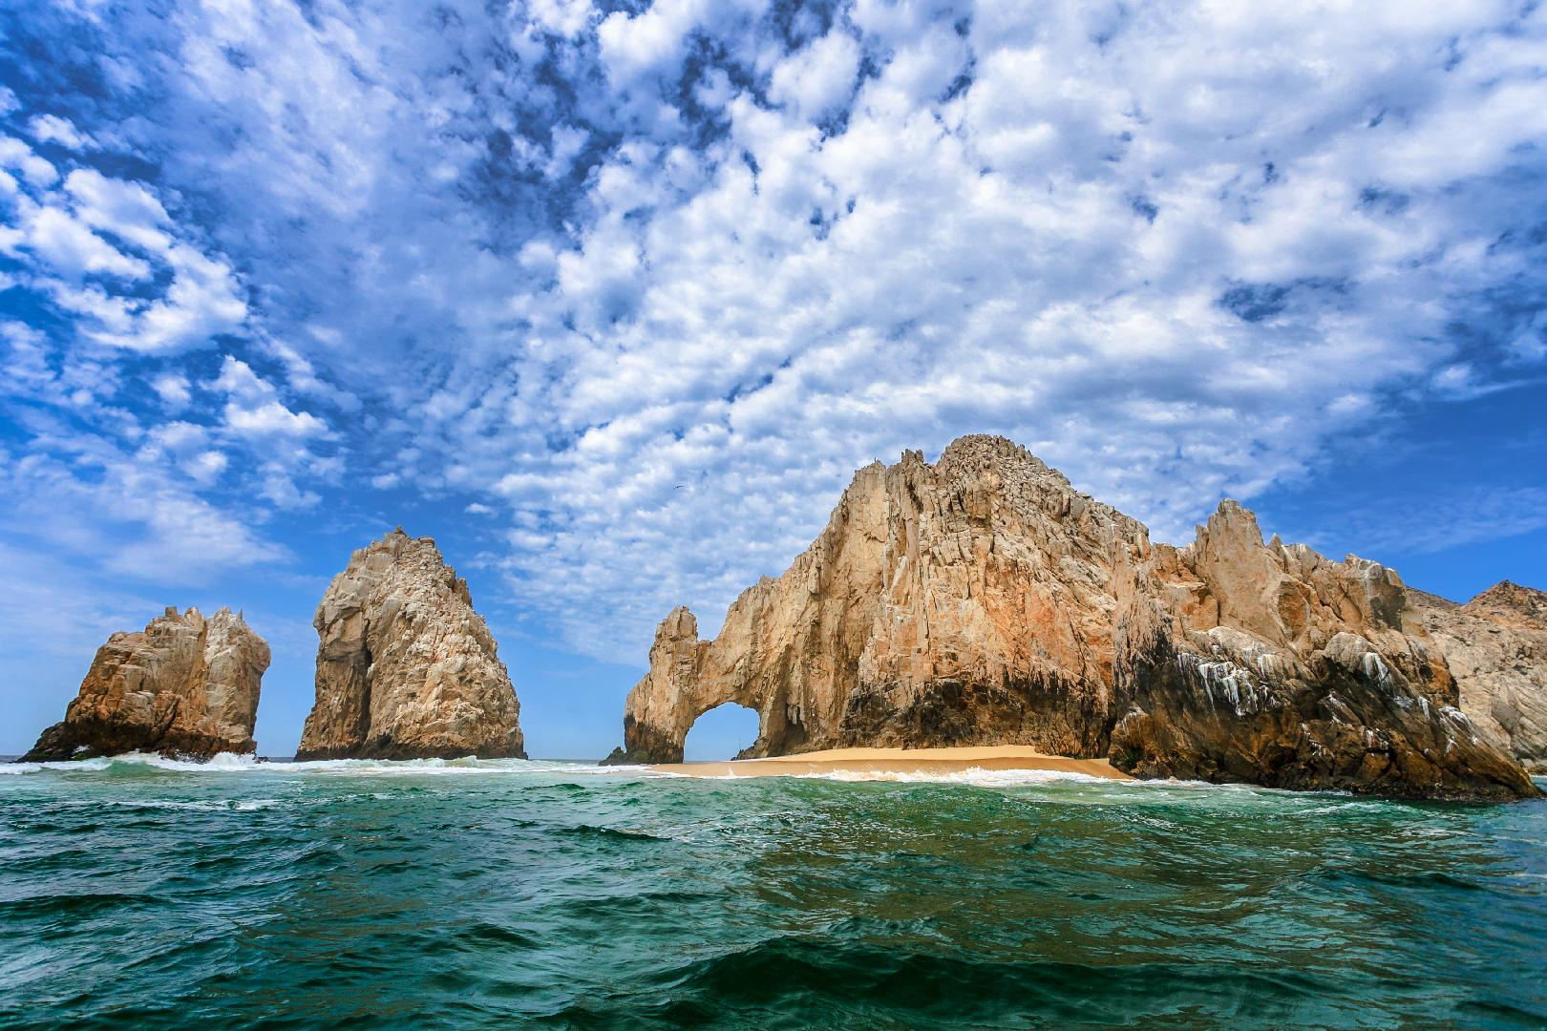
Can you compare the countries of Mexico and France?
What is the same, or similar, between the two countries?

Slide 11
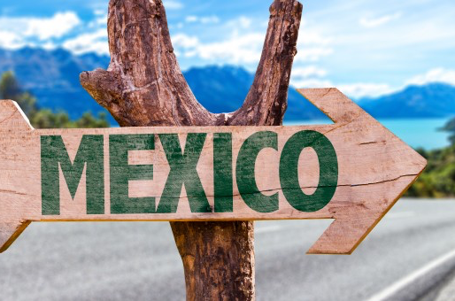
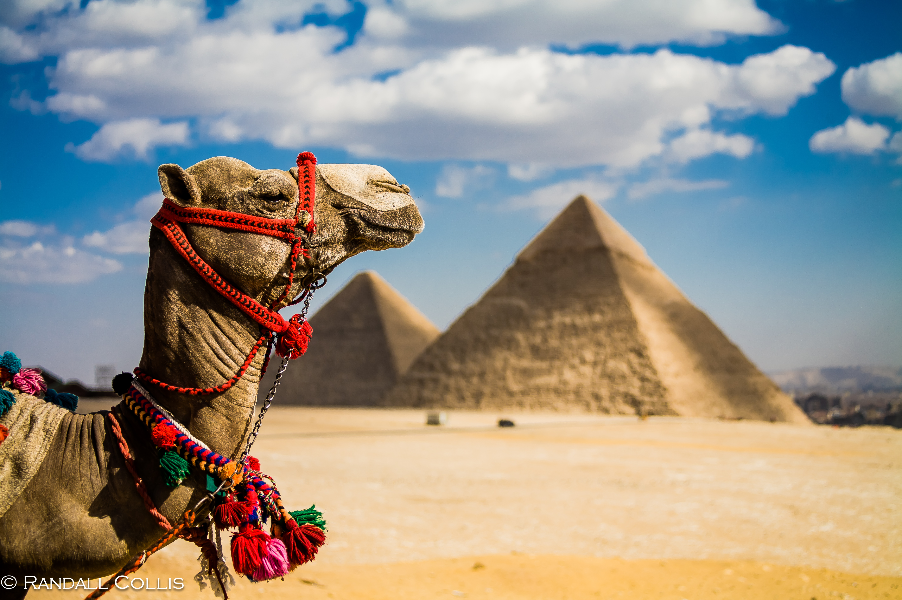
Great work! Let’s do it once more.
Compare the country of Egypt with Mexico!

Slide 12
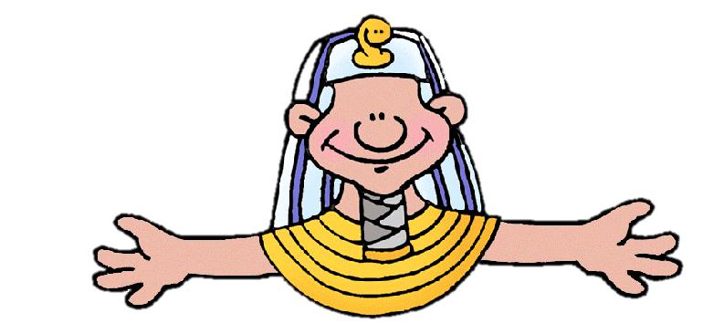
Great answers! You are great at comparing.

Slide 13
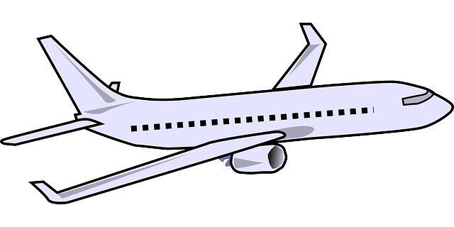
How do you travel to different countries?
Do you take a car, a plane, a train, or a bus?

Slide 14
We are going to read a book about using the Airport!

Slide 25
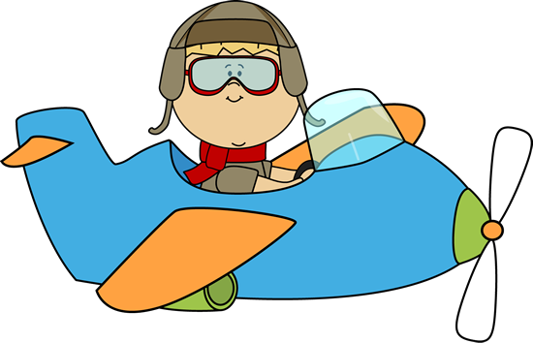
Nice reading!
Have you taken an airplane before?

Slide 26
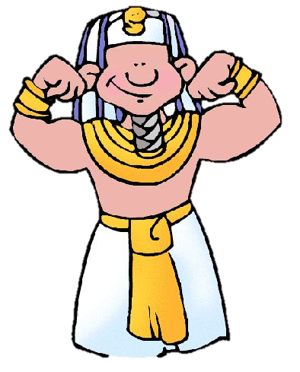
Review
Now we will review our sounds from this unit.
“Ough” “Augh” “U_e”

Slide 27
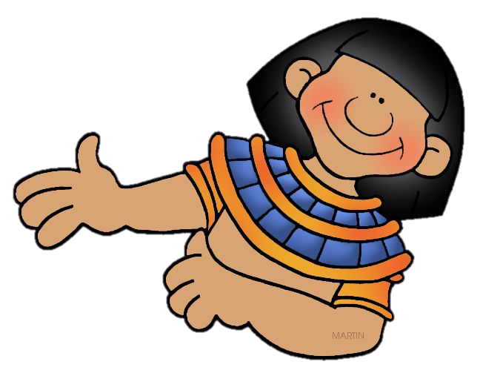
Fill in the blanks for the U_e words.
The Egyptian pyramids are ________.
I rode a _______ through the desert.

Slide 28
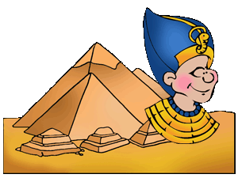
Write a sentence using a “u_e” word

Slide 29
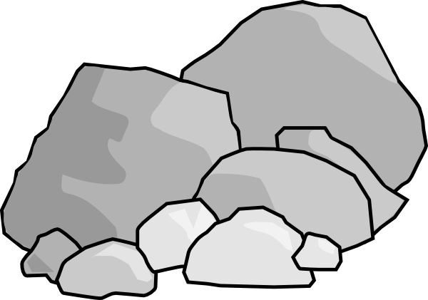
Fill in the blanks for the “ough” words.
Knead the ______________ to make the bread.
He kicked the ball ________________ the window.
The road was ______________ and rocky.

Slide 30
Fill in the blanks for the “augh” words.
My brother is funny, he makes me _____________
We went fishing and _____________ a fish!
She is her father’s ________________.

Slide 31
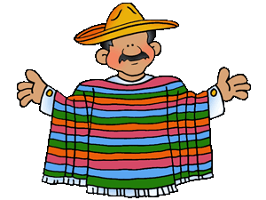
Great, that was fun. What did we learn today?
A review of France, Mexico and Egypt
Learning to compare
Reading about the Airport
A review of “ough”, “augh” and “u_e” words

Slide 32
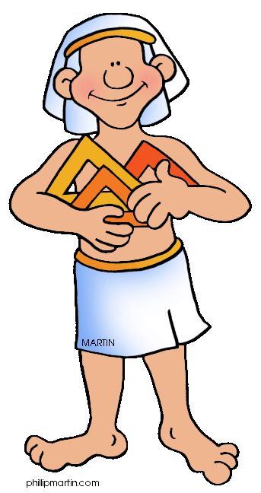
Let’s look at the homework now.
Do you have any questions?

Slide 33
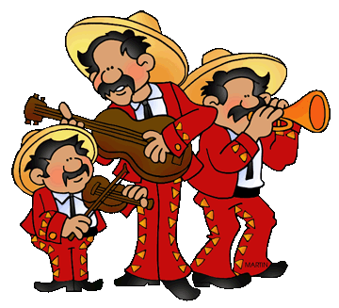
Thank you for a great class today.
We will see you next time!

