Slide 1



Around the World
Unit 8 Lesson 5

Slide 2


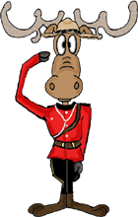
What will we be learning this class?
A look into a new country
A review of the “i_e” sound

Slide 3



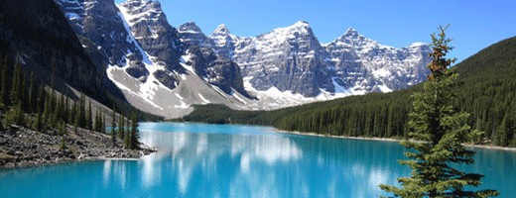
Today we will be looking into another country.
Can you guess which country it is?

Slide 4

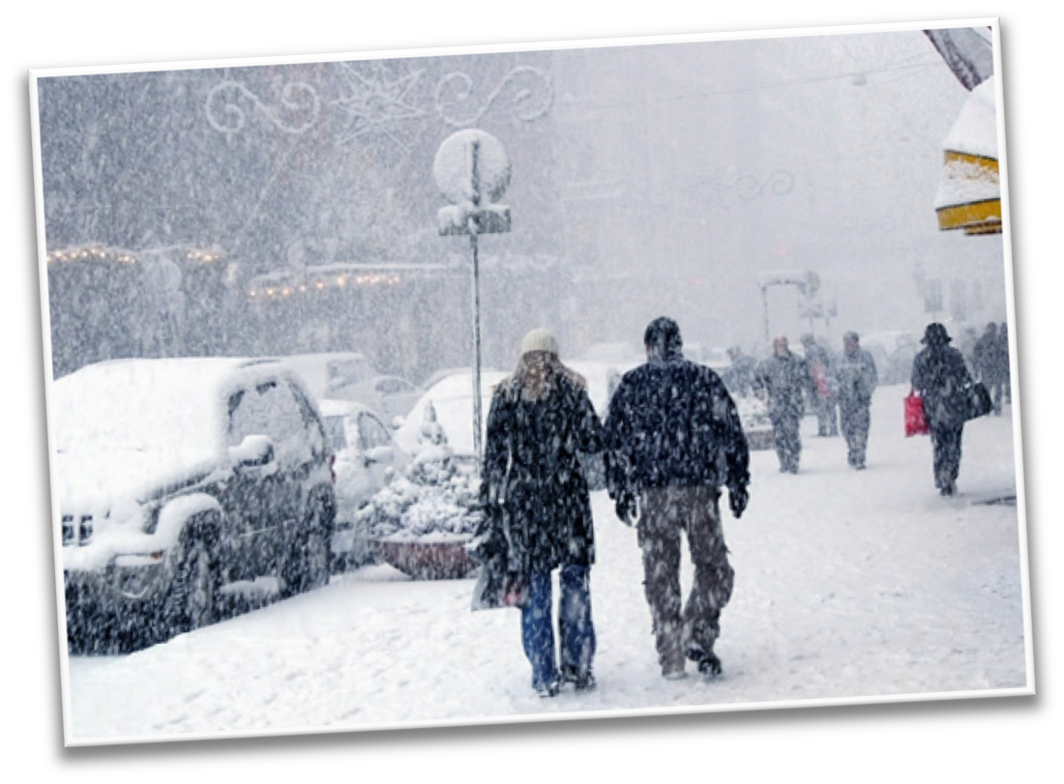




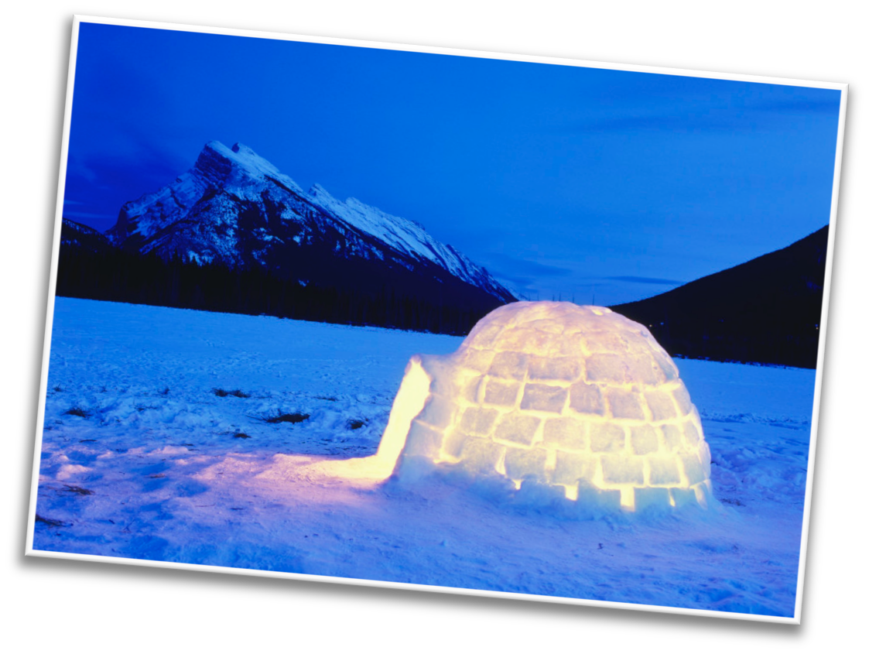
Here are some hints:
It is cold in the winter!

Slide 5
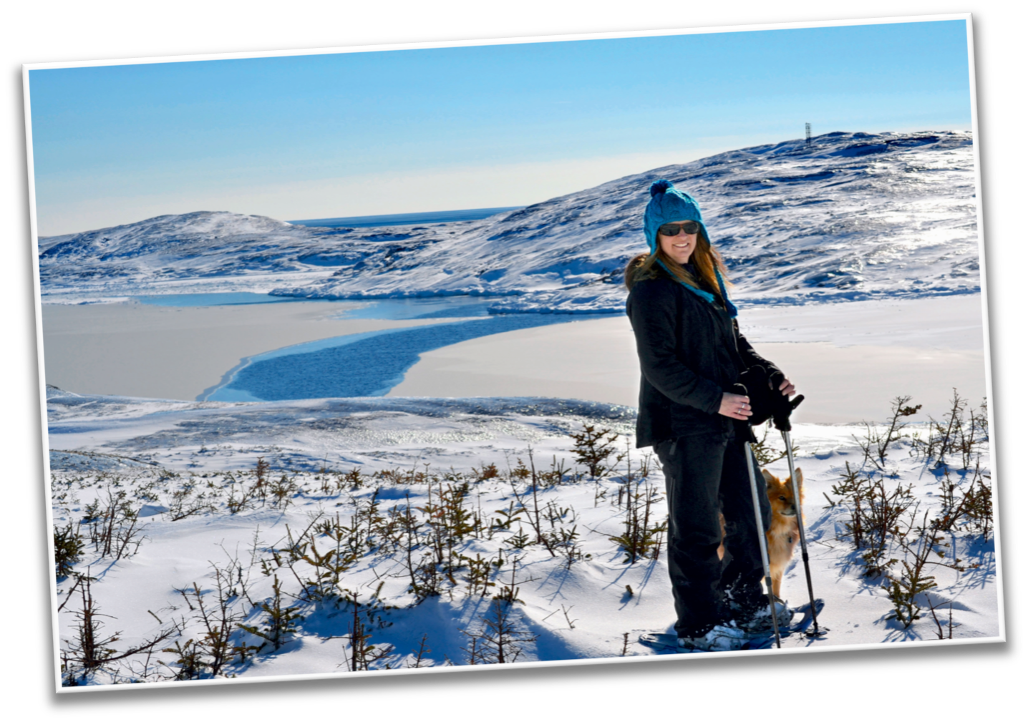

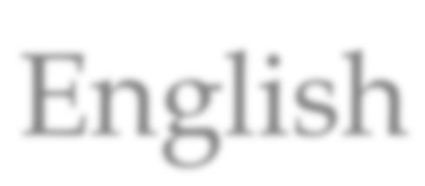
Most people who live here speak English

Slide 6
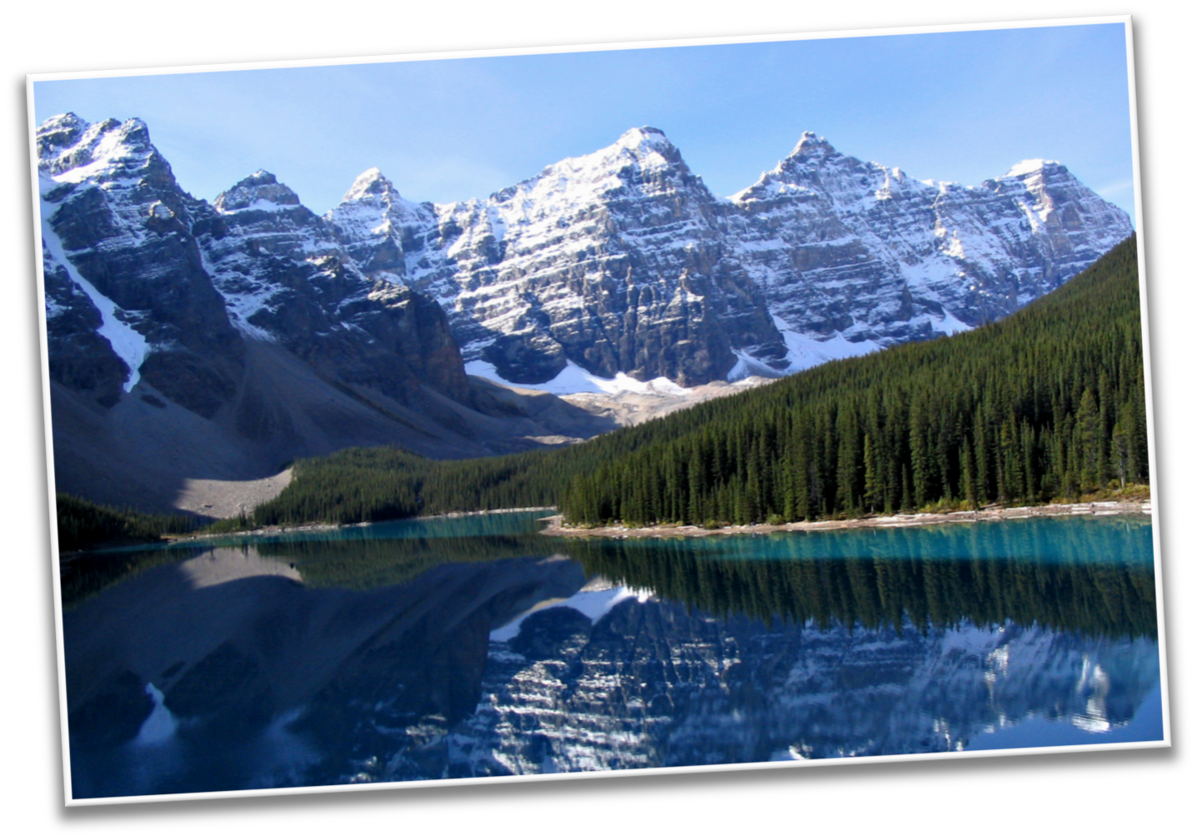
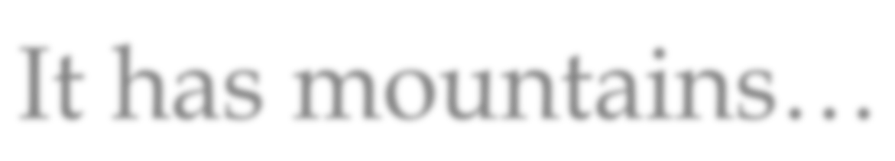
It has mountains…

Slide 7
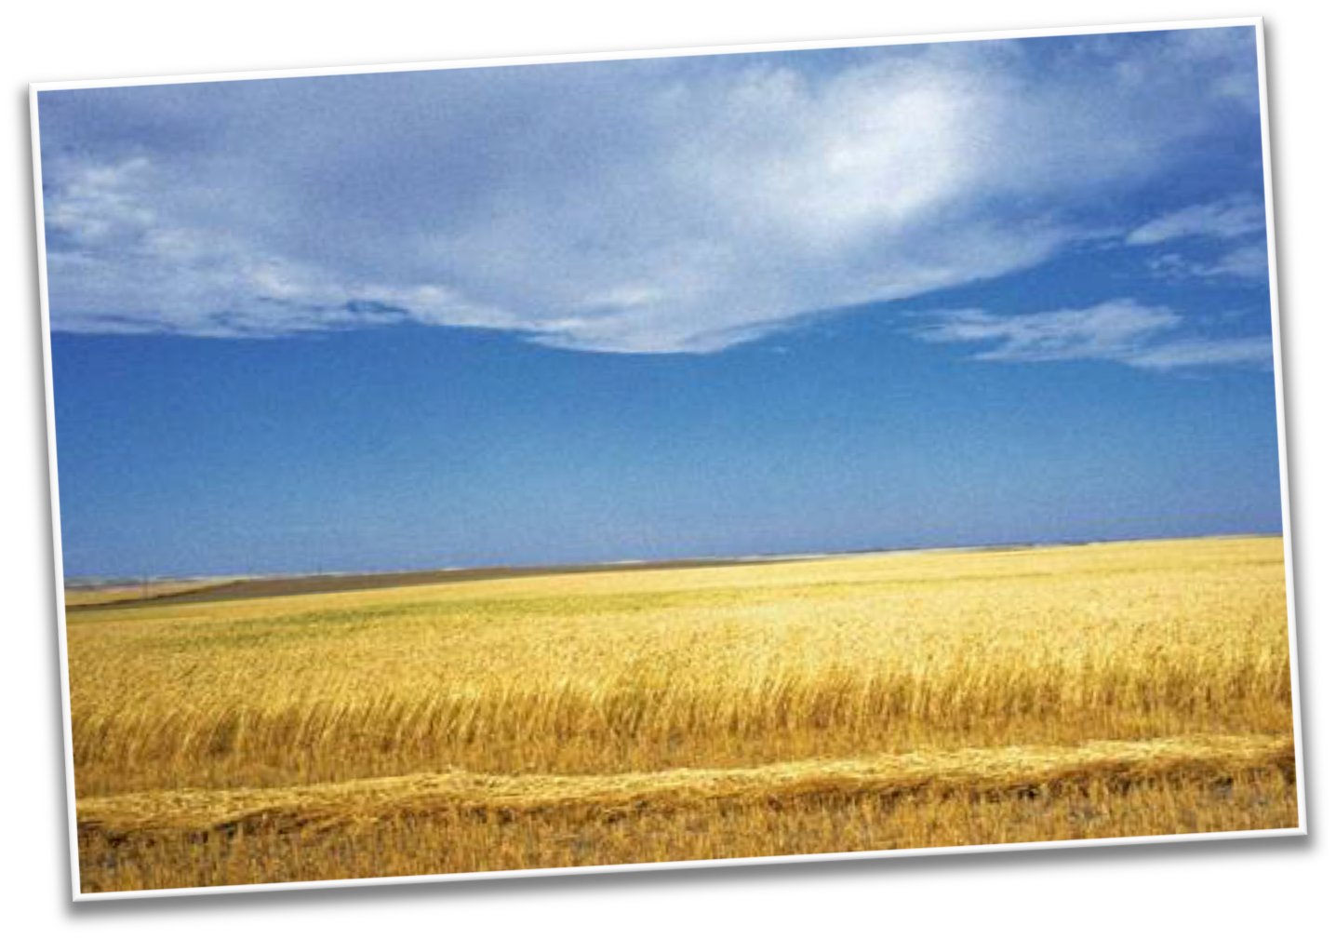

And it also has flat lands…

Slide 8
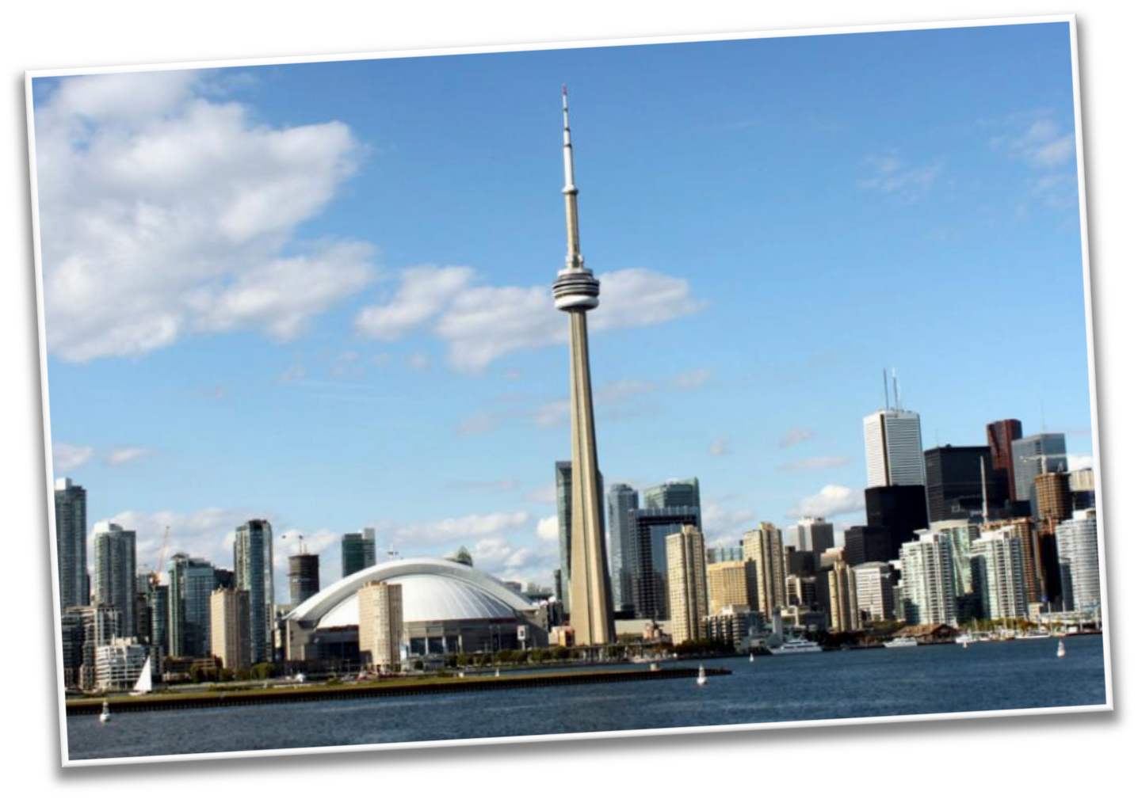

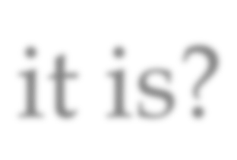
Can you guess what country it is?

Slide 9
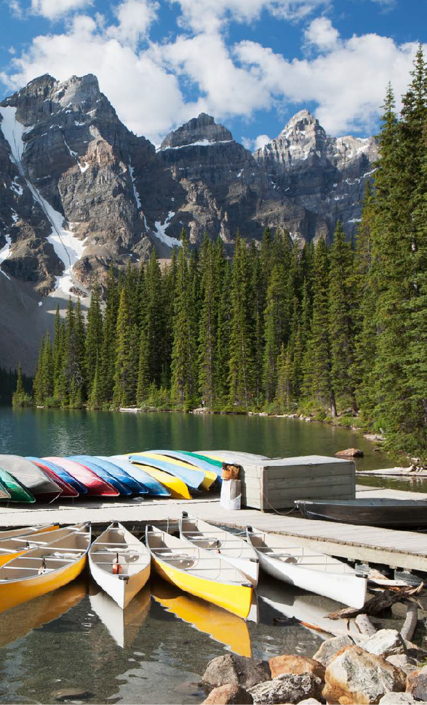





Let’s find out!
LEVELED BOOK • J
Canada
We will now read a book about Canada!
Written by Will Angelo
www.readinga-z.com

Slide 10


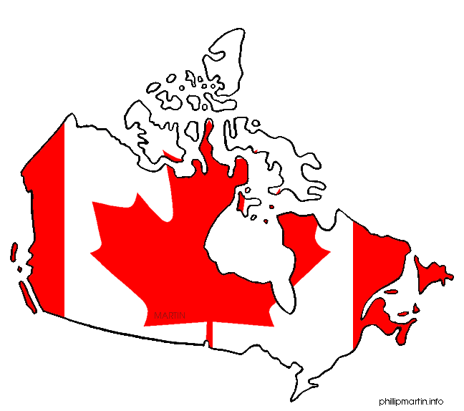
What did you like about Canada?

Slide 11

Review
Now that you have read the book…
What animals live in Canada?
Do more people live in the North or in the South?

Slide 12

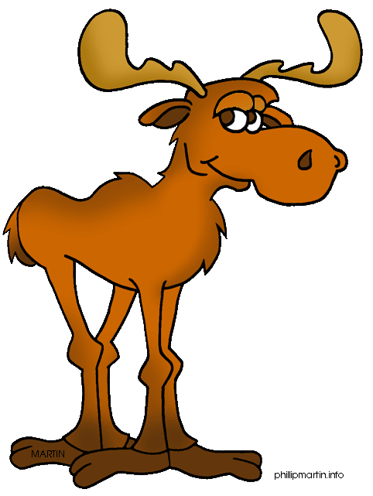
Great work!
Now we will review the “i_e” sound!

Slide 13


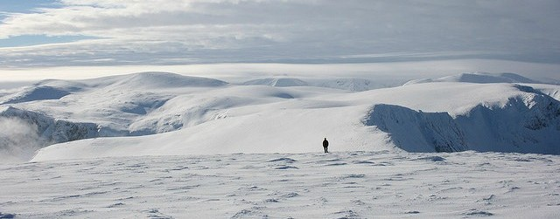
Look at this photo of Canada
What i_e word would fit in the sentence?
There is lots of cold _________ in Canada.

Slide 14


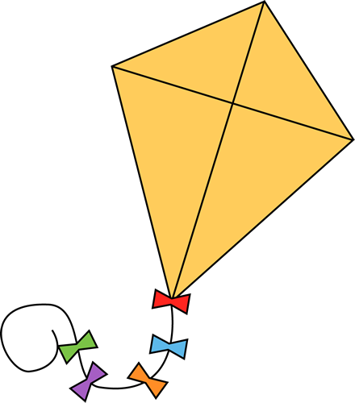
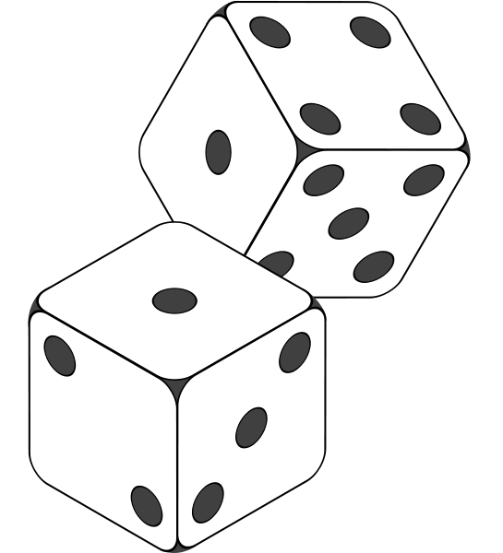
Let’s practice using some words in a sentence.
When I play a game, I like to roll the ________.
I am good at riding my ________________.
When it is windy, I like to fly a _____________.

Slide 15



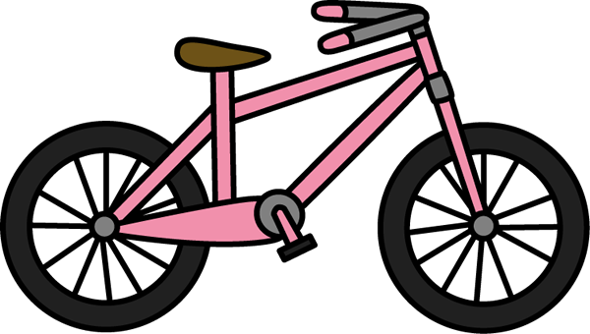
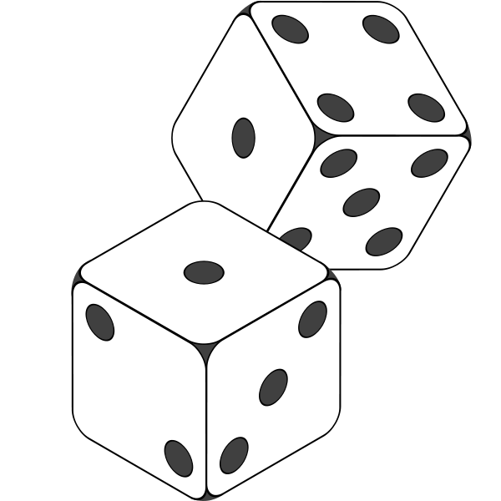

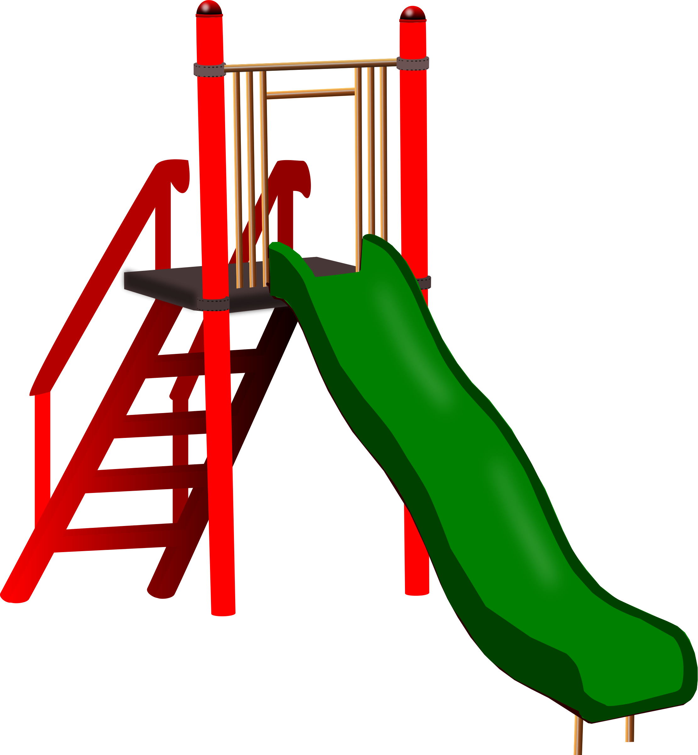

Can you name all of the i_e words?

Slide 16

Nice job! Use two of these words in a sentence.

Slide 17



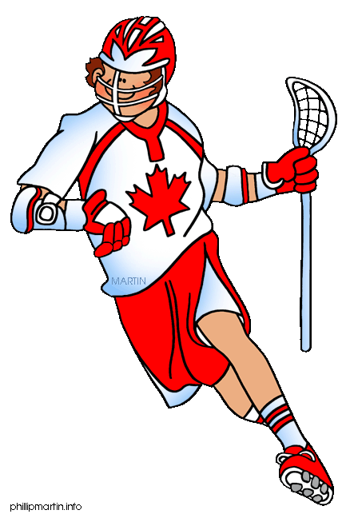
List three different i_e words

Slide 18


Very good job! What did we learn today?
A look into Canada
Practicing Predictions
A review of “i_e” words

Slide 19

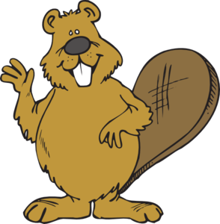
Let’s look at the homework now.
Do you have any questions?

Slide 20

Thank you for a great class today. We’ll see you next time!

