Slide 1



Around the World
Unit 8 Lesson 6

Slide 2


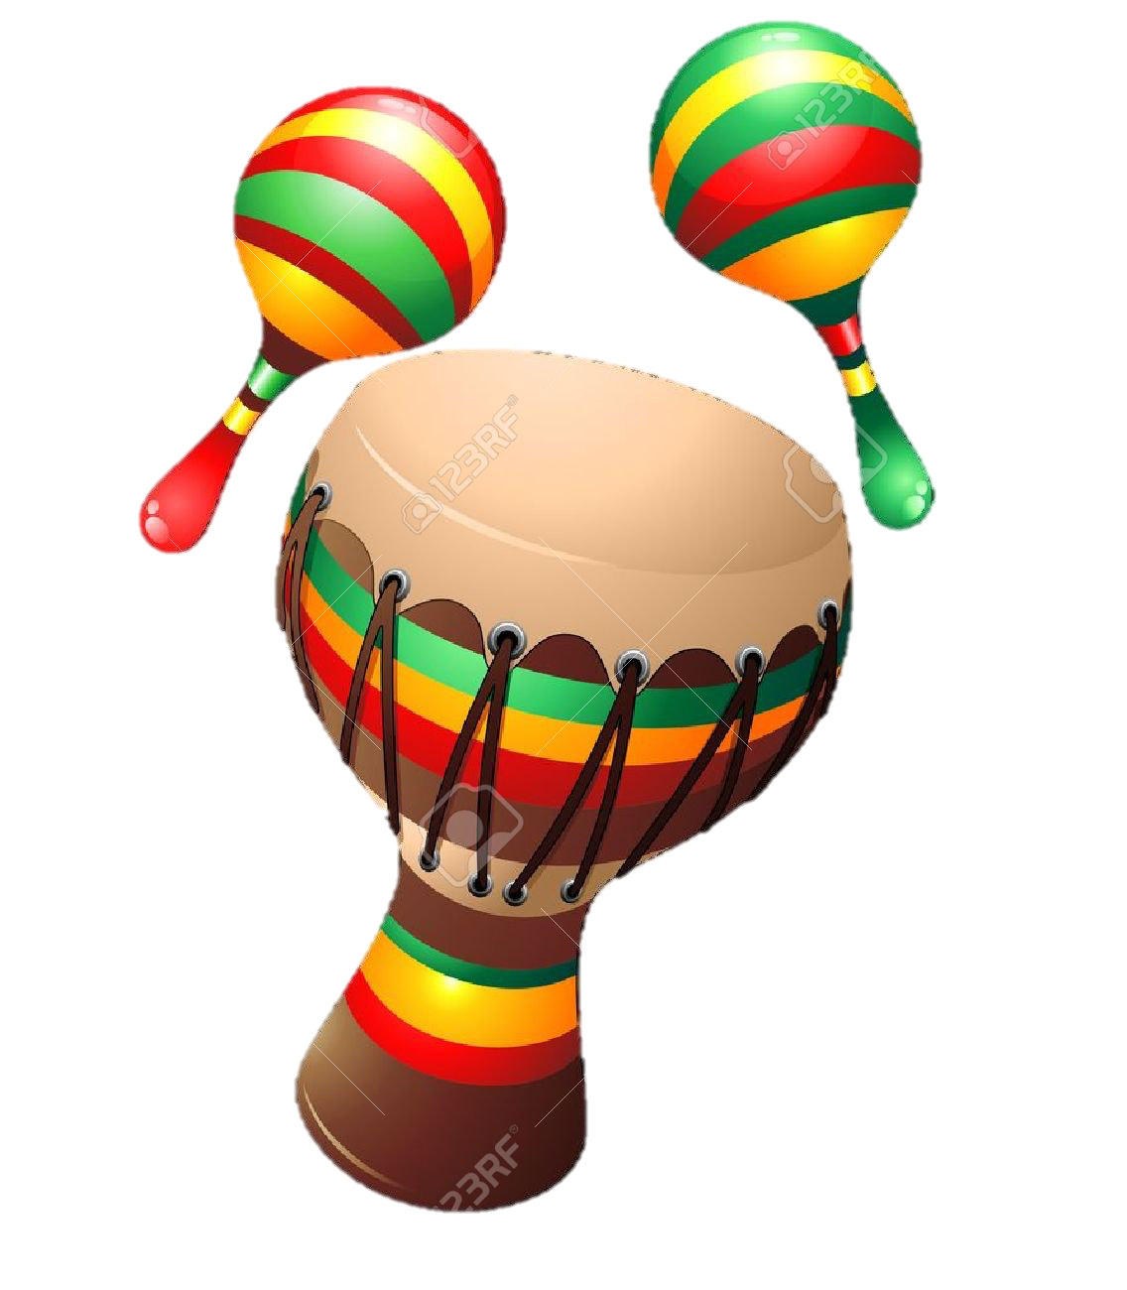
What will we be learning this class?
A look into a new country
A review of the “a_e” sound

Slide 3


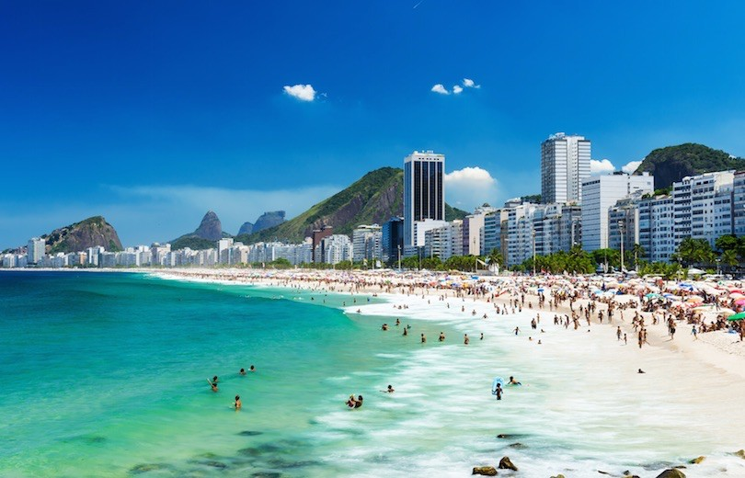
Today we will be learning about another country.
This country has beautiful beaches…

Slide 4

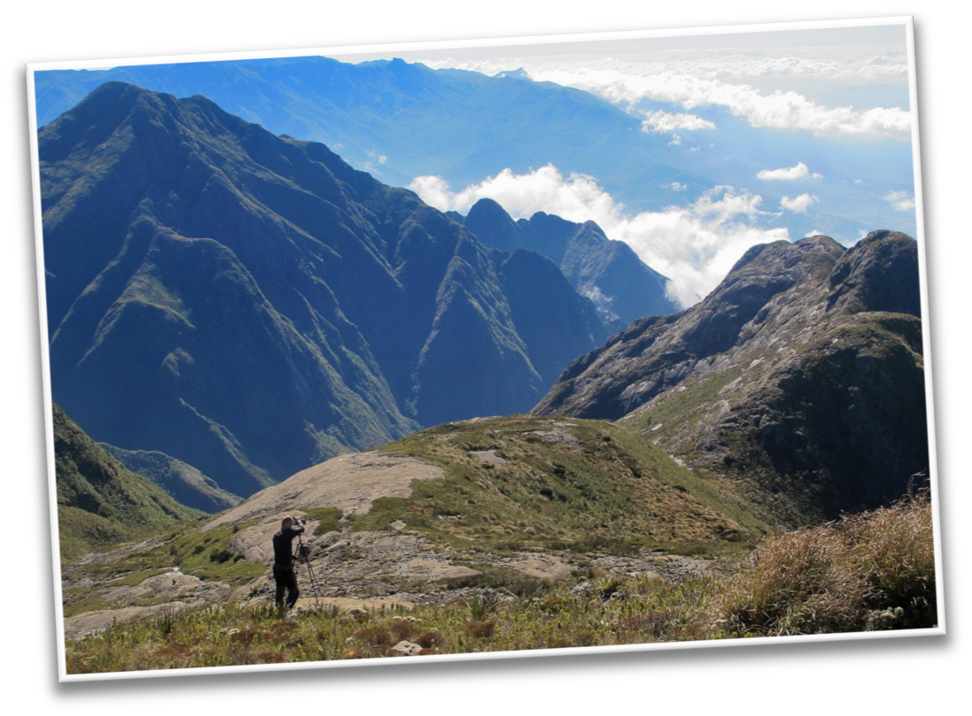


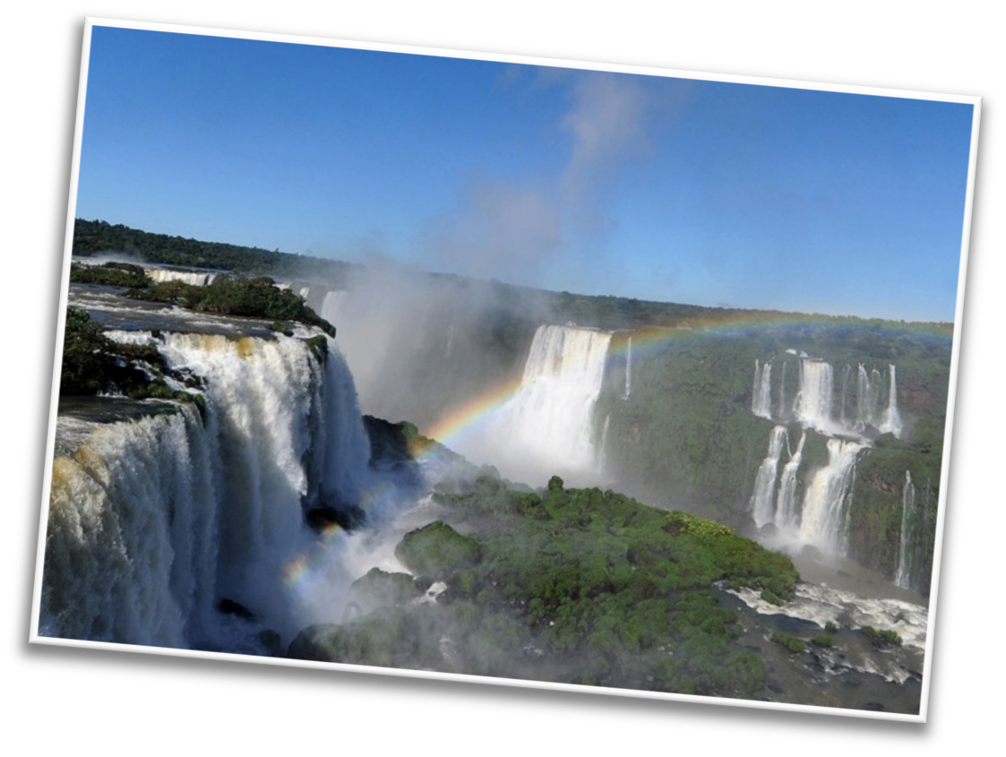

It has mountains…
And waterfalls!

Slide 5

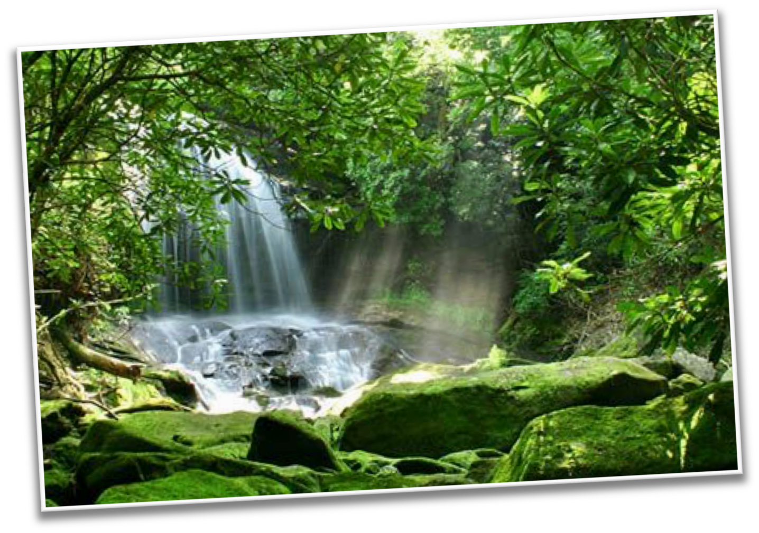
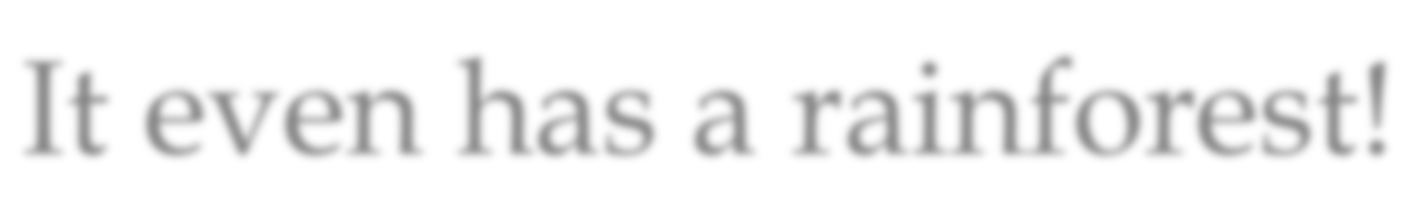
It even has a rainforest!

Slide 6
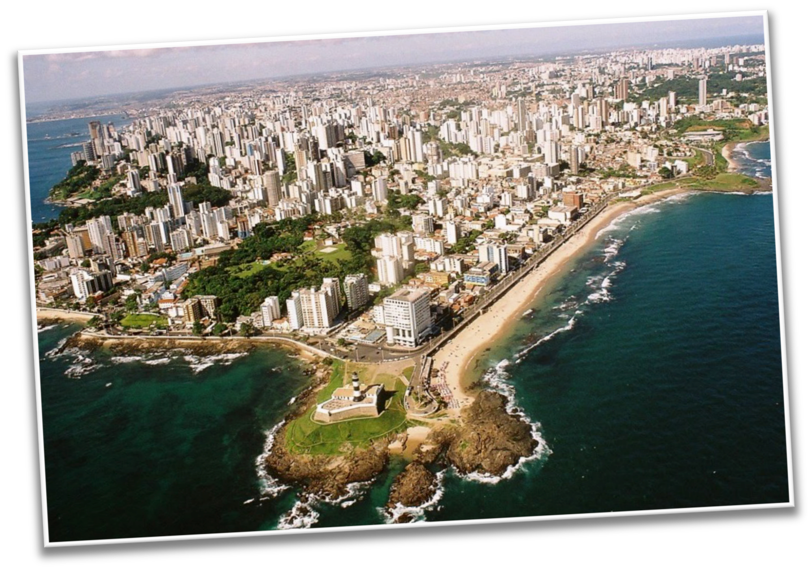
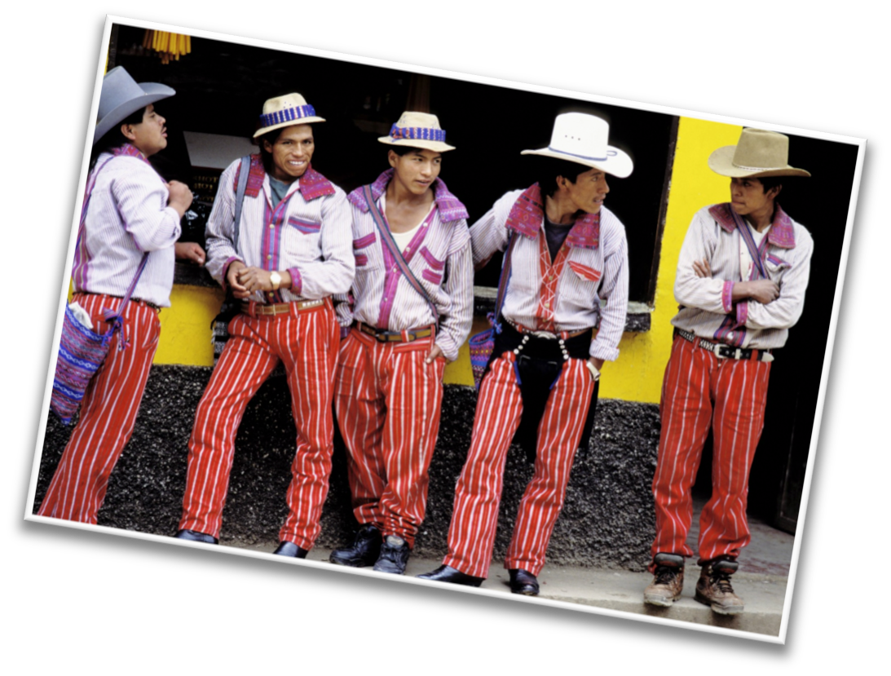
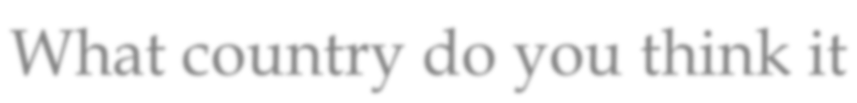
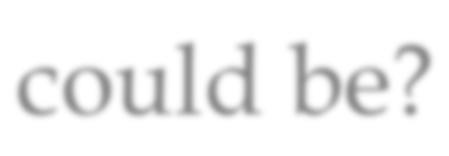
What country do you think it could be?

Slide 7


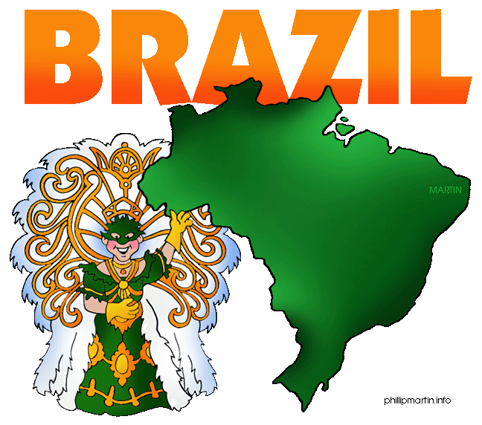
What do you know about Brazil? Write it below

Slide 8




Let’s make some predictions…
What sorts of celebrations do you think Brazilians have?

Slide 9


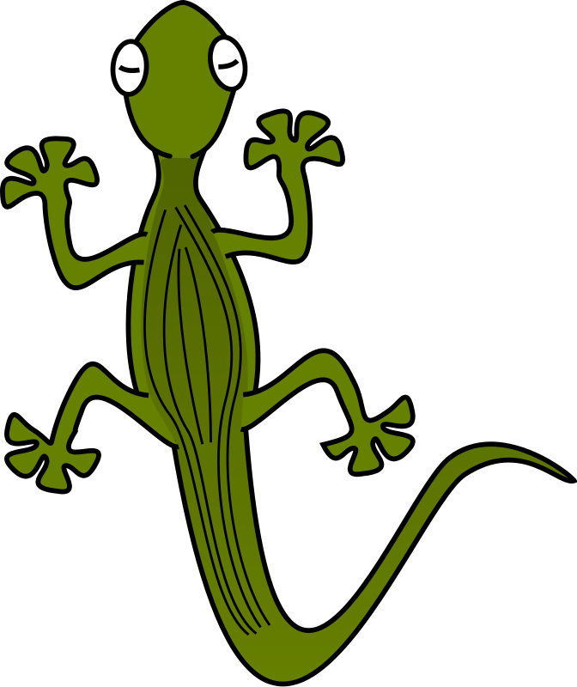
What animals do you think live in Brazil?

Slide 10
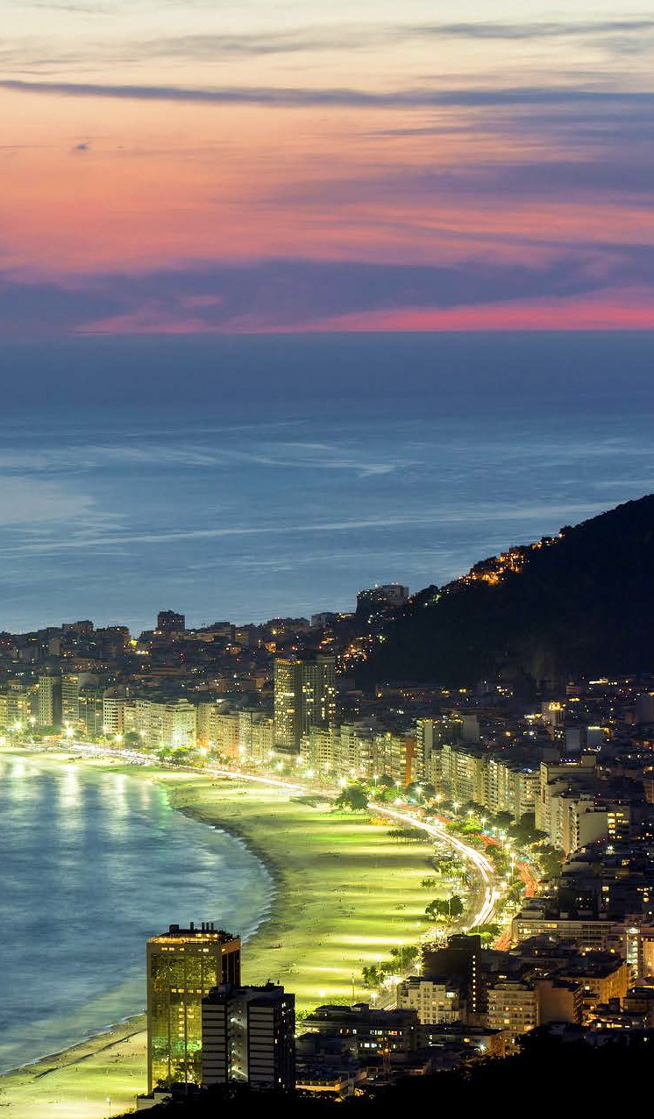



Let’s find out!
LEVELED BOOK • J
Brazil
We will now read a book about Brazil!
Written by Maya Guinn
www.readinga-z.com

Slide 11


What did you like about Brazil?

Slide 12

Review
Now that you have read the book…
What celebrations take place in Brazil?
What animals live in Canada?

Slide 13

Great work!
Now we will review the “a_e” sound!

Slide 14


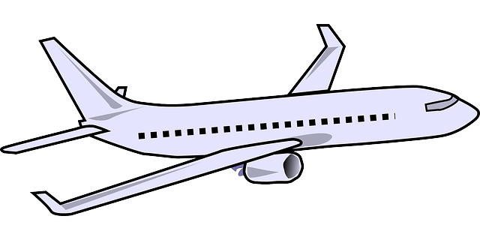
What vehicle would you have to take to get to Brazil?

Slide 15


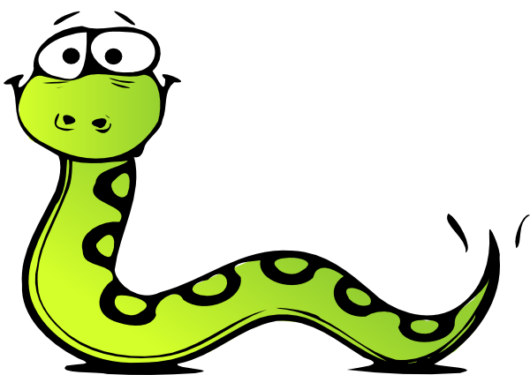
How many a_e words can you pick out?
This morning, I lay awake in my bed. Today was the date! I was going to travel to Brazil! I packed my suitcase to take on the plane. I hope we go to the rainforest, I want to see a snake!

Slide 16




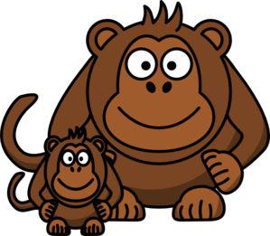
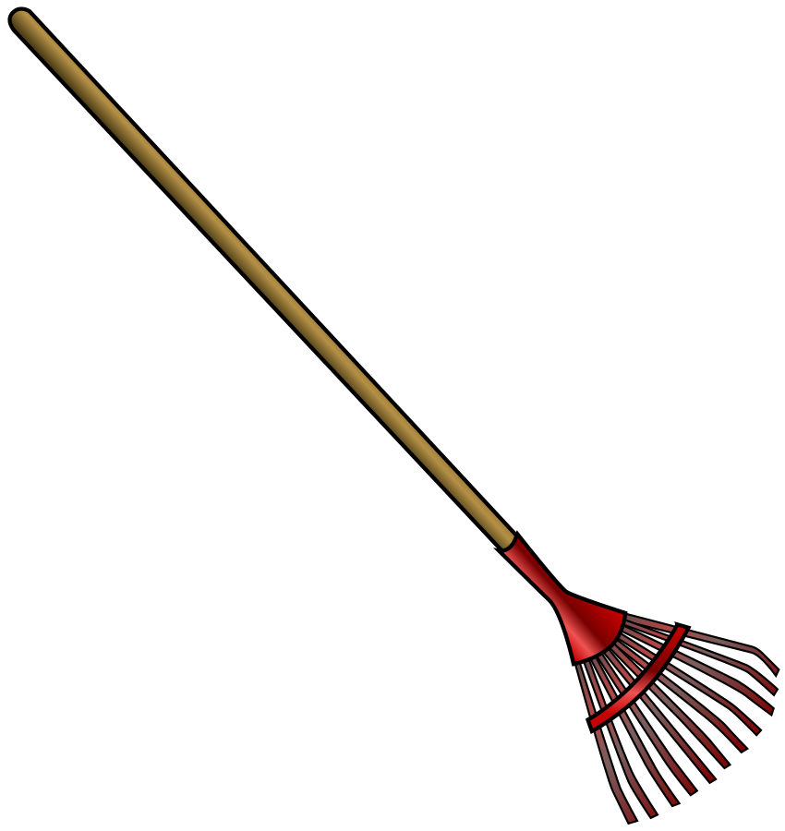
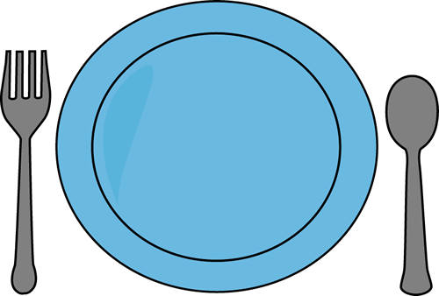
What do you notice about a_e words? How do they sound?

Slide 17


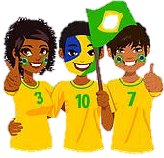
List as many a_e words as you can in 1:00.

Slide 18


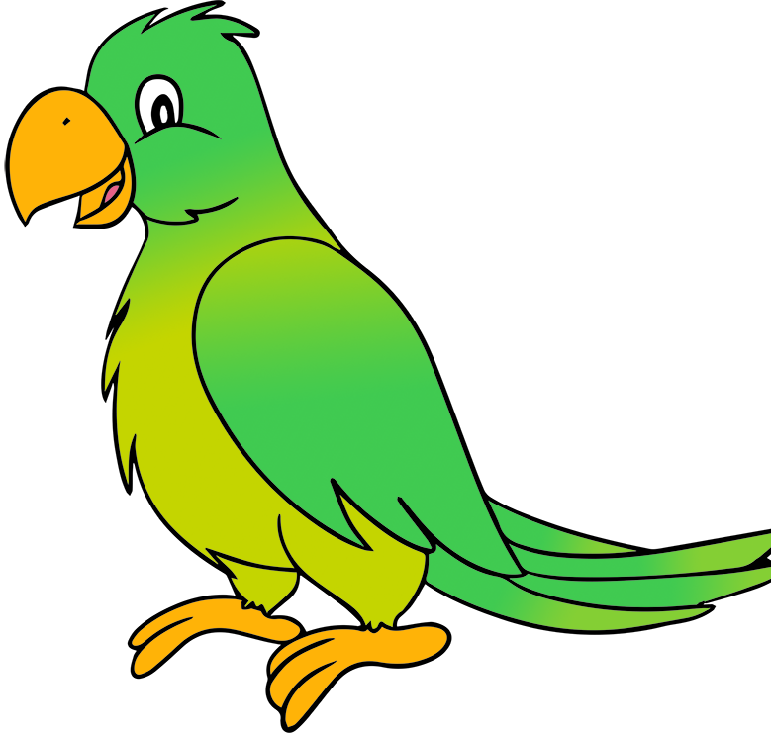
Very good job! What did we learn today?
A look into Brazil
Practicing Predictions
A review of “a_e” words

Slide 19

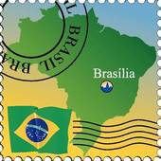
Let’s look at the homework now.
Do you have any questions?

Slide 20
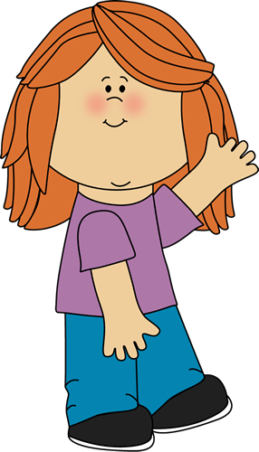
Thank you for a great class today.
As they say in Portuguese, Adeus!

