Slide 1
Around the World
Unit 8 Lesson 6

Slide 2
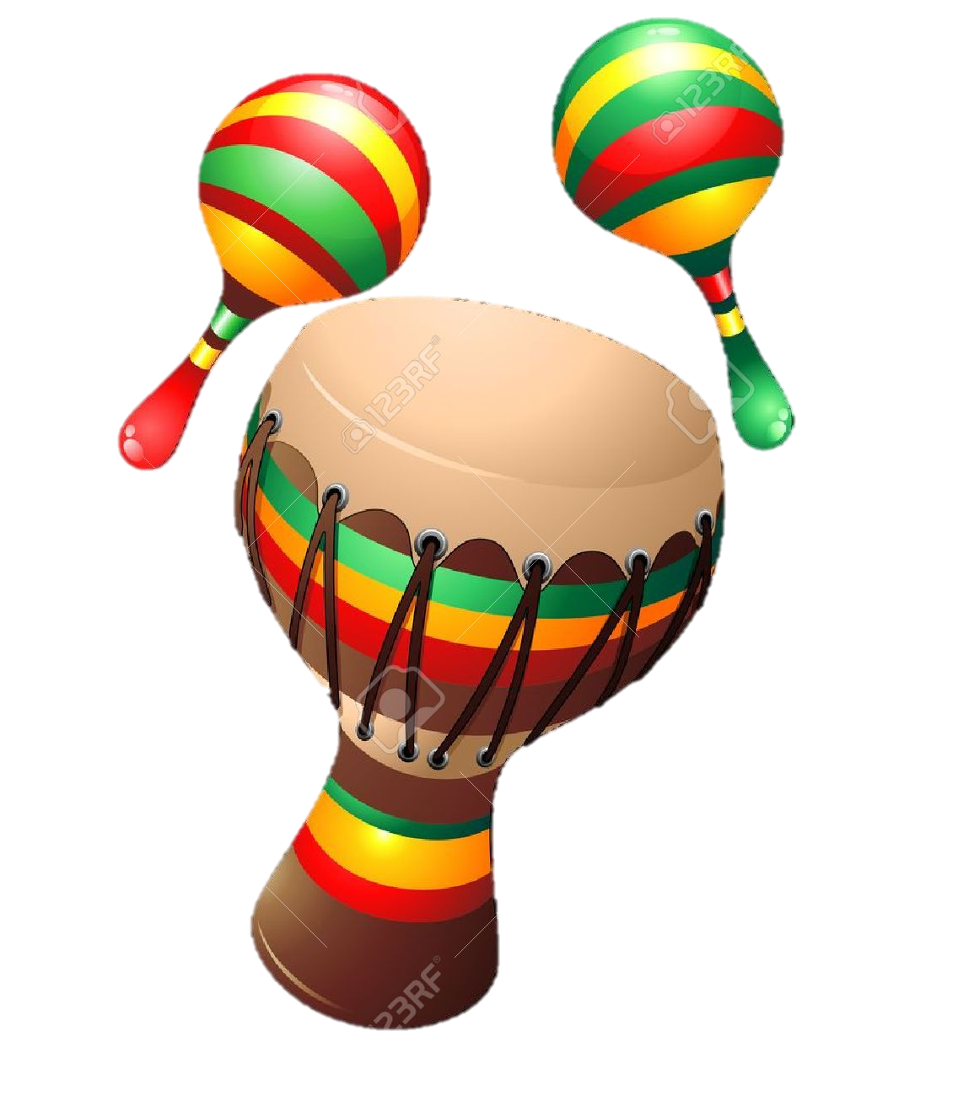
What will we be learning this class?
A look into a new country
A review of the “a_e” sound

Slide 3
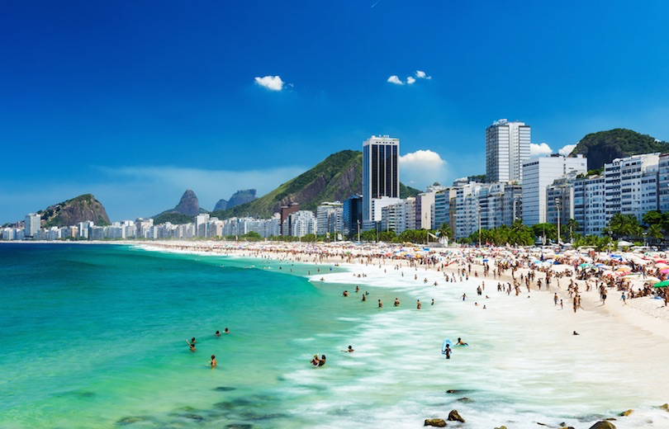
Today we will be learning about another country.
This country has beautiful beaches…

Slide 4
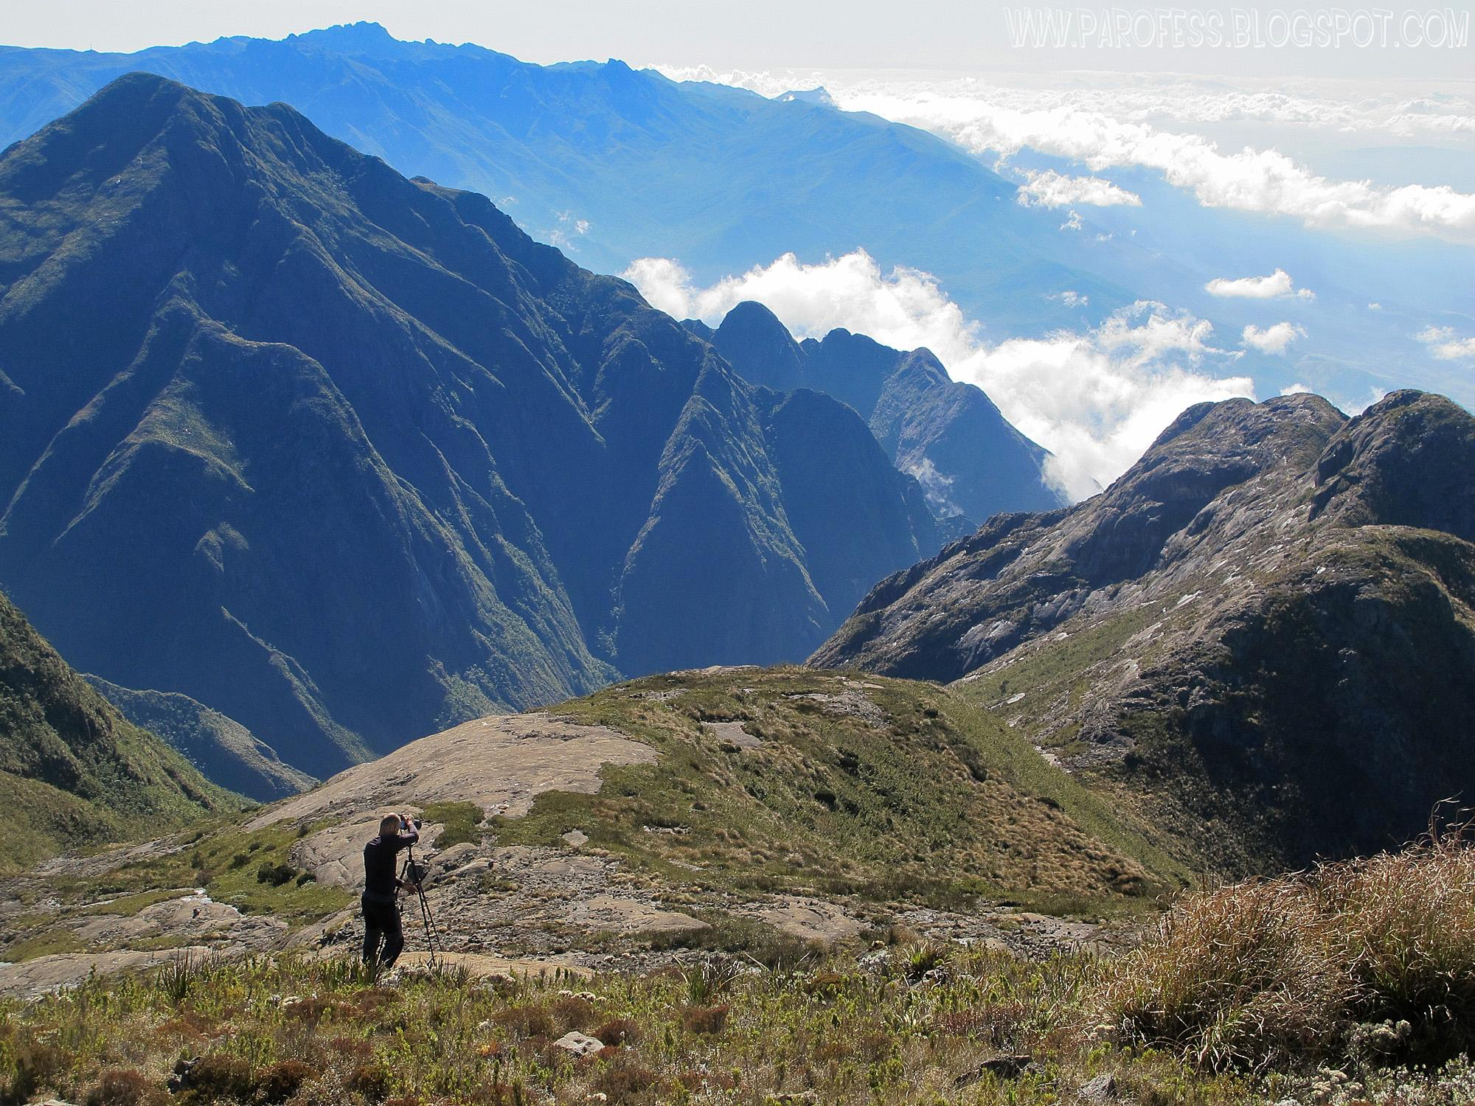
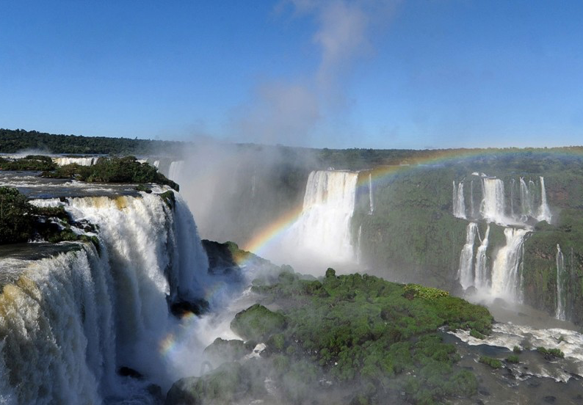
It has mountains…
And waterfalls!

Slide 5
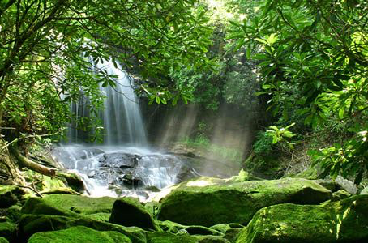
It even has a rainforest!

Slide 6
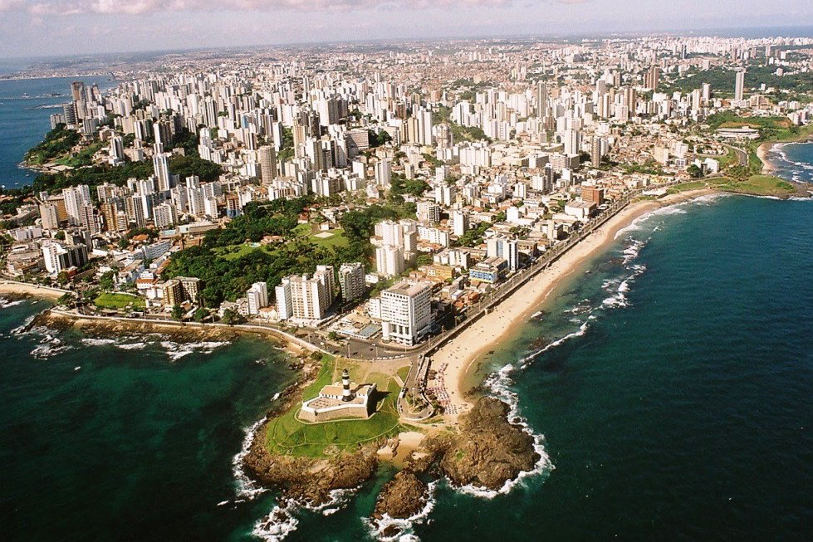
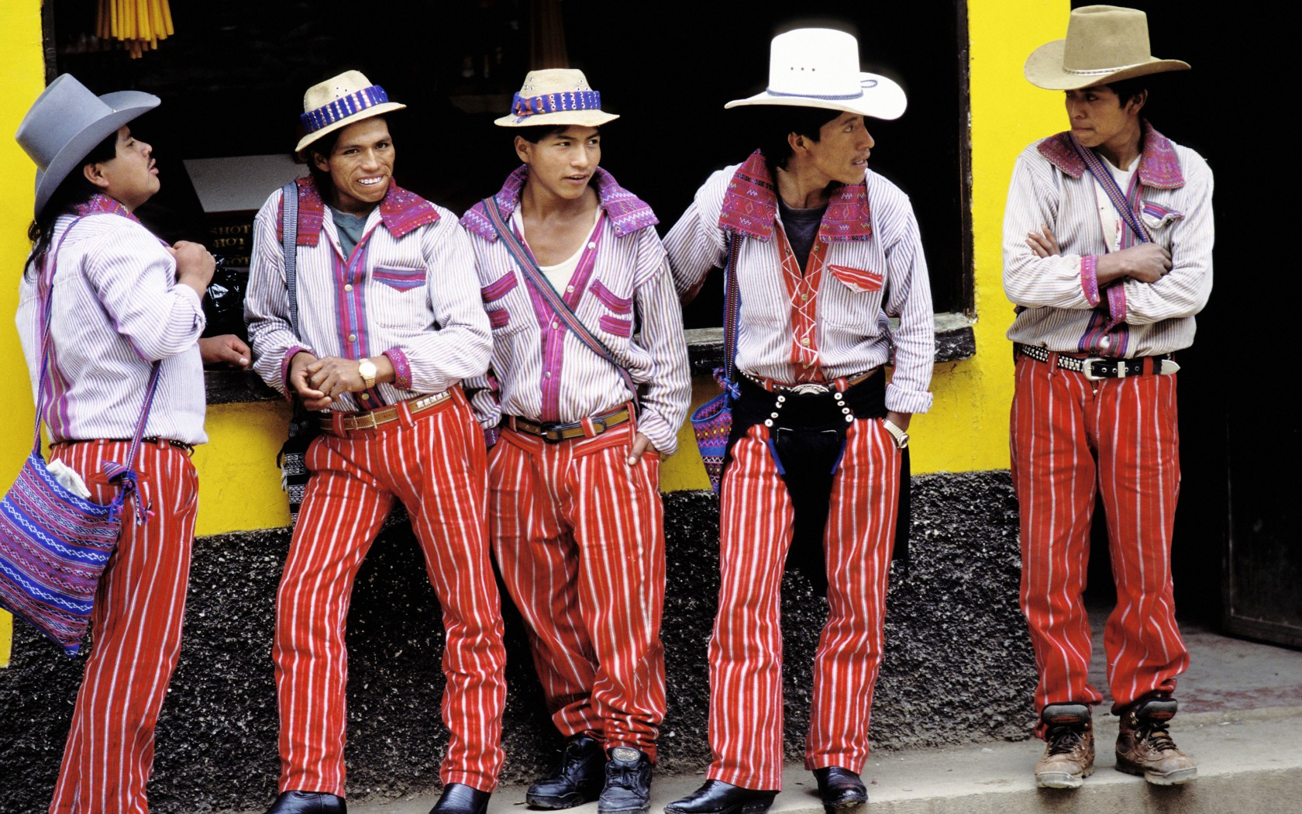
What country do you think it could be?

Slide 7
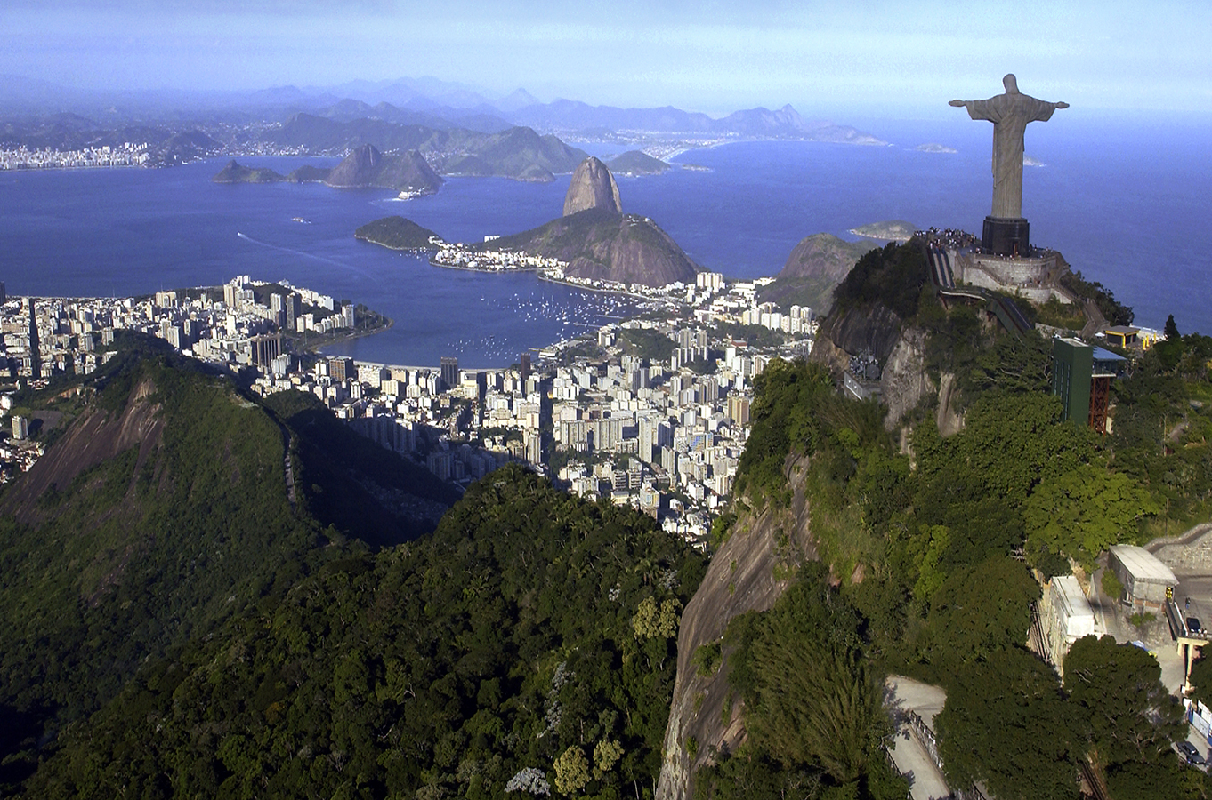
It is Brazil! We will be learning about this country today.

Slide 8

What do you know about Brazil? Write it below

Slide 9

Let’s make some predictions…
What sorts of celebrations do you think Brazilians have?

Slide 10
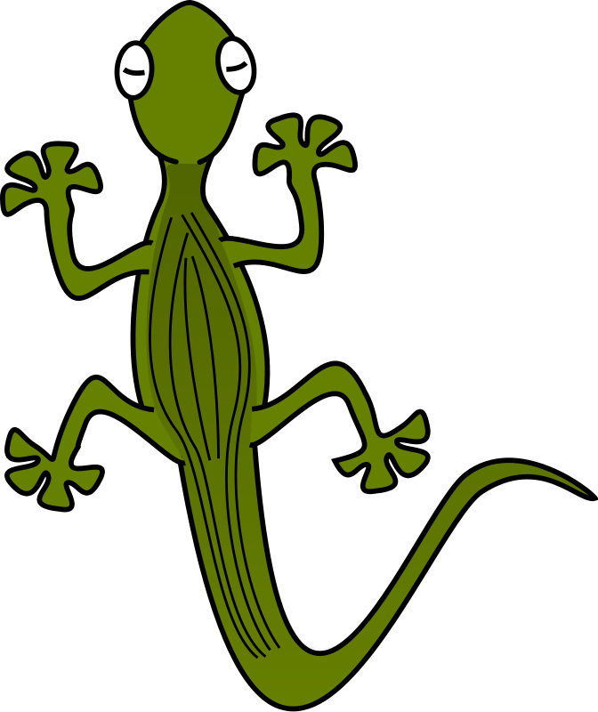
What animals do you think live in Brazil?

Slide 11
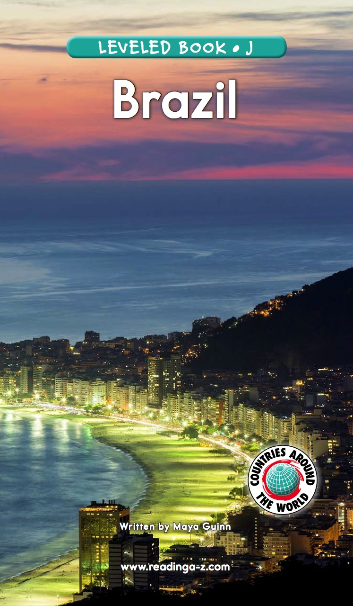
Let’s find out!
We will now read a book about Brazil!

Slide 12
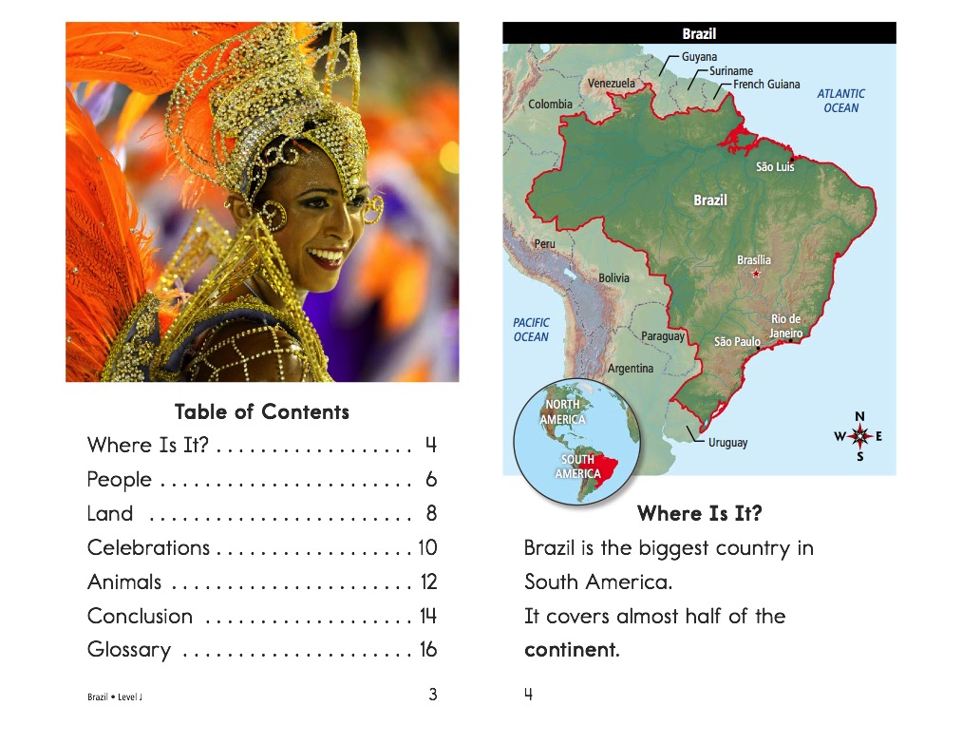

Slide 14
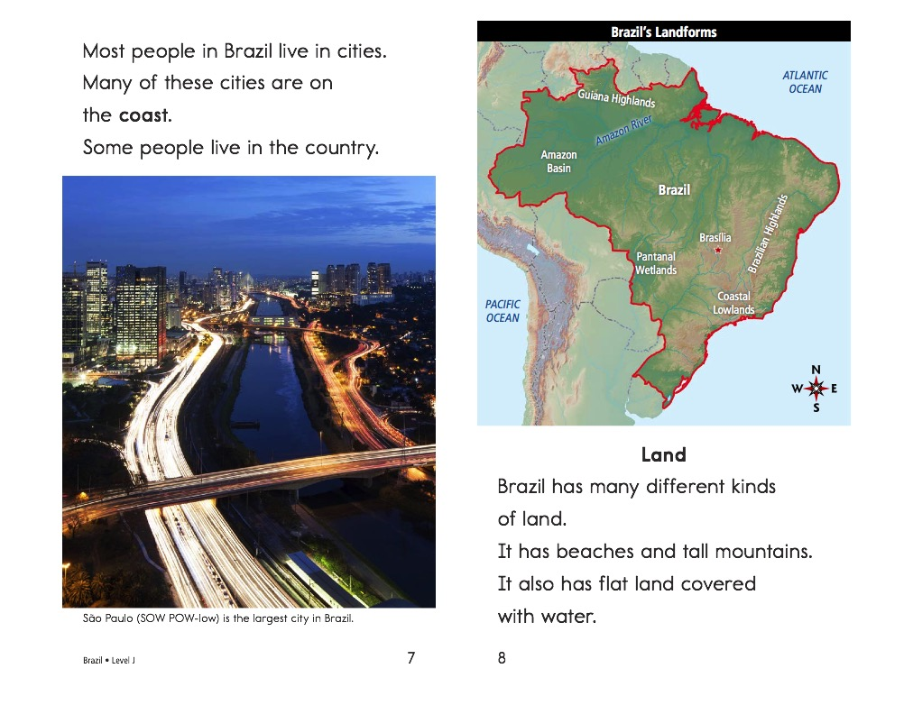

Slide 18
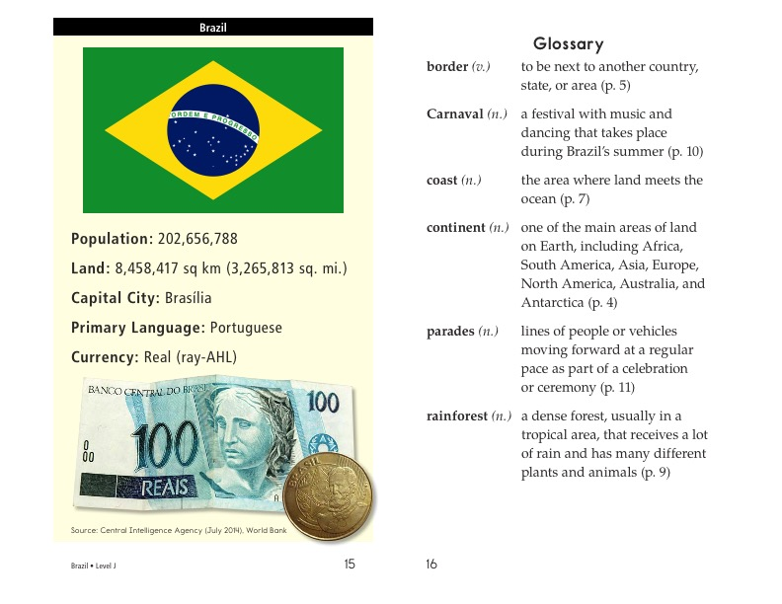

Slide 19
What did you like about Brazil?

Slide 20
Review
Now that you have read the book…
What celebrations take place in Brazil?
What animals live in Canada?

Slide 21
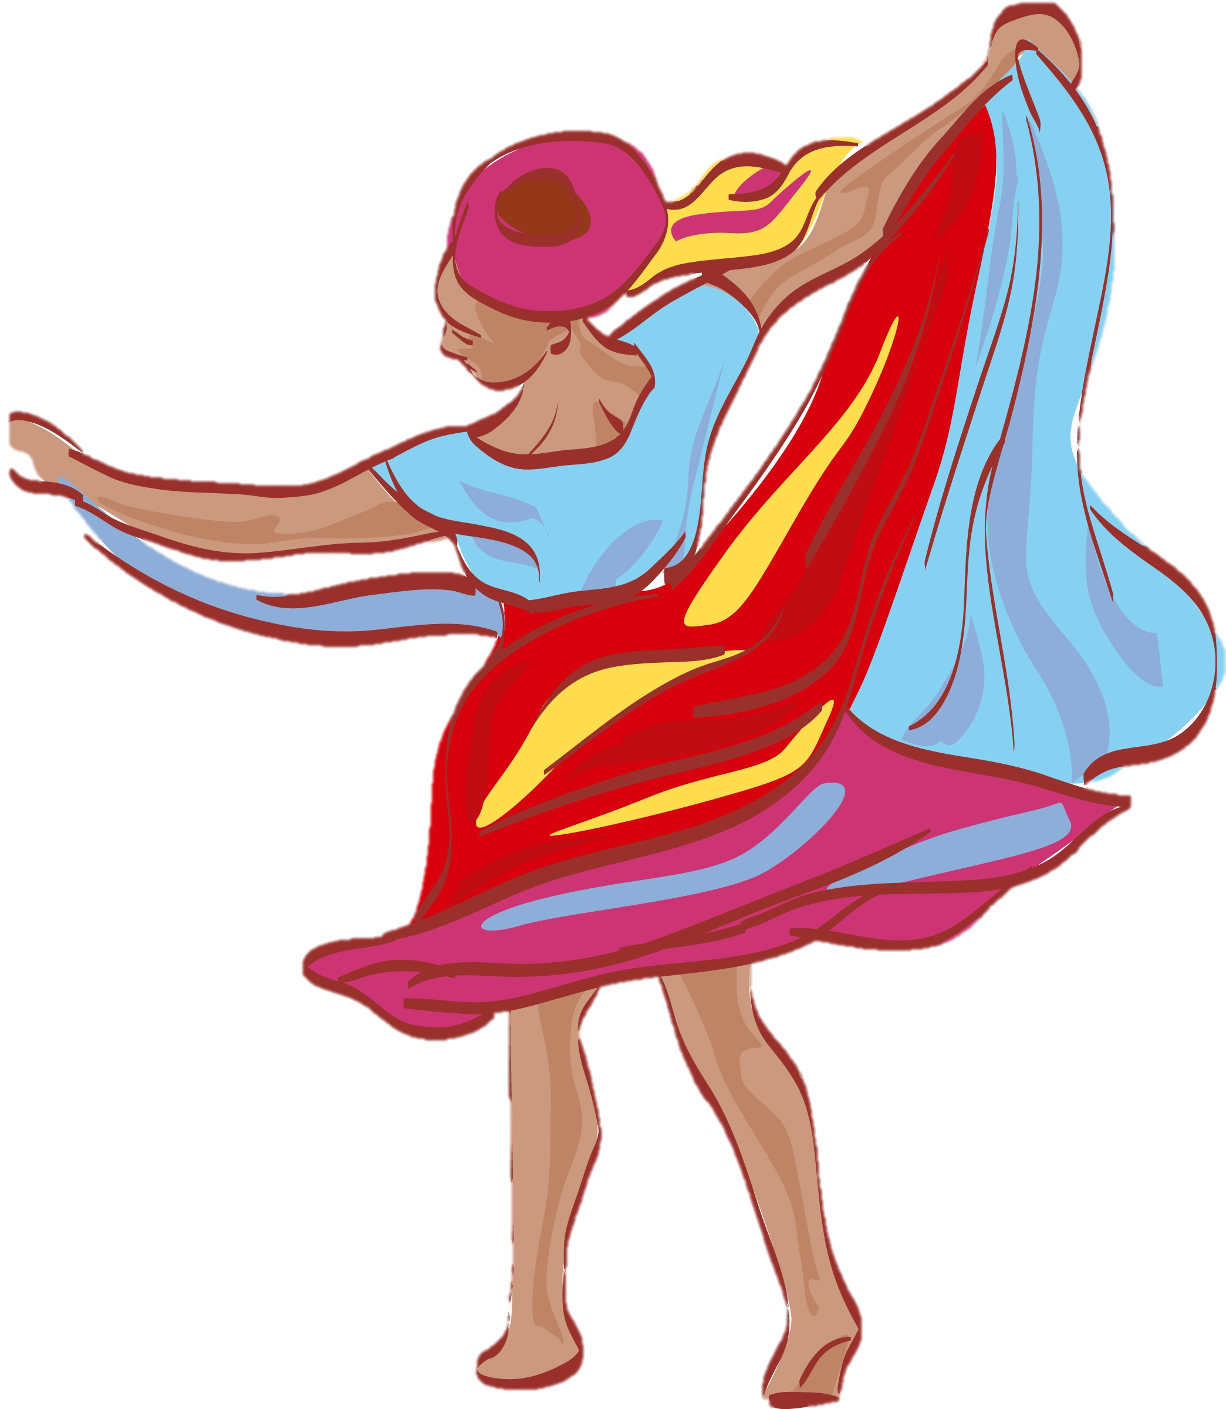
Great work!
Now we will review the “a_e” sound!

Slide 22
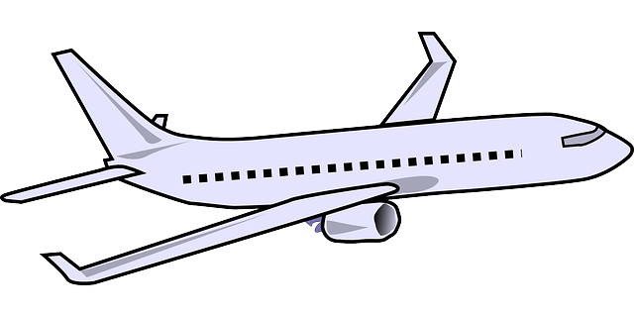
What vehicle would you have to take to get to Brazil?

Slide 23
Correct, a plane!
That is an a_e word!

Slide 24

How many a_e words can you pick out?
This morning, I lay awake in my bed. Today was the date! I was going to travel to Brazil! I packed my suitcase to take on the plane. I hope we go to the rainforest, I want to see a snake!

Slide 25
Here they are!
This morning, I lay awake in my bed. Today was the date! I was going to travel to Brazil! I packed my suitcase to take on the plane. I hope we go to the rainforest, I want to see a snake!

Slide 26


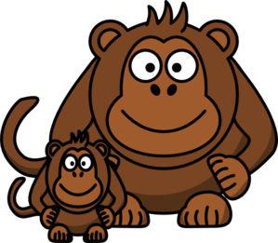
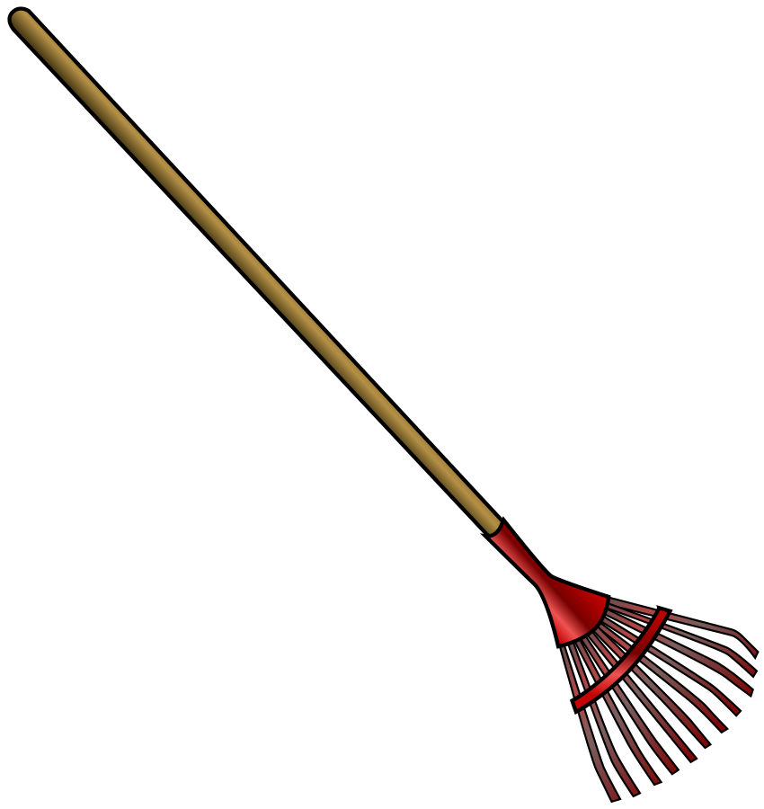
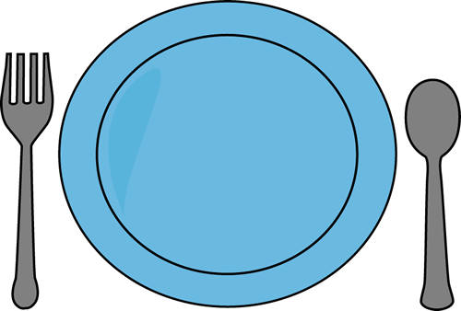
What do you notice about a_e words? How do they sound?

Slide 27
They all make a long a sound!
Say each word out loud.

Slide 28
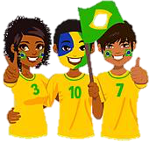
List as many a_e words as you can in 1:00.

Slide 29
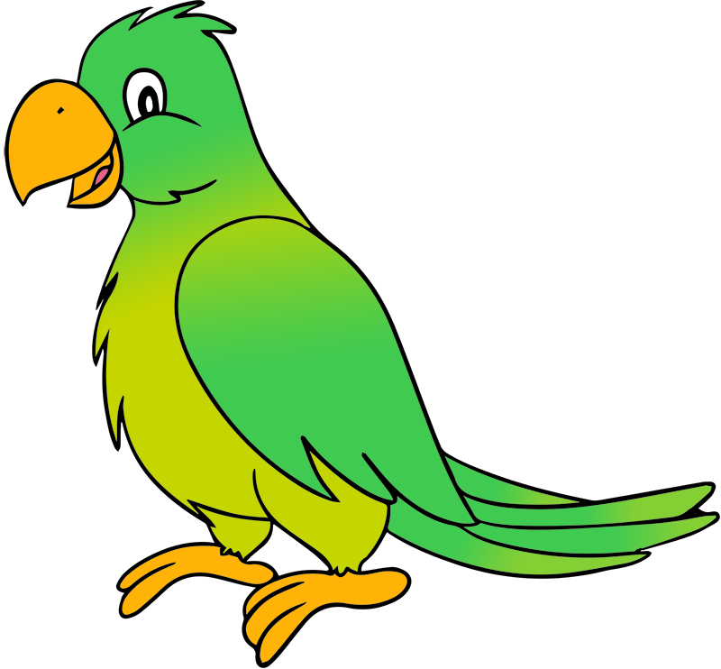
Very good job! What did we learn today?
A look into Brazil
Practicing Predictions
A review of “a_e” words

Slide 30
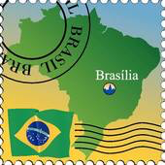
Let’s look at the homework now.
Do you have any questions?

Slide 31
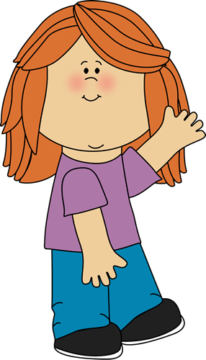
Thank you for a great class today.
As they say in Portuguese, Adeus!

