Slide 1
Around the World
Unit 8 Lesson 7

Slide 2
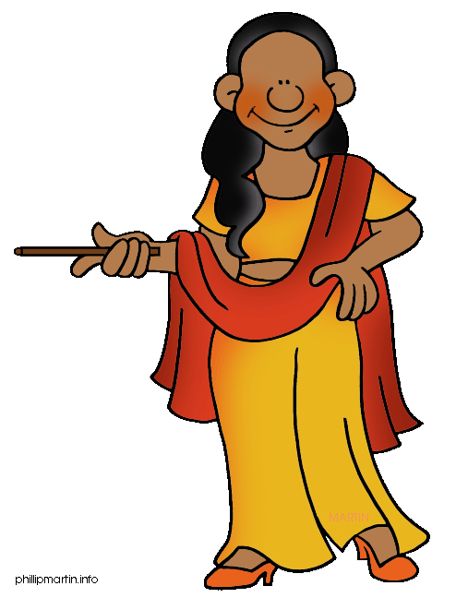
What will we be learning this class?
A look into a new country
A review of the “e_e” sound

Slide 3
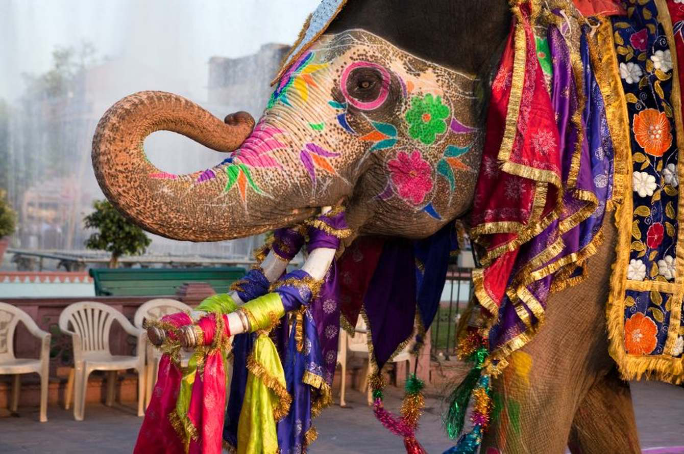
Today we will be learning about another country.
This country has beautiful animals…

Slide 4
It has temples…
And beaches!

Slide 5
And a very high population! What is a population?

Slide 6
What country do you think it could be?

Slide 7
What do you know about India? Write it below

Slide 8
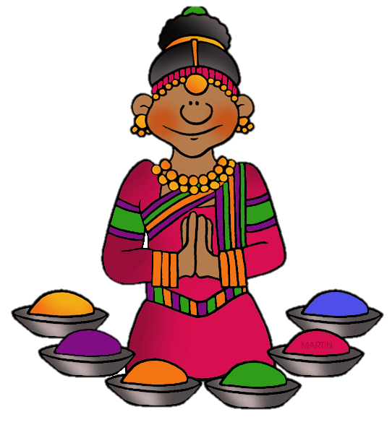
Let’s make some predictions…
What do you think most people from India do for work?

Slide 9
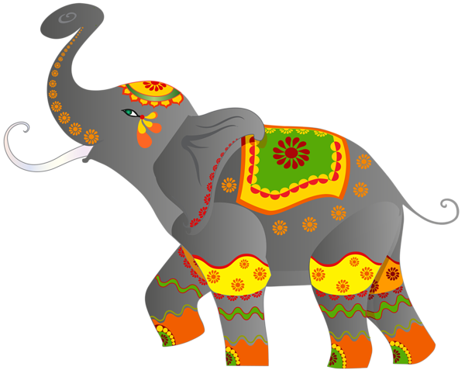
What animals do you think live in India?

Slide 10
Let’s find out!
We will now read a book about India!

Slide 11
What did you like about India?

Slide 12
Review
Now that you have read the book…
What do people from India mostly do for work? What animals live in India?

Slide 13
Great work!
Now we will review the “e_e” sound!

Slide 14
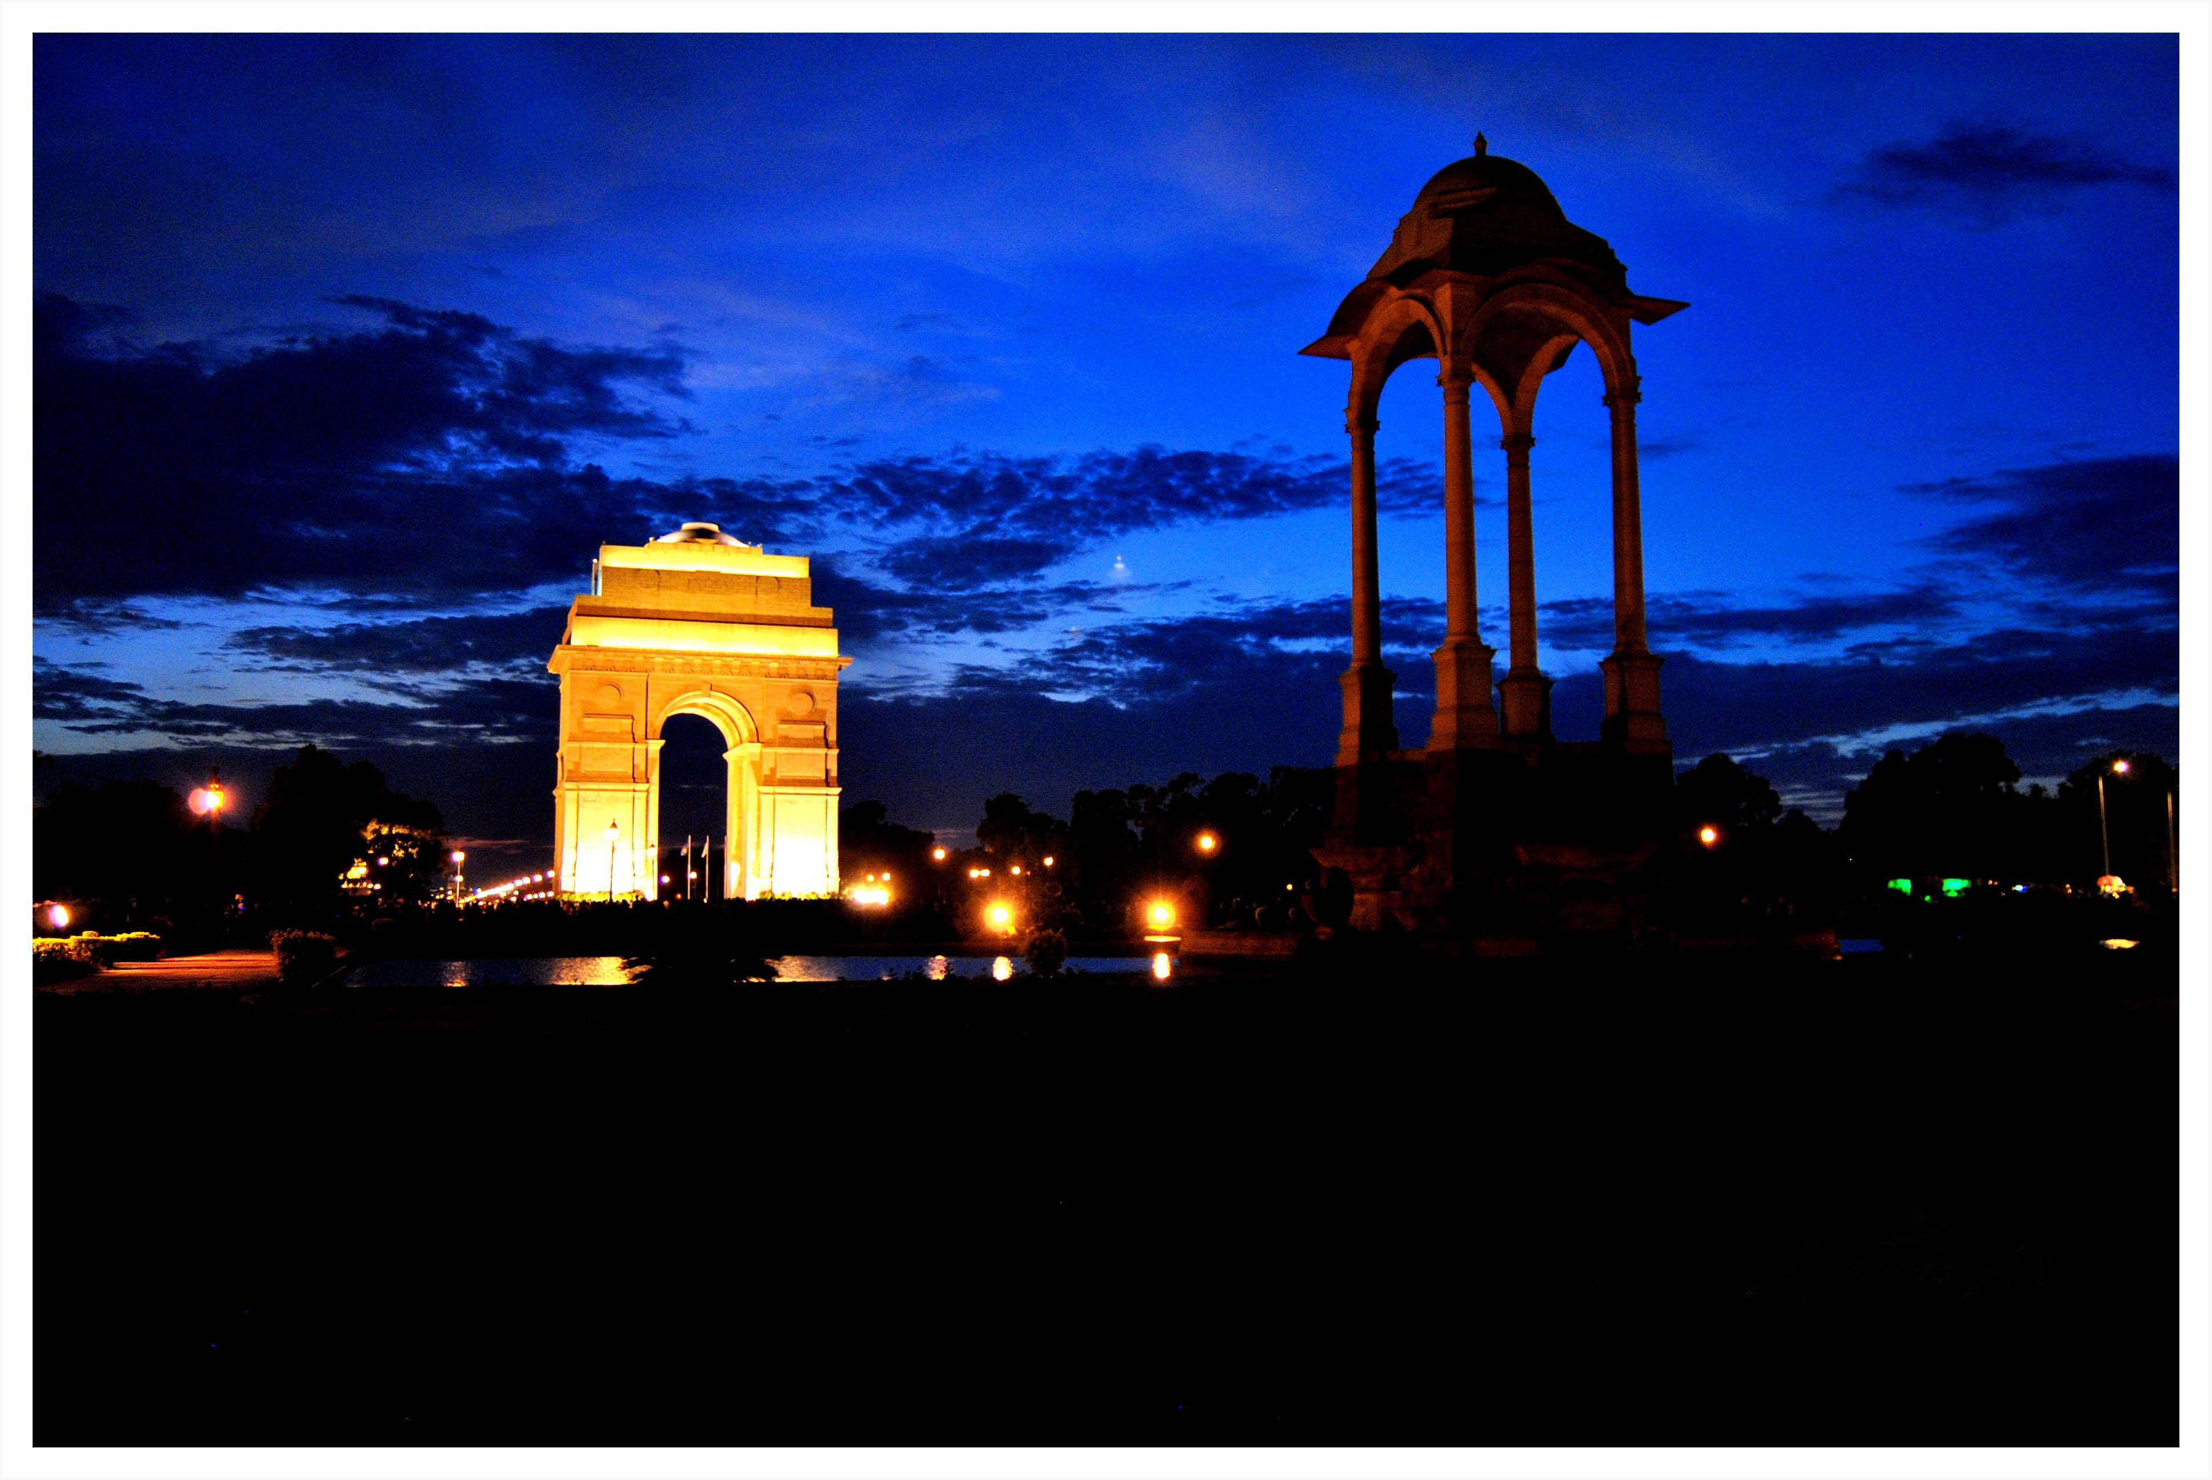
What time of day is it in this photo of India?

Slide 15
Here are some more e_e words. Can you read them?
Extreme
Theme
Complete
Scene
These
Freeze

Slide 16
Great, try to use a word in a sentence!
Extreme
Theme
Complete
Scene
These
Freeze

Slide 17
Can you name these e_e words? How do they sound?

Slide 18
Use one of these words in a sentence.

Slide 19
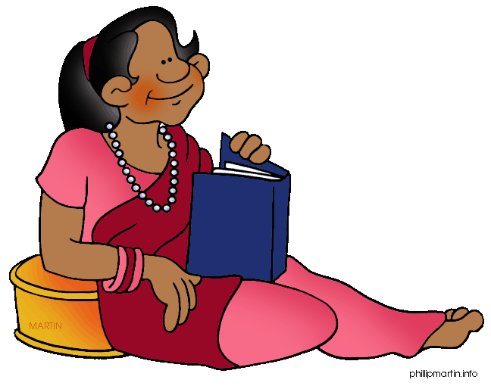
List as many e_e words as you can in 1:00.

Slide 20
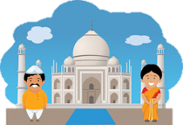
Very good job! What did we learn today?
A look into India
Practicing Predictions
A review of “e_e” words

Slide 21
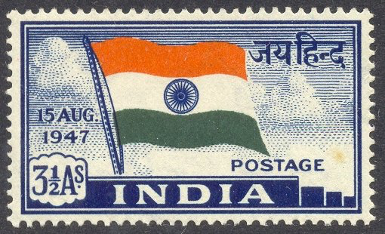
Let’s look at the homework now.
Do you have any questions?

