Slide 1
Around the World
Unit 8 Lesson 7

Slide 2
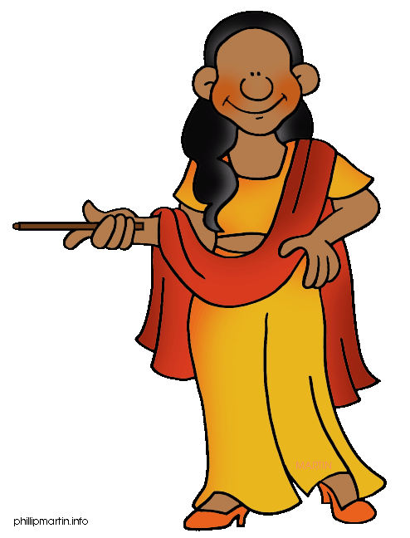
What will we be learning this class?
A look into a new country
A review of the “e_e” sound

Slide 3
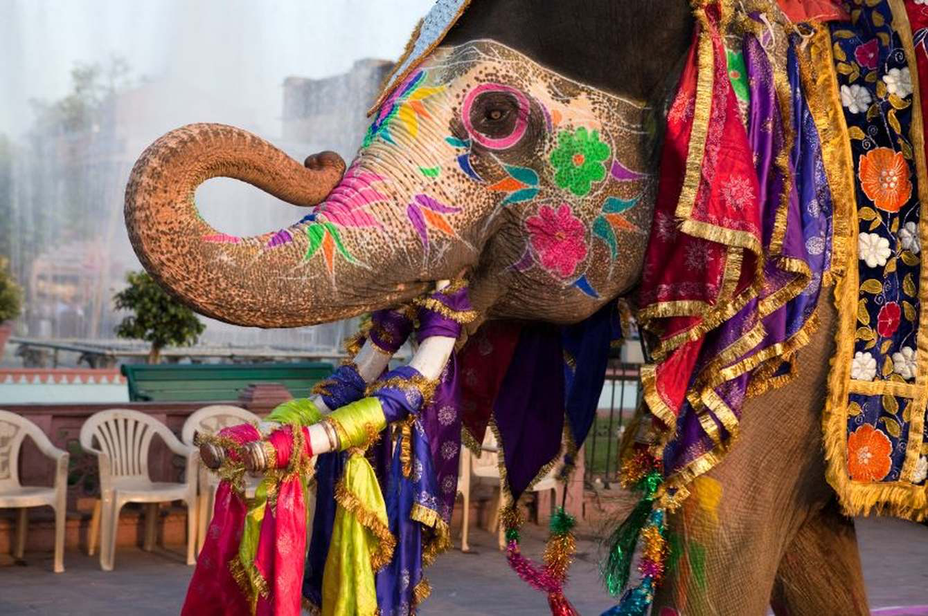
Today we will be learning about another country.
This country has beautiful animals…

Slide 4
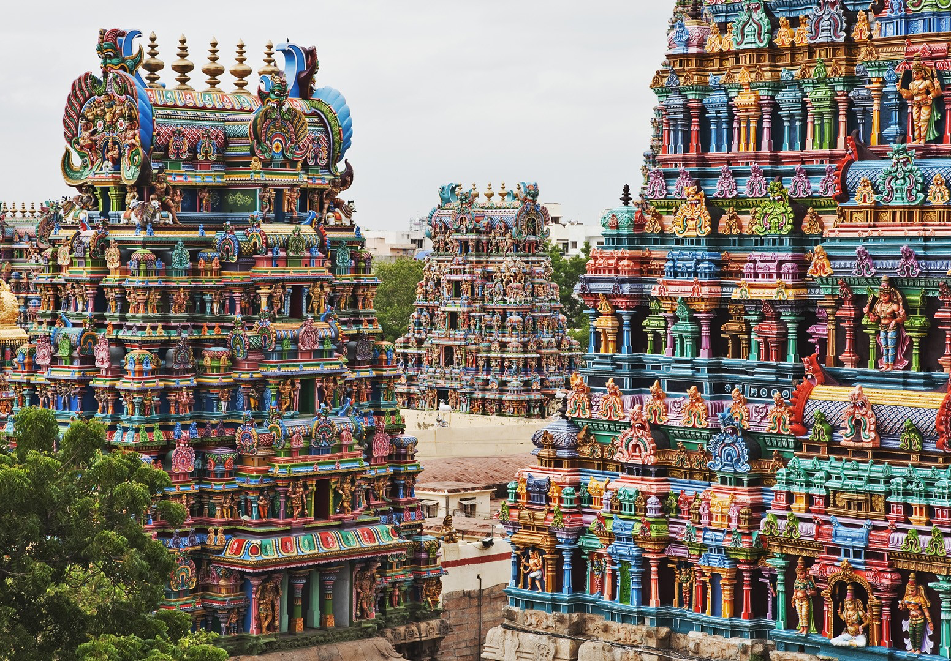
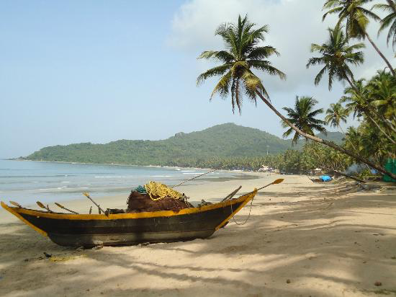
It has temples…
And beaches!

Slide 5
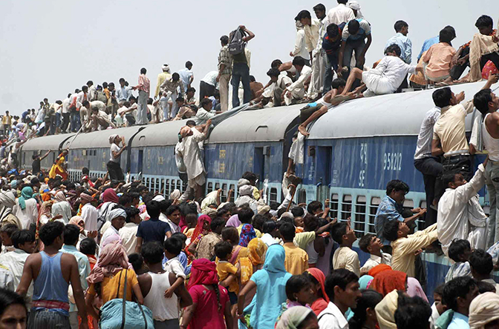
And a very high population!
What is a population?

Slide 6
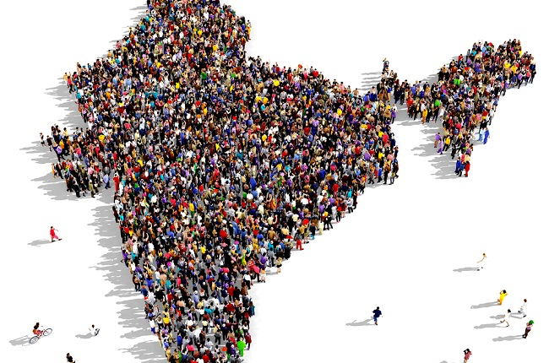
What country do you think it could be?

Slide 7
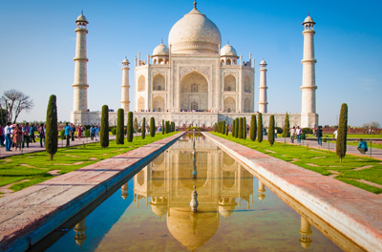
It is India! We will be learning about this country today.

Slide 8
What do you know about India? Write it below

Slide 9
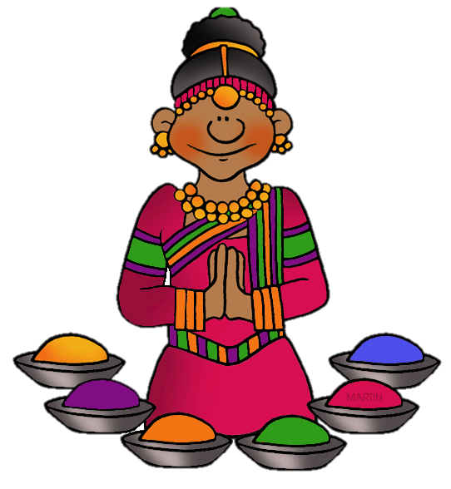
Let’s make some predictions…
What do you think most people from India do for work?

Slide 10
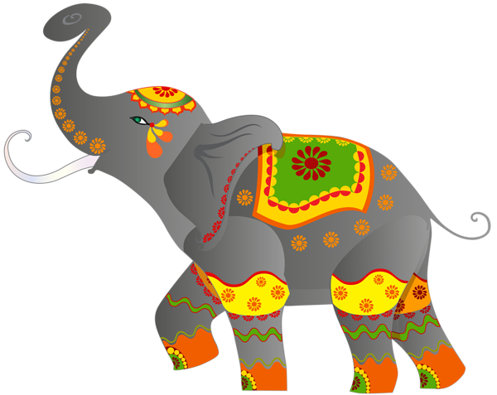
What animals do you think live in India?

Slide 11
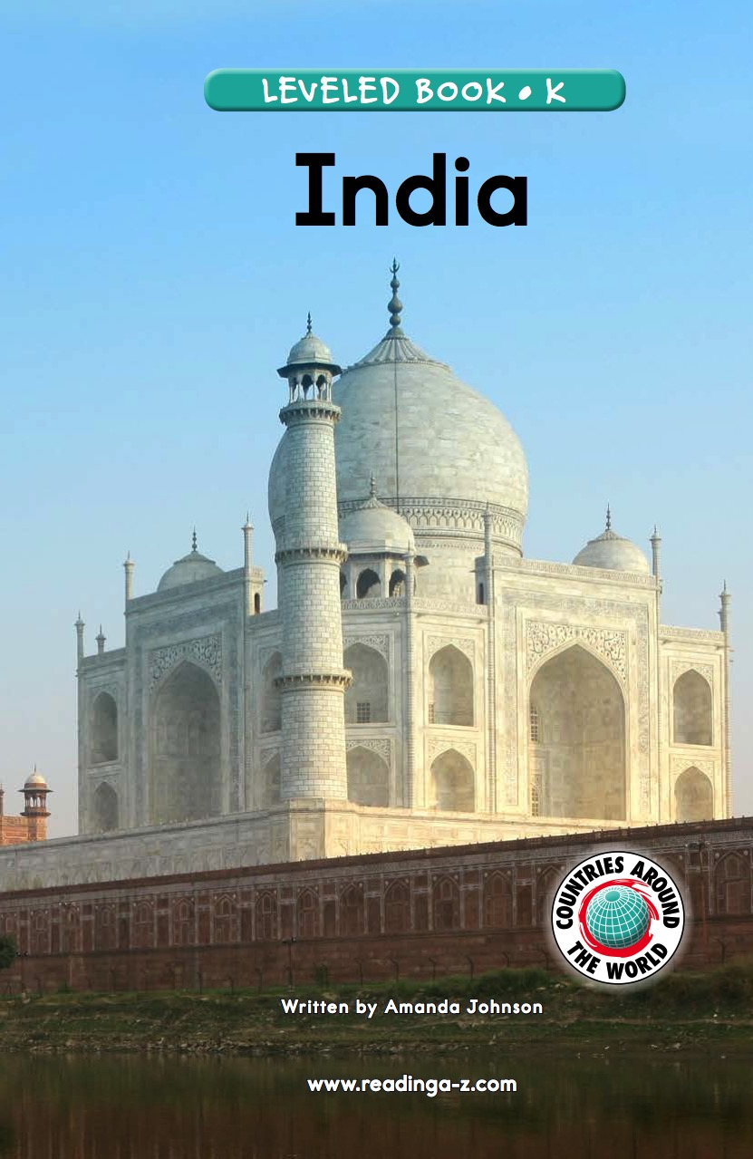
Let’s find out!
We will now read a book about India!

Slide 12
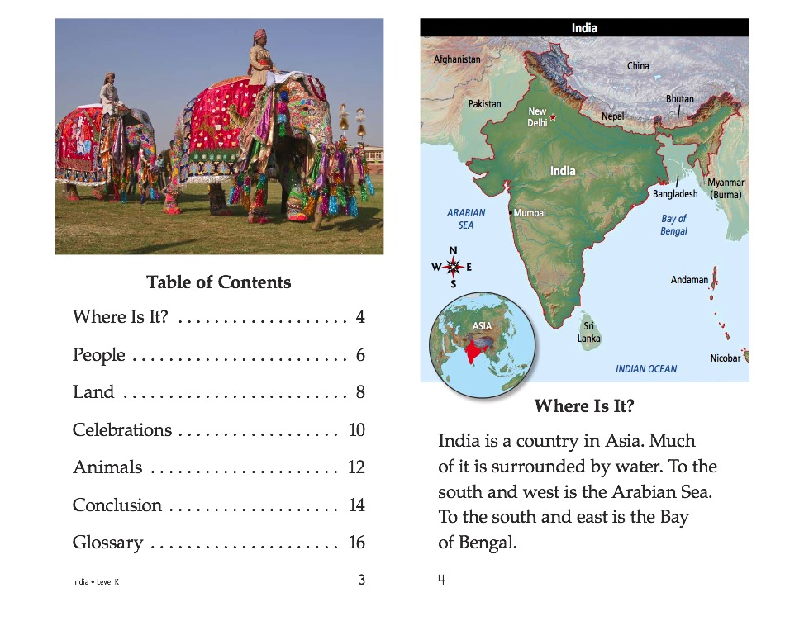

Slide 14
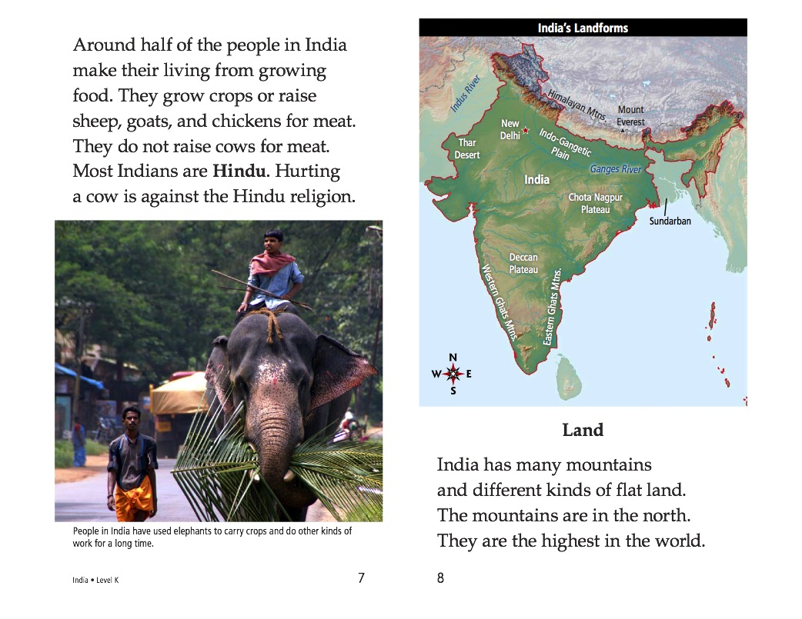

Slide 18
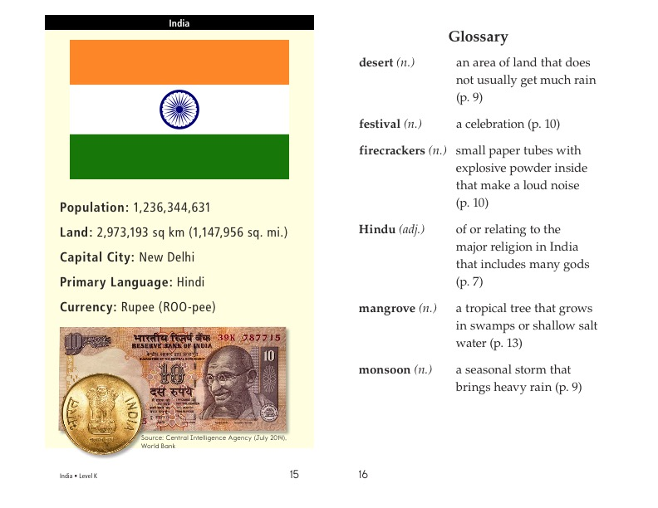

Slide 19
What did you like about India?

Slide 20
Review
Now that you have read the book…
What do people from India mostly do for work?
What animals live in India?

Slide 21

Great work!
Now we will review the “e_e” sound!

Slide 22
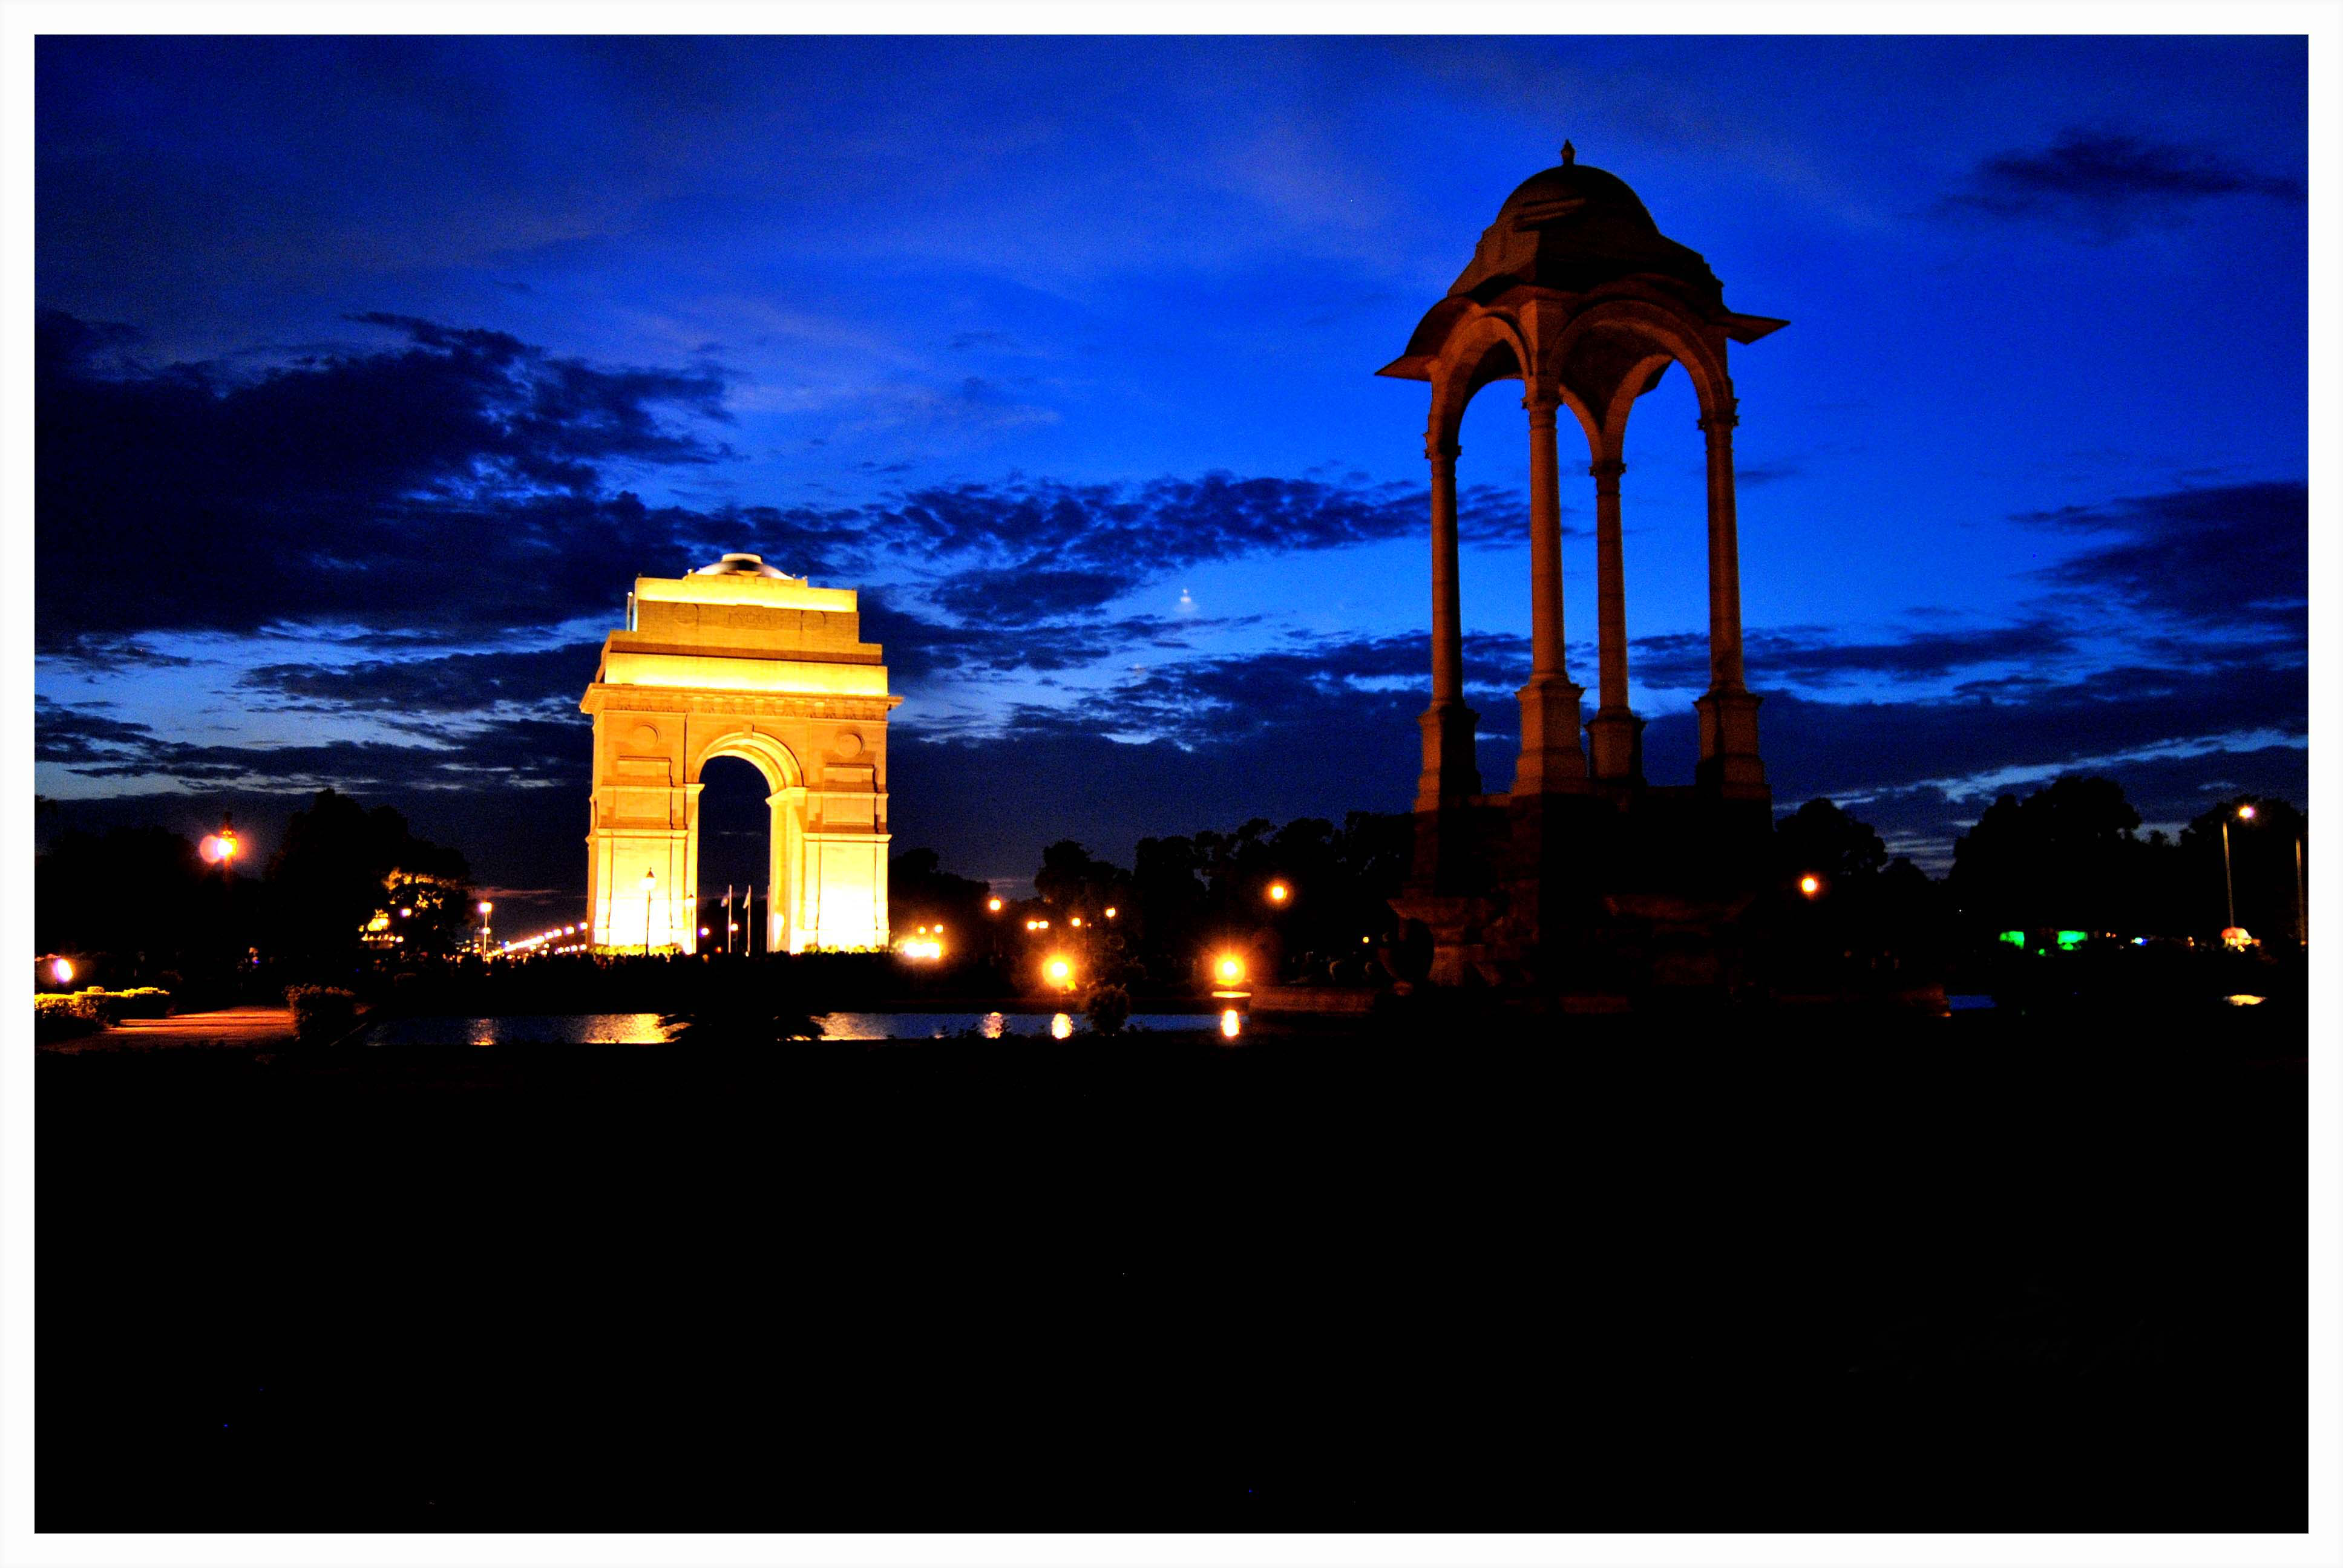
What time of day is it in this photo of India?

Slide 23

Correct, it is nighttime!
Another word for nighttime is evening. That is an e_e word!

Slide 24
Here are some more e_e words. Can you read them?
Extreme
Theme
Complete
Scene
These
Freeze

Slide 25
Great, try to use a word in a sentence!
Extreme
Theme
Complete
Scene
These
Freeze

Slide 26
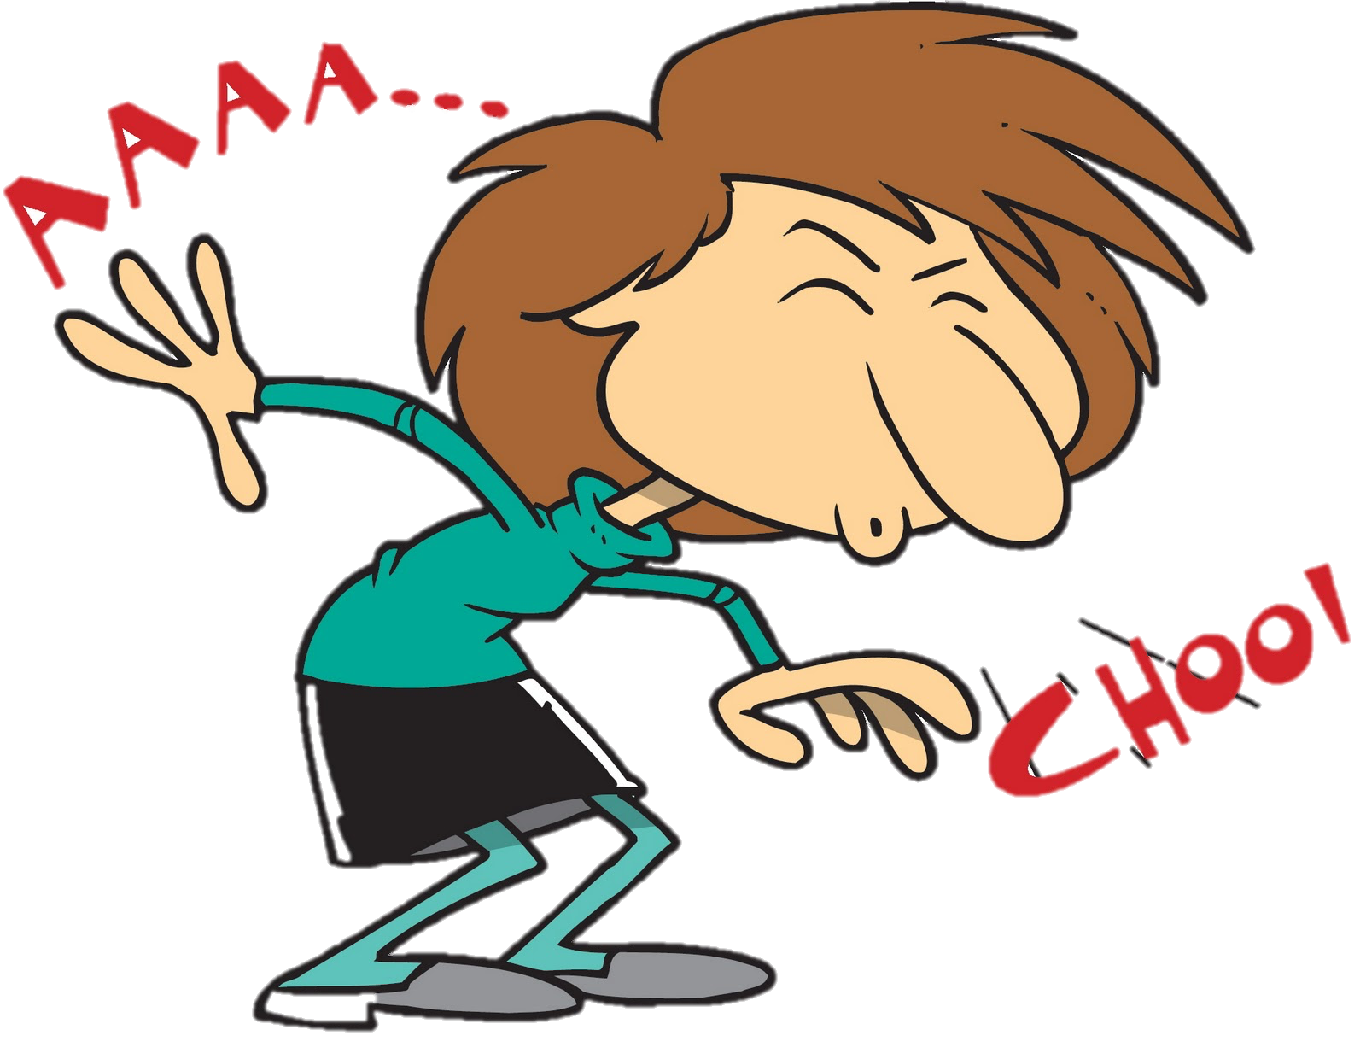



Can you name these e_e words? How do they sound?

Slide 27
Use one of these words in a sentence.

Slide 28
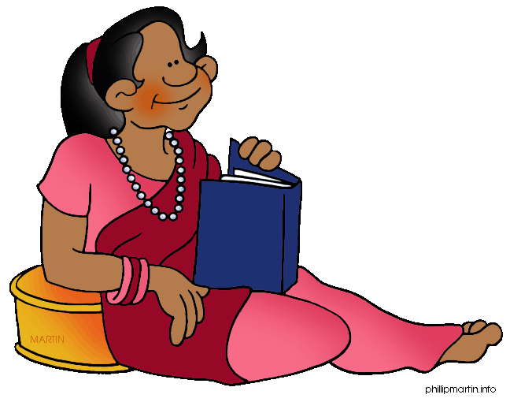
List as many e_e words as you can in 1:00.

Slide 29
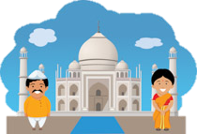
Very good job! What did we learn today?
A look into India
Practicing Predictions
A review of “e_e” words

Slide 30
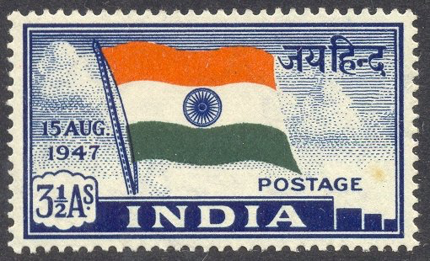
Let’s look at the homework now.
Do you have any questions?

