Slide 1



Around the World
Unit 8 Lesson 8

Slide 2


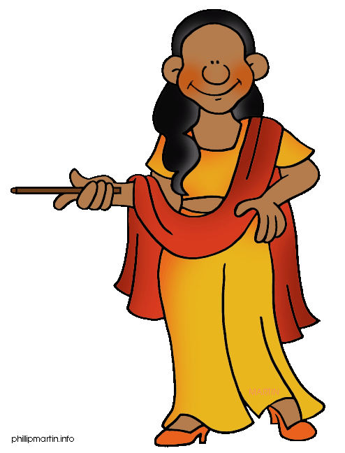
What will we be learning this class?
Comparing countries as a review
A review of the “i_e” “a_e” and “e_e” sounds

Slide 3
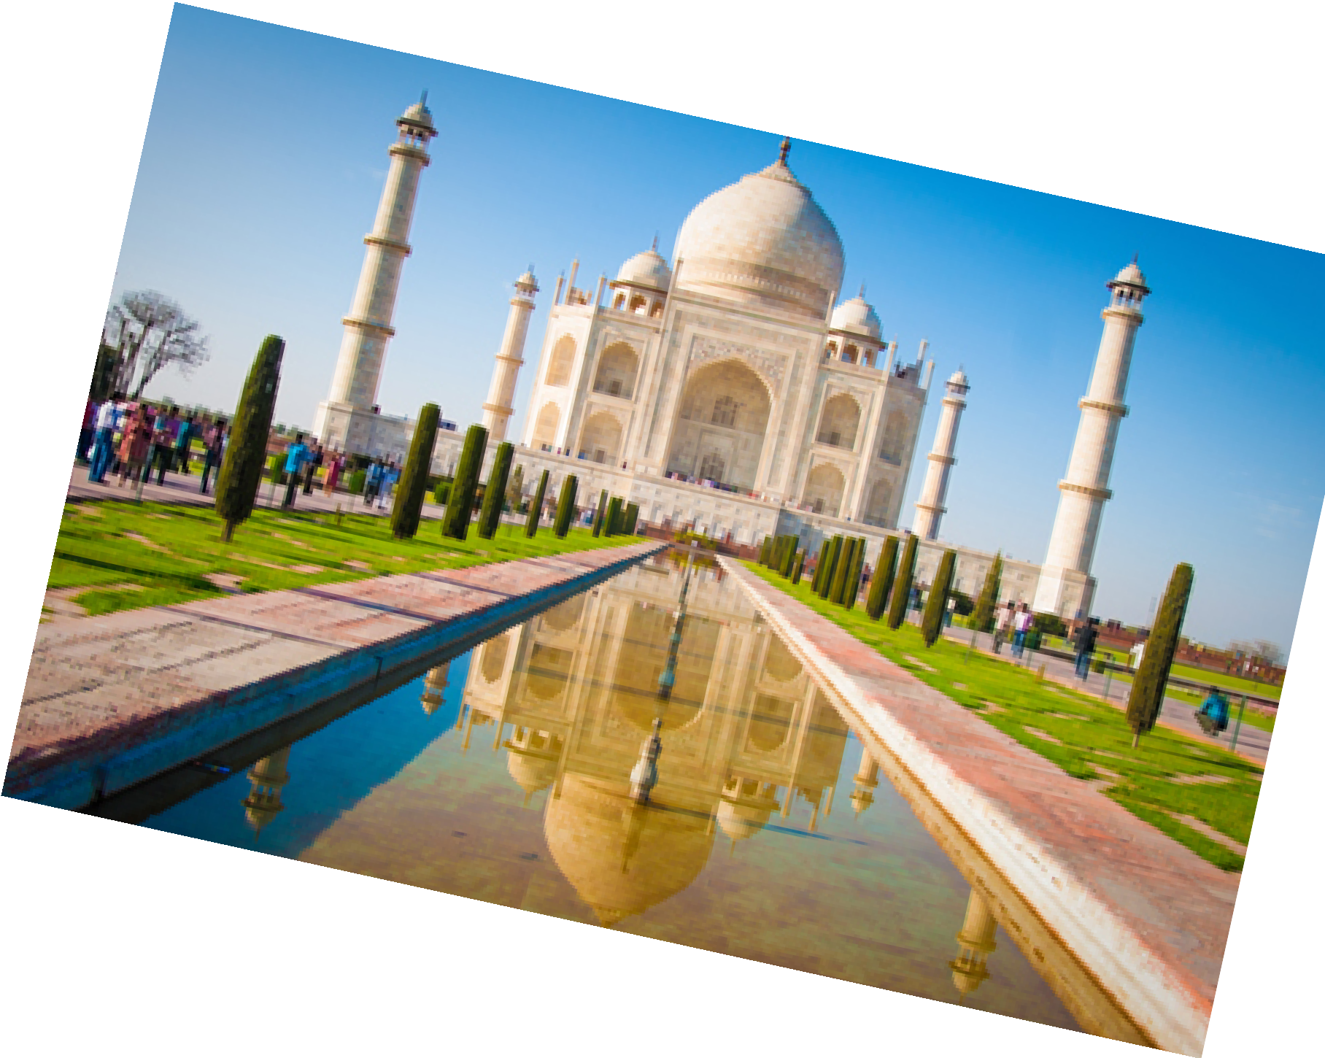
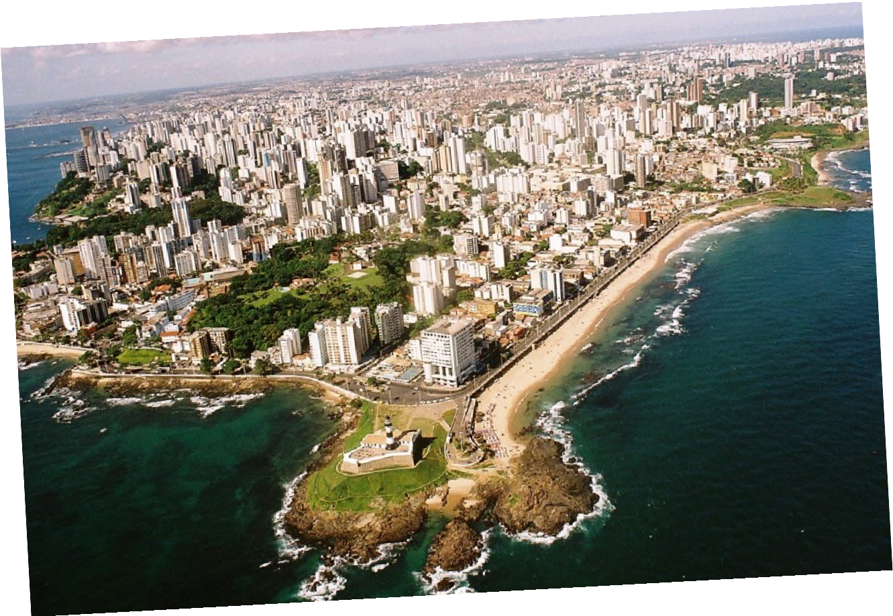
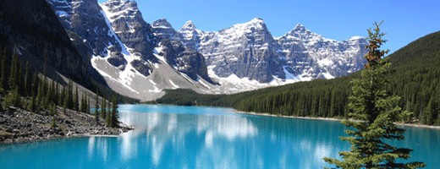
Do you remember? What countries have we learned about?

Slide 4
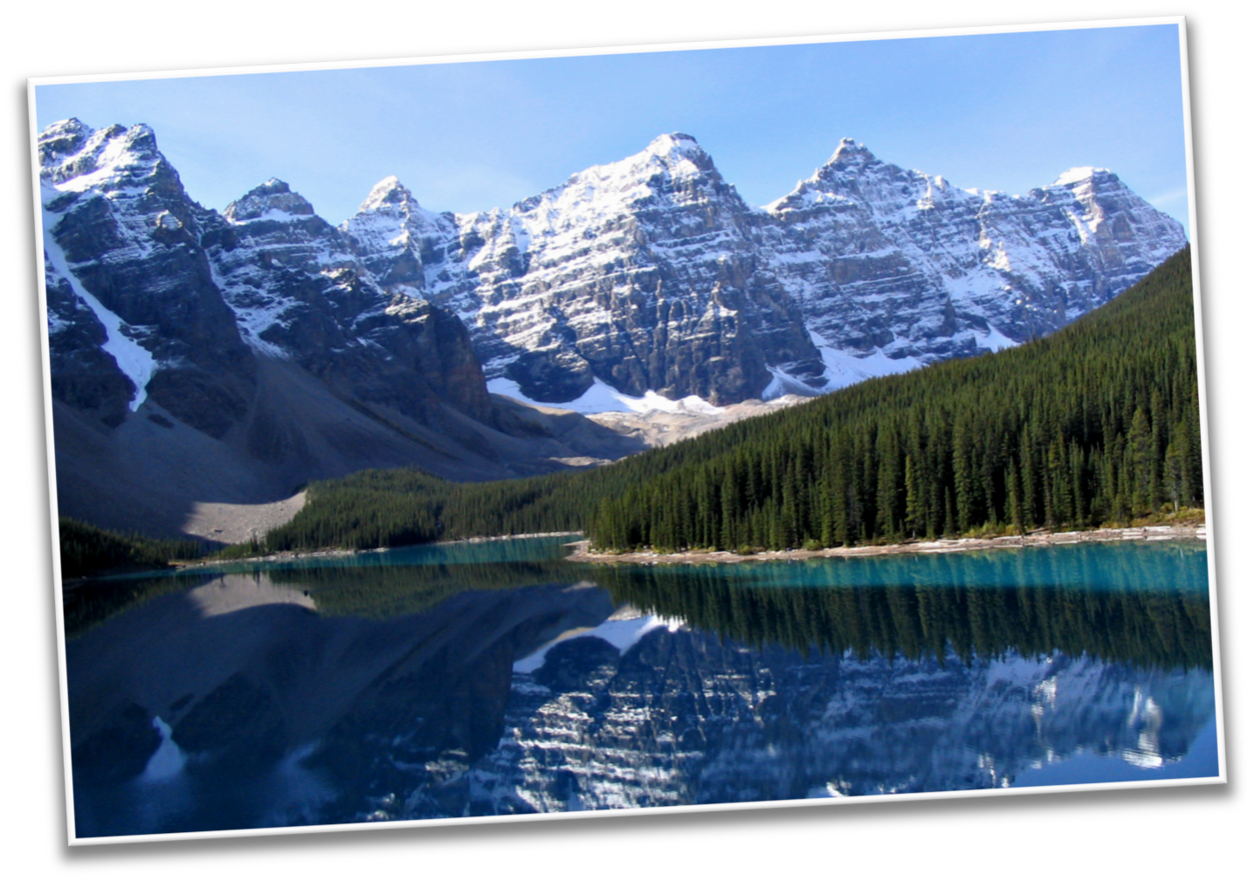
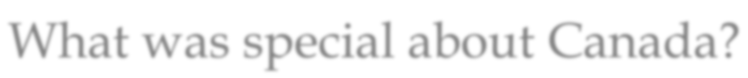
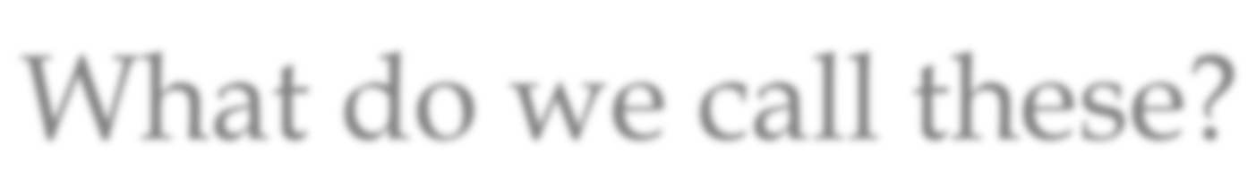
What was special about Canada?
What do we call these?

Slide 5
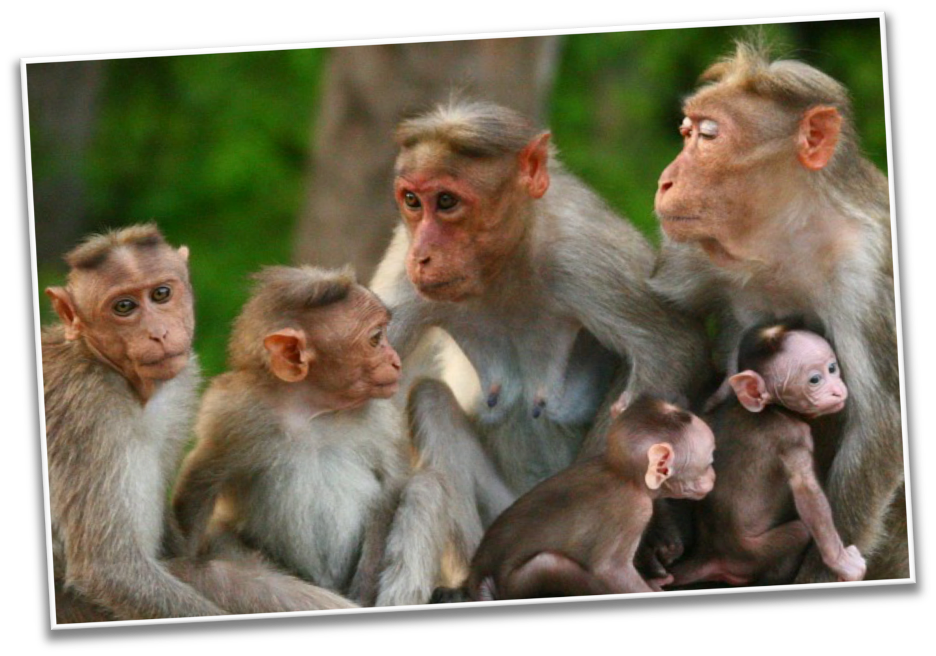

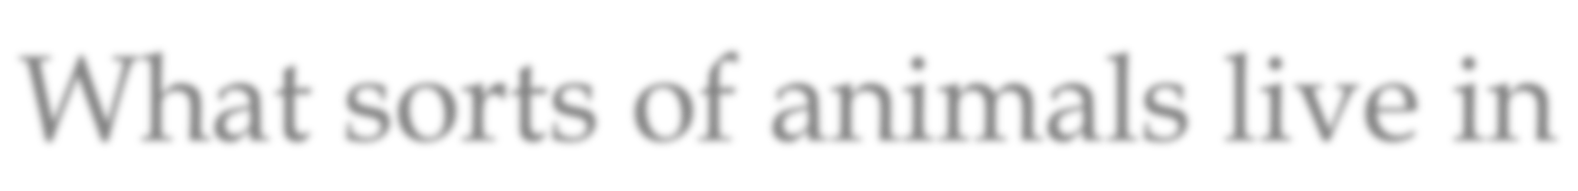

Do you remember?
What sorts of animals live in India?

Slide 6
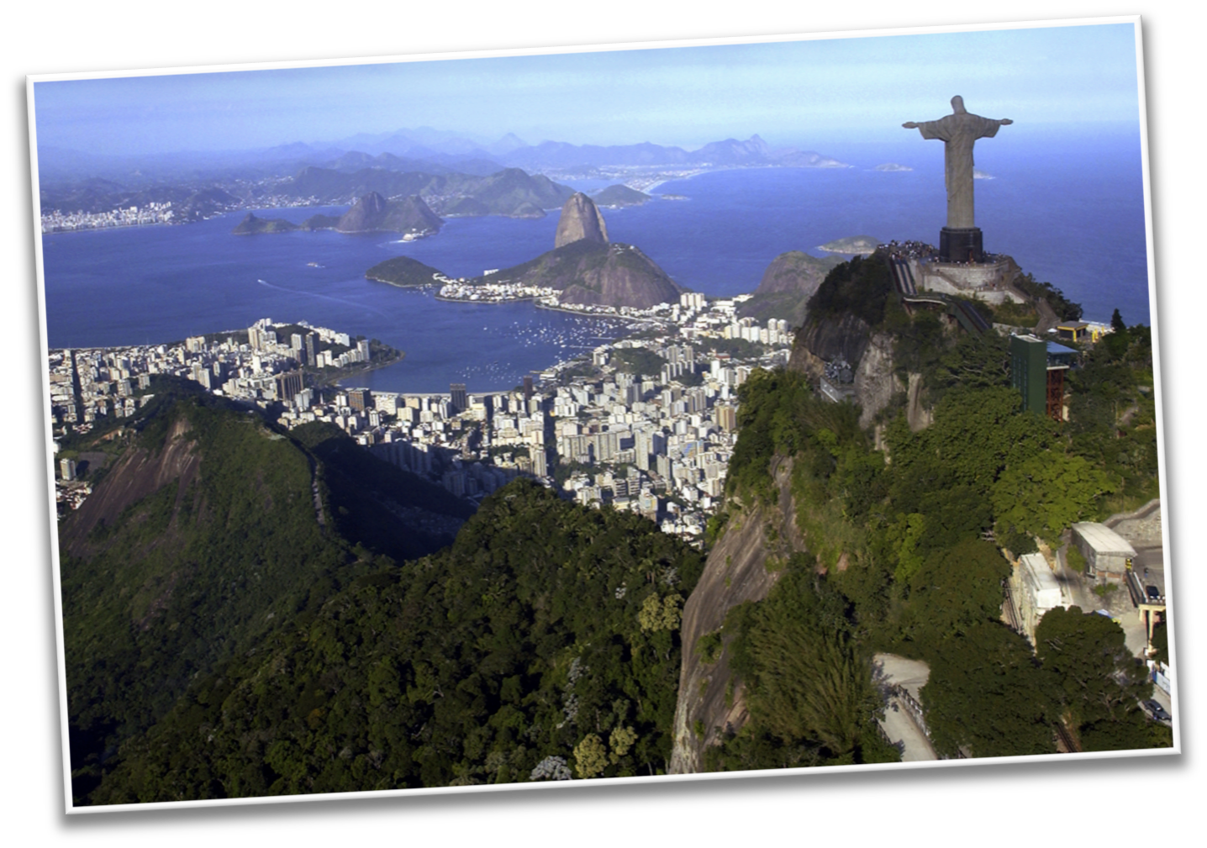

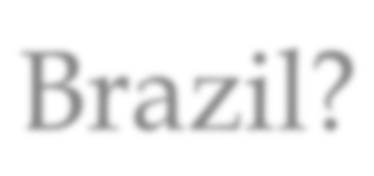

What did you like best about Brazil?

Slide 7




Do you remember how to compare?
To compare is to see what is the same about two people, places, or things.

Slide 8



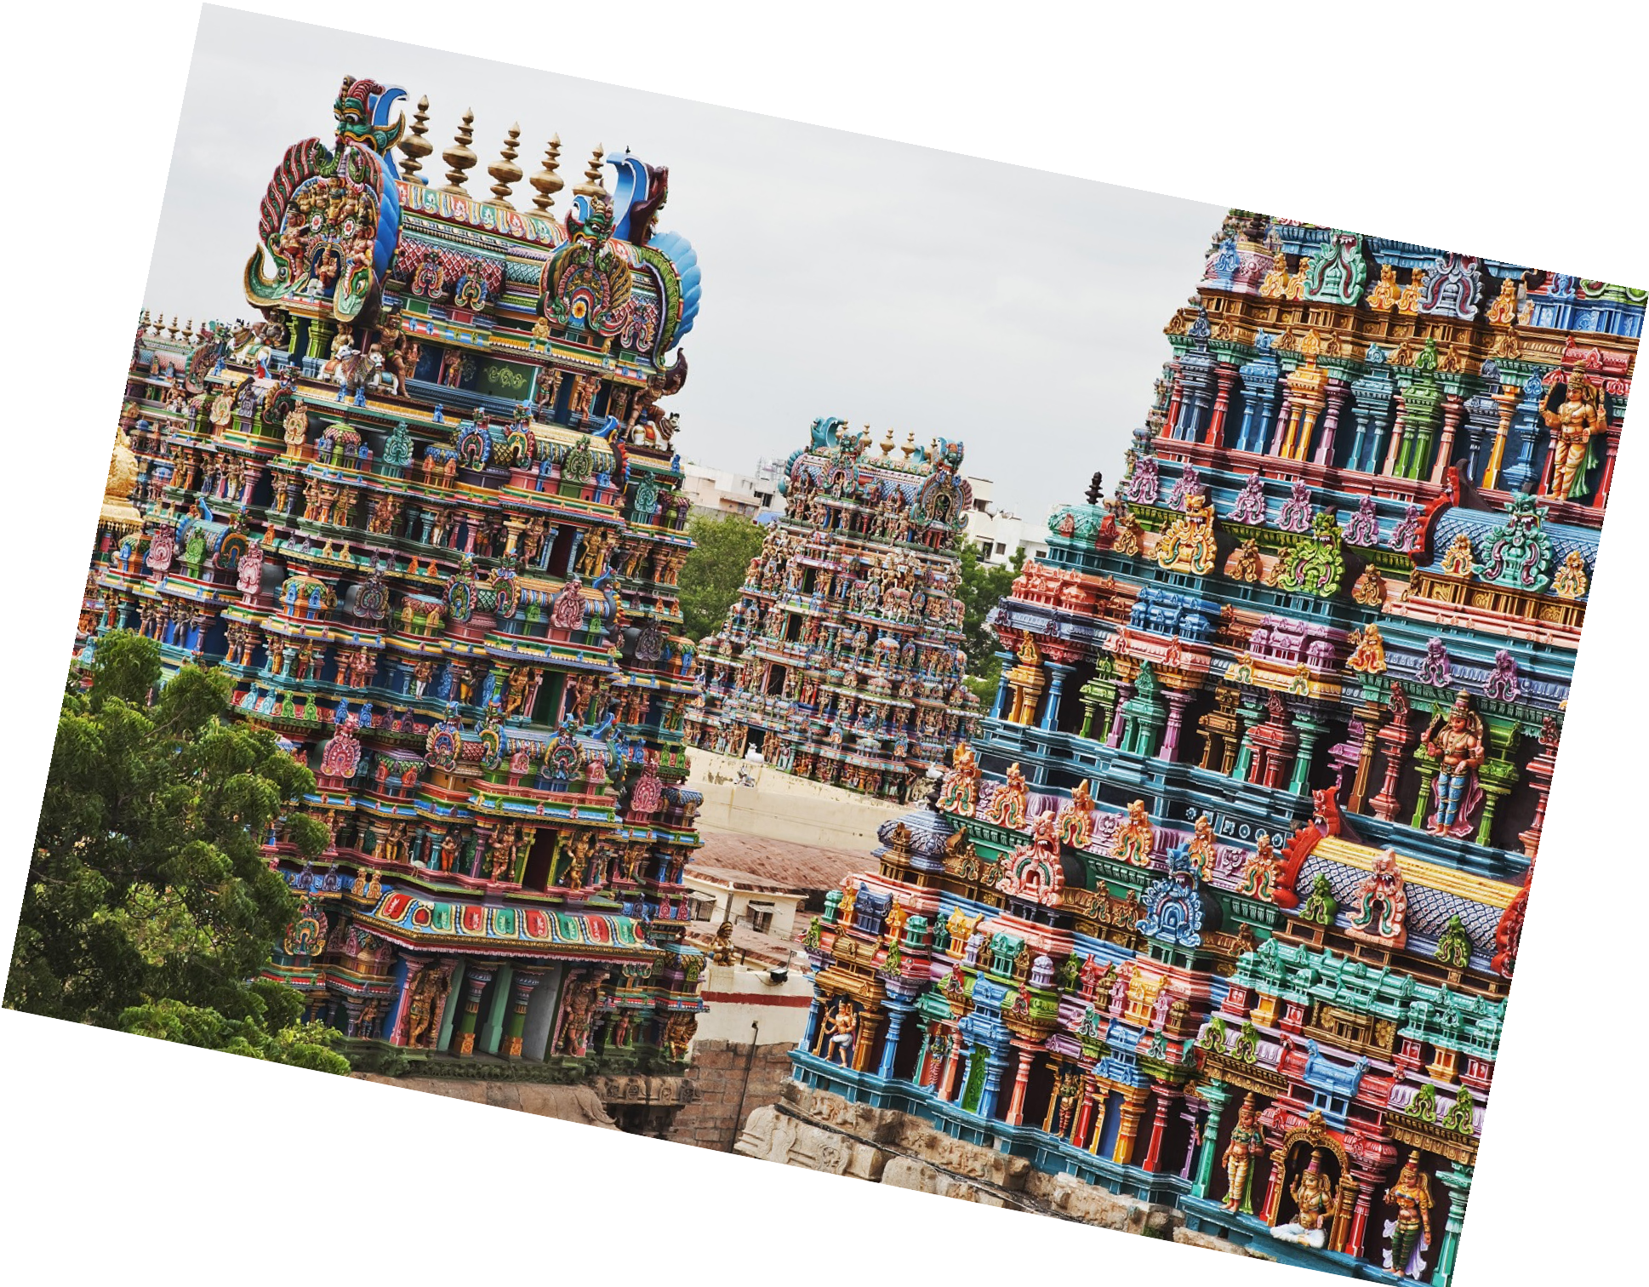
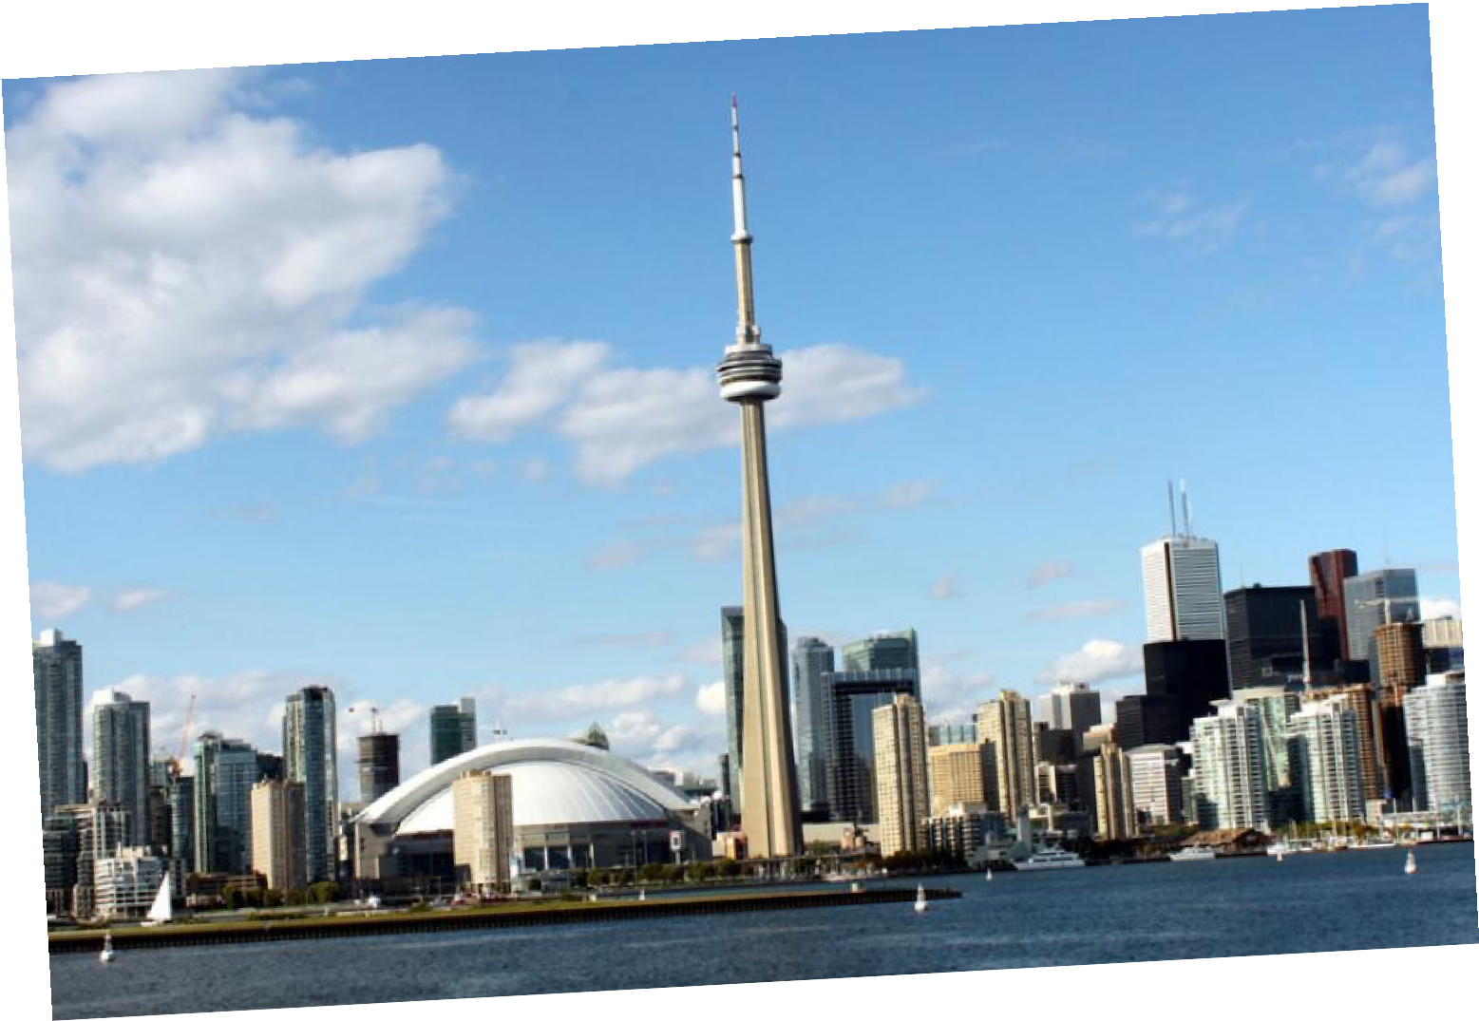
Can you compare the countries of Canada and India?
What is the same, or similar, between the two countries?

Slide 9



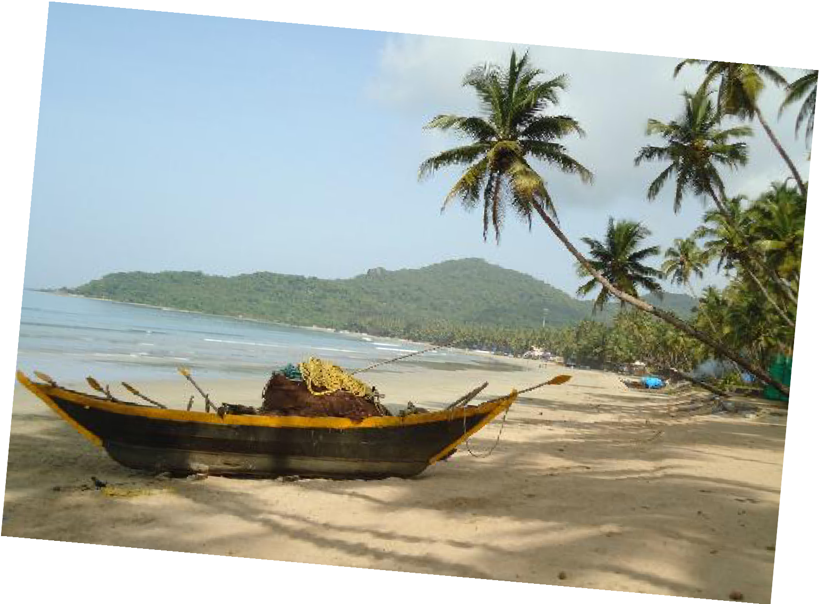
Great work! Let’s do it once more.
Compare the country of Brazil with India!

Slide 10


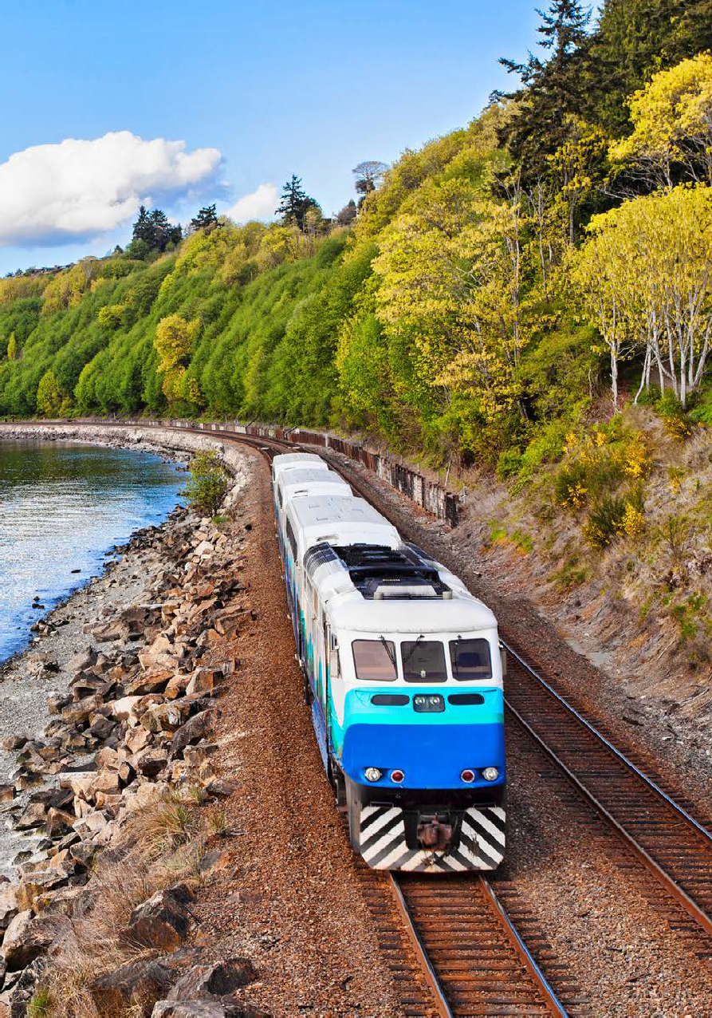





We are going to read a book about Taking the Train!
LEVELED BOOK • G
Taking the Train
Written by Marcie Aboff
www.readinga-z.com

Slide 11


Nice reading!
Have you taken the train before?
Where did you go?

Slide 12


Review
Now we will review our sounds from this unit.
“i_e”
“a_e”
“e_e”

Slide 13


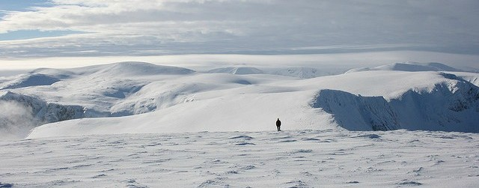
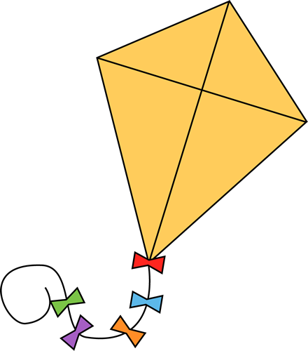
Fill in the blanks for the i_e words.
There is lots of cold __________ in Canada.
When it is windy, I like to fly a _________.

Slide 14


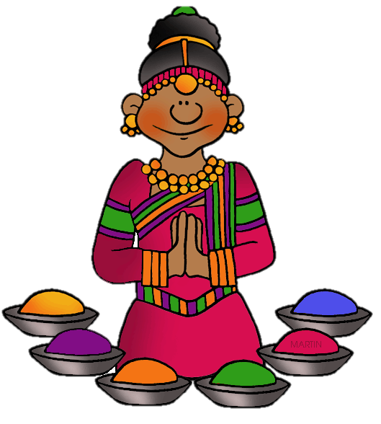
Write a sentence using a “i_e” word

Slide 15

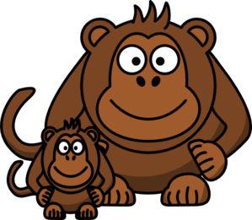


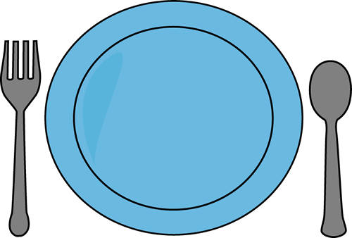
Fill in the blanks for the “a_e” words.
We saw a large_____________ in the Brazilian sea.
There was an _____ in the Indian rainforest.
I put the Canadian food on my___________.

Slide 16


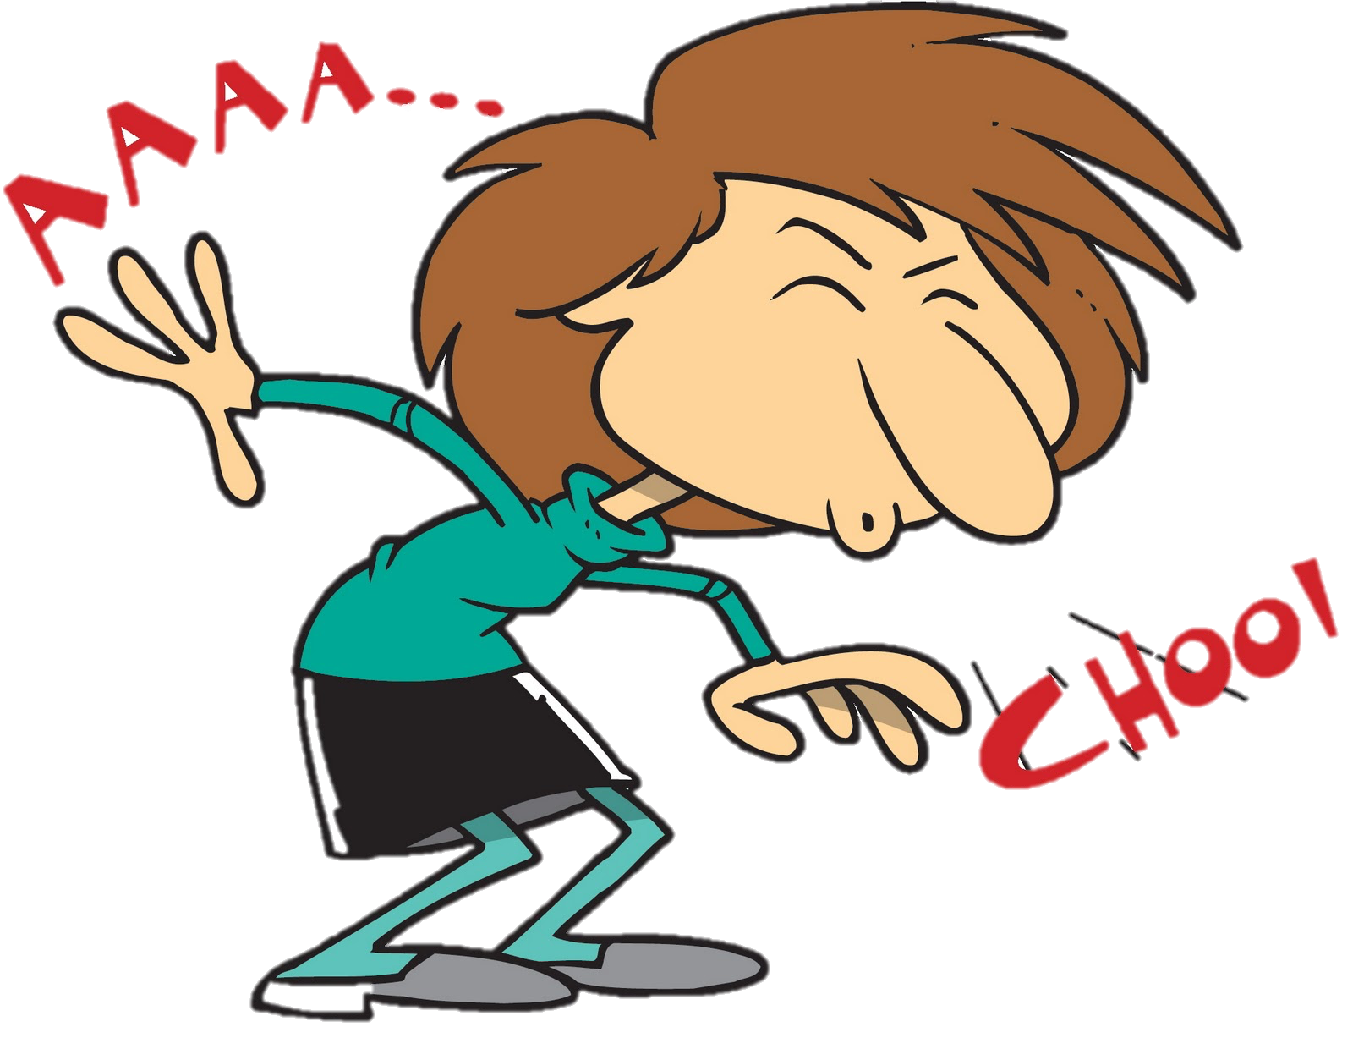

Fill in the blanks for the “e_e” words.
I ate lots of ___________ in Canada.
The Brazilian air made me __________. I got sand in my ______ from the beach.

