Slide 1
Around the World
Unit 8 Lesson 8

Slide 2
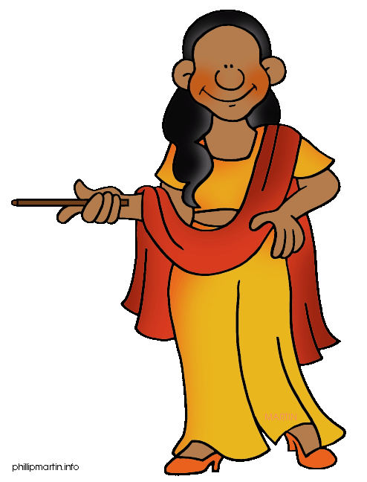
What will we be learning this class?
Comparing countries as a review
A review of the “i_e” “a_e” and “e_e” sounds

Slide 3
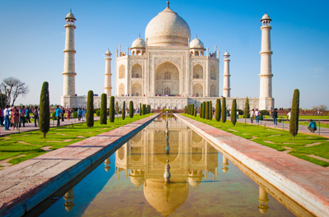
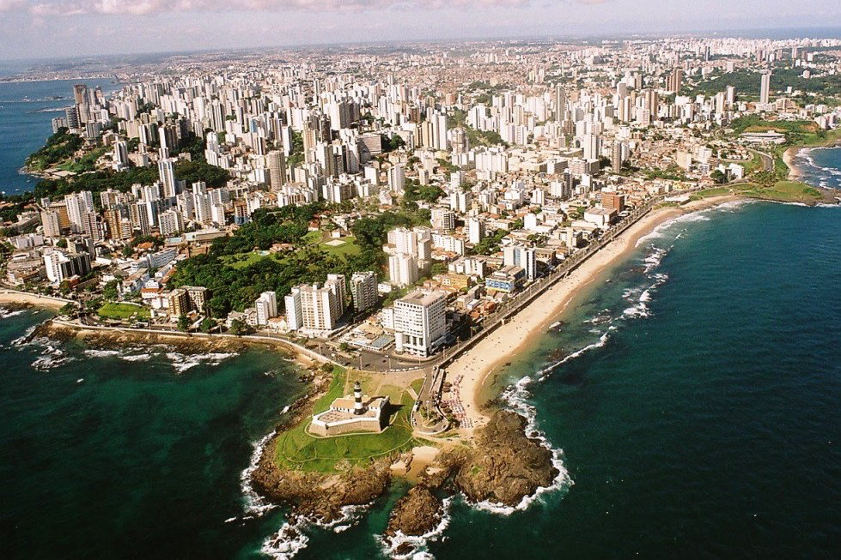
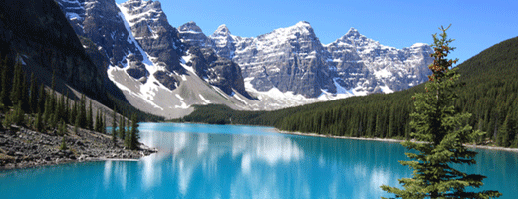
Do you remember? What countries have we learned about?

Slide 4
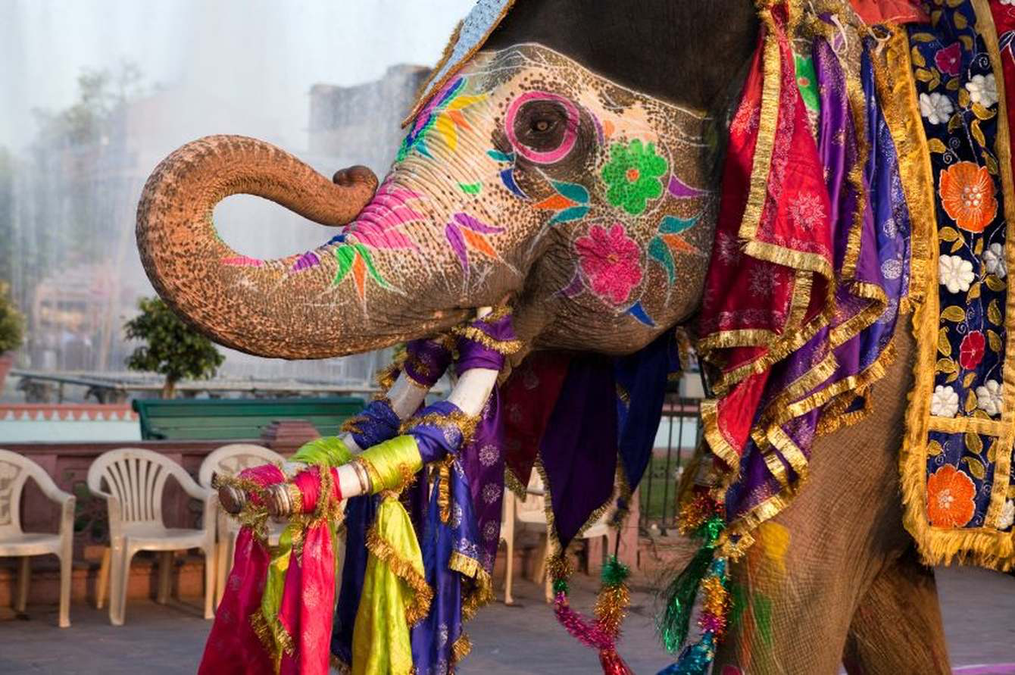
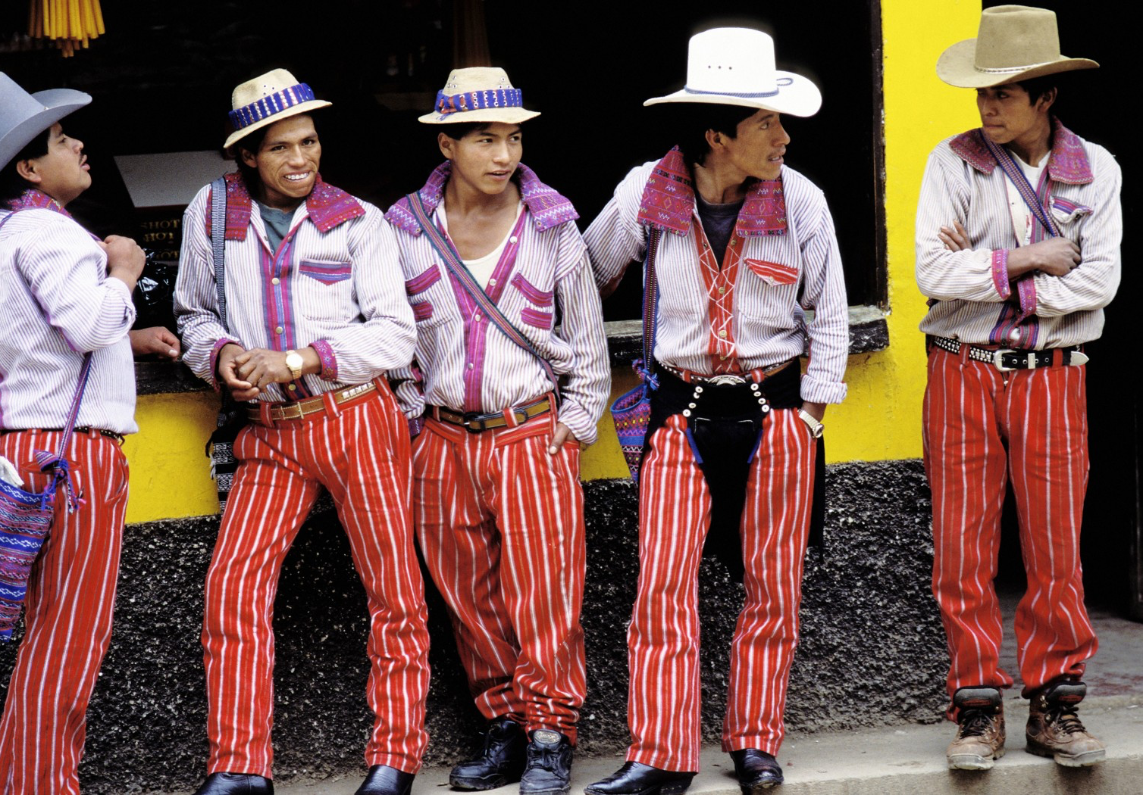
You are right!
Canada,
Brazil and India.
What country did you like the best? Why?

Slide 5
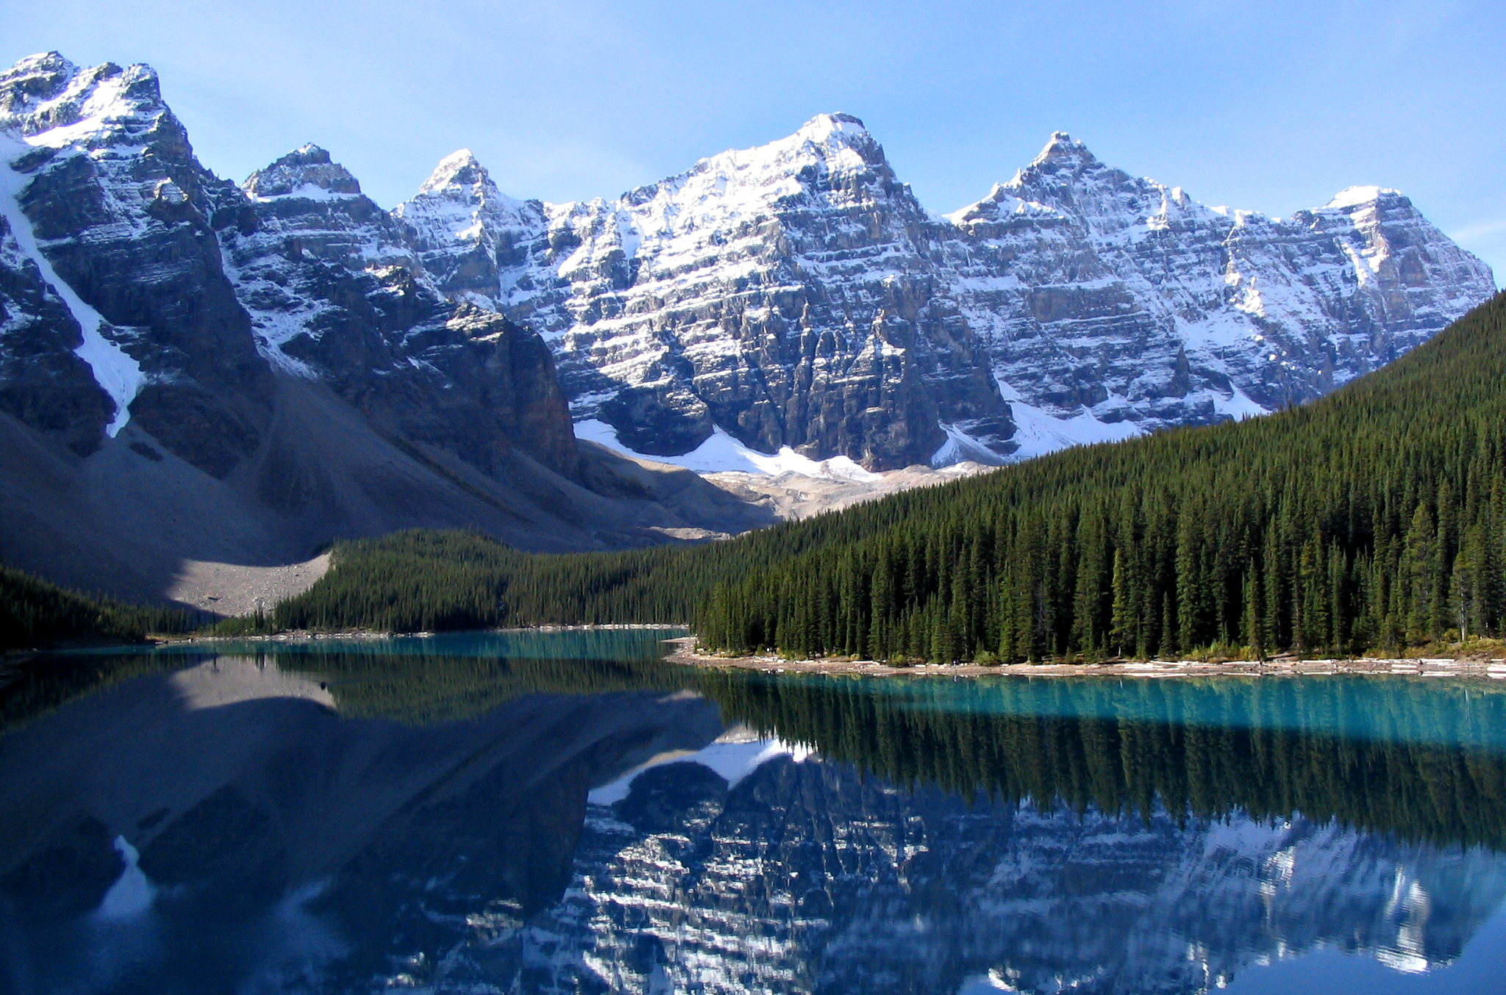
What was special about Canada? What do we call these?

Slide 6
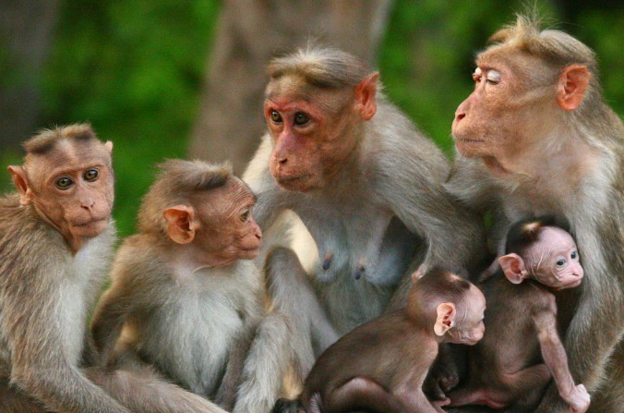
Do you remember?
What sorts of animals live in India?

Slide 7
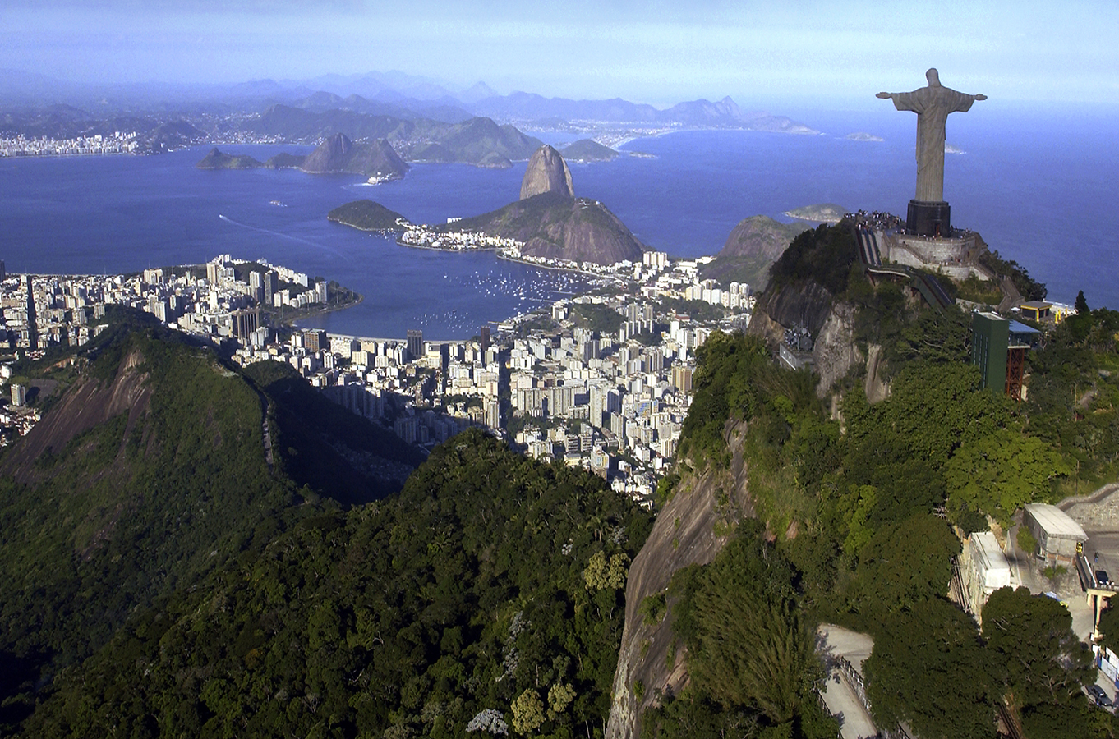
What did you like best about Brazil?

Slide 8


Do you remember how to compare?
To compare is to see what is the same about two people, places, or things.

Slide 9
Compare these flowers.
Both are tall.
Both have green stems.

Slide 10
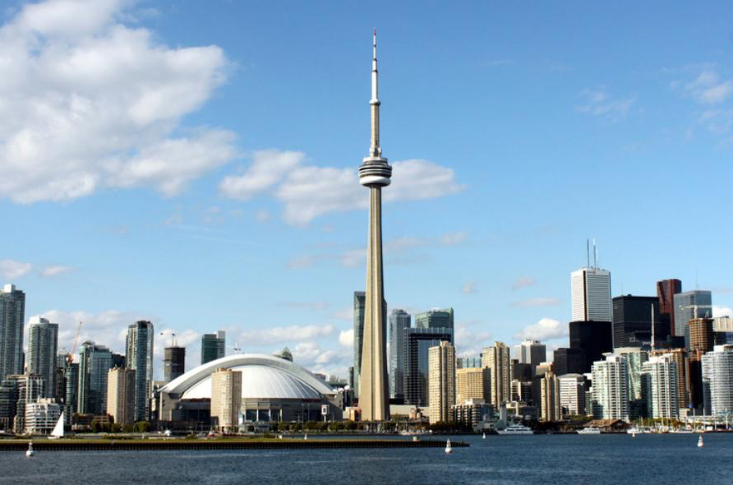
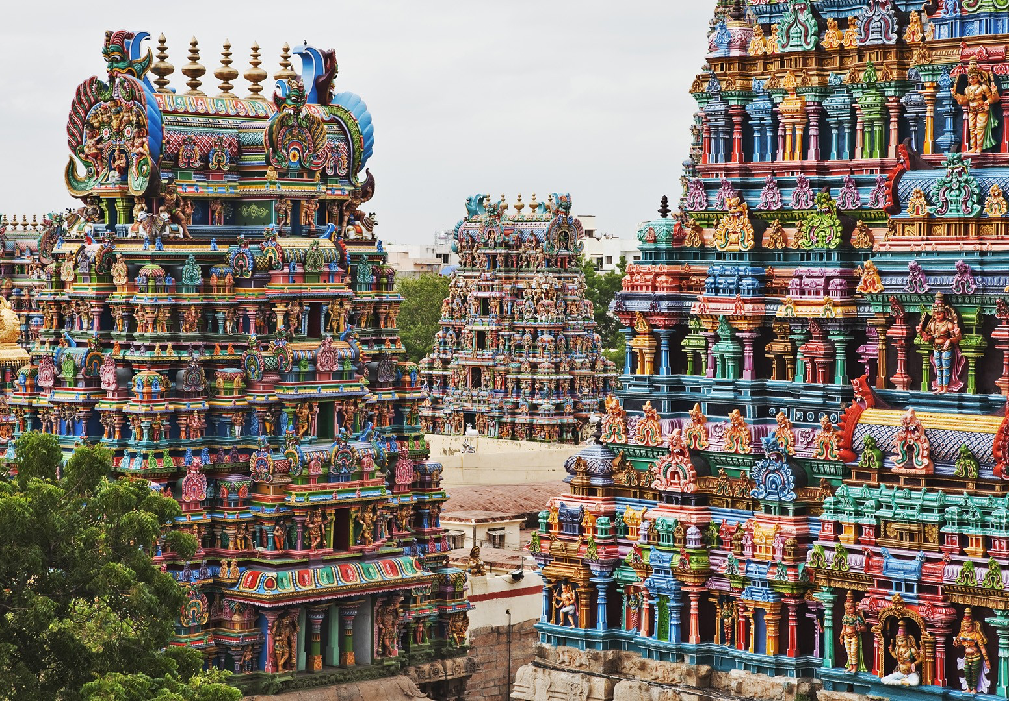
Can you compare the countries of Canada and India?
What is the same, or similar, between the two countries?

Slide 11
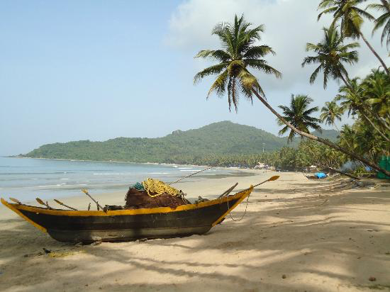
Great work! Let’s do it once more.
Compare the country of Brazil with India!

Slide 12
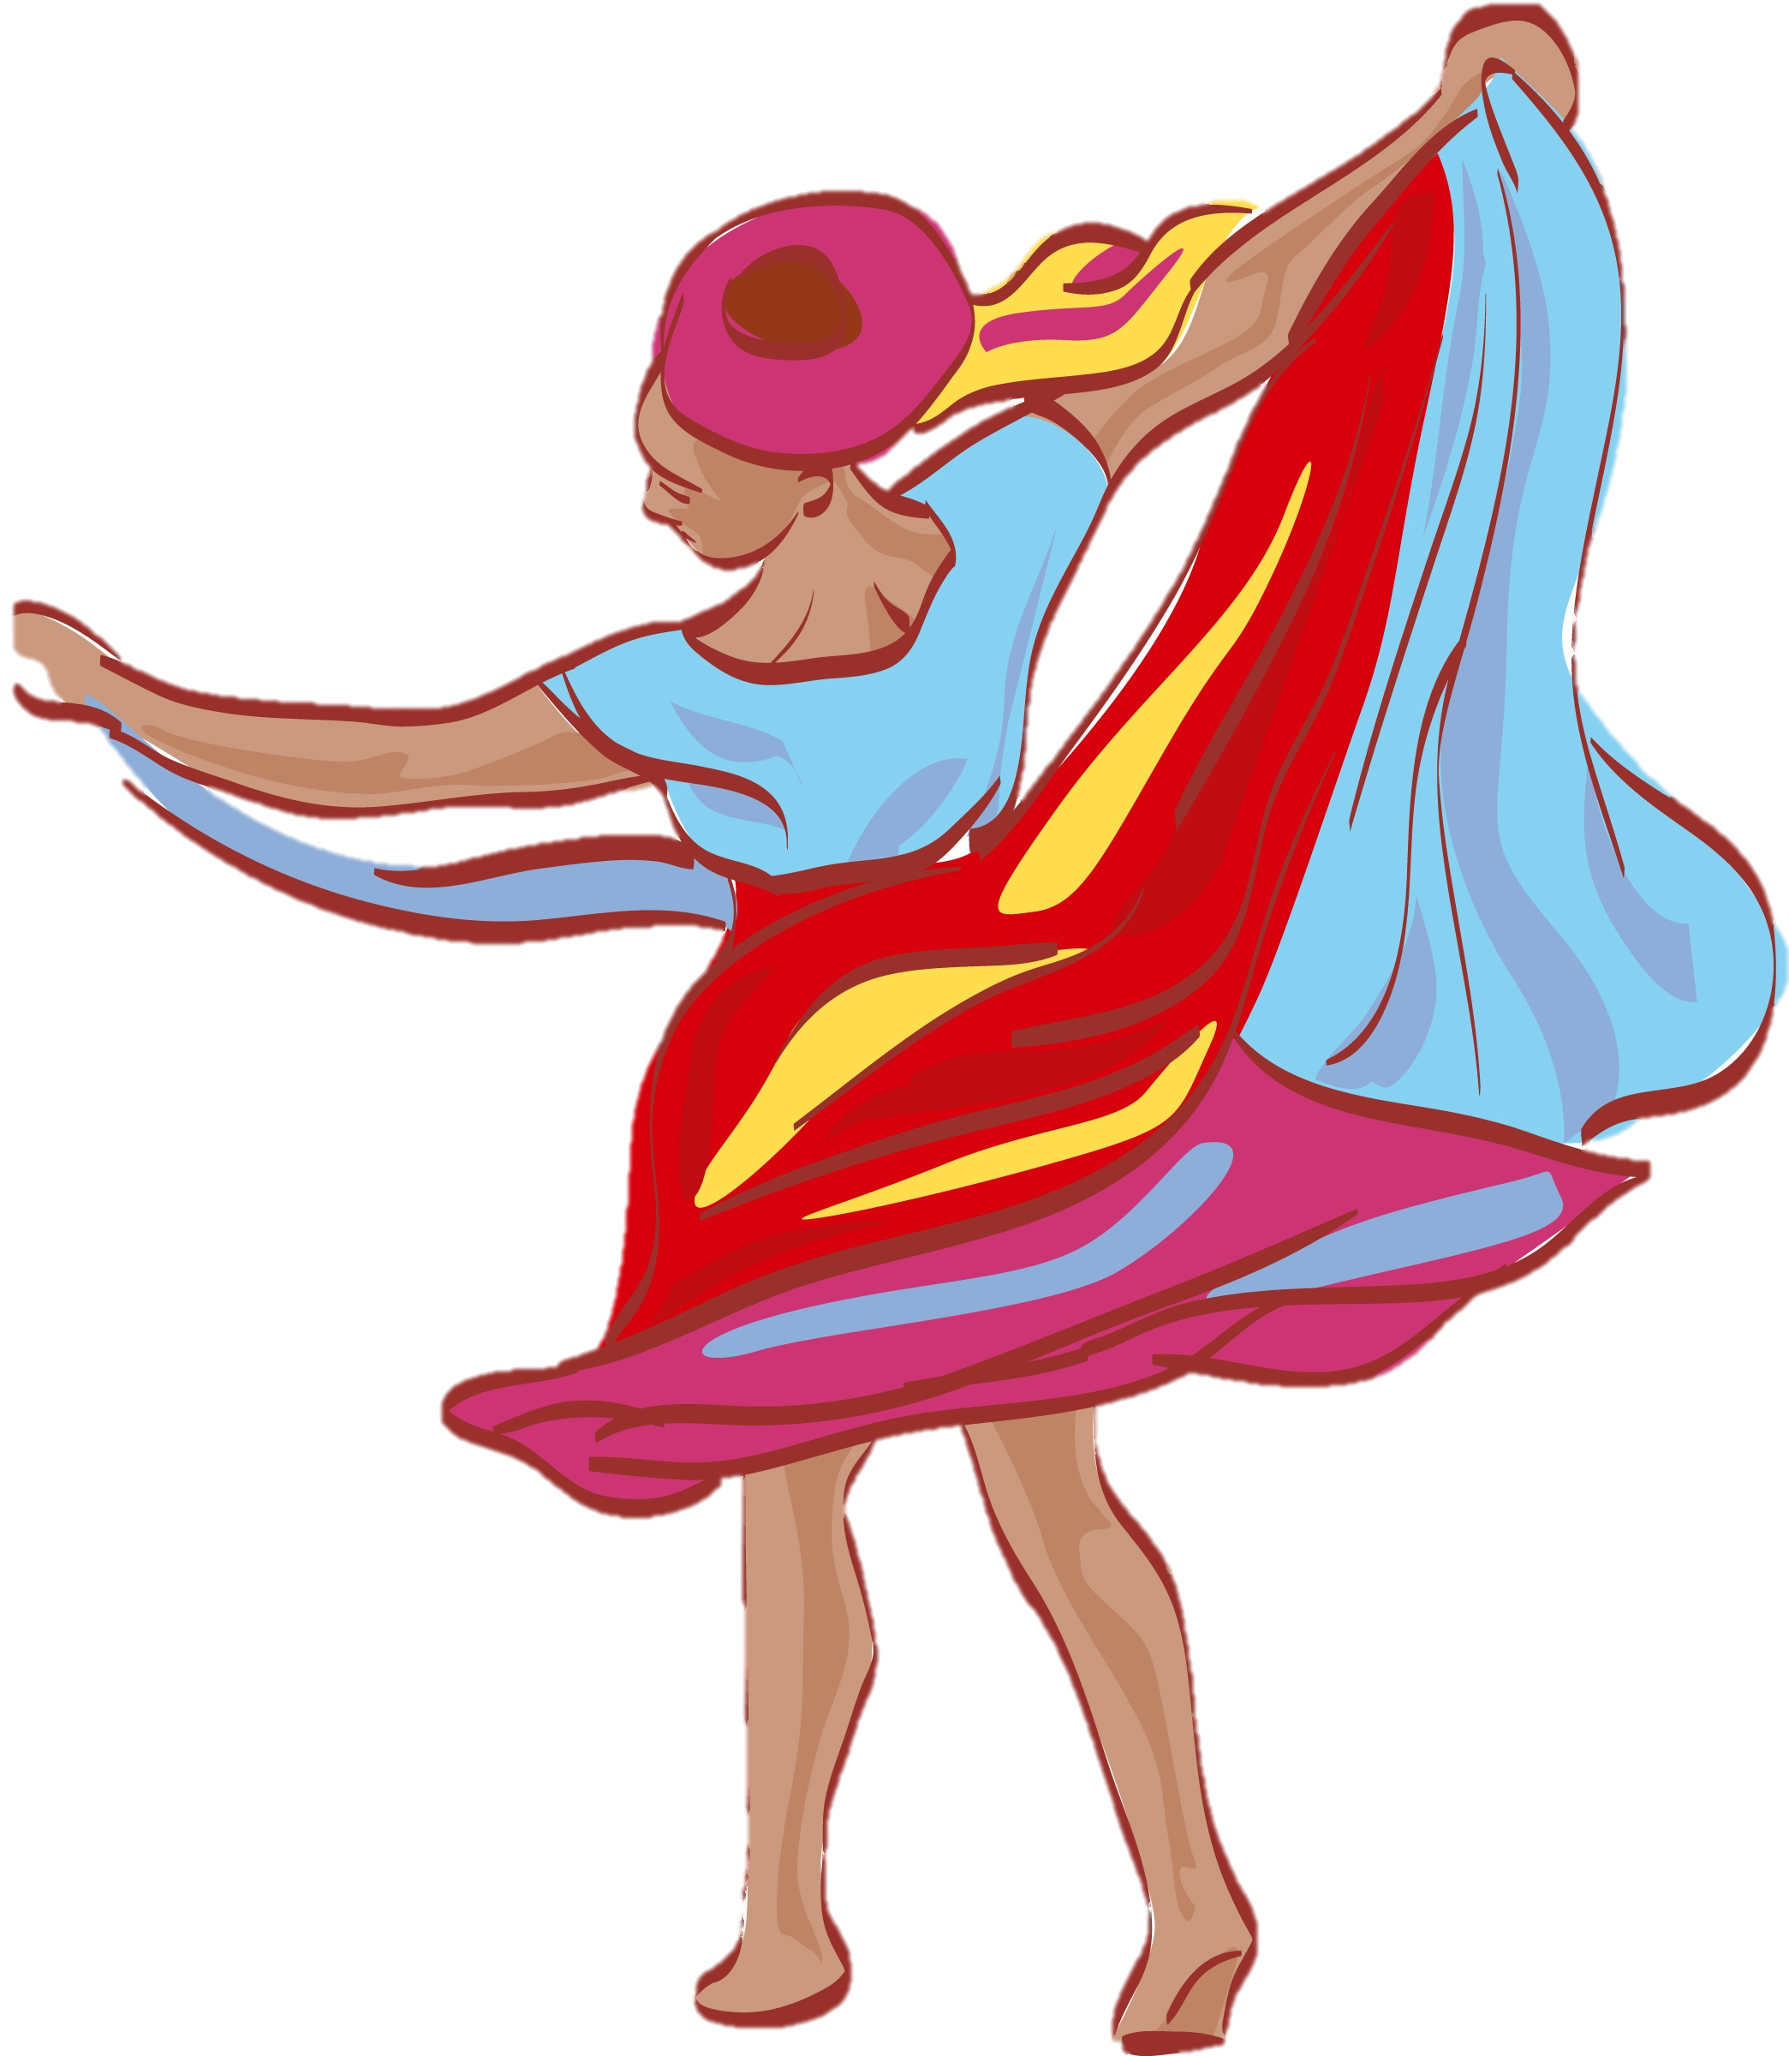
Great answers! You are great at comparing.

Slide 13
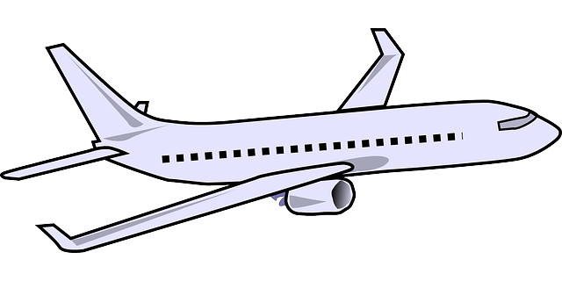

How do you travel to different countries?
Do you take a car, a plane, a train, or a bus?

Slide 14
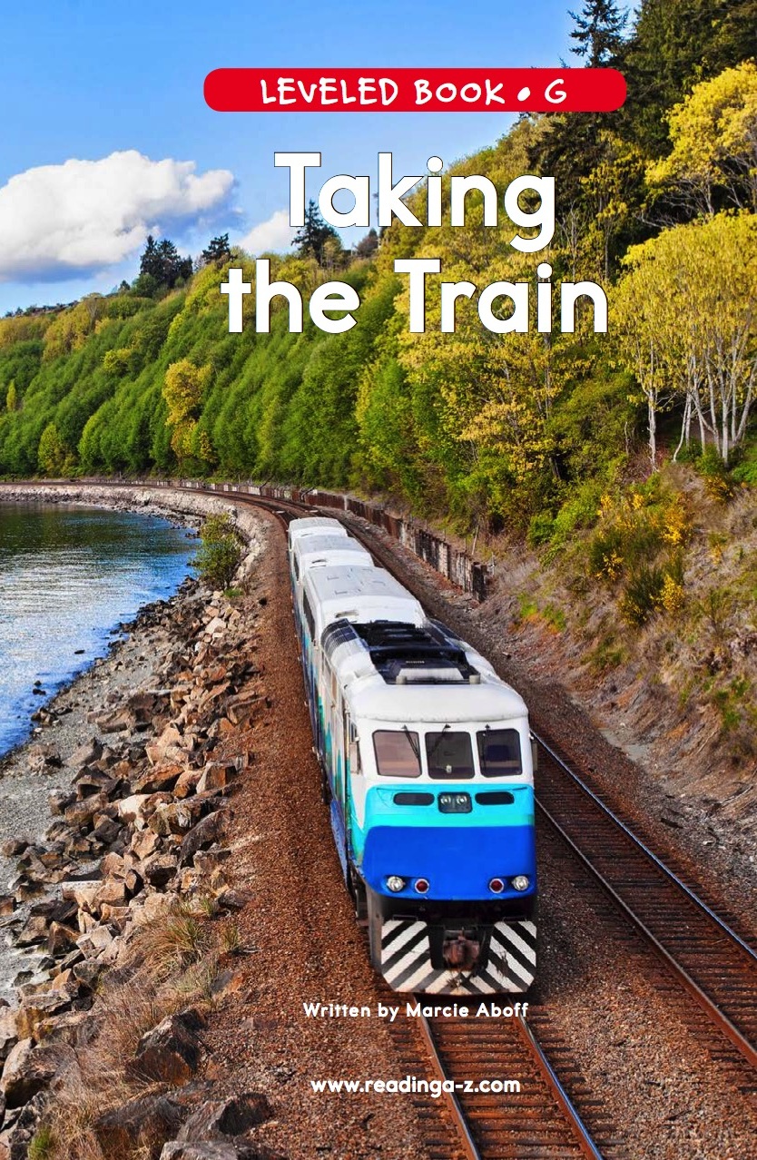
We are going to read a book about Taking the Train!

Slide 21

Nice reading!
Have you taken the train before? Where did you go?

Slide 22

Review
Now we will review our sounds from this unit.
“i_e”
“a_e”
“e_e”

Slide 23
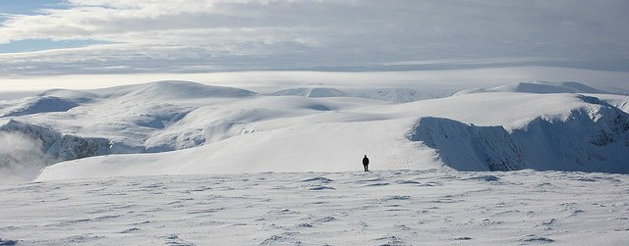
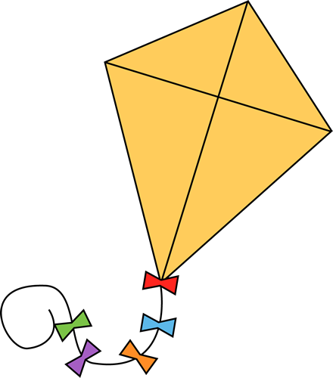
Fill in the blanks for the i_e words.
There is lots of cold _________ in Canada.
When it is windy, I like to fly a ___________.

Slide 24
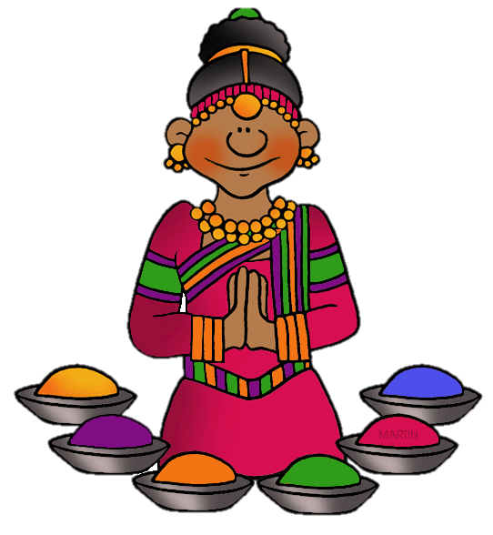
Write a sentence using a “i_e” word

Slide 25
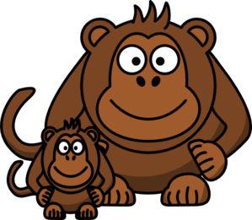

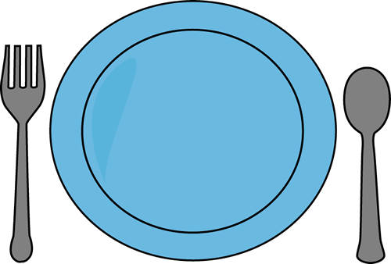
Fill in the blanks for the “a_e” words.
We saw a large _______ in the Brazilian sea.
There was an ____ in the Indian rainforest.
I put the Canadian food on my _________.

Slide 26

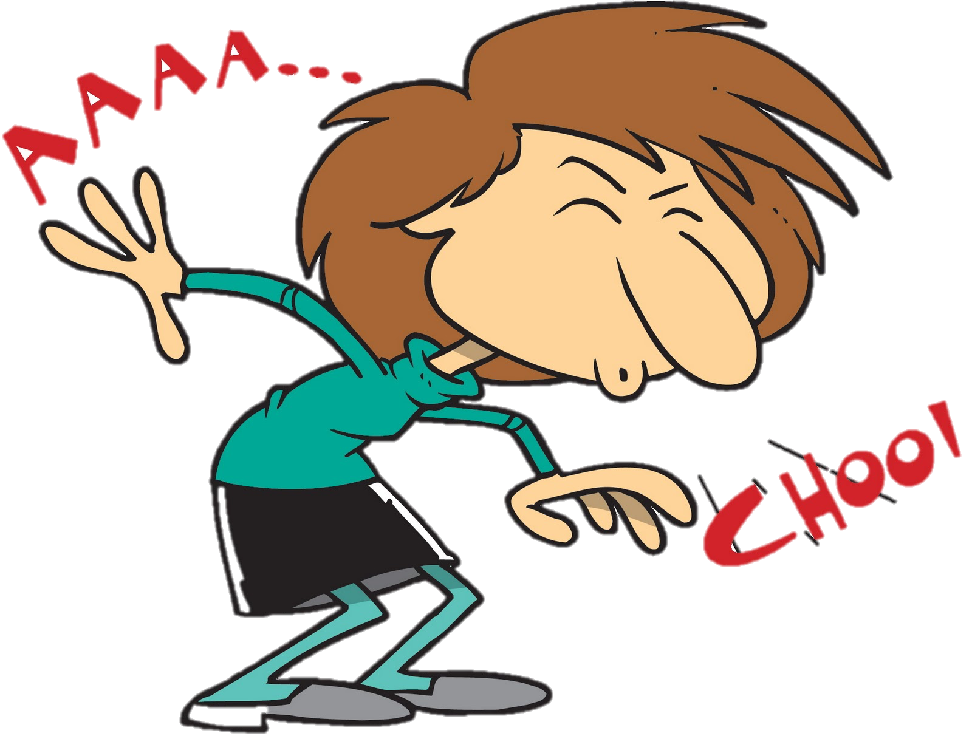

Fill in the blanks for the “e_e” words.
I ate lots of _______ in Canada.
The Brazilian air made me ___________.
I got sand in my ______ from the beach.

Slide 27
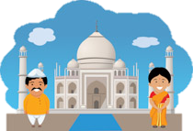
Great, that was fun. What did we learn today?
A review of Canada, Brazil and India
Continuing to compare
Reading about Trains
A review of “i_e”, “a_e” and “e_e” words

Slide 28
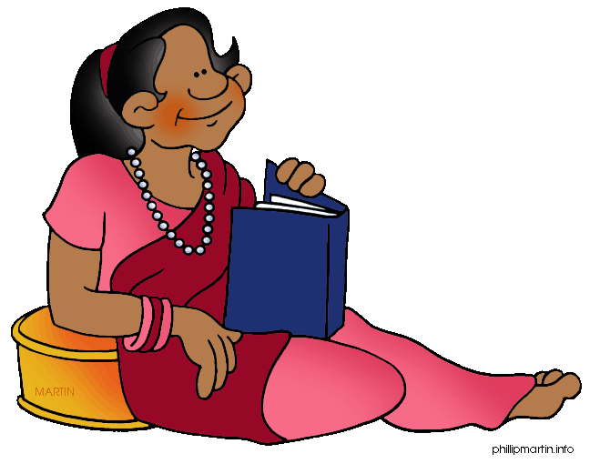
Let’s look at the homework now.
Do you have any questions?

Slide 29
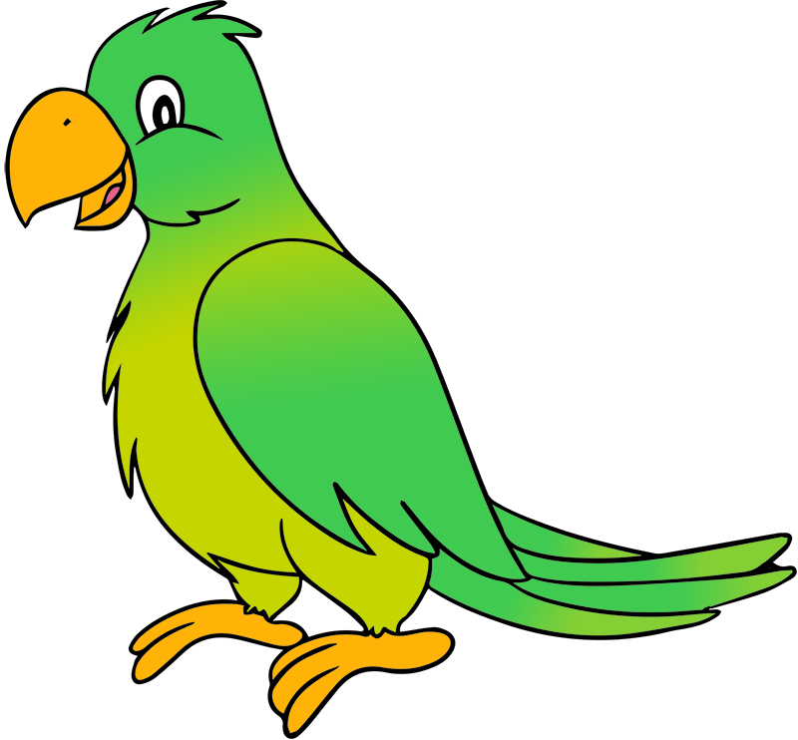
Thank you for a great class today.
We will see you next time!

