Slide 1



Around the World
Unit 8 Lesson 9

Slide 2


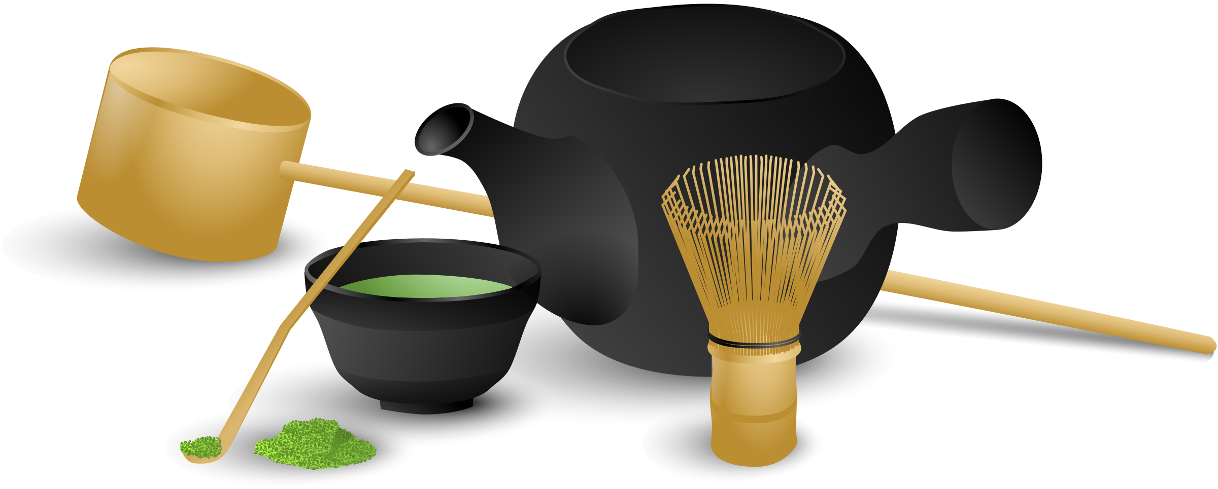
What will we be learning this class?
A look into a new country
A review of the “o_e” sound

Slide 3


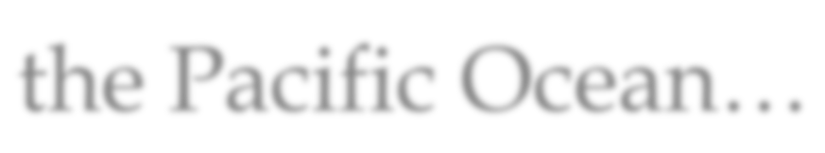
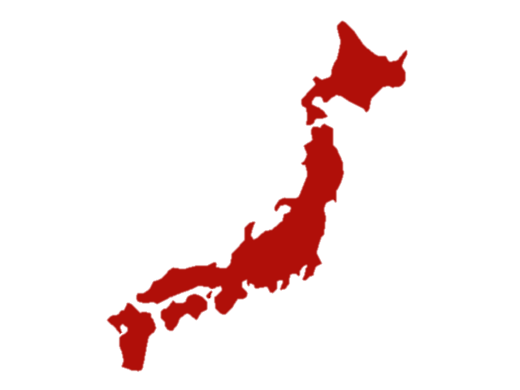
Today we will be learning about another country.
This country is made up of many islands in the Pacific Ocean…

Slide 4


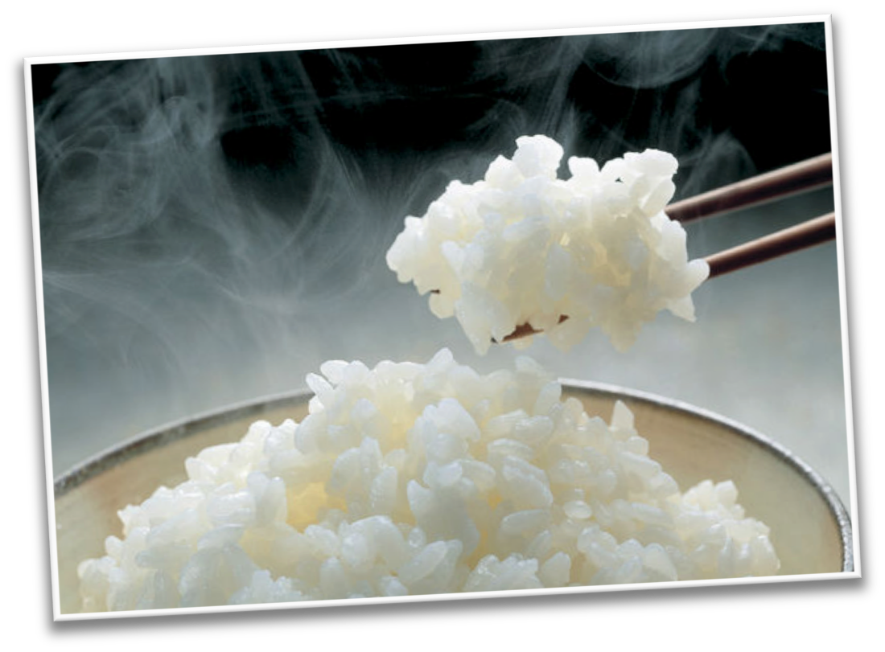


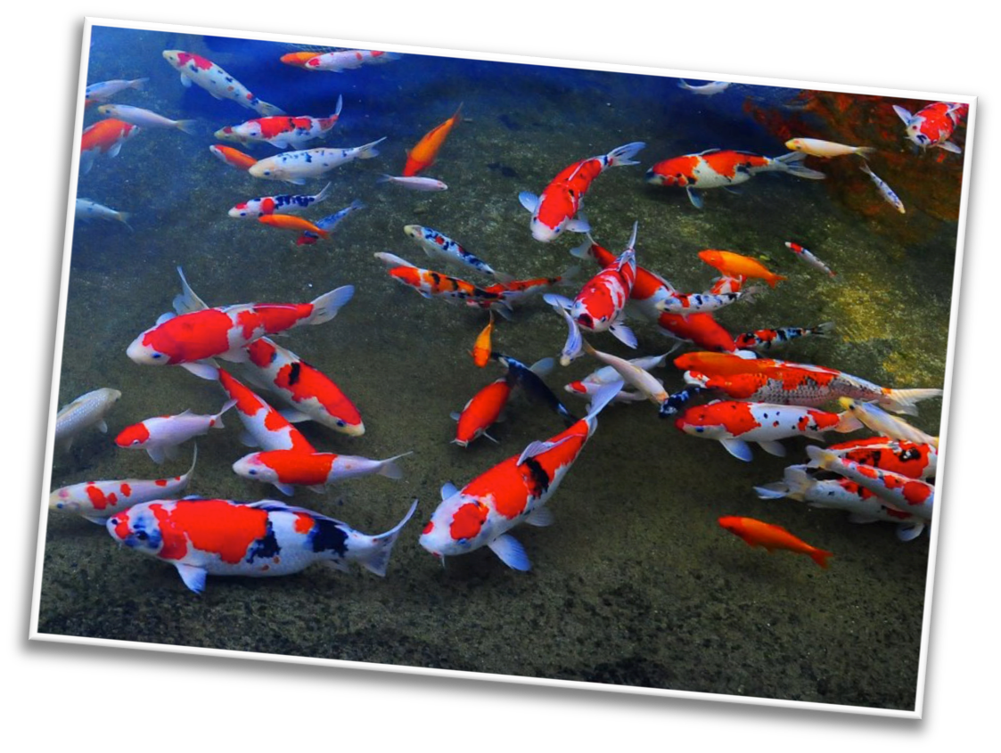

The country is known for growing rice…
And catching fish!

Slide 5
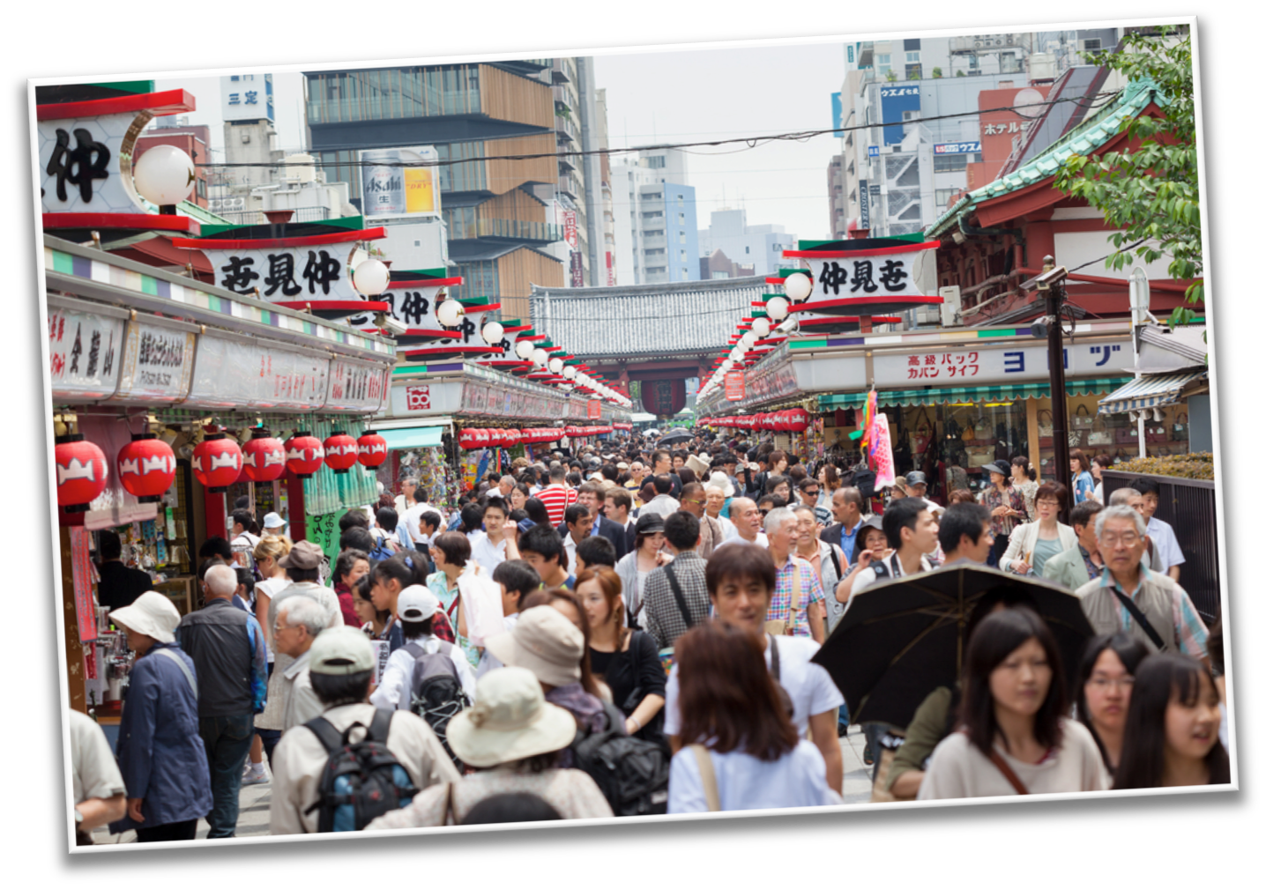
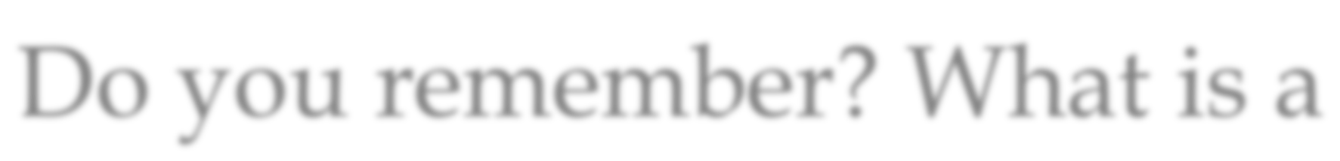


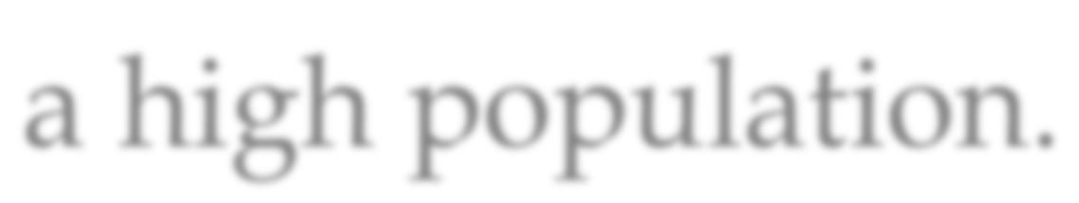
Do you remember? What is a population? This country also has a high population.

Slide 6
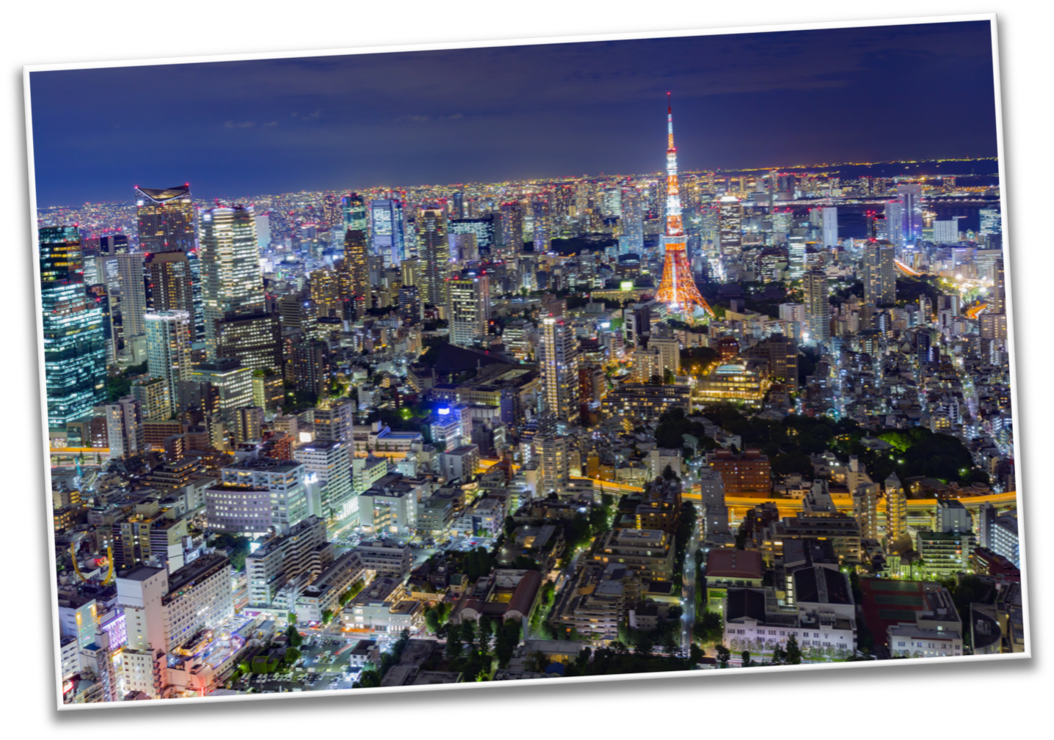
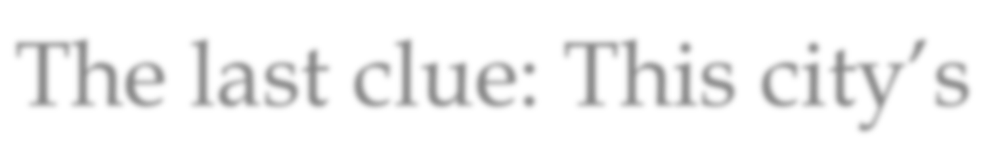
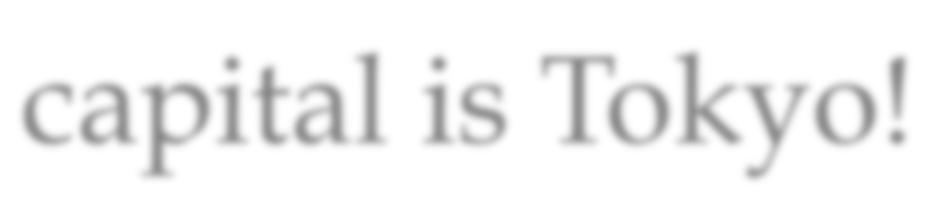
The last clue: This city’s capital is Tokyo!

Slide 7
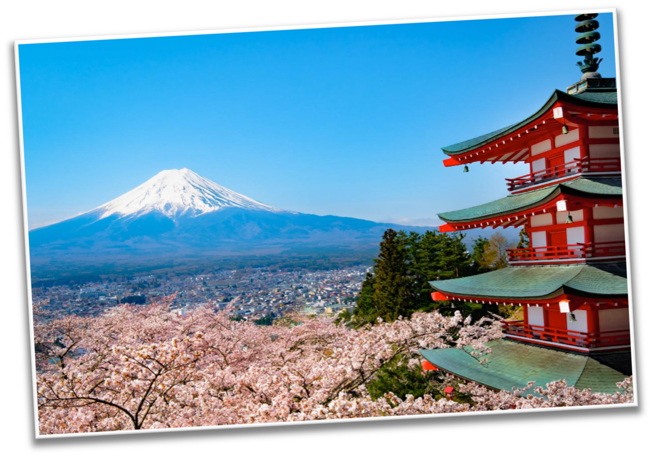
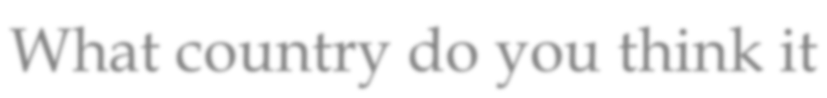
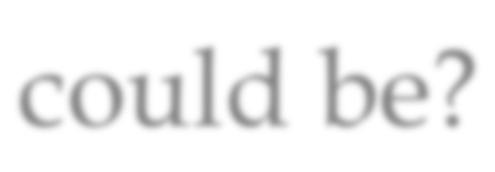
What country do you think it could be?

Slide 8



What do you know about Japan? Write it below

Slide 9


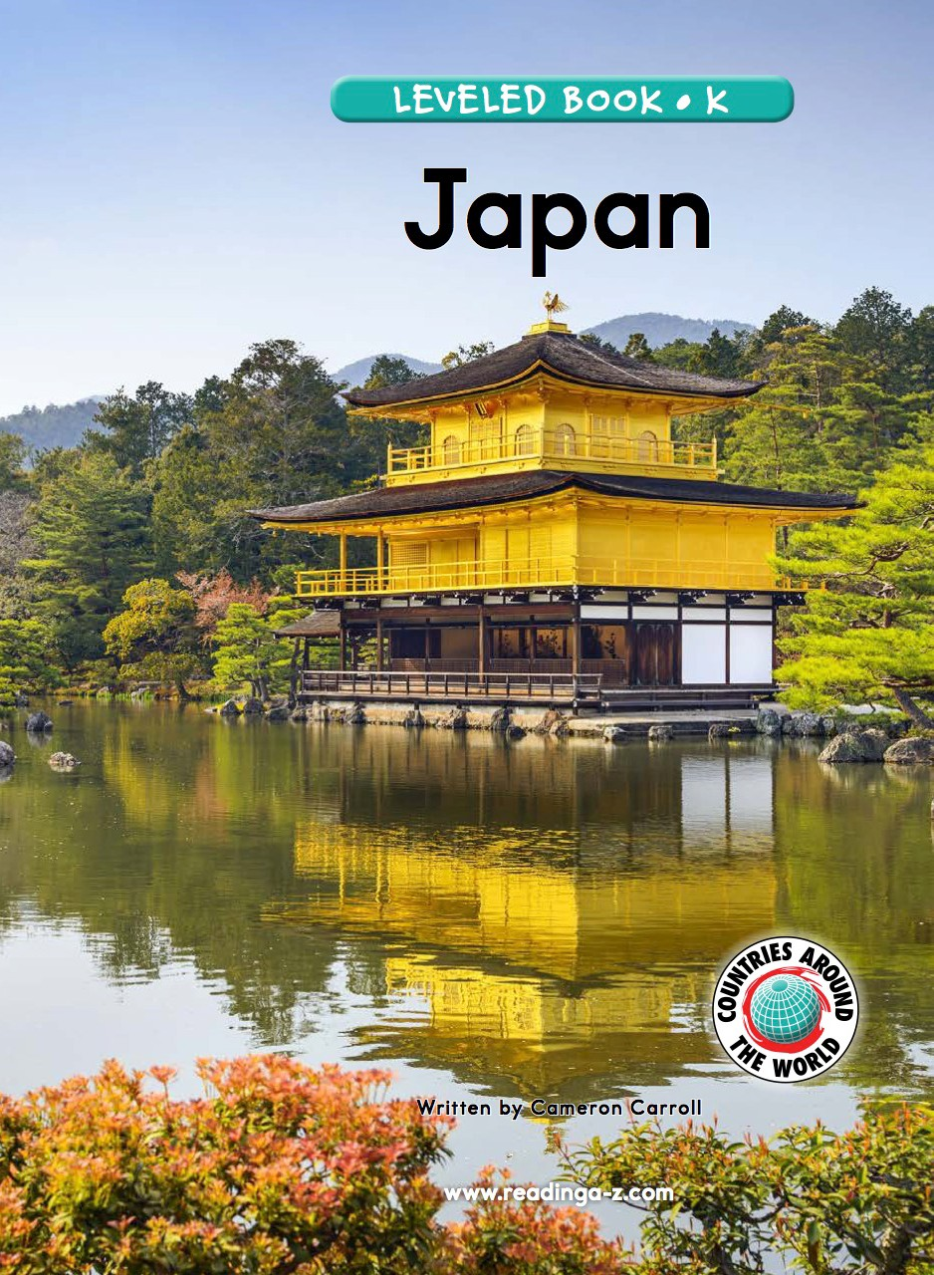
Let’s learn more about the country!
We will now read a book about Japan!

Slide 10


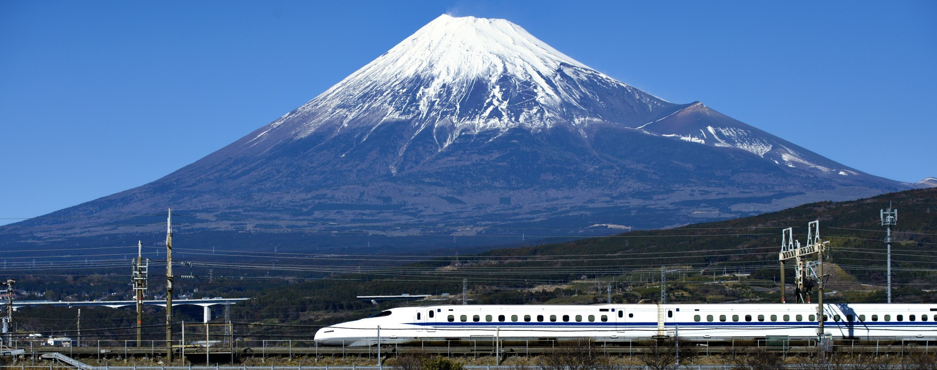
What did you like about Japan?

Slide 11



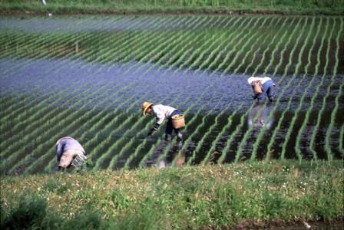
Japan has some similarities to China. Can you list some?

Slide 12



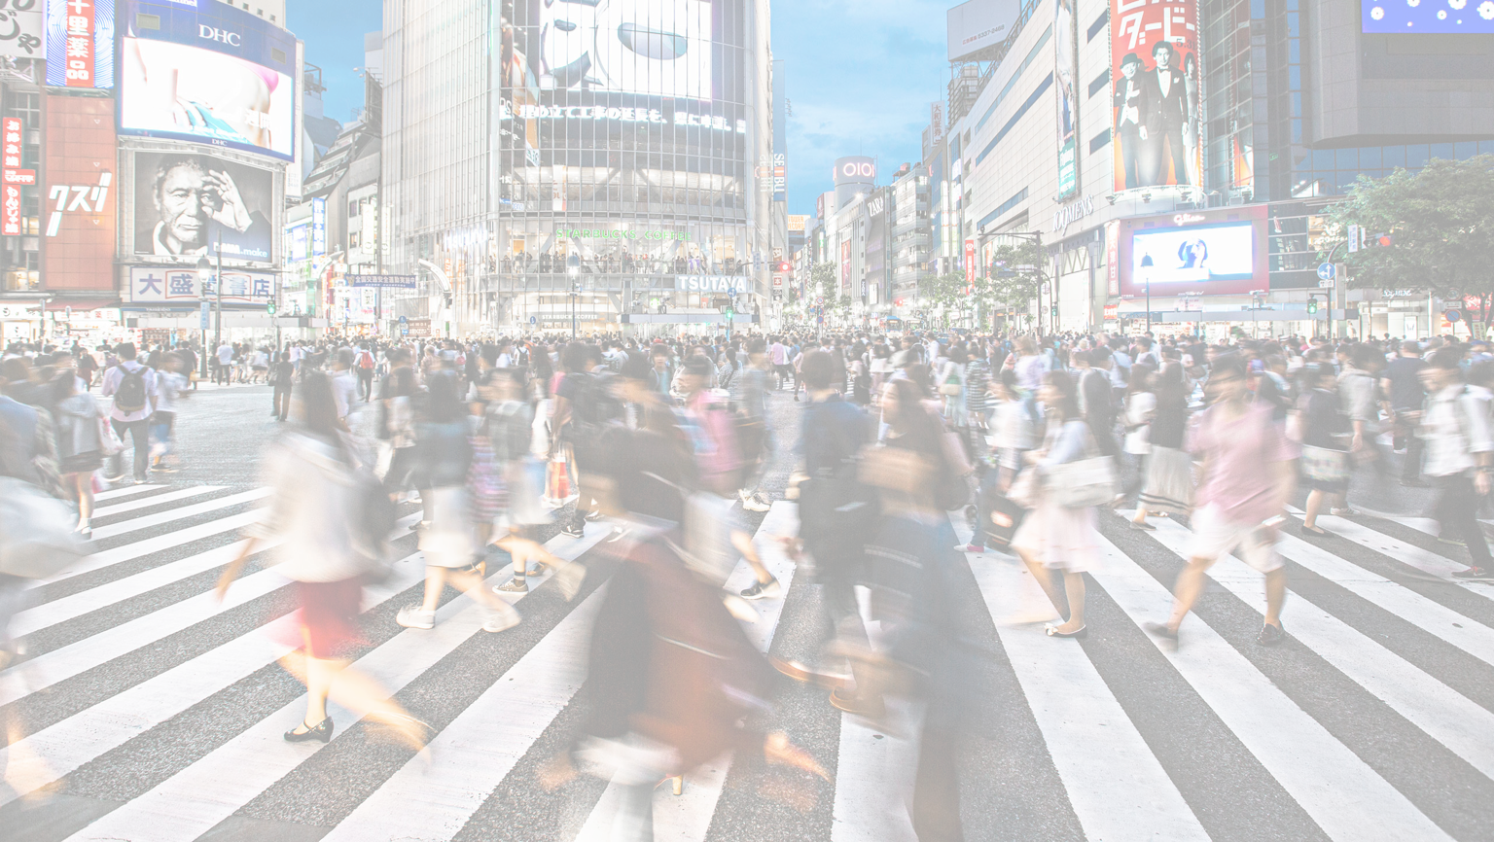
Japan also has differences. List some differences to China.

Slide 13



What word do you think is pictured?
H

Slide 14


Here are some more o_e words. Can you read them?
Smoke Hope Slope Froze Bone Globe

Slide 15


Great, try to use a word in a sentence!
Smoke Hope Slope Froze Bone Globe

Slide 16



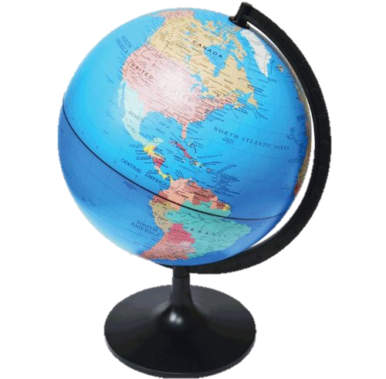
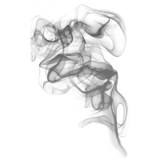
Can you name these o_e words? How do they sound?

Slide 17


Use one of these words in a sentence!

Slide 18


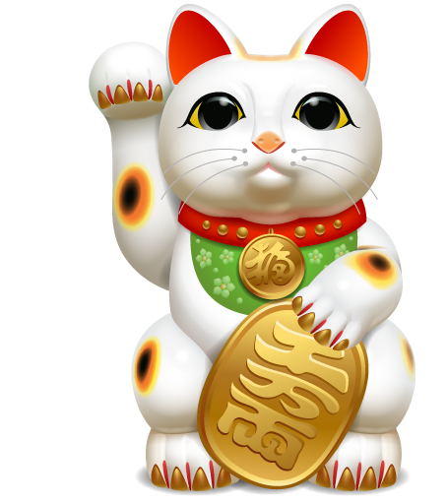
List as many o_e words as you can in 1:00.

