Slide 1
Around the World
Unit 8 Lesson 9

Slide 2
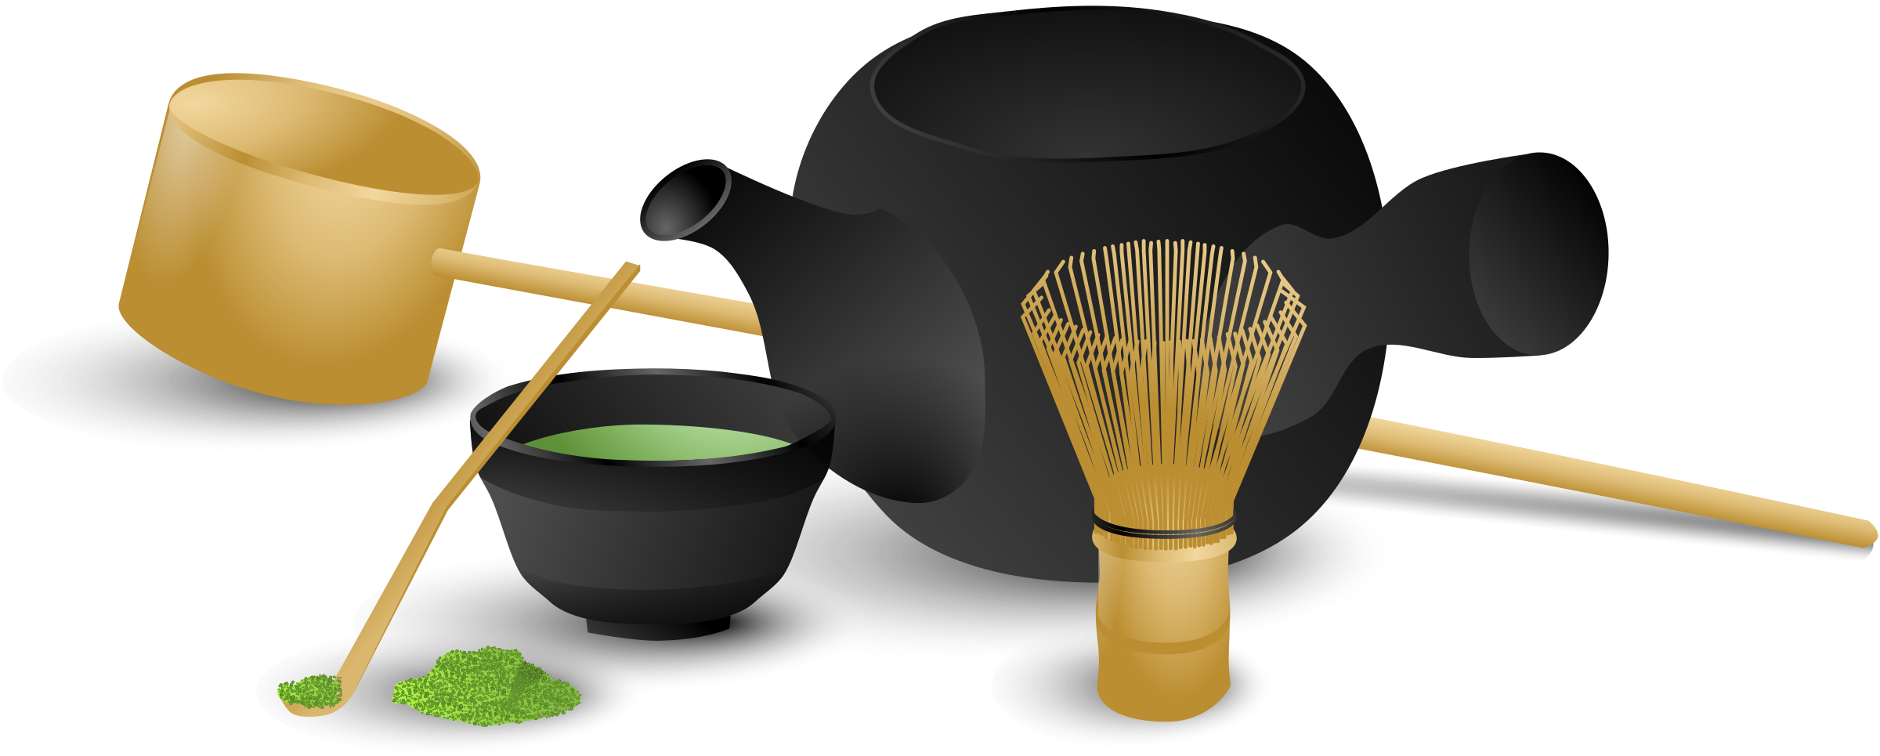
What will we be learning this class?
A look into a new country
A review of the “o_e” sound

Slide 3
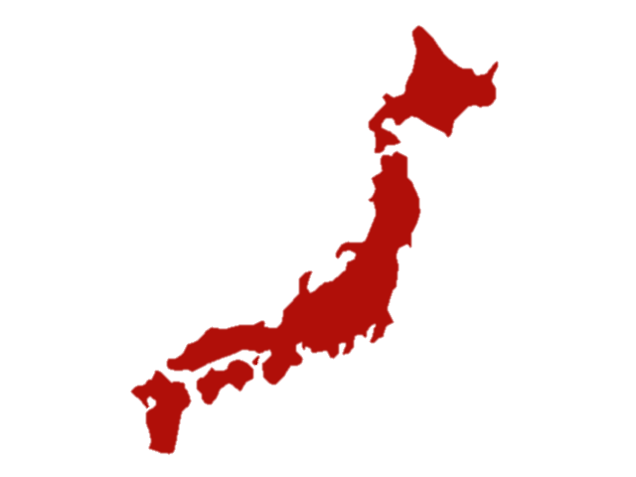
Today we will be learning about another country.
This country is made up of many islands in the Pacific Ocean…

Slide 4
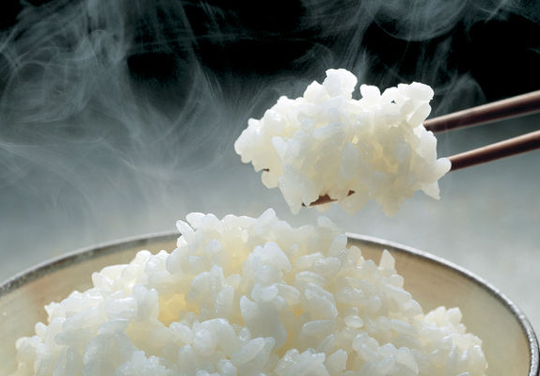
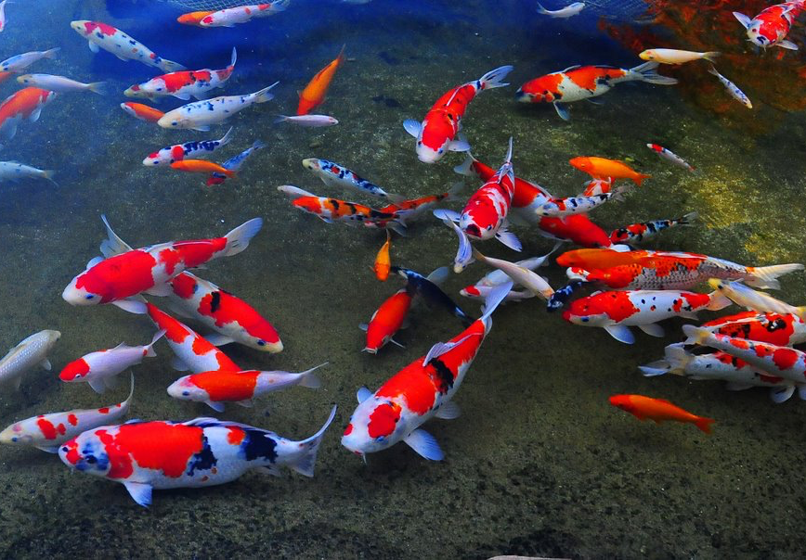
The country is known for growing rice…
And catching fish!

Slide 5
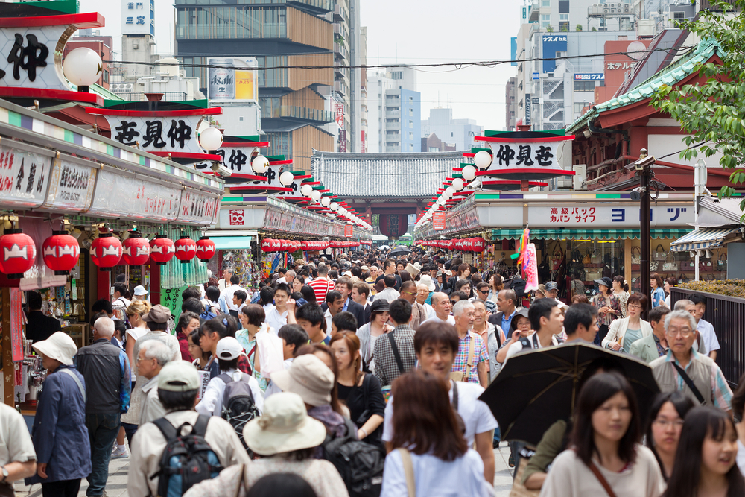
Do you remember? What is a population? This country also has a high population.

Slide 6
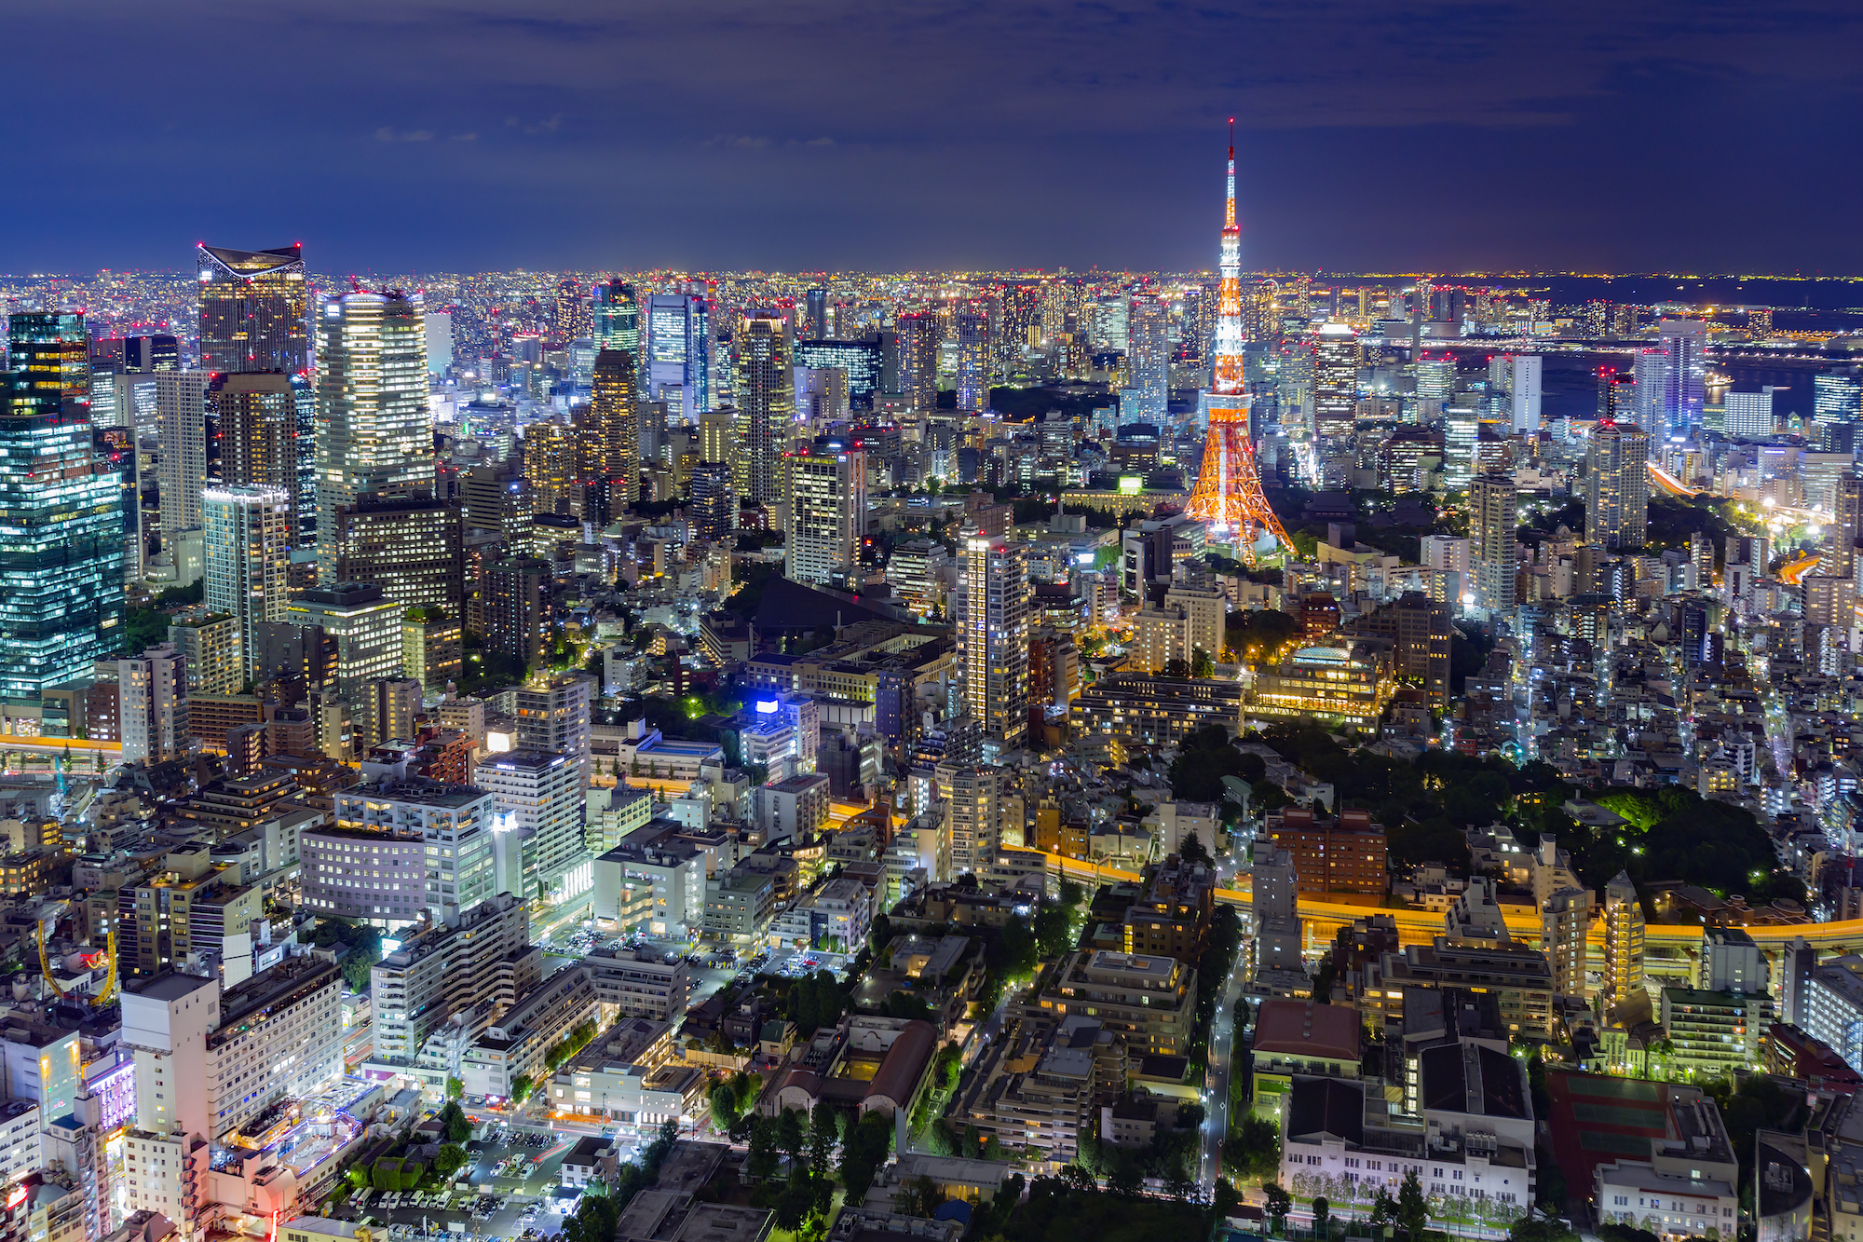
The last clue: This city’s capital is Tokyo!

Slide 7
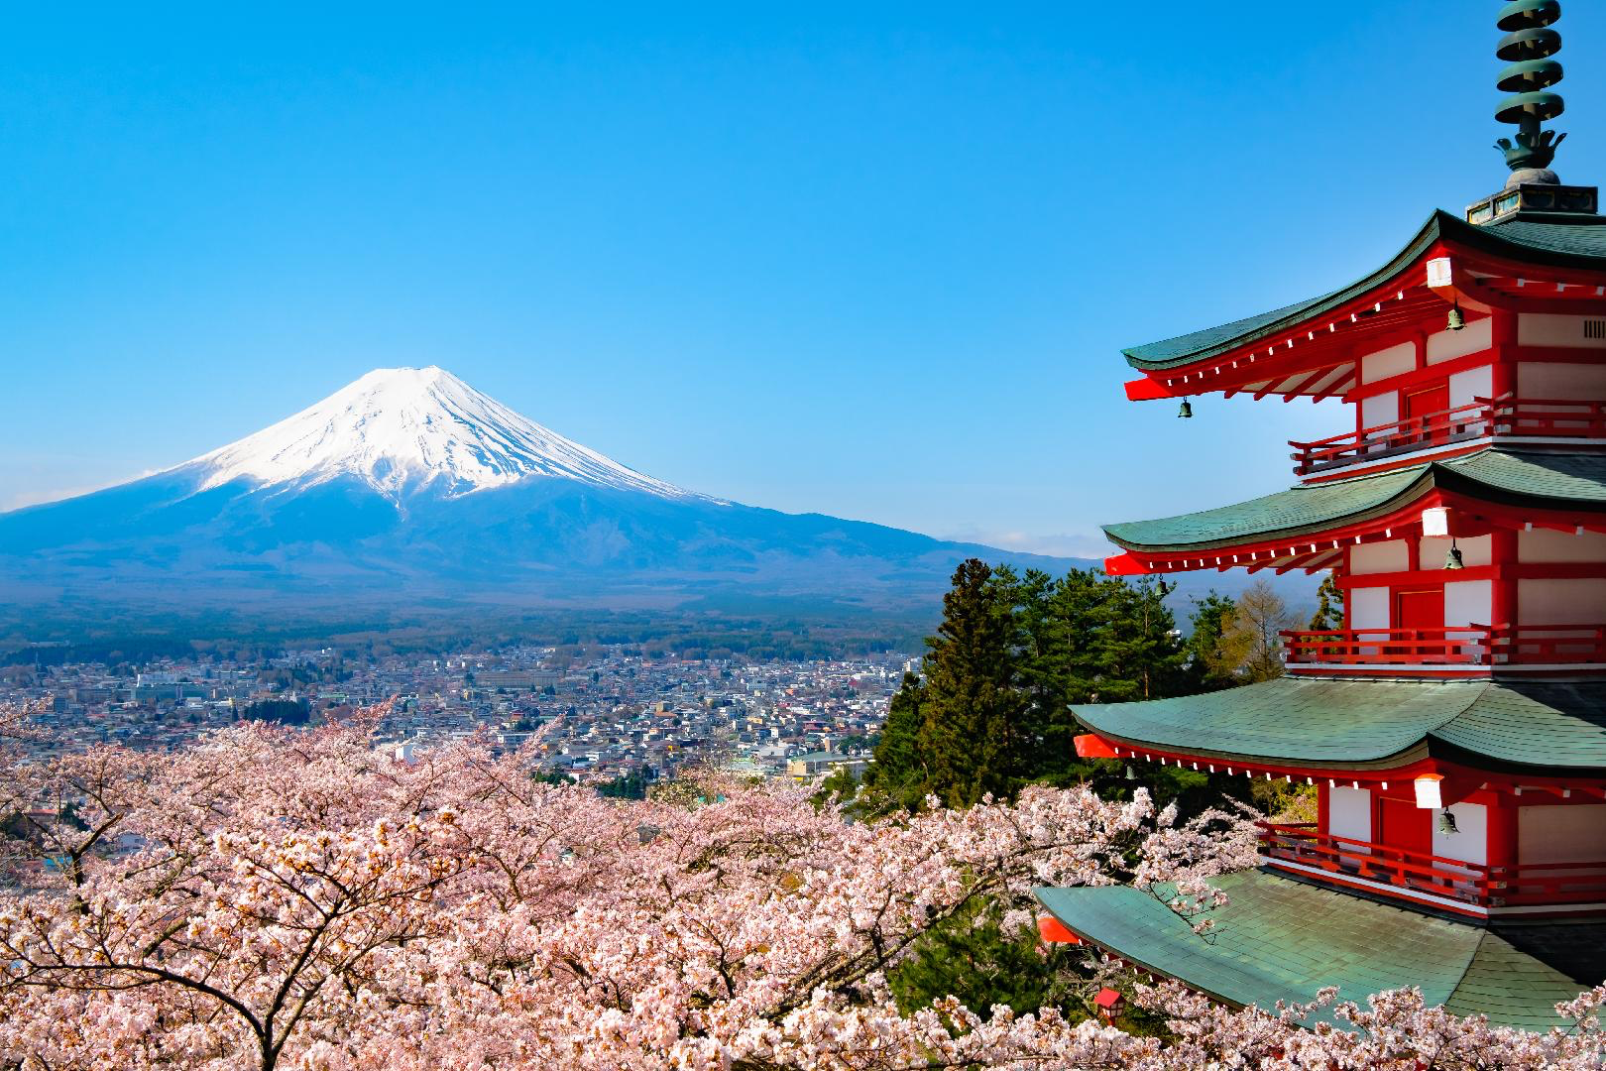
What country do you think it could be?

Slide 8
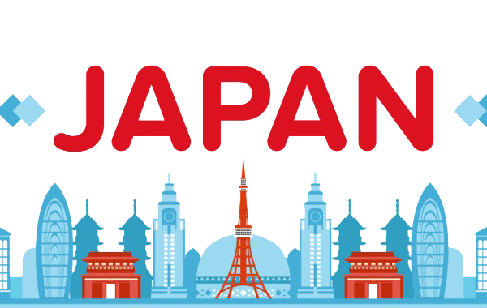
It is Japan! We will be learning about this country today.

Slide 9

What do you know about Japan? Write it below

Slide 10
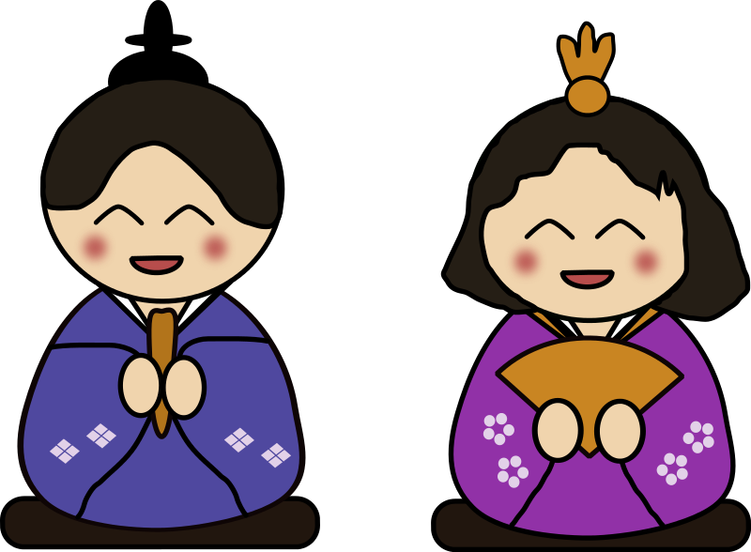
Have you visited Japan before? Tell us a story from your trip!

Slide 11
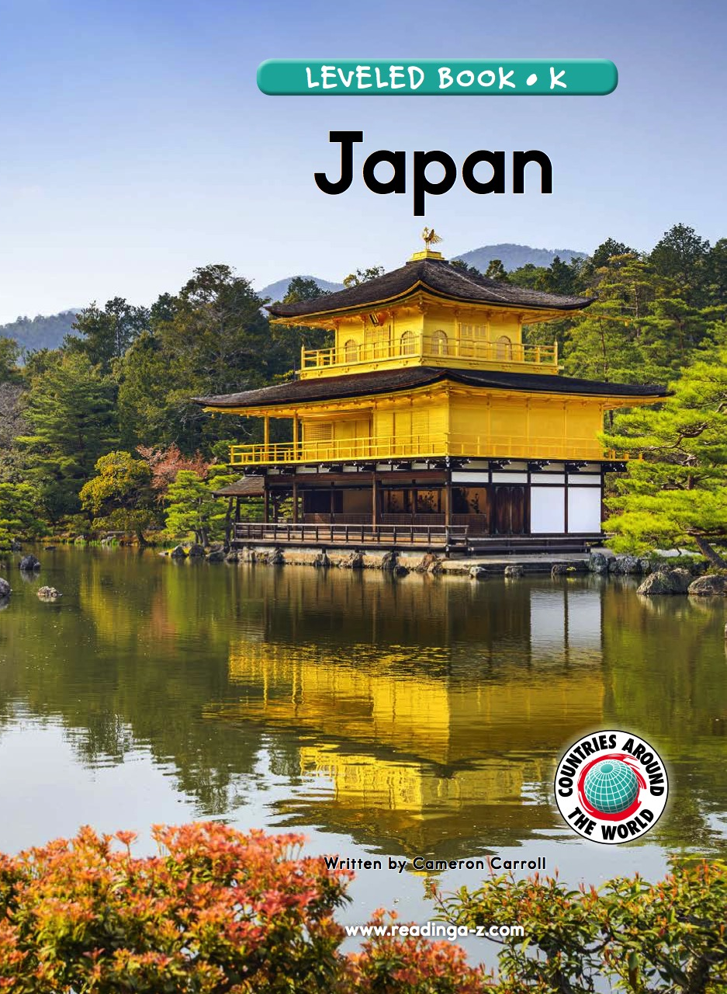
Let’s learn more about the country!
We will now read a book about Japan!

Slide 12
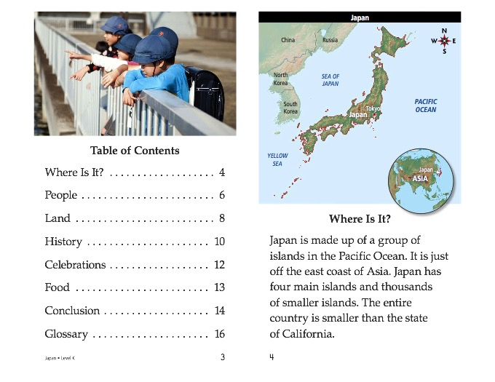

Slide 15
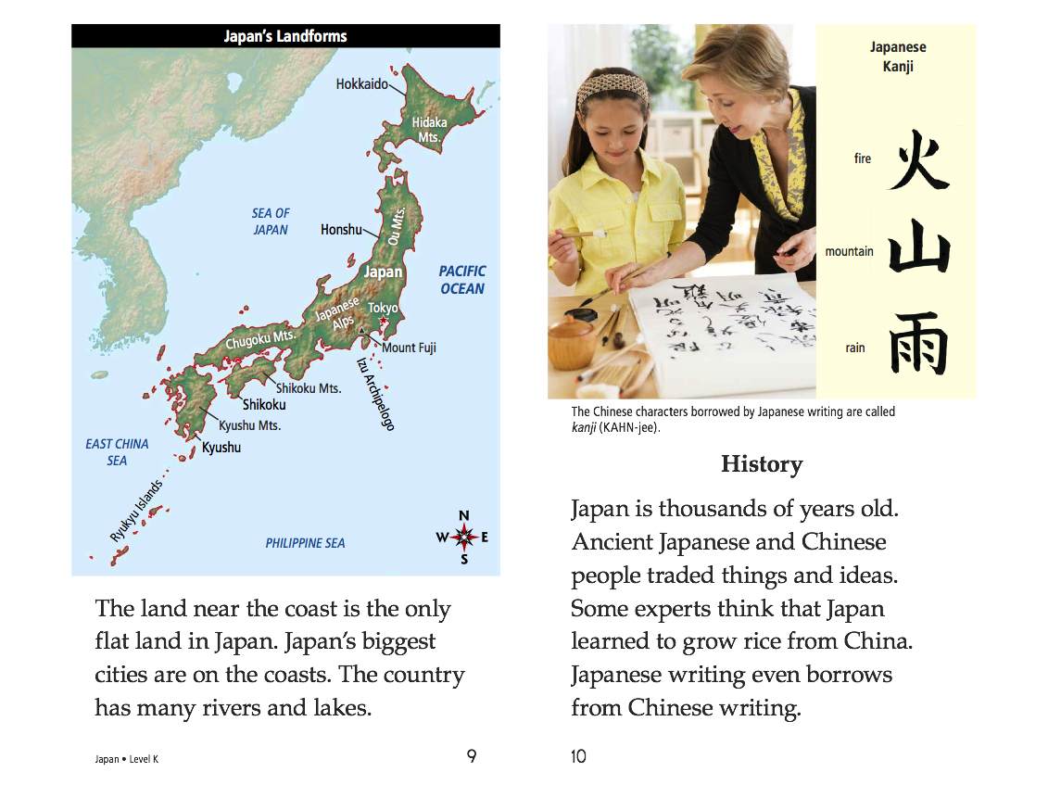

Slide 18
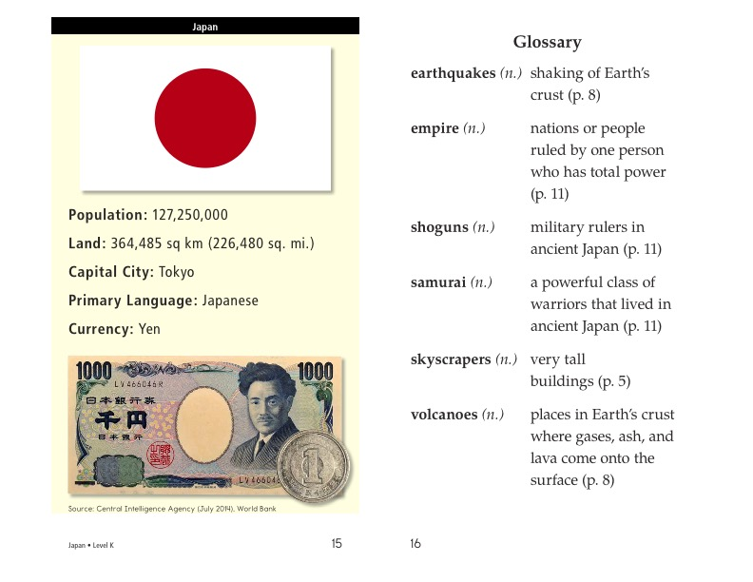

Slide 19
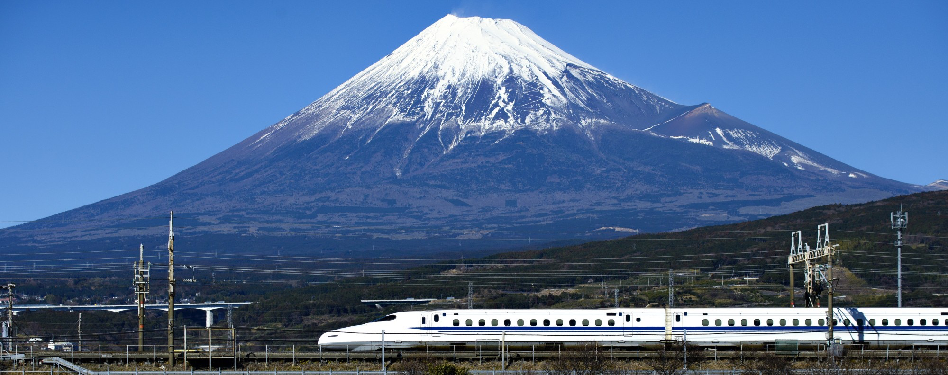
What did you like about Japan?

Slide 20
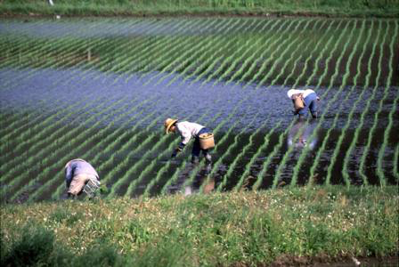
Japan has some similarities to China. Can you list some?

Slide 21
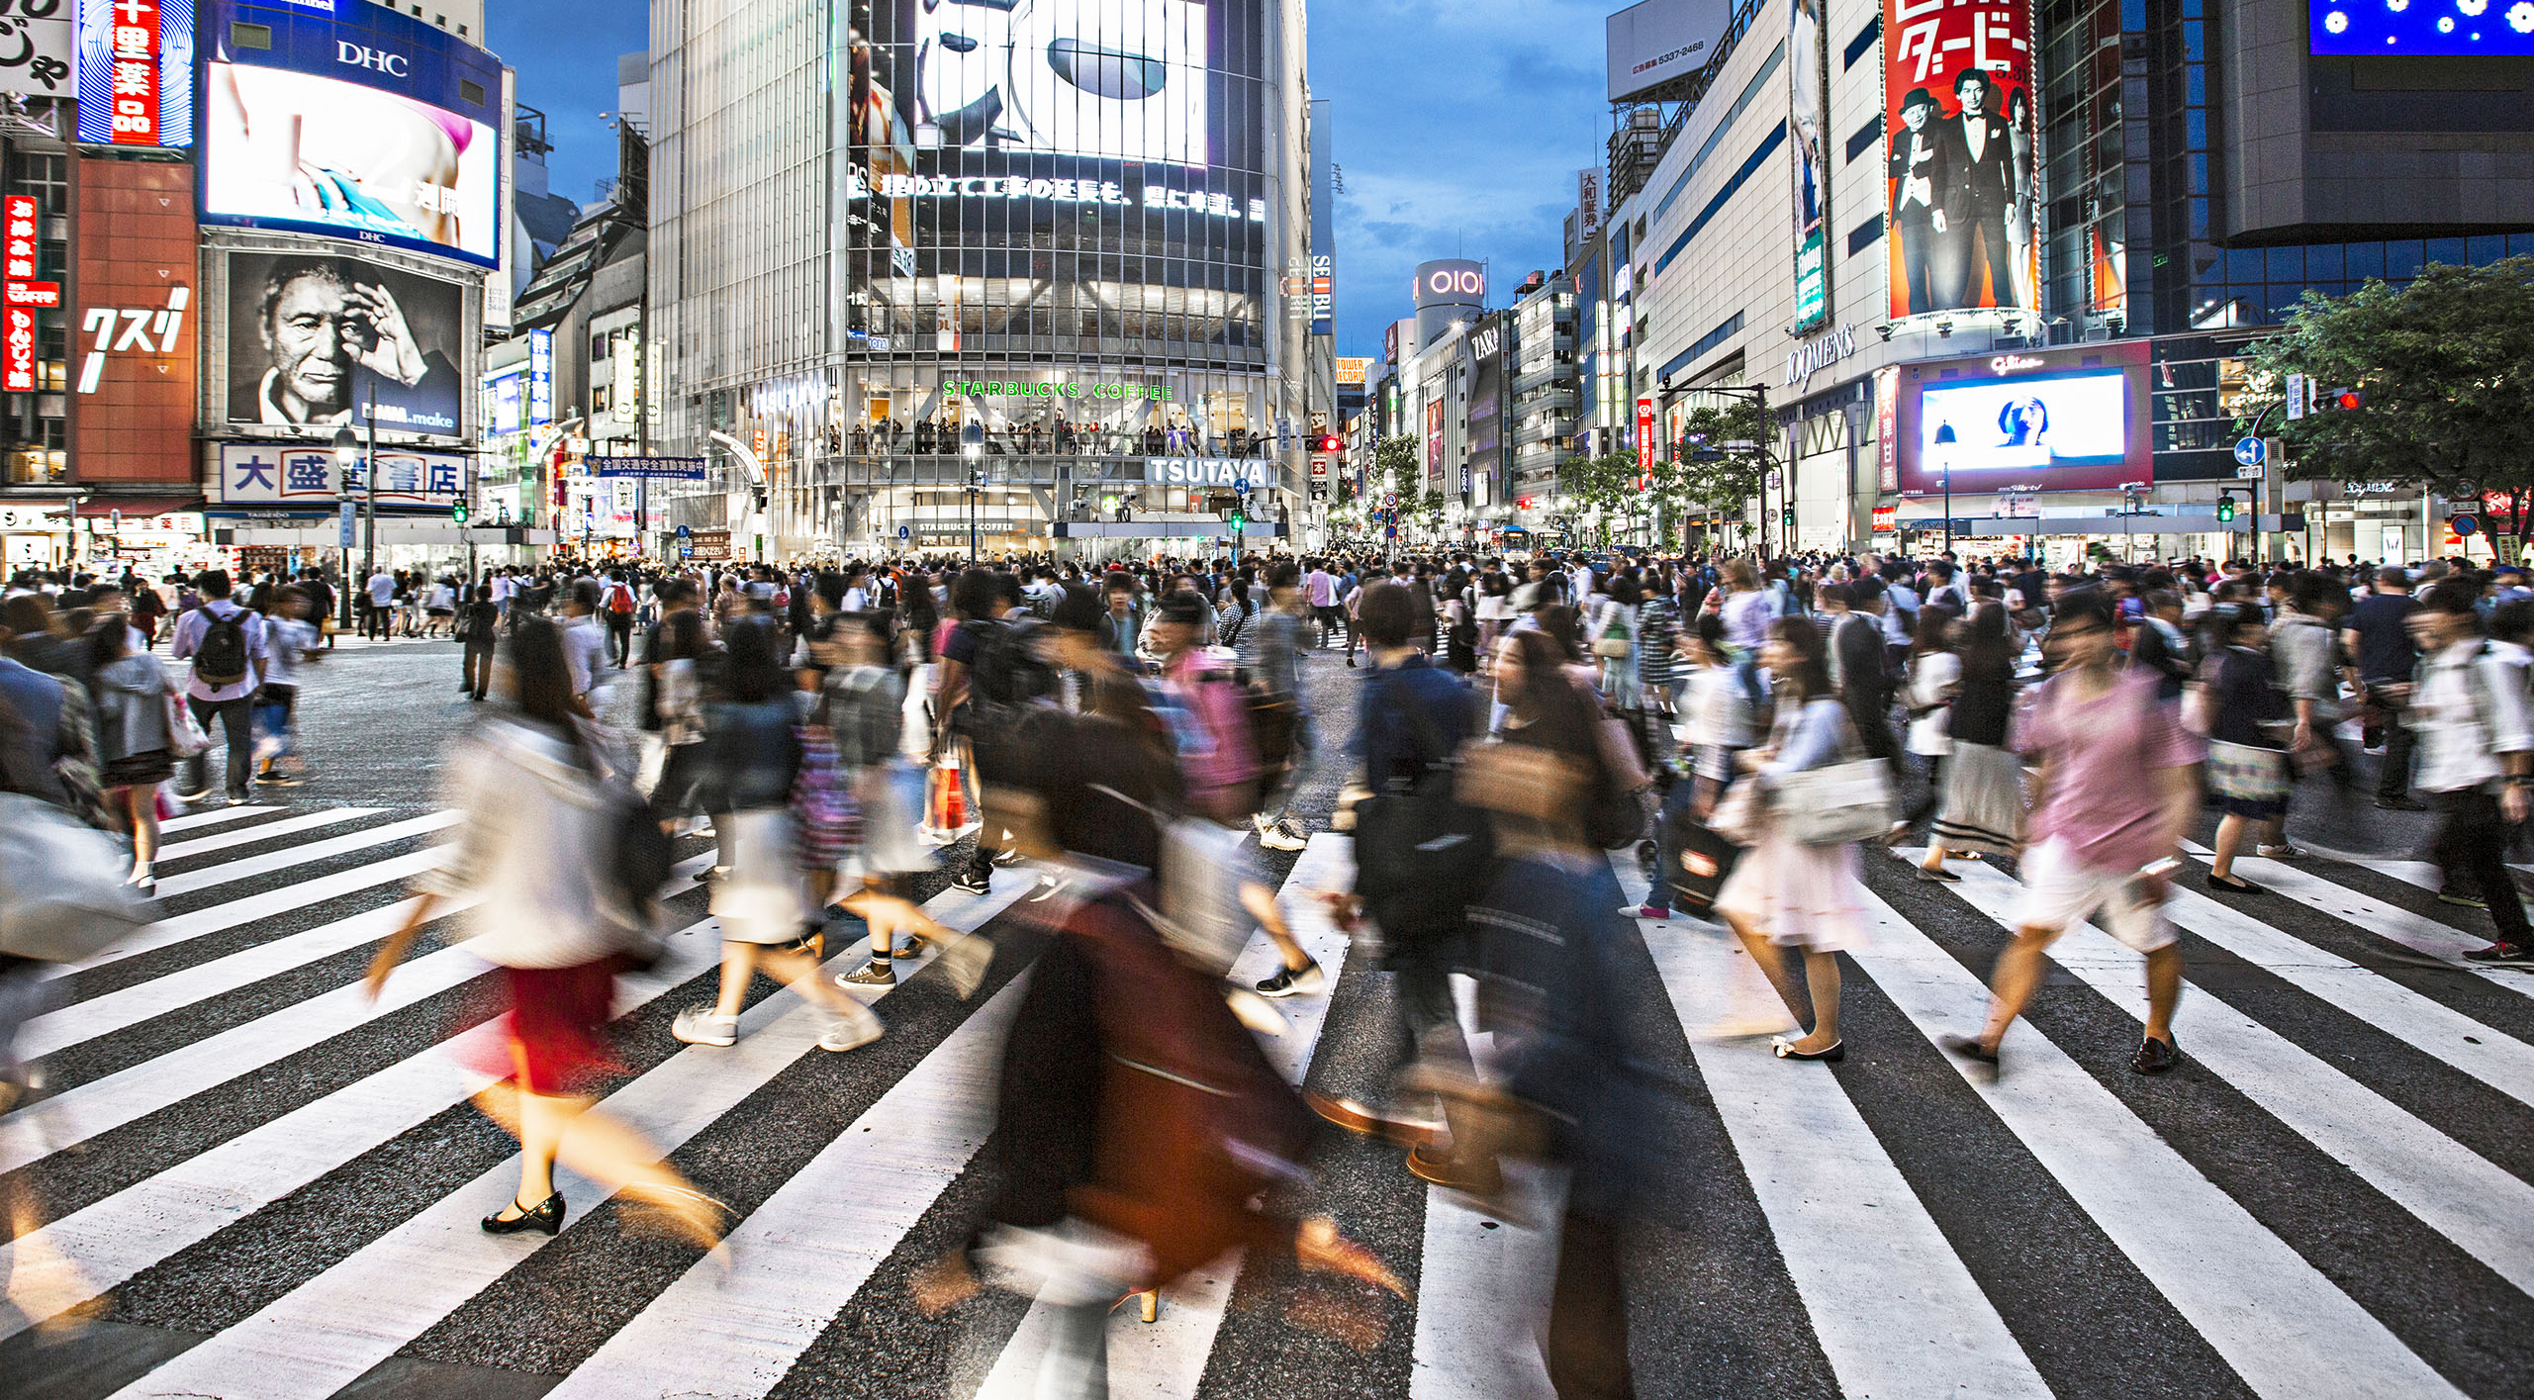
Japan also has differences. List some differences to China.

Slide 22
Great work!
Now we will review the “o_e” sound!

Slide 23

What word do you think is pictured?
H __ __ __

Slide 24

Correct, it is home!
That is an o_e word!

Slide 25
Here are some more o_e words. Can you read them?
Smoke
Hope
Slope
Froze
Bone
Globe

Slide 26
Great, try to use a word in a sentence!
Smoke
Hope
Slope
Froze
Bone
Globe

Slide 27

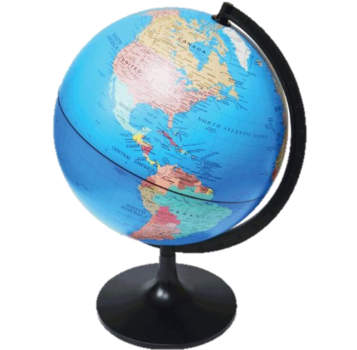
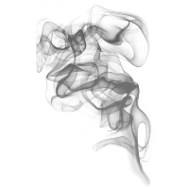
Can you name these o_e words? How do they sound?

Slide 28
Use one of these words in a sentence!

Slide 29
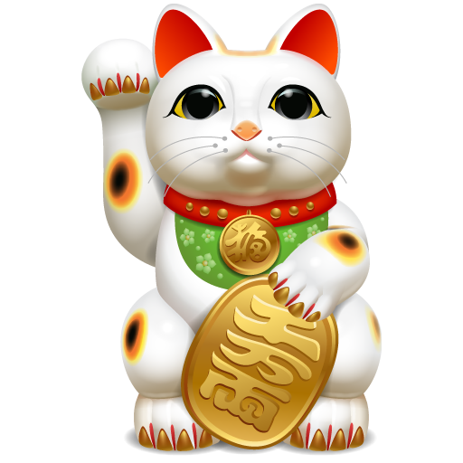
List as many o_e words as you can in 1:00.

Slide 30
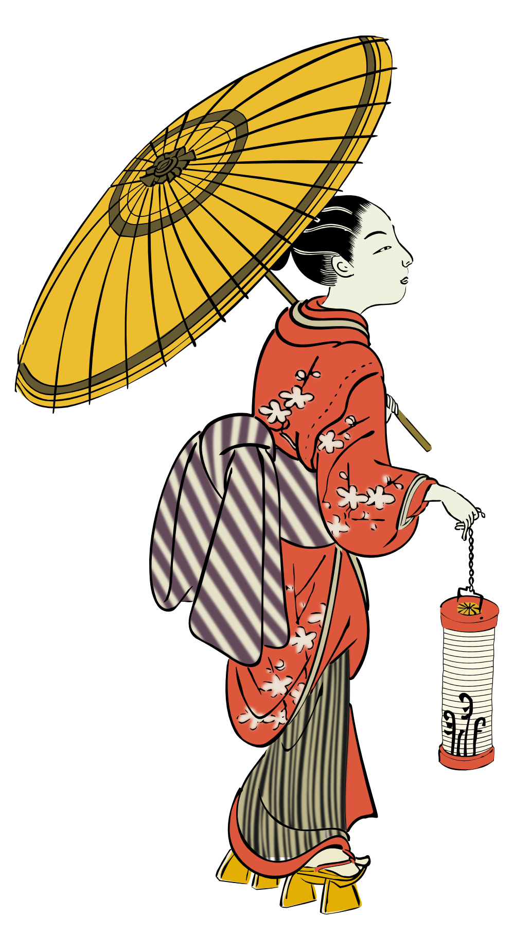
Very good job! What did we learn today?
A look into Japan
Similarities and Differences
A review of “o_e” words

Slide 31
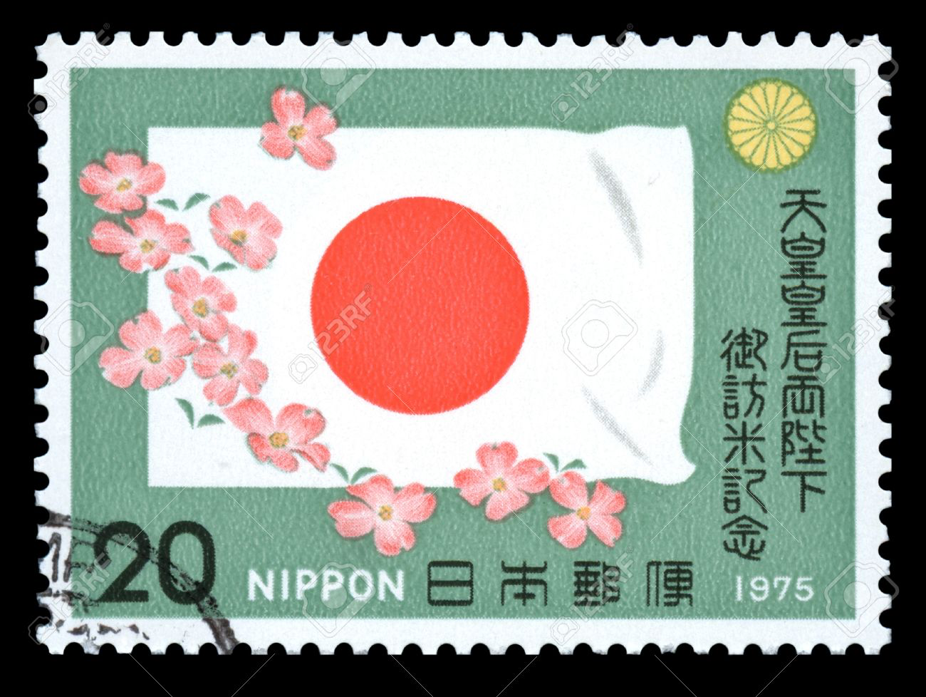
Let’s look at the homework now.
Do you have any questions?

