Slide 1
MLA Citations
Introduction to:

Slide 2
MLA Citations
MLA is a style of documentation that may be applied to many different types of writing.
Primarily used in English, Languages, Cultural, and Liberal Studies Classes

Slide 3
For this course, you will be using MLA Format. Please always refer the MLA Citation guide when creating your citations for all work completed for this course.

Slide 4
Plagiarism, and How to Avoid it
Notes:
Link: http://rosedaletube.com/zfiles/Other/academic-integrity/How%20to%20Avoid%20Plagiarism_%20In%205%20Easy%20Steps.mp4

Slide 5
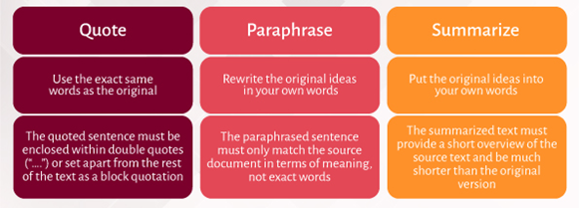
When do you use citations?
Always use citations when you are referencing information that is not your own. This includes…

Slide 6
Formatting MLA Citations
When you cite, you need to…
Create an In-Text Citation - This is indicated in the text of your paper, after the quotation, or paraphrase, or summary. This tells your reader precisely what is borrowed from your source and where to locate that information in the Works Cited Section.
Create a Works Cited Page - This is the list of your sources that you reference at the end of your paper that tells your reader what resources you used to write your paper.

Slide 7
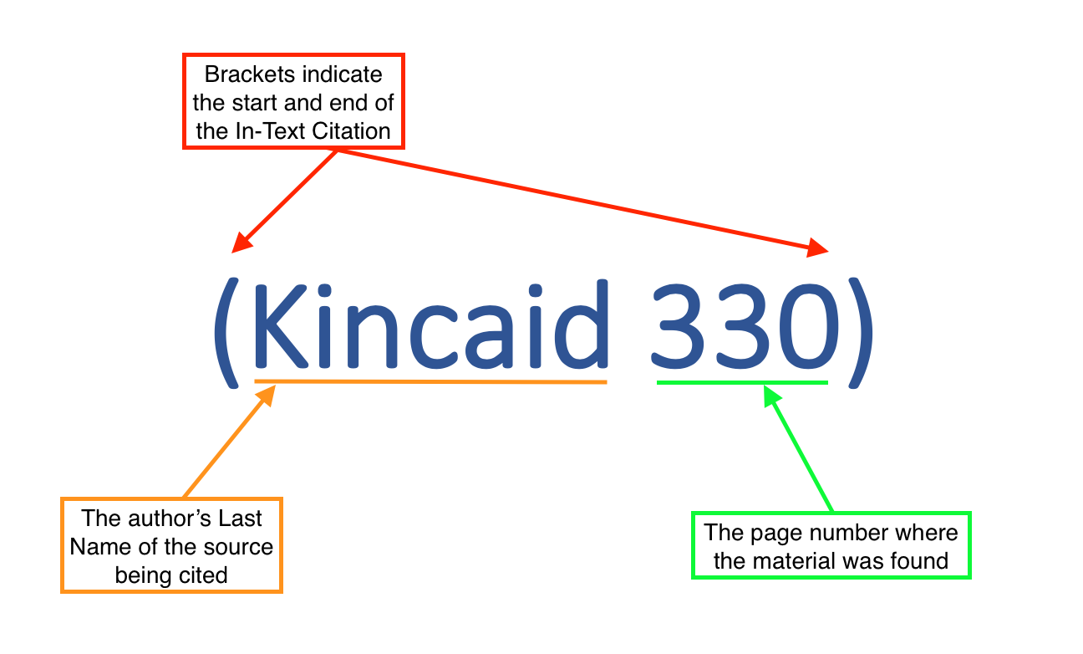
Notice the similarities between the In-Text Citation and the Complete Citation in the Works Cited list.

Slide 8
In-Text Citations
The in-text citation is a brief reference within your text that indicates the source you consulted

Slide 9
The in-text citation usually appears in parentheses and corresponds directly to an entry in your Reference List.
The author's last name and the year published are usually enough to indicate the location in the source.
If the author's name is used in the sentence, do not repeat it in the citation.

Slide 10
Punctuation with MLA Citations
"Direct quote" or Paraphrase (Author's last name page number).
OR
Author's Last Name states, "Direct Quote" or paraphrase (page number).
Take a moment to carefully consider the placement of the parts and punctuation of this in-text citation. Note that there is no punctuation indicating the end of a sentence inside of the quotation marks—closing punctuation should instead follow the brackets.

Slide 11
Punctuation with MLA Citations
There is no punctuation between the author’s last name and the page number inside of the parentheses. The misplacement of these simple punctuation marks is one of the most common errors students make when crafting in-text citations.

Slide 12
Works Cited
A Works Cited includes all elements from the resource you are giving credit to and is included at the end of your work
This will be called a Works Cited

Slide 13
Your COMPLETE citations in your Works Cited will include…
Author (Last Name, First Name)
In this case, the authors name is Jamaica Kincaid
Title of Work
The title of this work is called “Girl”
Name of “Container”
A “container” is where the source is found. A book is a container for the chapters. A Journal is a container for a journal article. This short story is in a container called The Vintage Book of Contemporary Short Stories
Name of Publisher
The publisher is the company that produced the source. The publisher here is "Vintage"
Publication Date
The publication date is the date that the source was printed, released, or posted online. The published date here is 1994
Location
The location of the source is where it can be found. This can be a URL link, page numbers, or physical place. This source location are pages 306-07

Slide 14
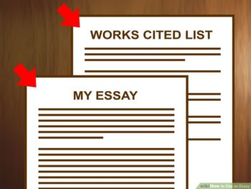
Formatting your Works Cited
Page numbers: Just as the rest of your paper, the top of the page should retain the right-justified header with your last name and the page number.
Title: On the first line, the title of the page—“References”—should appear centered and bolded. It should not be italicized, in capital letters or placed in quotation marks.
Alphabetical order: Starting on the next line after the page title, your complete citations should be listed in alphabetical order by author.
Spacing: Like the rest of your paper, this page should be double-spaced and have 1-inch margins (don’t skip an extra line between citations).
Hanging indents: Each citation should be formatted with what is called a hanging indent. This means the first line of each citation should be flush with the left margin (i.e., not indented), but the rest of that citation should be indented 0.5 inches further.

Slide 15
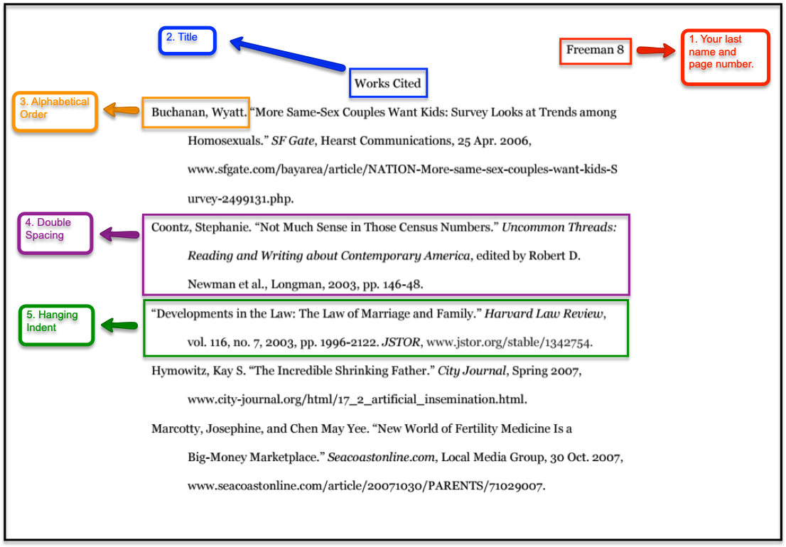
Correctly Formatted Works Cited

Slide 16
Now it’s your turn!
Complete the MLA Citation Module on your course page

