Slide 1
Demography

Slide 2
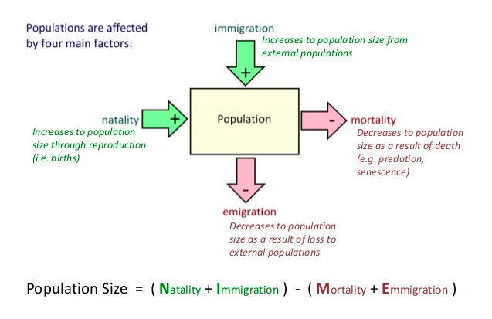
Demography is the study of the dynamic changes that occur in populations. It is known as the statistical study of the processes which affect the density and size of a population over time.
Ecologists use demographic analysis to predict the growth of a population. Four things are used to determine the growth rate of the population:
  Natality – birth rate
  Mortality – death rate
  Immigration – movement of
  individuals into a population
  Emigration – movement of individuals
  out of the population

Slide 3
Life Tables
Life Tables are summaries of the demographic characteristics of a population.
Depending on the life span of the organism, different methods may be used in measuring the species’ lifespan.
Mortality rate is a measure of deaths in a population per unit of time. It can be viewed in two different ways: age-specific mortality (proportion of individuals that were alive at the start of an age interval but died during the age interval) and age-specific survivorship (proportion of individuals that were alive at the start of an age interval and survived until the start of the next age interval).

Slide 4
Table 1 Life Table for a Cohort of 843 individuals of Poa annua (annual bluegrass)
Age interval (in months) | Number alive at start of age interval | Number dying during age interval | Age-specific mortality rate | Age-specific survivorship rate | Proportion of original cohort alive at start of age interval | Age-specific fecundity (seed production)
0-3 | 843 | 121 | 0.144 | 0.856 | 1.000 | 0
4-6 | 722 | 195 | 0.270 | 0.730 | 0.856 | 300
7-9 | 527 | 211 | 0.400 | 0.600 | 0.625 | 620
10-12 | 316 | 172 | 0.544 | 0.456 | 0.375 | 430
13-15 | 144 | 90 | 0.625 | 0.375 | 0.171 | 210
16-18 | 54 | 39 | 0.722 | 0.278 | 0.064 | 60
19-21 | 15 | 12 | 0.800 | 0.200 | 0.018 | 31
22-24 | 3 | 3 | 1.000 | 0.000 | 0.004 | 10
25+ | 0 | - | - | - | - | -

Slide 5
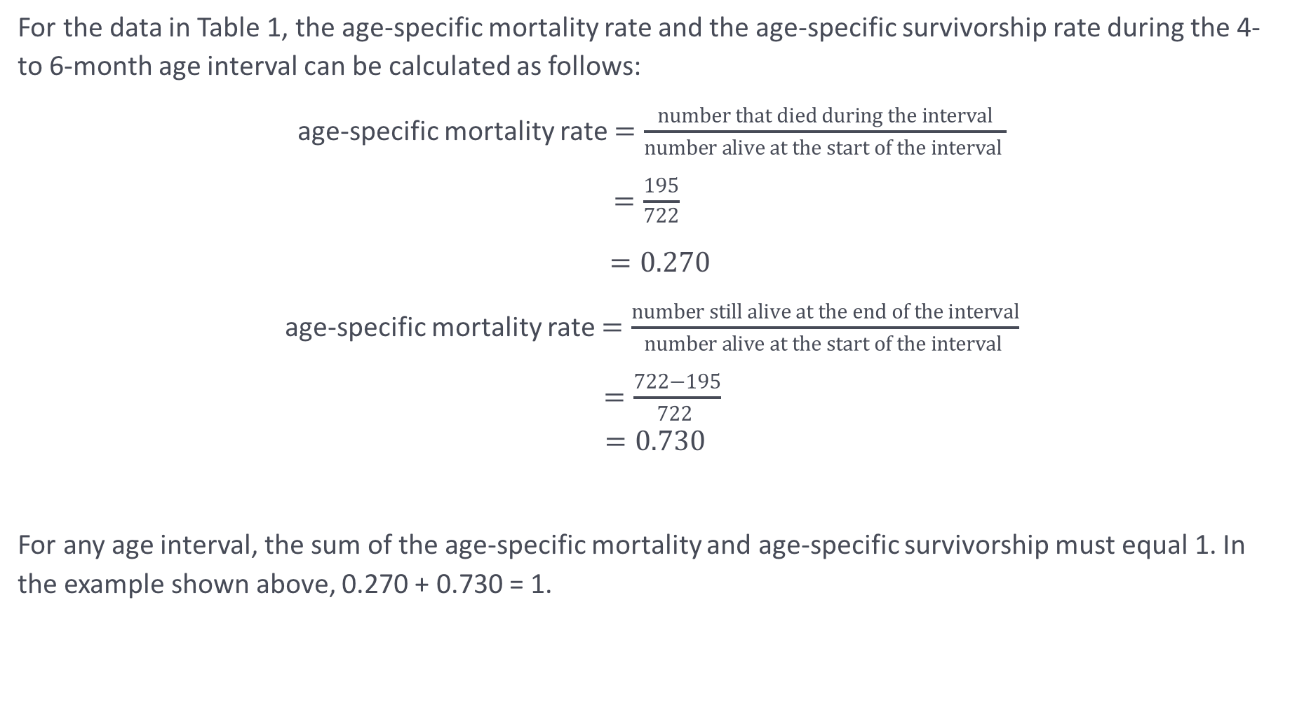
For the data in Table 1, the age-specific mortality rate and the age-specific survivorship rate during the 4- to 6-month age interval can be calculated as follows:
age-specific mortality rate $=\frac{number that died during the interval}{number alive at the start of the interval }$
  $=\frac{195}{\begin{aligned}722 \\ \end{aligned}}$
                $=0.270$
age-specific mortality rate $=\frac{number still alive at the end of the interval}{number alive at the start of the interval }$
$=\frac{722−195}{722 }$
$$=0.730$$
For any age interval, the sum of the age-specific mortality and age-specific survivorship must equal 1. In the example shown above, 0.270 + 0.730 = 1.

Slide 6
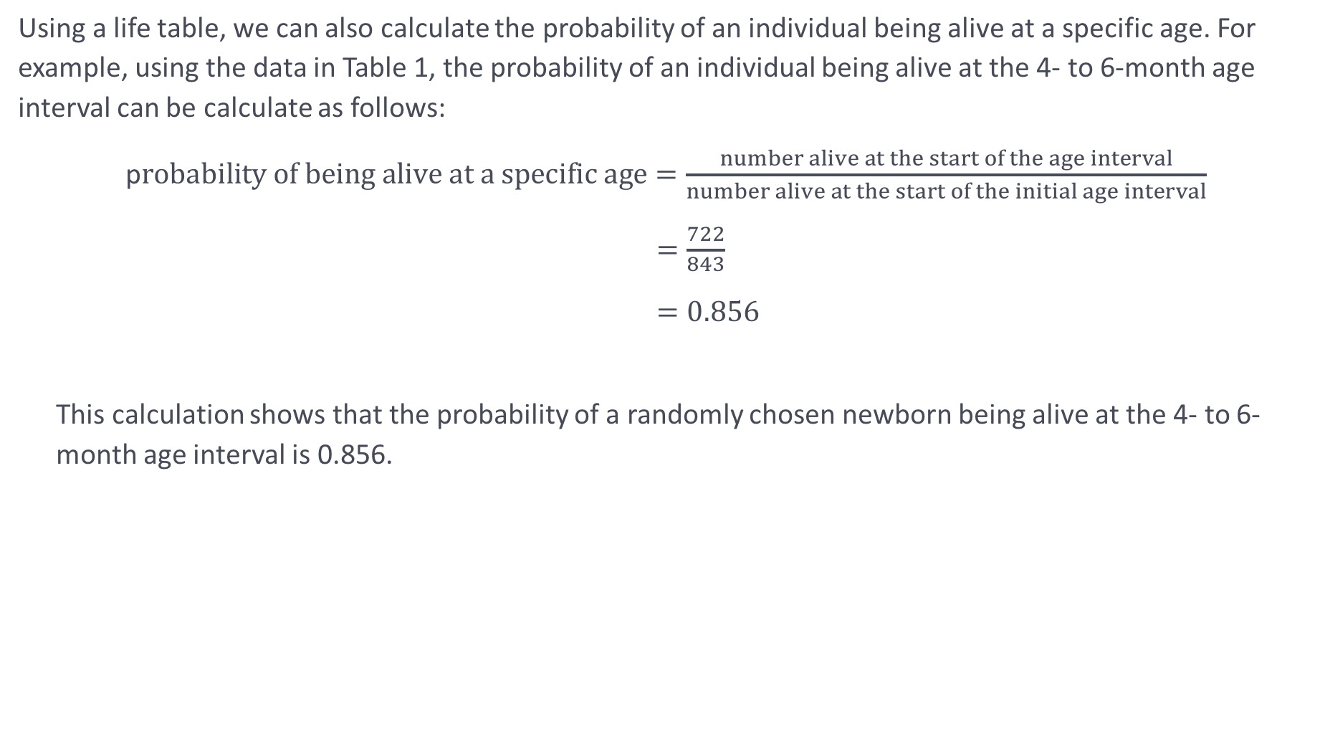
Using a life table, we can also calculate the probability of an individual being alive at a specific age. For example, using the data in Table 1, the probability of an individual being alive at the 4- to 6-month age interval can be calculate as follows:
p$robability of being alive at a specific age=\frac{number alive at the start of the age interval}{number alive at the start of the initial age interval}$
  $=\frac{722}{\begin{aligned}843 \\ \end{aligned}}$
  $=0.856$
  This calculation shows that the probability of a randomly chosen newborn being alive at the 4- to 6-month age interval is 0.856.

Slide 7
Survivorship Curves
Information collected about survival can be depicted graphically in a survivorship curve, which demonstrates the survival of individuals over the lifespan of the species
There are three general survivorship curves: Type I, Type II, and Type III

Slide 9
Type I Curves
Type I curves are relatively flat at the start, reflecting a low death rate in the early and middle years, and drop steeply as the death rate increases in the older age groups.
These curves are typical for large animals that produce few young and provide their young with extended care, reducing juvenile mortality
Type II Curves
Type II curves reflect a relatively constant rate of mortality in all age groups. This produces a steadily declining survivorship.
Organisms that have type II curves generally feed on type III but are preyed on by type I organisms
Type III Curves
Type III curves drop rapidly at the start, reflecting a very high death rate early in life, and then flatten out as the death rate declines for the few individuals that survive the critical stage.
This type of curve is characteristic of species that produce a large number of offspring.
Many plants, insects, marine invertebrates, and fish have type III survivorship curves.

Slide 10
Fecundity
Fecundity is the potential reproductive capacity of an individual or population, varying from species to species.
Fecundity is very dependent on environmental conditions. In years when there is an abundance of resources and optimal climate, species will tend to have higher rates of reproduction. In contrast, in years where there is little food and precipitation, fecundity rates can dramatically drop.

Slide 12
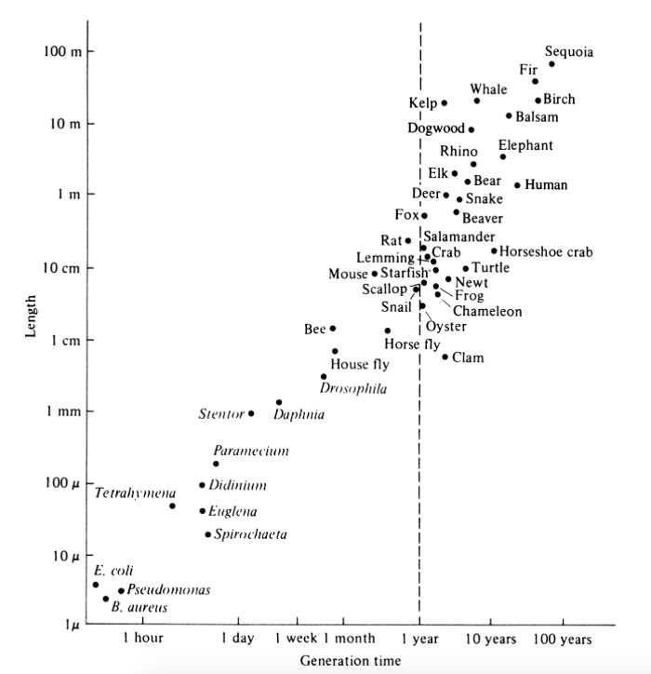
Fecundity is also influenced by several other characteristics:
  The age structure of different populations
    Age structure describes the number of individuals in one of three categories:
      Individuals below the age of sexual maturity (pre-reproductive)
      Individuals at the reproducing age (reproductive)
      Individuals above the age of sexual maturity (post-reproductive)
    Age structure represents its growth history and can predict its growth potential in the future
  Generation time
    Generation time is the time, on average, a species takes to complete a generation
    For example, a species
  Sex ratio of populations

