Slide 1
Properties of Water

Slide 2
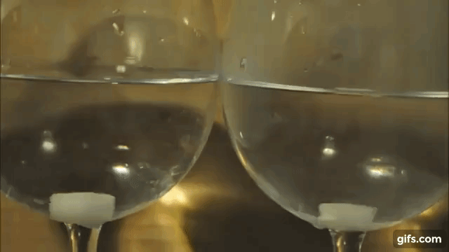
Solutions can be made by mixing certain solids in water. When a solid dissolves, the bonds between ions or molecules that comprise the solid are disrupted, causing the solid to break apart and disperse evenly throughout the liquid to create a homogeneous mixture. In the animation below, ionic bonds between sodium and chloride ions are broken, causing the ionic compound to break up and the individual Na+ and Cl- ions to disperse throughout the water, creating an aqueous solution.

Slide 3
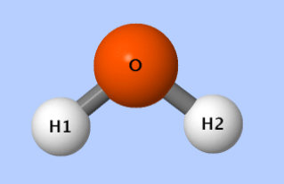
Water (H₂O) is a polar molecule. This is due to differences in the way that oxygen and hydrogen atoms attract the shared electrons that make up the covalent bonds between oxygen and hydrogen atoms.
Slightly Negative Charge
The ability to attract shared electrons is called electronegativity. Oxygen has a higher electronegativity value and as a result the oxygen end of a water molecule tends to have a slight negative charge while the hydrogen atoms tend to have a slight positive charge. This difference in electronegativity makes water molecules slightly polar.
Slightly Positive Charge

Slide 4
Dissolving Ionic Compounds

Slide 5
When an ionic compound dissolves, polar water molecules surround ions causing the dissociation of the ionic compound which leads to the dissolving of the solid. Surrounded ions are then dispersed evenly throughout the solvent, creating a uniform solution.

Slide 6
Dissociation
Dissociation is the process where ions dissociate from ionic cyrstals to become individual ions (ie. Na⁺, Cl⁻). Dissociation can be represented by a chemical equation, for example, the dissociation of solid sodium chloride (table salt) can be represented as follows:
NaCl (s) → Na⁺ (aq) + Cl⁻ (aq)

Slide 7
Dissolving Molecular Compounds
http://www.mhhe.com/physsci/chemistry/animations/chang_7e_esp/clm2s3_4.swf

Slide 8
Like Dissolves Like
Water has the ability to dissolve polar solutes due to its polar nature. However, non-polar solutes like crude oil do not dissolve in water. This is because the polar nature of water molecules cannot disrupt the bonds between molecules of a non-polar solute. However, non-polar solvents are able to dissolve non-polar solutes.

Slide 9
A solution is a homogeneous (uniform throughout) mixture of two or more substances. Samples taken from two different locations in a solution will have the exact same composition.

Slide 10
Solutions are homogenous mixtures which means they have only one phase (visible part) and all of the components of the mixture are evenly distributed throughout.
Heterogeneous mixtures have 2 or more phases, such as oil & water mixed together. Some mixtures may appear homogenous such as blood, but are actually heterogeneous when examined under the microscope.

Slide 11
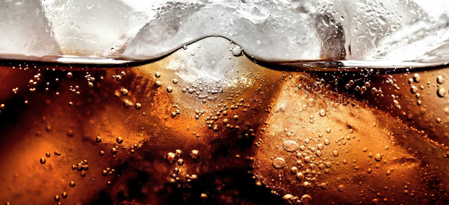
Solutions can exists as solids, liquids or gases.
Solutions can exist as a mixture of two substances in different states (liquid-liquid, gas-gas, solid-solid, solid-liquid, gas-liquid, solid, gas)
CO₂ gas in can of pop
Metal alloys (steel)
Salt water

Slide 12
Solutions are made up of at least 2 components: Solute & Solvent
Solvent – The substance that does the dissolving (the substance that is in greater quantity)
Solute – the substance that is dissolved (the substance in lesser quantity).
Examples: Salt (solute) dissolved in water (solvent)
40% Alcoholic beverage = 40% alcohol (solute)/60 % water (solvent)
75% Alcohol beverage = 75% alcohol (solvent)/25% water (solute)

Slide 13
A solution with a high percentage of solute is concentrated. A solution with a low percentage of solute is dilute.

Slide 14
The most common types of solutions are aqueous solutions. Aqueous solutions are any solutions that have water as the solvent. Many common products are in fact aqueous solutions such as pop, shampoo, bleach, etc.

Slide 15
Success!
You have reached the end of this learning activity. You will know that you have achieved the goals for this lesson when you can describe what a solution is, can compare homogeneous and heterogeneous mixtures and can describe solutions in terms of solutes, solvents and concentration.
Back to Start

