Slide 1

A student creates a solution of barium chloride by dissolving 17.1 g of BaCl₂ in 250 mL of water. What are the concentrations of barium and chloride ions in the solution?
Convert units if necessary
Determine amount of solute in moles
Write dissociation equation
Use mole ratio to determine concentration of ions
Use volume of solution to determine concentration of ions
NOTE: Slides contain audio explanation. Click on the speaker icon to play audio on each slide.

Slide 2
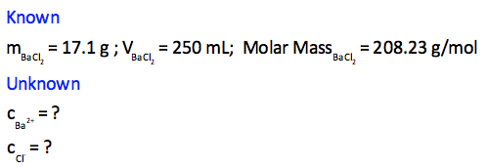
1. List known and unknown values
Note: Use the periodic table to determine the molar mass of BaCl₂

Slide 3
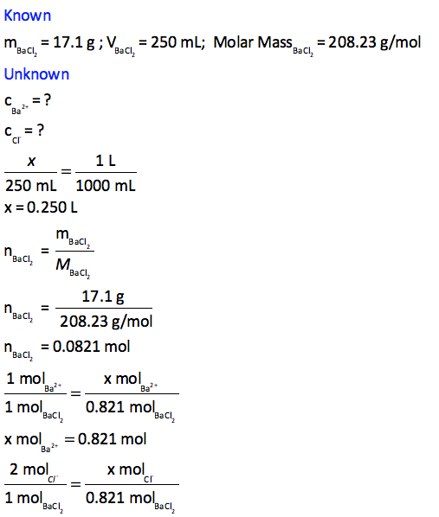
2. Convert Units to L
Therefore, the volume of barium chloride solution is 0.250 L

Slide 4
3. Solve for the amount, in moles, of BaCl₂ in 17.1 g.
Therefore, in 17.1 g of barium chloride there are 0.821 moles.

Slide 5
4. Write the dissociation equation.
BaCl₂ (s) --> Ba²⁺ (aq) + 2Cl⁻ (aq)
Therefore, 1 mol of barium chloride dissociates into 1 mol of Ba²⁺ ions and 2 moles of Cl⁻ ions.

Slide 6
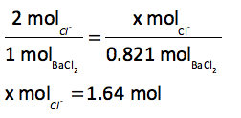
5. Use the mole ratio from the dissociation equation to determine the amount of Ba²⁺ ions and Cl⁻ ions in solution.
BaCl₂ (s) --> Ba²⁺ (aq) + 2Cl⁻ (aq)
Therefore, 0.821 mole of Ba²⁺ ions are in solution and 1.64 moles of Cl⁻ ions are in solution.

Slide 7
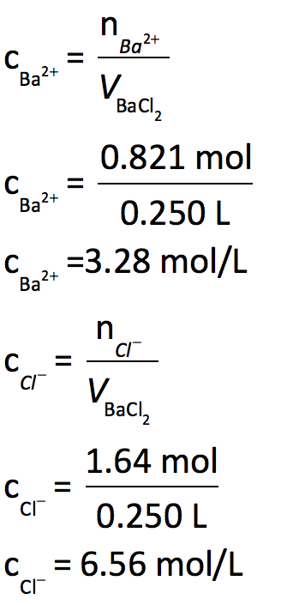
5. Use the volume of solution to determine the concentration of ions in solution.
Therefore, 17.1 g of barium chloride in 250 mL of water dissociates to produce ion concentrations of 3.28 mol/L of Ba²⁺ and 6.56 mol/L of Cl⁻.

