Slide 1
A deep underground cave contains 2.24x10⁶ L of methane gas (CH₄) at a pressure of 1.50x10³ kPa and a temperature of 315 K. How many grams of CH₄ does the cave contain?
Note: Round your answer to 3 significant figures.

Slide 2
A deep underground cave contains 2.24x10⁶ L of methane gas (CH₄) at a pressure of 1.50x10³ kPa and a temperature of 315 K. How many grams of CH₄ does the cave contain?
Note: Round your answer to 3 significant figures.

Slide 3
A deep underground cave contains 2.24x10⁶ L of methane gas (CH₄) at a pressure of 1.50x10³ kPa and a temperature of 315 K. How many grams of CH₄ does the cave contain?
Note: Round your answer to 3 significant figures.

Slide 4
A deep underground cave contains 2.24x10⁶ L of methane gas (CH₄) at a pressure of 1.50x10³ kPa and a temperature of 315 K. How many grams of CH₄ does the cave contain?
Note: Round your answer to 3 significant figures.

Slide 5
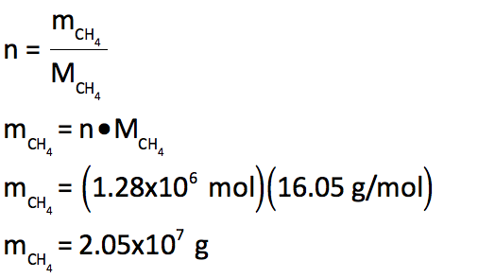
A deep underground cave contains 2.24x10⁶ L of methane gas (CH₄) at a pressure of 1.50x10³ kPa and a temperature of 315 K. How many grams of CH₄ does the cave contain?
Note: Round your answer to 3 significant figures.

Slide 6
A deep underground cave contains 2.24x10⁶ L of methane gas (CH₄) at a pressure of 1.50x10³ kPa and a temperature of 315 K. How many grams of CH₄ does the cave contain?
Note: Round your answer to 3 significant figures.

Slide 7
A deep underground cave contains 2.24x10⁶ L of methane gas (CH₄) at a pressure of 1.50x10³ kPa and a temperature of 315 K. How many grams of CH₄ does the cave contain?
Note: Round your answer to 3 significant figures.
Therefore the cave will contain 2.05x10⁷ g of methane gas.

