Slide 1
The Carnival
Rosedale Academy
Introduction to ESL

Slide 2
What will I learn today?
Find information in text using pictures
Listening in basic conversations
The “g, h, j, k” sounds
Notes:
Have the students read the goals if they can. I find that underlining sentences and asking students to read one sentence at a time works well.

Slide 3
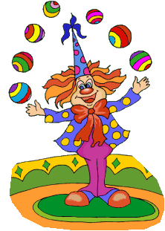
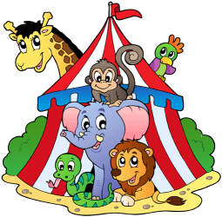
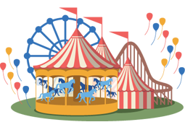
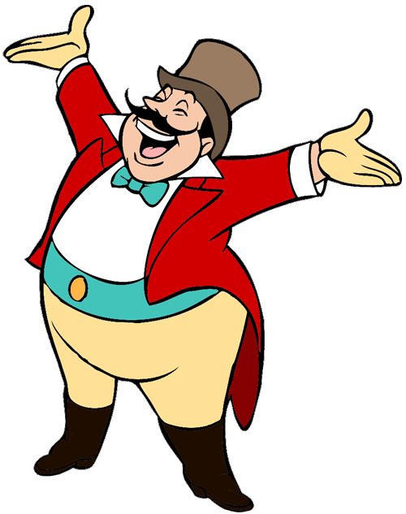
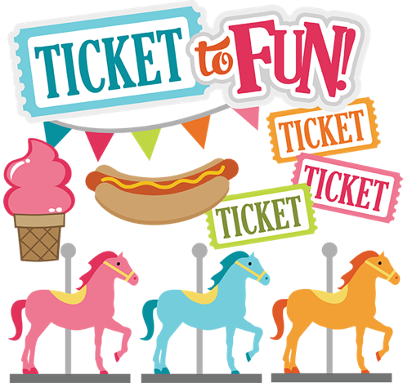
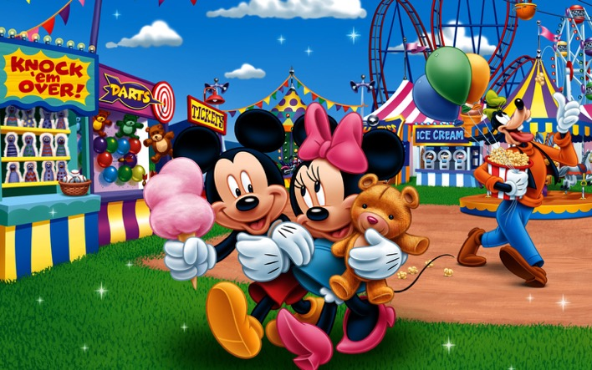
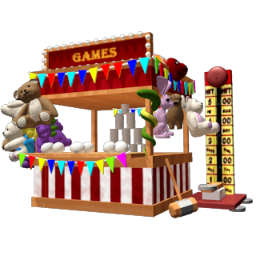
Welcome to the Carnival
Notes:
Review what you saw or did last class.
You might want to bring up the last handout from lesson 1 onto the whiteboard (have it pre completed) to remind them of the vocabulary words that they learned.
Bear, Robber, Cat, Acorn, Dog, Lid, Fox, Wife.

Slide 4
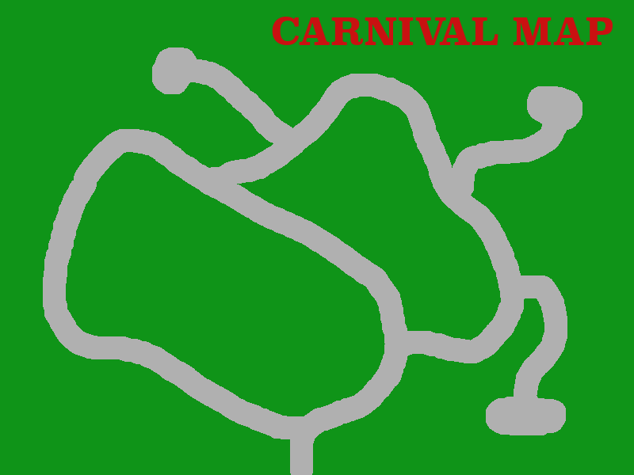
SHOW
RIDES
CIRCUS
FOOD
GAMES
PIE EATING CONTEST
EXIT
Notes:
Talk about the different areas that you can go when you are at a carnival. Today, you will go to pie eating contest and the rides.

Slide 5
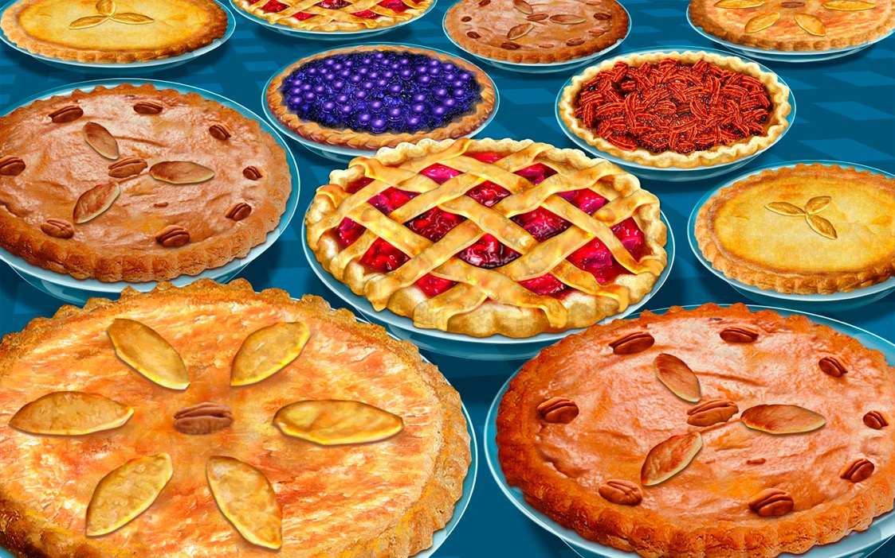
Pie eating contest
Notes:
Ask them if they know what pie is.
Describe/define what a pie is.
Talk about the different types of pies.
See if they can identify (by circling) a blueberry pie.

Slide 6
Apple Pie
Yesterday I picked the apples at the grocery store.
Today I bake the pie at half past four.
Tomorrow I will eat the pie with a yellow spoon.
And I’ll eat it all up till it looks like the moon.
Notes:
Learning Goal: Locate information in a text using visual cues.
Circle the pie and ask them to find the word pie in the title – ask them to underline or circle the word.
Circle the apples and ask them to use th epicture to find the word apples in the first line.
Circle the number 4 on the clock and ask them to find the word four in the second line
Circle the spoon and ask them to find the word spoon….
Circle the moon .....
THEN, read the poem with them. Do each line many times focus on rhythm and intonation. While you are not teaching these this lesson, it will help them. Click the speaker button to hear the rhythm of the poem.
But wait ... There are actions too.
Hold your arm like you are carrying a round basket and start picking apples from in front of you and put them into the basket
Bake the pie – put your palms together loosly and start flipping your hands upside down and right side up over and over like you’re kneeding dough
Hold one hand flat like a plate and start shovelling pretend food into your mouth
Put your hands over your head in a big circle like the moon
There is a video on the resource section of the Moodle Website.

Slide 7
Notes:
Read this book with the students – it is in the resources section as a .pdf file. You can share it as a document.
You can read it and have them repeat it or if they have the capability, they can read each page.
Then locate the different people/things in the pictures.
Draw their attention to new things (e.g., teapot, towel, etc. and spell these words for the stuents)
Focus on nouns that you can find that start with g, h, j, k (garden, hose, horseshoe, jam, kettle)

Slide 8
What will I learn today?
Find information in text using pictures
Listening in basic conversations
The “g, h, j, k” sounds
Notes:
Have the students read the goal that they just completed.
Explain what they learned if needed.
Congratulate them.

Slide 9
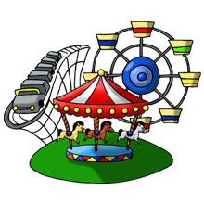
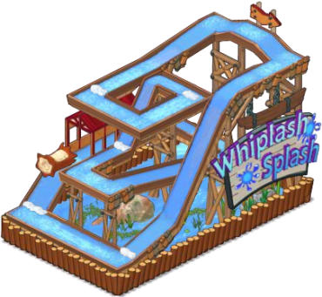
Carnival rides
Notes:
Talk about rides. Today, students will go on a roller coaster.
SHOW THE VIDEO OF THE ROLER COASTER RIDE.

Slide 10
Listening to others:
The first time I rode a rollercoaster …
Notes:
Complete the story for students. Offer about five or six sentences. Tell about:
How old you were
How you were feeling before
What happened
How you were feeling after

Slide 11
Listening to others:
How old was I when I first rode on a rollercoaster?
Notes:
Ask questions about your experience. See if the students understood the story you were telling them.
How was I feeling?
What happened when I rode the rollercoaster?
Who was I with?
What was I feeling before I rode the rollercoaster?
What was I feeling after I rode the rollercoaster?
Etc.

Slide 12
Log ride:
Notes:
Describe the log ride to the students if they don’t know what it is.
SHOW THE VIDEO OF THE LOG RIDE – IT IS IN MOODLE RESOURCES
Ask students if they would like to ride the log ride. Have them give reasons why or why not

Slide 13
Listening to others:
Why does/doesn’t he/she want to go on the log ride?
Notes:
Ask questions to each of the students about the other student responses.
What doesn’t [name] want to go on the log ride?
What does [name] want to go on the log ride?

Slide 14
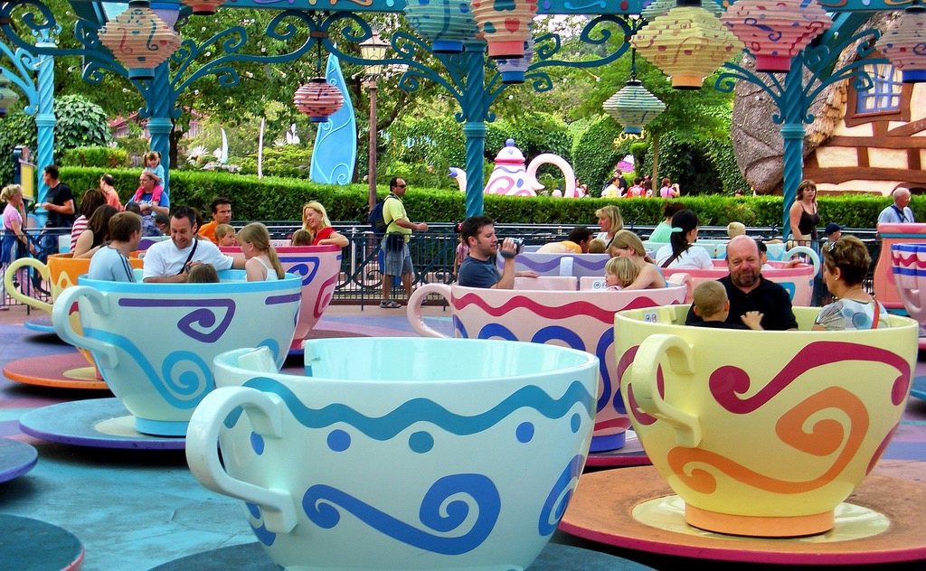
Teacup ride:
Notes:
Describe the teacup ride to the students if they don’t know what it is.
SHOW THE VIDEO OF THE TEACUP RIDE – IT IS IN MOODLE RESOURCES
Ask students what they like or do not like about the ride video.

Slide 15
Listening to others:
Did you like the teacup ride?
Notes:
Ask questions to each of the students about the other student responses.
Why doesn’t [name] like the teacup ride?
Why does [name] like the teacup ride?

Slide 16
What will I learn today?
Find information in text using pictures
Listening in basic conversations
The “g, h, j, k” sounds
Notes:
Have the students read the goal that they just completed.
Explain what they learned if needed.
Congratulate them.

Slide 17
And Now …
“That Sounds Great!”
Brought to you today by the letters:
Notes:
Just a timing slide. Go to the next slide to see the letters.

Slide 18
And Now …
“That Sounds Great!”
Brought to you today by the letters:
Notes:
Ask students if they recognize the letters.
Then ask them if they recognize the logos for the companies:
Google, Honda, The Toronto Blue Jays, Special K cereal.

Slide 19
The “g” Sound:
Notes:
Define garden and gown.
Have the students pronounce the words, then use them in a sentence

Slide 20
The “h” Sound:
Notes:
Define hospital and helmet
Have the students pronounce the words, then use them in a sentence

Slide 21
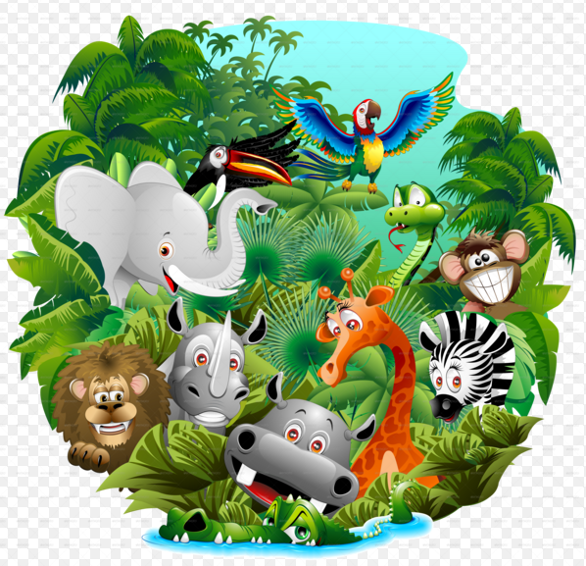
The “j” Sound:
Notes:
Define jeep and jungle.
Have the students pronounce the words, then use them in a sentence

Slide 22
The “k” Sound:
Notes:
Define kite and kayak.
Have the students pronounce the words, then use them in a sentence

Slide 23
Pick Two:
Go and pick up any two items in your house that start with any of the following letters and bring them back for us to see!
g h j k
Notes:
Read this slide to them and explain the game if they do not understand.
Then run off and grab two items that start with any of these letters yourself.
Whatever they bring back, write the words on the slide so they can see the spelling.

Slide 24
What will I learn today?
Find information in text using pictures
Listening in basic conversations
The “g, h, j, k” sounds
Notes:
Have the students read the goal that they just completed.
Explain what they learned if needed.
Congratulate them.

Slide 25
Story Time:
Let’s write a story about the fun we had at the carnival.
Notes:
If I have spare time at the end of a class, I like to go to a blank whiteboard and have the students tell me about what they did today. I will write out (in words) what they did and ask them to illustrate it. Then we read the story and I take a screen shot of it and send it to the administrators in China to pass on to the students.
ALTERNATIVELY: You can go to the whiteboard and write down all the new words that they learned today.
In this second class, I like to get a screencapture shot of the students from the first class (before this class) and photoshop out the background so it’s just their head. Then I get them to write a story about what we all did today. When they are done, I ask them to draw the setting (e.g., if we were on a rollercoaster, I get them to draw a park and rollercoaster). Then I import their heads and draw a stick figure body into the picture. The kids, and parents love it.

Slide 26
What I learned today:
How to find information in text using pictures
How to listen in basic conversations
How to use the “g, h, j, k” sounds
Notes:
You can review with the students everything that they learned today.

Slide 27
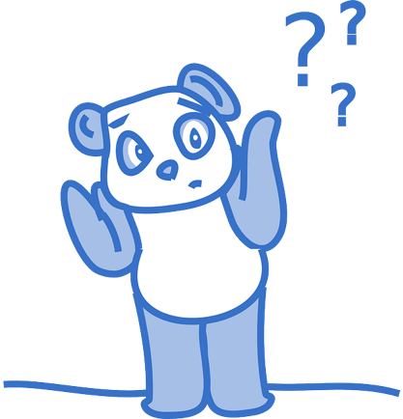
Final Thoughts?
Do you have any questions?
What are you taking away from today?
Do you understand the handout?

