Slide 1
Welcome
ESL Live Introduction Session

Slide 2



Who are we?
Bryan Thompson
ESL / English Program Manager

Slide 3
What is ESL Live?
Fully online
Easy to access
Personalized Learning
Quality Education
Course Credit

Slide 4
Fully Online Live Classes
Ready
Set
Go
Basic Language Skills when and where the student is through our online platform.
Live class with a professional Canadian teacher focused on real communication skills
Creative and realistic language activities that help to build skills and demonstrate proficiency

Slide 5


Easy to Access

Slide 6






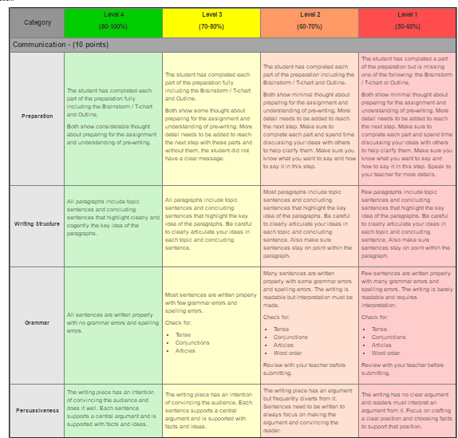
Personalized Learning
1
Diagnostic Assessment
3
Basic Grammar Knowledge
Speaking Assessment
Reading and Writing Assessment
Differentiated Instruction
Activities based on student Interests
Assignments where students can express their ideas, opinions and prior knowledge
2
Leveled Courses
4
ESLEO
Descriptive Feedback
ESLDO
Detailed support for students
Clear, actionable feedback based on rubrics and personalized for students.
ESLCO
ESLBO
ESLAO

Slide 7

Quality Education
Designed by ESL and Education Technology Experts
Based on the Ontario Education System
Based on Education research from around the world.

Slide 8



Course Credit
Ontario Accredited School

Slide 9



ESL Live Plus
Ready
Lesson Plan Support
Instructions of the teacher to support student understanding
Lesson PowerPoint
Set
PowerPoint to guide the instruction in class
Supporting Materials
Go
Materials for learning activities

Slide 10
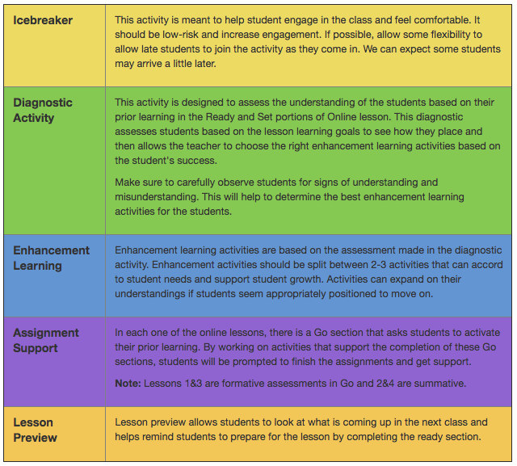
ESL Live Plus
1.5 Hour Lessons
Introduces the class
Checks the Level of the students
Builds Understanding
Helps students with assignments
Introduces the class’ content

Slide 11
Next Steps
Course | Module 1 | Module 2 | Module 3 | Module 4
ESLAO | 2 Units | 2 Units | 2 Units | 2 Units
ESLBO | 2 Units | 2 Units | 2 Units | 2 Units
ESLCO | 2 Units | 2 Units | 2 Units | 2 Units
ESLDO | 2 Units | 2 Units | 2 Units | 2 Units
ESLEO | 2 Units | 2 Units | 2 Units | 2 Units
More Automatically Graded Quizzes and Assignments (as little grading as possible)
Revised and Improved Assignment Instructions
Better geared to a more general audience
Down the road → New Format / Look / Feel

Slide 12
Let’s take a look at how we do things differently?

Slide 13
Welcome
ESLBO Trial Lesson

Slide 14




What we’ll learn
If you were an animal?
Easy Questions - Making a sentence into a question
Is it easy?
Yes, It is easy.

Slide 15











If I were an animal…
Choose an animal.
How are you like that animal?
monkey
fox
wolf
snake
I am…
Friendly
Creative
Silly
Smart
A good listener
sneaky
rabbit
cheetah
owl
moose
rhino
giraffe
zebra
elephant
lion

Slide 16
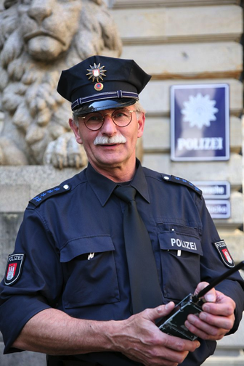
Sentence → Question
Sentence:
He | is | a | police | officer.
Question:
Is | he | a | police | officer?
Answer:
Yes, | he | is.

Slide 17
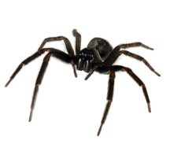


Sentence → Question
Sentence | Question
You are a farmer. | ____________________________
____________________________ | Is it a spider?
The apple is green. | ____________________________
 | Was the celebration big?
The party is on Friday. | ____________________________
____________________________ | Was the movie fun?
You are in China. | ____________________________
Only use:
is / are / was

Slide 18


Eye spy!
Is it a cranberry?
No, it isn’t.
From the picture, choose one thing. Then say “ I spy something that is blue.”
Blackberry
Is it a blueberry?
Cranberry
Yes, it is.
Strawberry
Blueberry

Slide 19
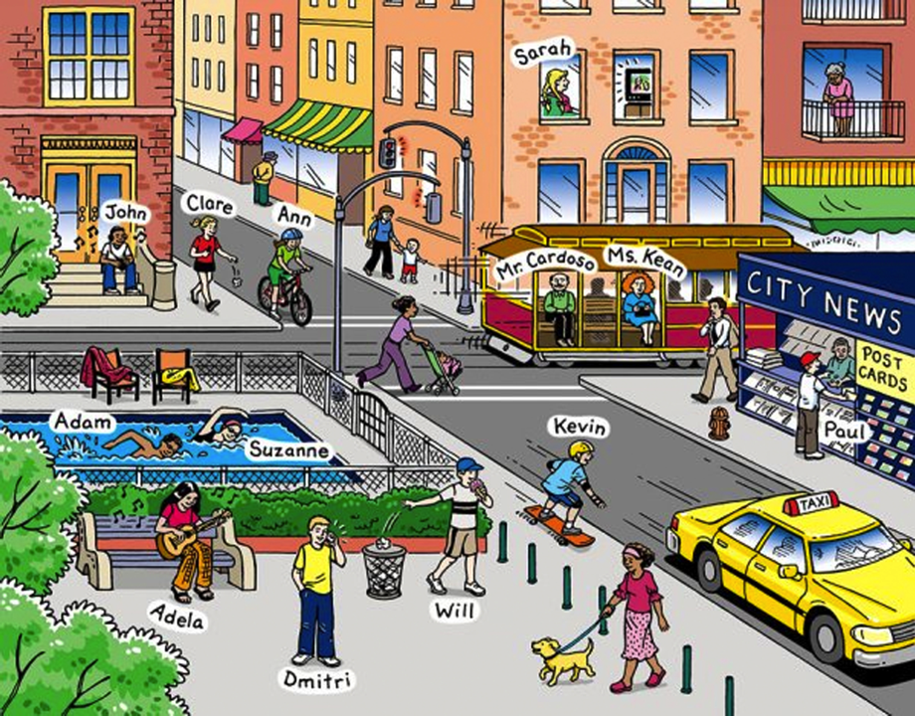

Eye spy!
I’m thinking of something in the picture. Guess what it is by asking questions.

Slide 20


Eye spy!
monkey
I’m thinking of something in the picture. Guess what it is by asking questions.
parrot
toucan
panther
tiger
flower
frog
butterfly
leaves

Slide 21
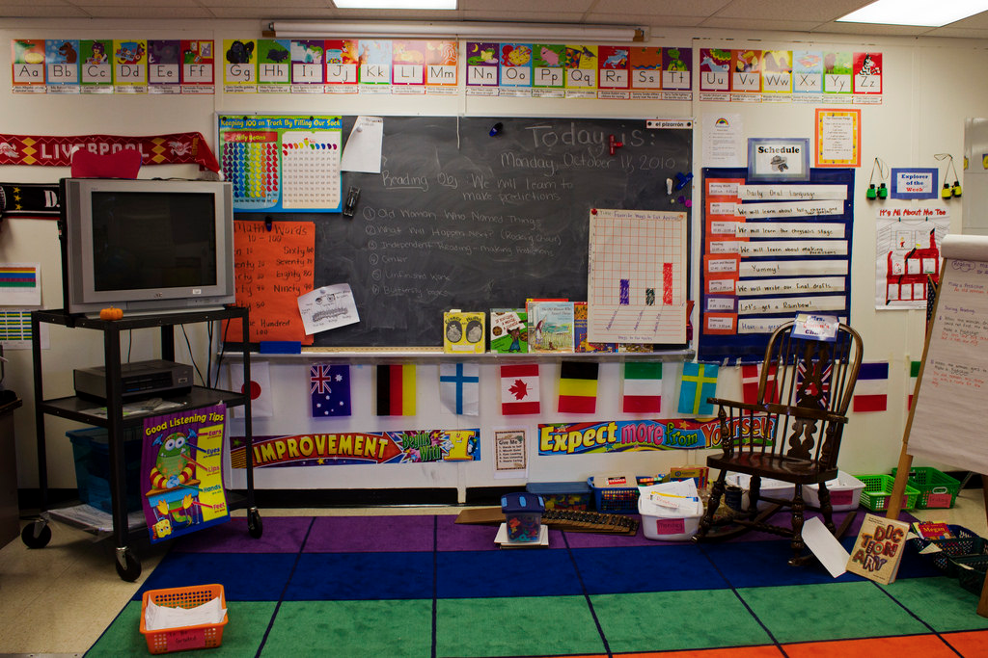
Eye spy!
I’m thinking of something in the picture. Guess what it is by asking questions.

Slide 22
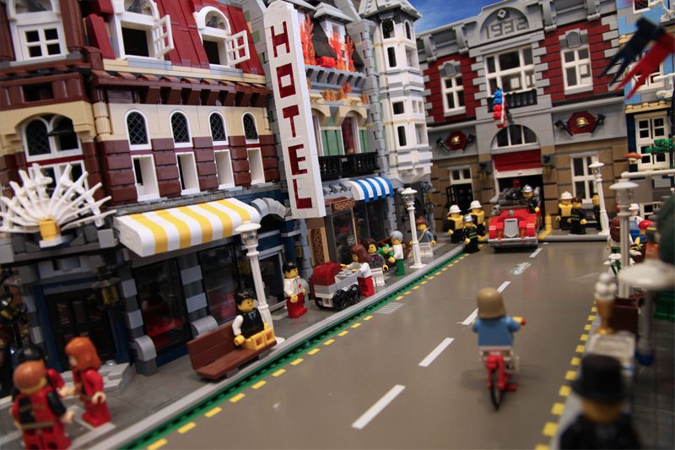
Eye spy!
I’m thinking of something in the picture. Guess what it is by asking questions.

Slide 23
What we learned
If you were an animal?
Easy Questions - Making a sentence into a question
Is it easy?
Yes, It is easy.

Slide 24
Thanks for joining us.
We look forward to seeing you in our next class.

Slide 25
Questions?

Slide 26
Thank you for joining us
Further questions?
Email: bryan.thompson@rosedaleacademy.com

