Slide 1
Lesson 2
In the classroom

Slide 2
Ask about objects in the classroom
Use plurals in speaking
Short /e/ sound

Slide 3
Test your vocabulary!
Your teacher has given you a list of many words from your lesson. Beside each words draw a picture or pictures to match.
Label each picture using “this is….” or “these are…”
Example:
These are pencils.

Slide 4
Supported Plurals T-Chart
PLURALS T-CHART
This/That | These/Those
This is a pen. | These are pens.

Slide 5
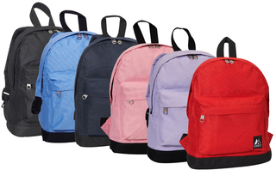
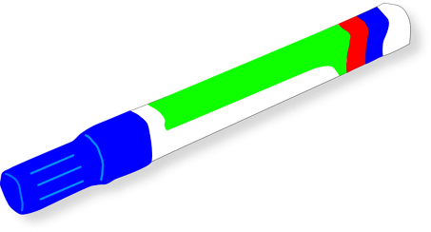
Conversation:
Supported Plurals T-chart
I He/She | need want | (a) | scissors. pencil. pencils.
Q:
What | do does | you he/she | need? want?
A:
What do you want?
I want _________.

Slide 6
Plurals T-Chart
PLURALS T-CHART
This/That | These/Those
This is a pen. | These are pens.

Slide 7
Conversation:
Plurals T-Chart
Grammar Note:
It is = It’s
Mike: | What is that?
Matt: | Where?
Mike: | That!
Matt: | That’s a backpack.
Mike: | Do you need a backpack?
Matt: | Yes, I do.
Mike: | Do you want that backpack?
Matt: | No, not really.

Slide 8
Plurals Conversation
PLURALS T-CHART
This/That | These/Those
This is a pen. | These are pens.

Slide 9
Conversation:
Plurals Conversation
Grammar Note:
It is = It’s
Salesperson: | Hello, what’s your name?
Jane: | My name is Jane. Nice to meet you.
Salesperson: | Nice to meet you too.
Jane: | What is it?
Salesperson: | It’s a computer. What do you need?
Jane: | I need backpacks.
Salesperson: | Backpacks are right here.

Slide 10
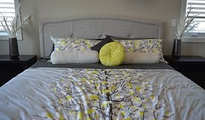
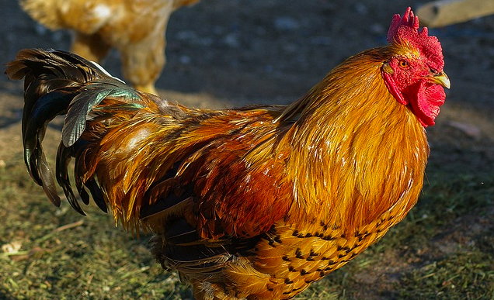
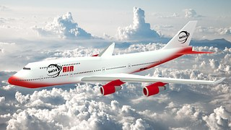
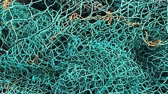
Short /e/ sound
Review the Short /e/ Sound
bed
gem
hen
jet
men
net

Slide 11
Short /e/ Practice
Short vowel story – Circle the short /E/ words.
Sam likes to go to the beach a lot. He can surf on his surfboard. He likes to catch the big waves. He is wet when he gets out of the water. After he has a swim, Sam looks for shells. He is happy when he finds a pretty shell. Sam takes a net to catch a fish, and he finds crabs to cook in a pot. He takes a shovel with him so he can dig in the sand. Sam always has fun at the beach. He goes home before he gets too hot.

Slide 13
Vocabulary Practice

Slide 14
Grammar Practice

Slide 15
Phonics Check

Slide 16
