Slide 1
Lesson 3
What can you do?

Slide 2
Describe what you can do
Use simple present and present continuous
Short /e/ sound

Slide 3
Go Fish!
On a piece of paper, right down three things you can do.
Walk around the classroom. Ask your classmates if they can do the things you wrote on your list.
If someone can do the same thing you can do, write their name on your paper. Example on the next slide.

Slide 4
Conversation
Can you send an email?
Yes, I can.
Grammar
Q:
Can | you | Send an email?
A:
Yes, No, | I | can. cannot.

Slide 5
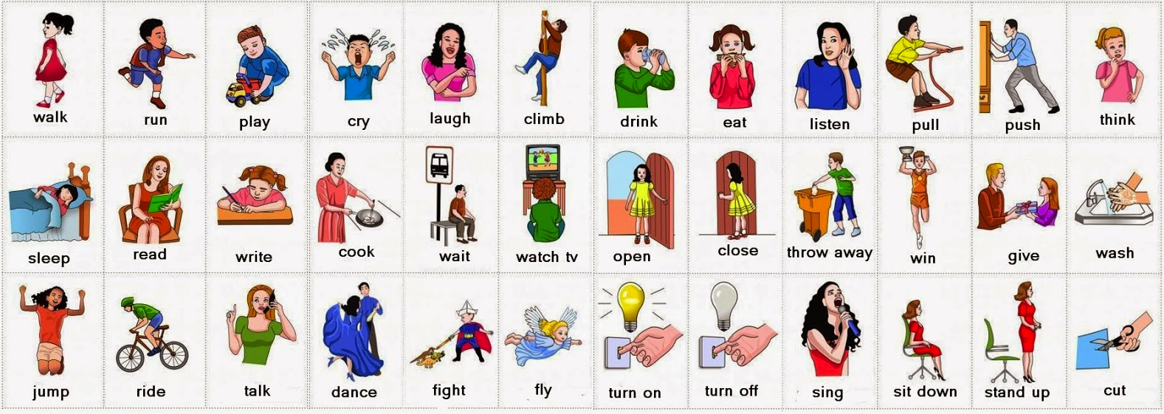
Vocabulary – Introduce your classmates
Q:
Can | you he she | swim?
A:
Yes, No, | I he she | can. cannot.

Slide 6
Conversation
Tell the group what your partner can do.
My partner’s name is: ______
She/he can:
1.
2.
3.

Slide 7
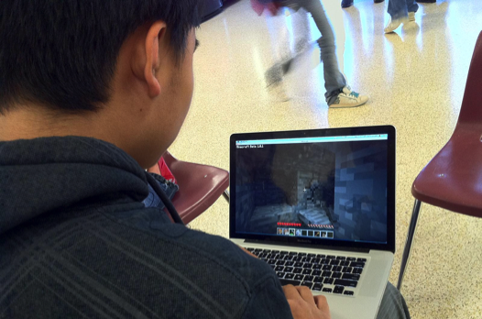
Review - Adding “ing”:
Simon Says/Charades
Q:
What | are is | you he/she | doing?
A:
I He/She | am is | swimming.
run | running
talk | talking
jump | jumping
write | writing
talk | talking
walk | walking
sleep | sleeping
play | playing
sleeping
playing

Slide 8
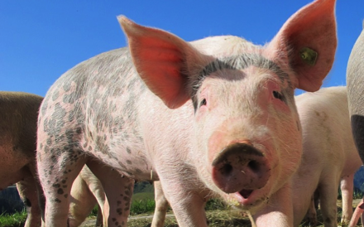
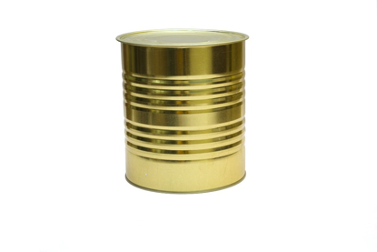
Short /i/ sound
Review
pig
dig
kid
tin
pin
big

Slide 9
Short /i/ Practice
Short vowel story – Circle the short /I/ words.
Sam likes to go to the beach a lot. He can surf on his surfboard. He likes to catch the big waves. He is wet when he gets out of the water. After he has a swim, Sam looks for shells. He is happy when he finds a pretty shell. Sam takes a net to catch a fish, and he finds crabs to cook in a pot. He takes a shovel with him so he can dig in the sand. Sam always has fun at the beach. He goes home before he gets too hot.

Slide 11
Vocabulary Practice

Slide 12
Grammar Practice

Slide 13
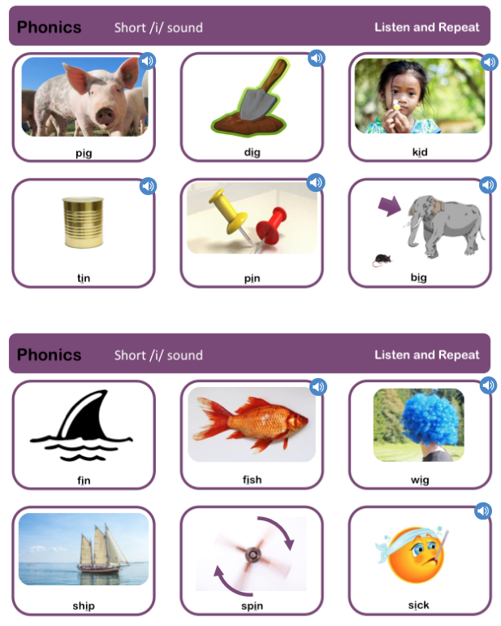
Phonics Check

Slide 14
