Slide 1
Lesson 4
Likes and Dislikes

Slide 2
Describe your likes and dislikes
Describe your favourite things
Short /o/ sound

Slide 3
Go Fish!
Write down three things you like.
Now ask your classmates!
Q:
Do | you | like | pizza?
A:
I | like dislike | pizza.
What do you like?
What do you dislike?

Slide 4
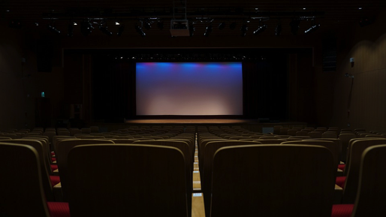
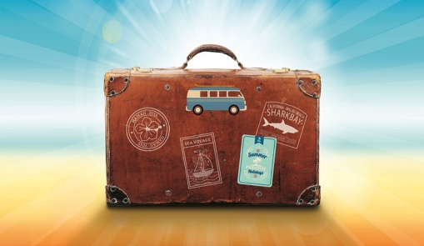
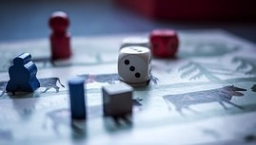
Mini-Poster Likes/Dislikes
I like movies | I like travel.
I dislike sports. | I dislike board games.

Slide 5
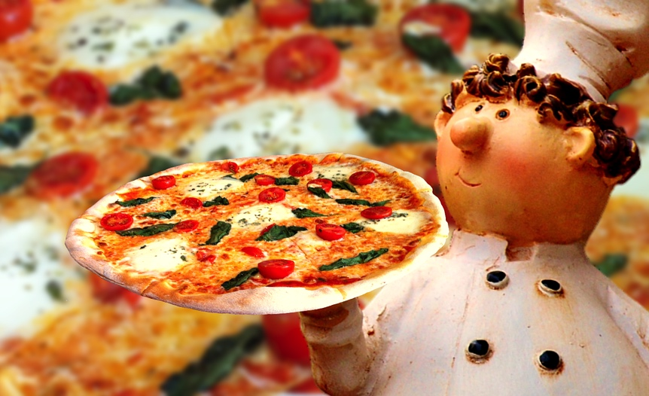
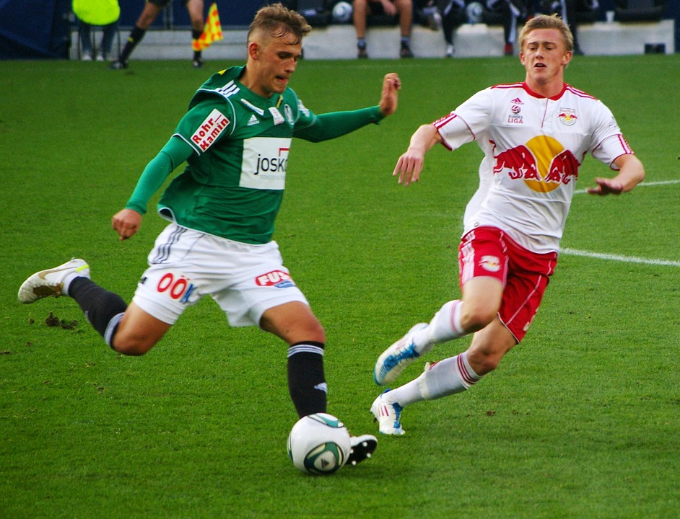
Conversation Review
What is your favourite sport?
My favourite food is pizza.
What is your favourite food?
My favourite sport is soccer.
Grammar
Q:
What | is | your his/her | favourite | sport?
A:
My His / Her | favourite | sport | is | soccer.

Slide 6
Likes and Dislikes - Bingo
Respond and Share

Slide 7
Favourites- Bingo
Fill in your Bingo card, then as your classmates!
Food | Seasons | Sports | Animals | Activities

Slide 8
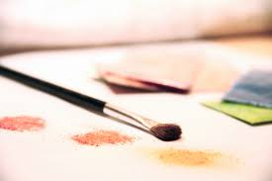
Vocabulary
board games
travel
art
sports
movies
music

Slide 9
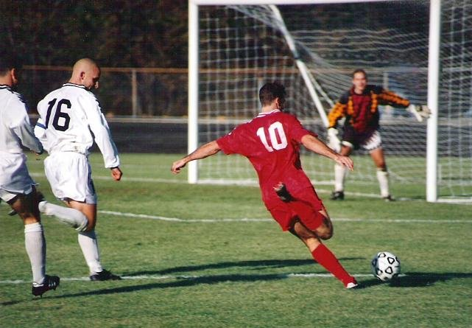
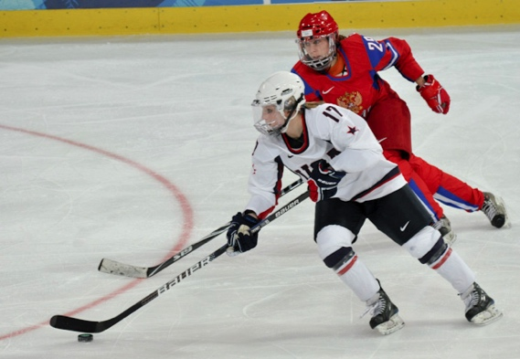
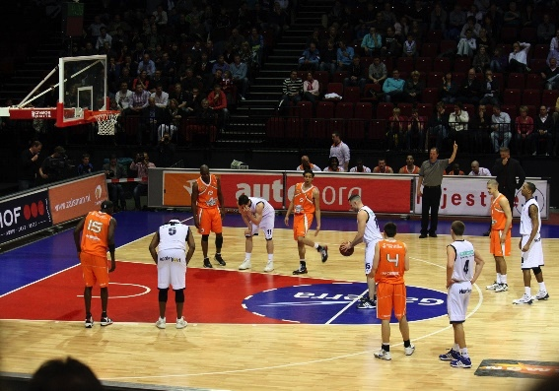
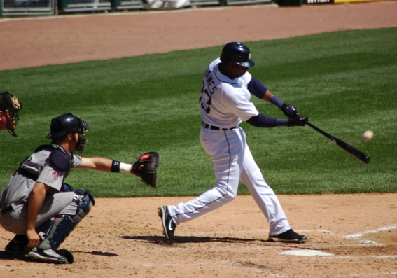
Vocabulary
Respond and Share
hockey
soccer
Sports
basketball
baseball

Slide 10
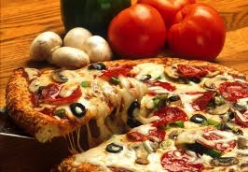
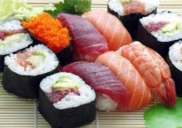
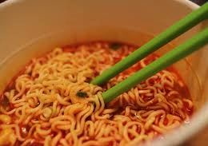
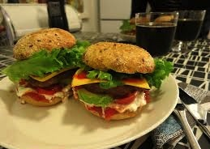
Vocabulary
Respond and Share
pizza
sushi
Food
hamburgers
noodles

Slide 11
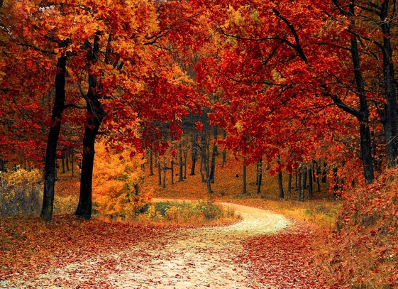
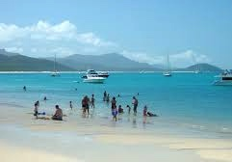
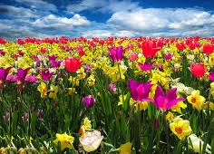
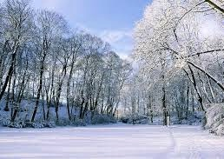
Vocabulary
Respond and Share
summer
fall
seasons
spring
winter

Slide 12
Four Truths and a Lie
Example:
My favourite food is pizza.
I like basketball.
I dislike noodles.
My favourite season is summer.
I dislike dogs.

Slide 13
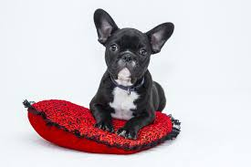
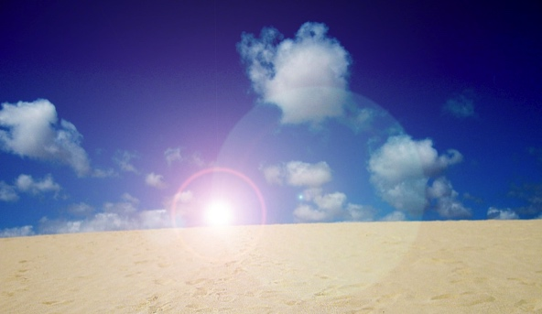
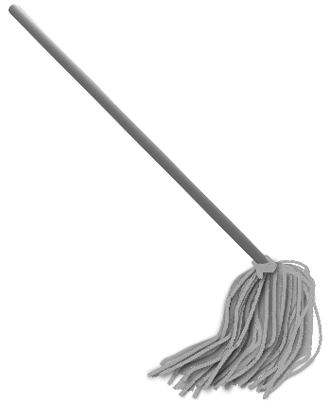
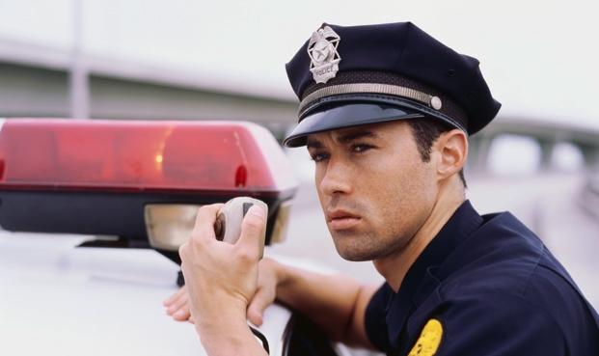
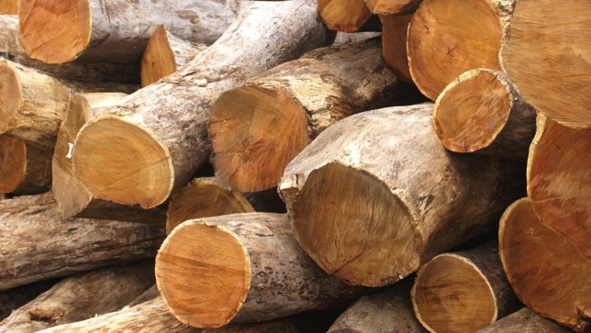
Short /o/ sound
Listen and Repeat
dog
hot
mop
This is a dog
cop
dot
log

Slide 14
Short /e/ Practice
Short vowel story – Circle the short /O/ words.
Sam likes to go to the beach a lot. He can surf on his surfboard. He likes to catch the big waves. He is wet when he gets out of the water. After he has a swim, Sam looks for shells. He is happy when he finds a pretty shell. Sam takes a net to catch a fish, and he finds crabs to cook in a pot. He takes a shovel with him so he can dig in the sand. Sam always has fun at the beach. He goes home before he gets too hot.

Slide 16
Vocabulary Practice

Slide 17
Grammar Practice

Slide 18
Phonics Check

Slide 19
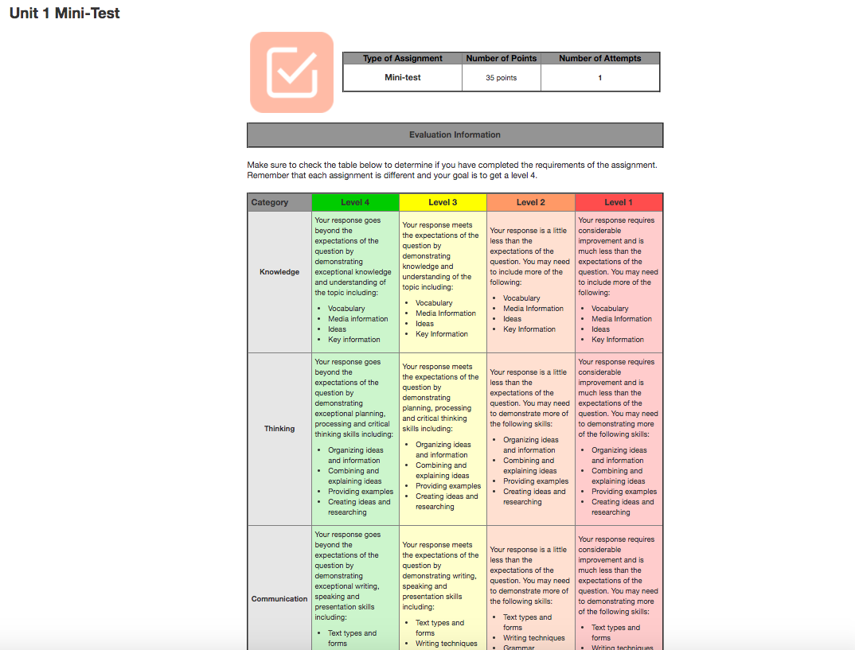
Test

Slide 20
