Slide 1
Lesson 1

Slide 2
Conversation practice- where are you from?
Conversation practice – where do you want to go?
Short /u/ sound practice

Slide 3
Conversation
Where are you from?
I am from Brazil.
Where are you from?
I am from Singapore.
Grammar
Q:
Where | are is | you he/she/it | from?
A:
I he/she/it | am is | from | India.

Slide 4
Find the people from your country!
Country
China
Canada
India
Russia
United States
Egypt
South Africa
England
Australia
You have a country name in your hand. Ask your classmates where they are from. When you find someone from the same country, stay together to find others form your country.
Where are you from?
I am from Canada.

Slide 5
Label the blank map and complete the worksheet.

Slide 6
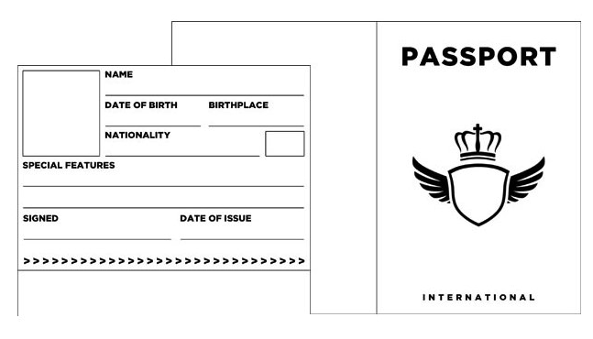
Conversation
Fill in your passport with your information.
What’s your name?
What’s your date of birth?
What is your birth place?
Where are you from?

Slide 7
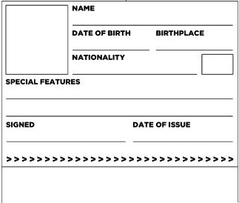
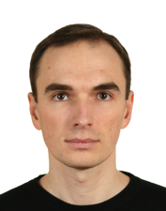
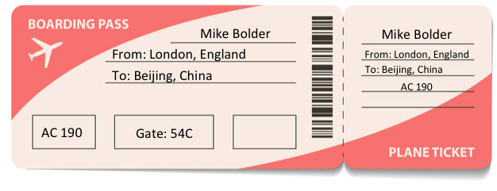
Conversation
Where is he from?
Where is he going?
He is English.
He is going to China.
Mike L. Bolder
03/15/1995
London, England
English
M. L. Bolder
03/22/2015

Slide 8
Where do you want to go?
Q:
Where | do does | you he/she/it | want to go?
A:
I he/she/it | want wants | to go to | Japan.
France
Italy
Korea
Japan
Mexico
Indonesia
Argentina
New Zealand

Slide 9
Why do you want to travel?
Ken is going to France. He likes French Food. His favourite is French Bread. Ken is not French. He is Australian. He does not speak French. He needs to study French.
Jane is South African. She loves to travel. She is going to Canada, The United States and England. She likes American food. She really likes pizza and hamburgers.

Slide 10
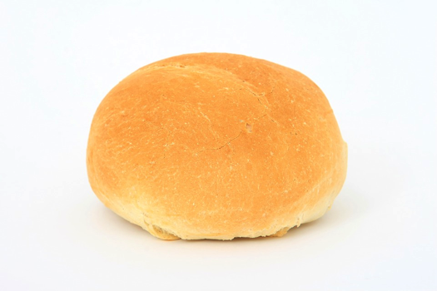
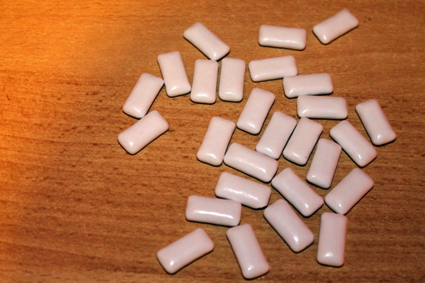
Short /u/ sound
Listen and Repeat
cup
bun
bug
gum
sun
rug

Slide 11
Short /u/ story
Story – Circle the short /U/ words.
Sam likes to go to the beach a lot. He can surf on his surfboard. He likes to catch the big waves. He is wet when he gets out of the water. After he has a swim, Sam looks for shells. He is happy when he finds a pretty shell. Sam takes a net to catch a fish, and he finds crabs to cook in a pot. He takes a shovel with him so he can dig in the sand. Sam always has fun at the beach. He goes home before he gets too hot.

Slide 13
Vocabulary Practice

Slide 14
Grammar Practice

Slide 15
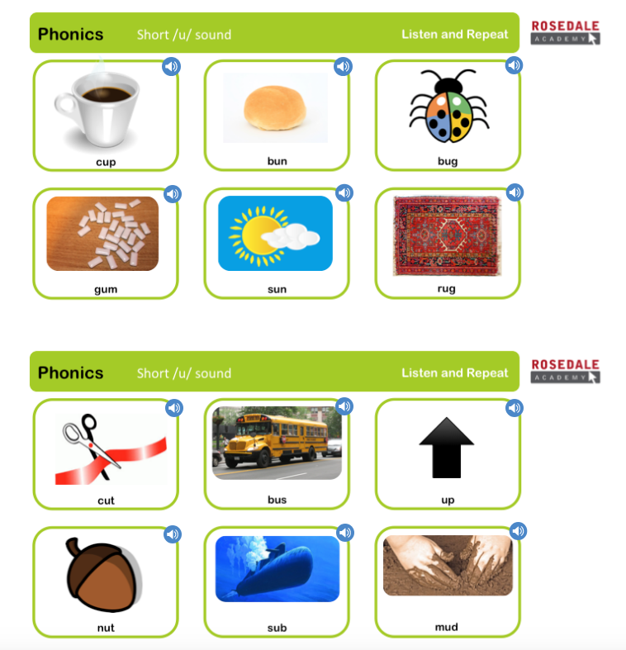
Phonics Check

Slide 16
