Slide 1
Lesson 2

Slide 2
Colors
Using ‘and’
/ee/ sound

Slide 3
Colour Slap
Green
Blue
Black
Yellow
Red
White
Purple
Orange

Slide 4
Guess my flag! Choose one flag. Ask others about the colour of their flag.
Q:
Is | your | flag | blue?
A:
The | flag | is | blue.
 | France |  | China
 | Brazil |  | United States
 | Canada |  | South Korea
 | Italy |  | Egypt

Slide 5
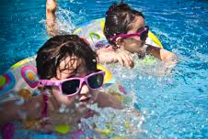
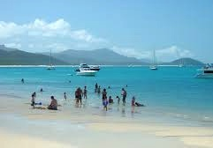
Make your Flag! - Example
My favourite colour is blue.
I can swim. I like summer!

Slide 6
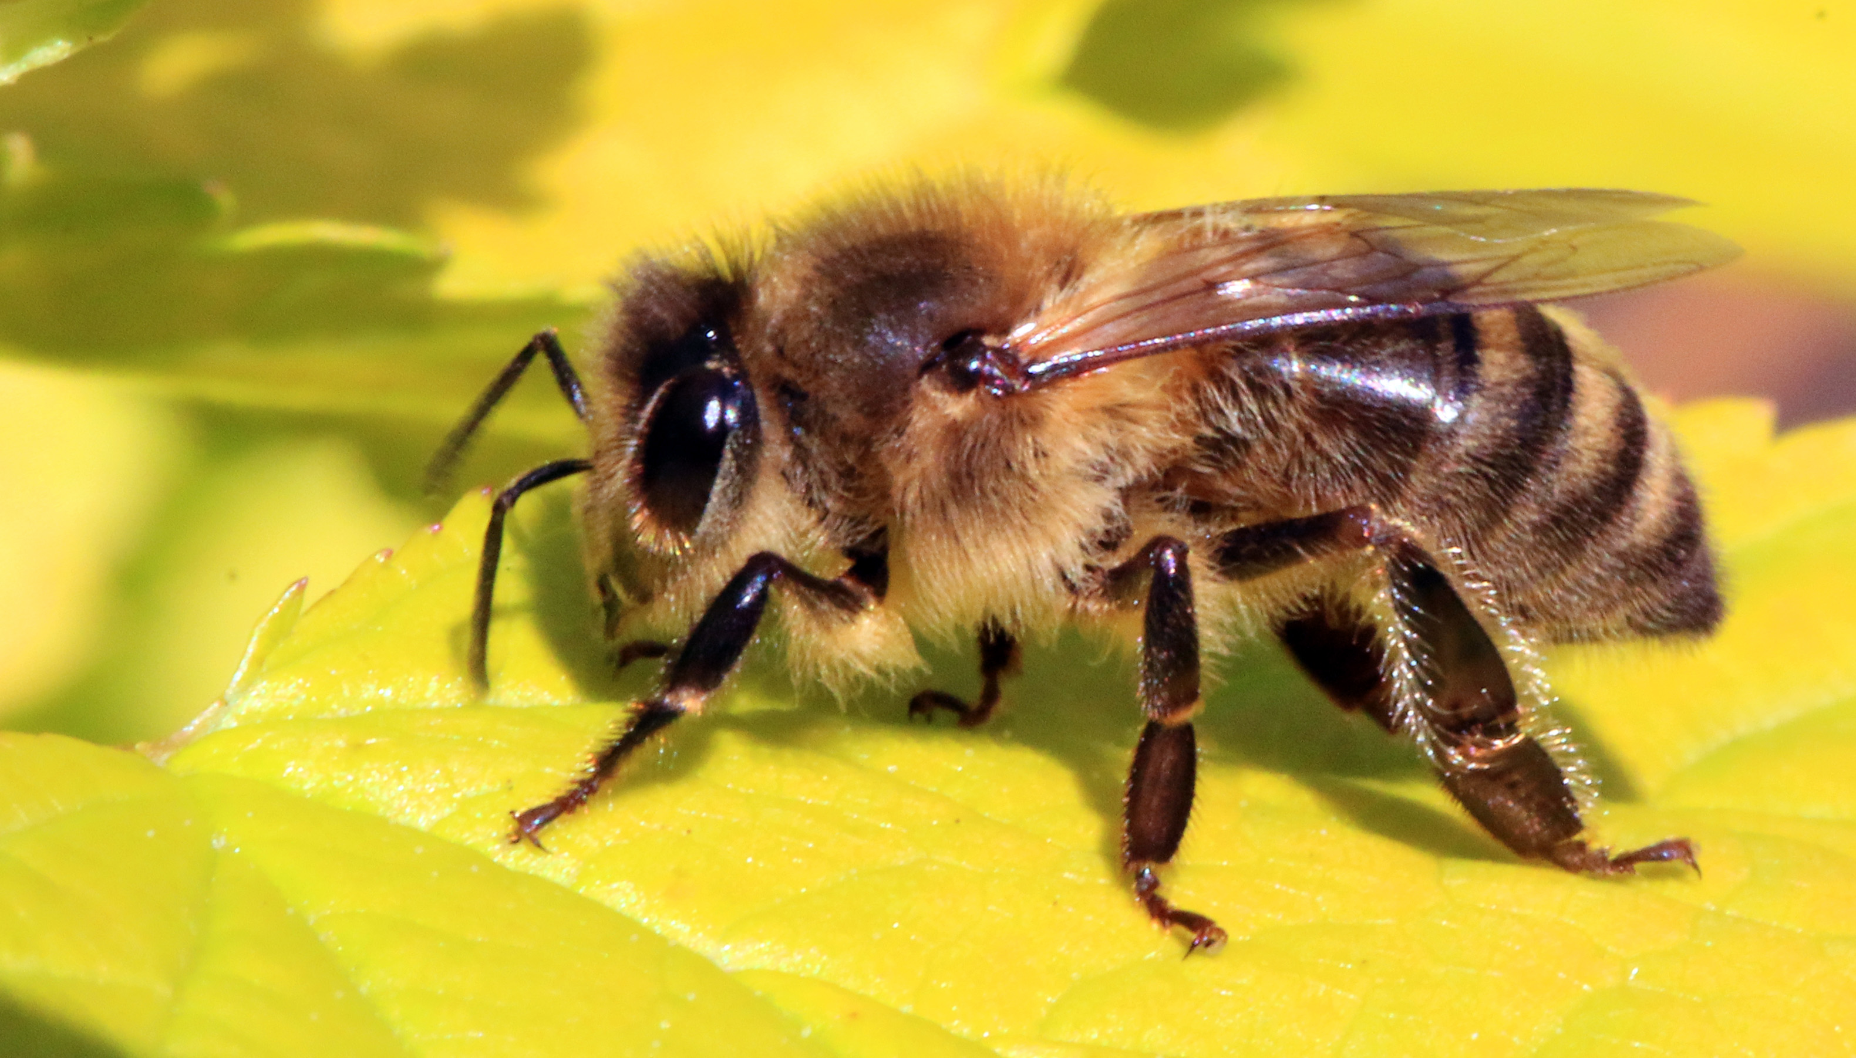
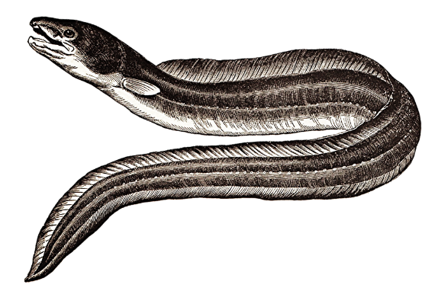
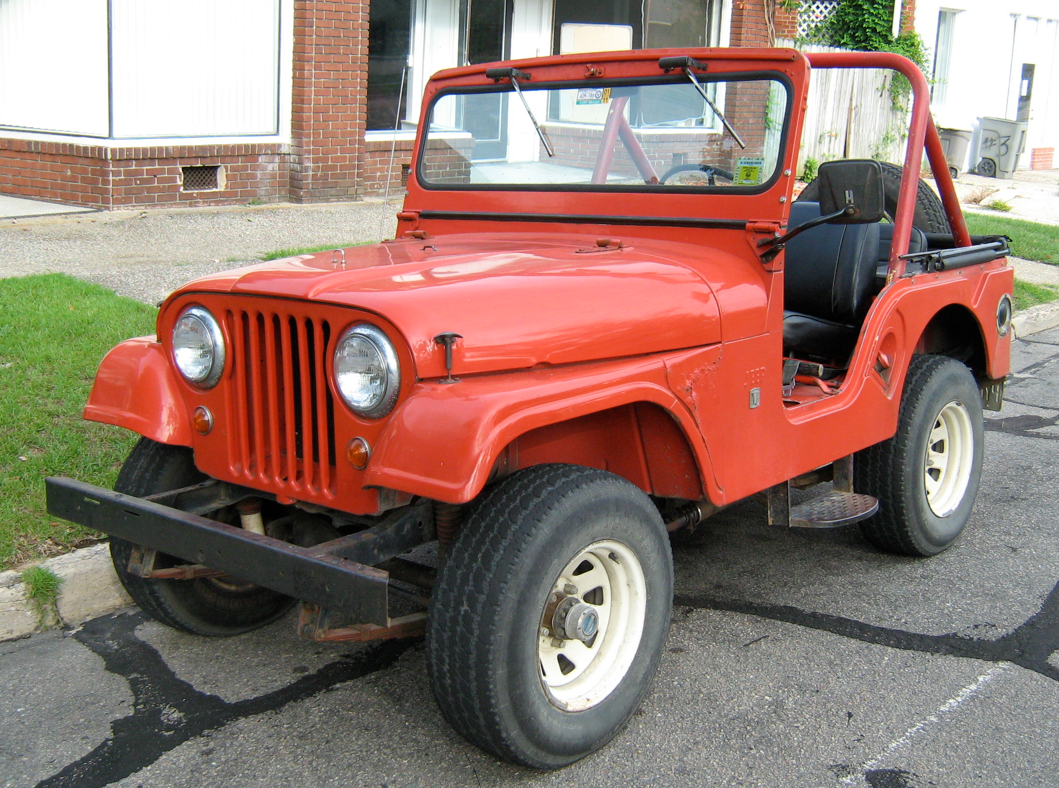
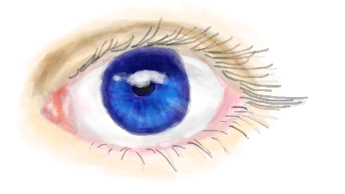
Short /ee/ sound
Listen and Repeat
tree
bee
eel
jeep
tee
see

Slide 7
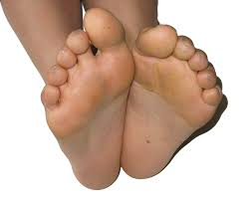
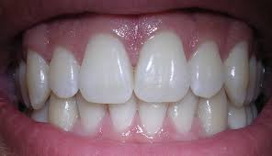
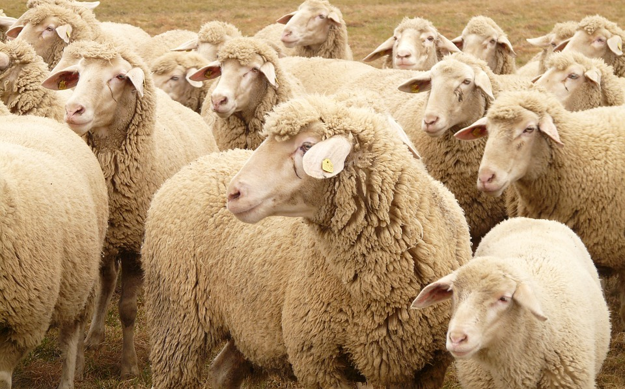
Short /ee/ sound
Listen and Repeat
Z
$0.00
free
zee
feet
teeth
sheep
sleep

Slide 9
Vocabulary Practice

Slide 10
Grammar Practice

Slide 11
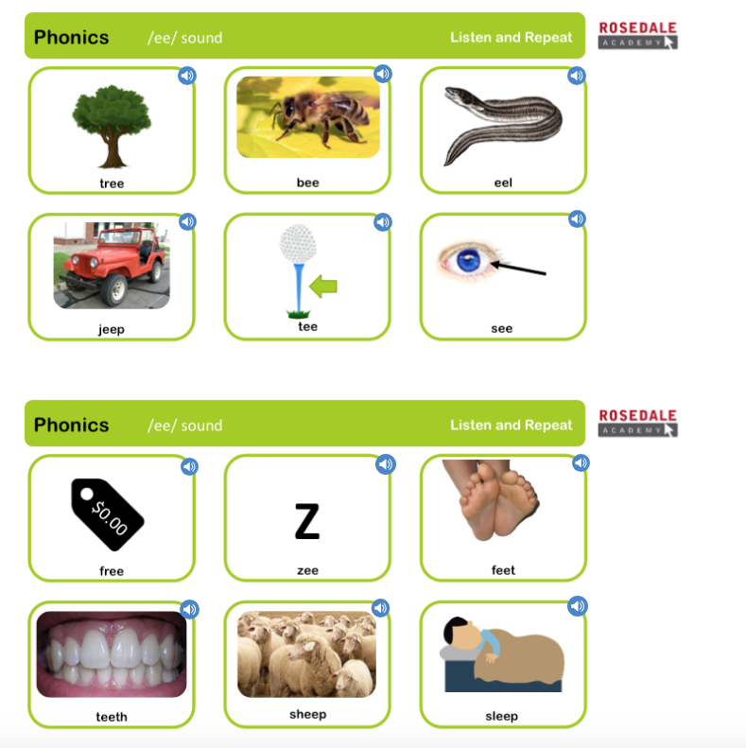
Phonics Check

Slide 12
