Slide 1
Lesson 3

Slide 2
Listening practice – Numbers & Ages
Listening Practice - Time of Day
Class survey – counting practice
Long /oo/ words

Slide 3
Numbers review
1 - one
2 - two
3 - three
4 - four
5 - five
6 - six
7 - seven
8 - eight
9 - nine
10 - ten
11 - eleven
12 - twelve
13 - thirteen
14 - fourteen
15 - fifteen
16 - sixteen
17 - seventeen
18 - eighteen
19 - nineteen
20 - twenty
21 - twenty-one
22 - twenty-two
23 - twenty-three
24 - twenty-four
25 - twenty-five
26 - twenty-six
27 - twenty-seven
28 - twenty-eight
29 - twenty-nine
30 - thirty
40 - forty 50 - fifty 60 - sixty | 70 - forty 80 - fifty 90 - sixty | 100 - one hundred

Slide 4
Telephone!
Listen carefully as you hear the phone number whispered to you. Whisper it to the person behind you.

Slide 5
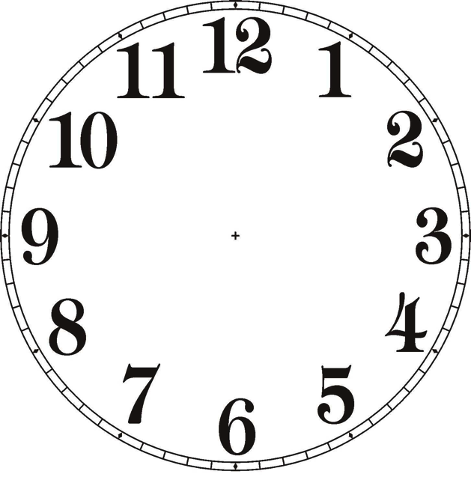
Conversation
Q:
What | time | is | it?
A:
It | is | three | o’clock.
3:00
7:10
9:50
three o’clock
seven-ten
Nine-fifty

Slide 6
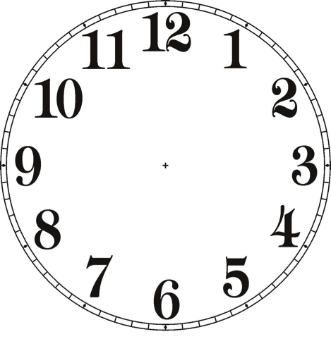
Conversation
Q:
What | time | is | it?
A:
It | is | three | o’clock.

Slide 7
Conversation
Ask questions using the telephone numbers below:
My number is 416-787-3468
What’s your telephone number?
Phone Numbers:
905-387-7032
416-456-789
647-233-8967
231-778-9797
605-899-9067

Slide 8
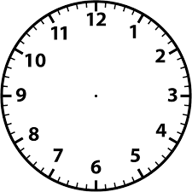
Listening – What time is it? What’s your number?
Listen to the time. Draw the hands on the clock.

Slide 9
Listening to your Partner
With your partner, take turns listening and speaking about the time and telephone numbers. While your partner talks, fill in the blanks.
My name is ___________________________.
I am _____ years old.
My phone number is _______________________________________.

Slide 10
Class Survey
Think of ten questions for your class. Write them on the board.
Question | Number of Students
How many students like pizza? | 24
How many students like baseball? | 16
Count how many students are in each category.
Work with a partner to create a bar graph that shows your survey.

Slide 11
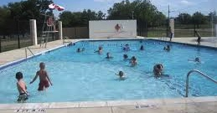
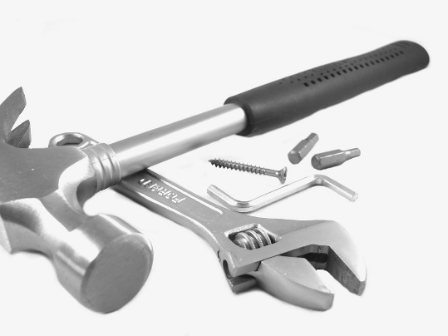
/oo/ sound
Listen and Repeat
root
pool
hook
tool
boot
food

Slide 12
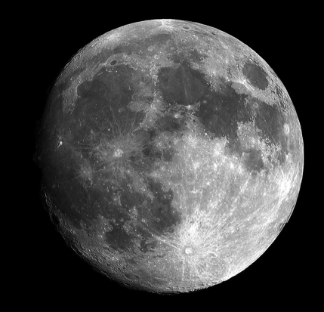
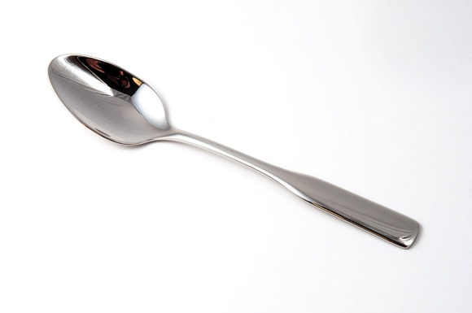
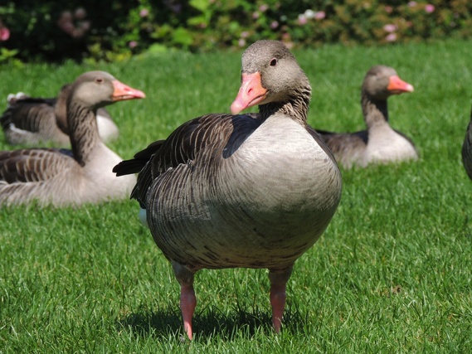
short /oo/ sound
Listen and Repeat
hoop
moon
spoon
goose
broom
cool

Slide 14
Vocabulary Practice

Slide 15
Grammar Practice

Slide 16
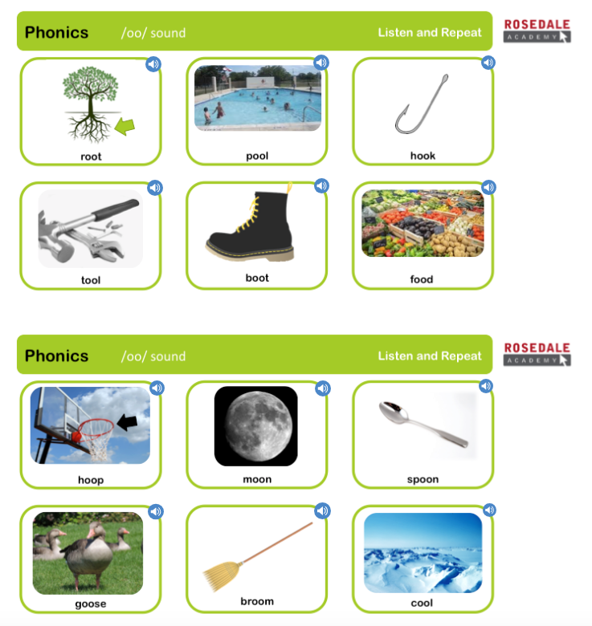
Phonics Check

Slide 17
