Slide 1
Lesson 4

Slide 2
Flashcard Race Review – Review of Phonics
Memory – Review of Nationalities and Countries
My Secret Identity- Review of Favourites, Personal Infromation
Race Against Time – Review time

Slide 3
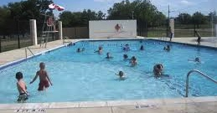
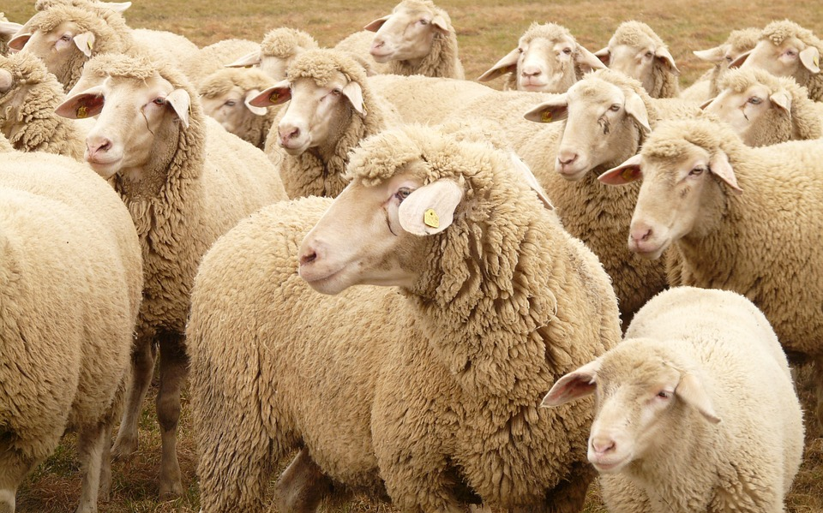
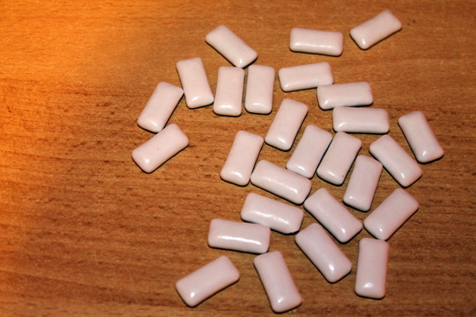
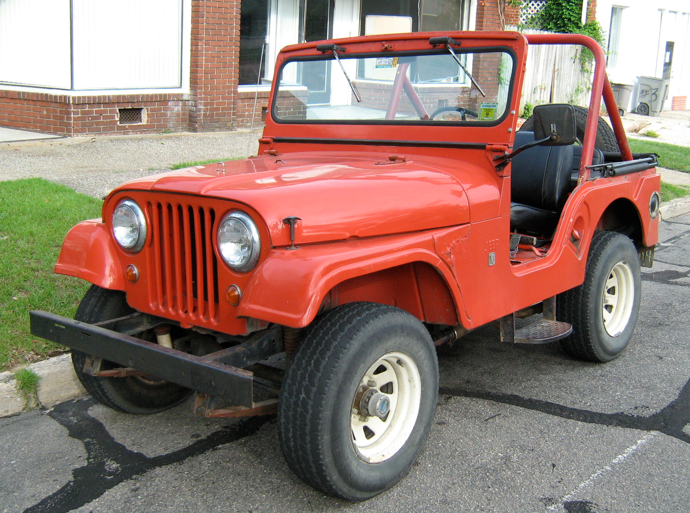
Race!
/oo/ /ee/ /u/ sound
cup
pool
sheep
gum
boot
jeep

Slide 4
Memory – Countries and Nationalities
Country | Nationality
China | Chinese
Canada | Canadian
India | Indian
Russia | Russian
United States | American
Egypt | Egyptian
South Africa | South African
England | English
Australia | Australian

Slide 5
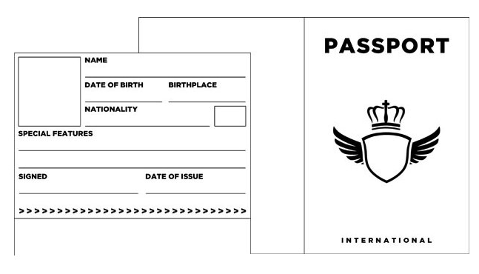
My Secret Identity Activity
James Thomas Gardner
01/13/1999
New York, USA
Canadian
J. T. Gardner
02/13/2014

Slide 6
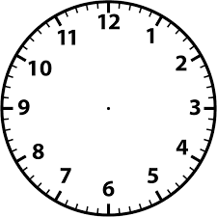
Listening Activity – Race Against Time
Listen to the time. Draw the hands on the clock.

Slide 7
Numbers review – Class Counting Activity
1 - one
2 - two
3 - three
4 - four
5 - five
11 - eleven
12 - twelve
13 - thirteen
14 - fourteen
15 - fifteen
16 - sixteen
17 - seventeen
18 - eighteen
19 - nineteen
20 - twenty
21 - twenty-one
22 - twenty-two
23 - twenty-three
24 - twenty-four
25 - twenty-five
26 - twenty-six
27 - twenty-seven
28 - twenty-eight
29 - twenty-nine
30 - thirty
6 - six
7 - seven
8 - eight
9 - nine
10 - ten
40 - forty 50 - fifty 60 - sixty | 70 - forty 80 - fifty 90 - sixty | 100 - one hundred

Slide 8
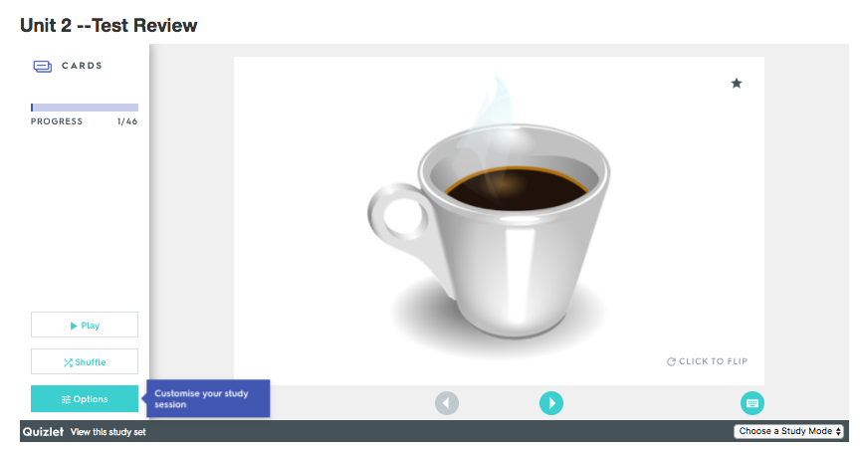
Module 1 Test

Slide 9
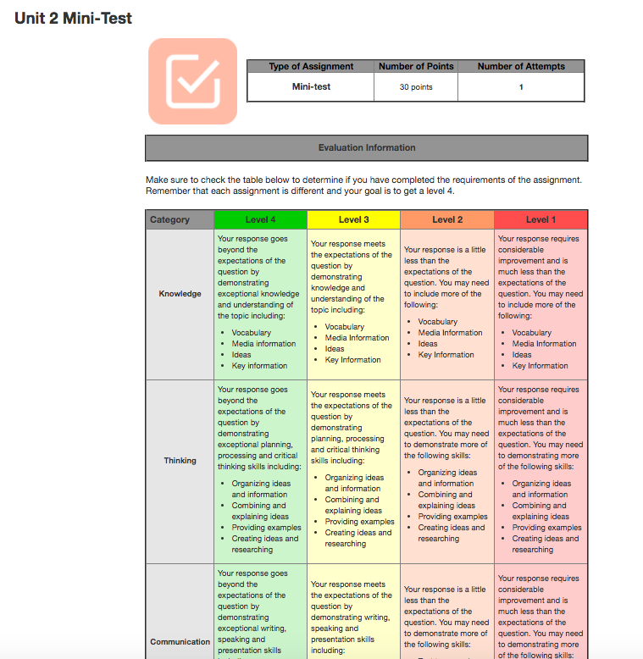

Slide 10
Unit 3, Lesson 1 - Preview
What are some direction words you know? Write them on the board.

