Slide 1
Unit 1 Memories and Ideas
Lesson Three
ESLCO

Slide 2
Make predictions about a reading based on the title
Make text-to-self connections after reading a story
Ask effective questions in the past, present and future tenses
Learn to ask follow-up questions in speech

Slide 3
What Story Am I?
The Adventures of Huckleberry Finn
Action
Horror
Historical
Biography
Sci-fi/ Fantasy
Drama
Suspense
Romance

Slide 4
Questions Creation
Information to ask
Example Question
Who- important people
How- things, people, ideas
When- time or age
Where- locations, or places
Why- things, places, or goals
Who was the most inspiring person in your life?
Where did you go with your ideas?
When did you decide to do this?
Why was it important to make this product?
How did you train for your work?

Slide 5
Question Types: Past, Present, Future
What age where you when you decide to become an astronaut
What are the things you do at work now?
What Training do you feel you still need to complete before you can achieve your goal?

Slide 6
Put the questions in the right place.
Past | Present | Future
What was your favourite thing to do growing up?
When did you decide to become a doctor?
What are you working on right now?
What do you think you will achieve in the next few years?
What is your favourite place to go right now?
Where do you go most often?
How did you fix that problem?
Why did you decide to visit that country?
Who was your favourite person growing up?

Slide 7
Follow Up Questions Create a question that adds more information!
Why did you become a Chef?
A: I became a Chef because I love creating.
What is your favourite meal to cook?

Slide 8
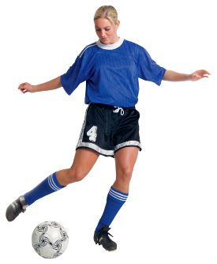
Interview with the Stars!
What was your favourite team growing up?
Create questions for your favourite famous person.

Slide 9
Lesson Assignment
In this assignment, you will take a news article , and with the information given create a ghost written story for a person who may have been at the event.
Remember to include:
Facts about event.
Personal reflections about the event.
Use language that shows you are ghost writing.

Slide 10
Rubrics
Category | Level 4 | Level 3 | Level 2 | Level 1
Thinking | Included 3-4 details from the News article created excellent personal reflections | Included 2-3 details from the News article created good personal reflections | Included 1-2 details from the News article created some personal reflections | Included 1 details from the News article Created few personal reflections
Communication | Used many words that reflected ghost writing style All full sentences and no spelling or grammar errors | Used some words that reflected ghost writing style Mostly full sentences and 2-3 spelling or grammar errors | Used few words that reflected ghost writing style Some full sentences and some spelling or grammar errors | Used no words that reflected ghost writing style Few full sentences and many spelling or grammar errors

Slide 11
Coming Up Next!

