Slide 1

Unit 1
Memories and Ideas
Lesson Four
ESLCO

Slide 2
Understand the importance of audience when writing and speaking
Use pre-writing and planning to help organize ideas and prepare
Present speaking pieces by focusing on 6 tips that make for good speaking

Slide 3



Signal Circle
Use body language to pass along the emotion. No speaking!

Slide 4
Brainstorming With Focus
Include:
Connect all supporting ideas to main idea you want to share.
A main idea you are sharing.
Connect supporting thoughts to the main idea
Create a conclusion that restate your main idea.
Focus: Main idea
Supporting Idea
Supporting Idea
Supporting Idea
Supporting Idea
Supporting idea
Supporting idea

Slide 5
Speaking Presentation
Introduction
Introduce Topic
Create Interest
Body
Support with Ideas
Conclusion
Restate the Topic
Recommendation/suggestion

Slide 6
Organize the Presentation
Introduction
Body
Conclusion
  Today I will be talking about the dangers of distracted driving
  Many accidents occur because people are doing other tasks while driving
  Eating, texting, talking to others, using GPS and adjusting the radio are just some of the common distractions
  Using a cellphone while driving is one of the top ways to be distracted
  Remember to plan to stay focused on the task while driving, remove distracting objects
  Accidents can cause injury and change lives
  For the safety of others we need to remember to drive without distractions

Slide 7
Speaking Techniques
Use these tips to help make your speaking presentation better.
Volume, Tone of voice
Eye contact
Speed of speaking
Body Language
Speaking! No Reading

Slide 8
Lesson Assignment
In this assignment, you will brainstorm about a specific area of your group’s topic. You will work with all information brainstormed to complete an outline of a speaking presentation on the topic.
Remember to include:
One main focus for the presentation.
Use 3-4 ideas to support main focus.
Make sure to organize ideas.

Slide 9
Rubrics
Category | Level 4 | Level 3 | Level 2 | Level 1
Thinking | Had a specific main idea (one topic) Had 4 or more supporting ideas connected to main topic | Had a good main idea Had 3 or more supporting ideas connected to main topic | Had a general main idea Had 2-3 supporting ideas connected to main topic | Had multiple ideas Had 1-2 supporting ideas connected to main topic
Communication | Had a excellent organization Used specific topic related words, and no spelling mistakes | Had a good organization Used some topic related words, and no spelling mistakes | Had a some organization Used few topic related words, and some spelling mistakes | Had a little organization Used no topic related words, and many spelling mistakes

Slide 10
Unit Test
Multiple Choice
Reading Questions
Writing Questions
Vocabulary Questions

Slide 11
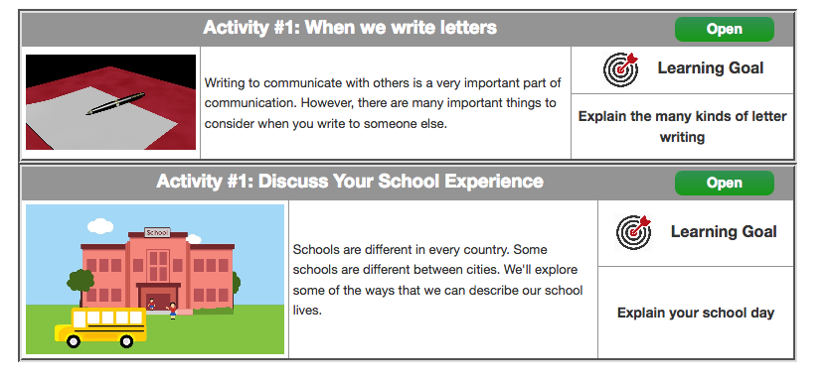
Coming Up Next! Unit 2!

Slide 12
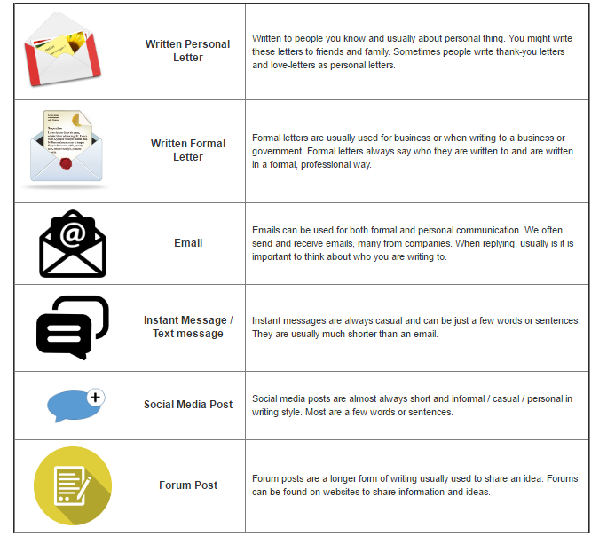

Slide 13
