Slide 1
Unit 2: Letters to a Friend
Lesson One
ESLCO

Slide 2
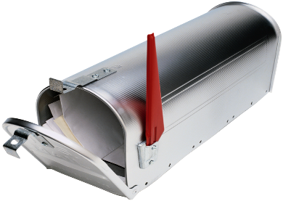
Write a letter in response
Make inferences while reading

Slide 3
Inference Riddles
Try to figure out what the answer is with the clues
Think about hidden information in sentences
What do you think about when reading the sentences
Use your experiences, and prior knowledge !

Slide 4
Create Your Own Riddle!
Include:
Riddle
5-6 clues that hint at the answer
An answer
Use good key words about your person, place or thing!
Clue one
Clue two
One of me a day keeps the doctor away
Answer
An Apple
I grow on a tree. I am ready for you to pick me in the fall

Slide 5
Inference : While Reading
What is inferencing: It is when you reach a conclusion from the text based on your reasoning skills.
Using prior knowledge of things, people, places we can figure out information that is implied by the text.
Example: It was a snowy day
Inferences:
it is winter,
it is cold,
you need to wear winter boots.

Slide 6
Try this sentences: Answer the questions with your inferences.
Her ears ring as I walk through the hallway.
He looked for his umbrella.
I was going to be late because of the turtle on the road.
The leaves were falling off the trees.
My eyes were closed and I counted.
What is making her ears ring?
Why would he need an umbrella?
Why was the turtle a problem?
What season is it?
What game is being played?

Slide 7
Thank You Letter
Personal Greeting
Dear Susan,
Body of letter. Include: what you are thanking them for, how you feel, and other information.
Thank you so much for the wonderful birthday gift. You always know just what I will enjoy, and it shows how much you care. I am very much enjoying the sweater you bought me, and have received many complements.
Restate your thank you message.
Thank you so much for such a thoughtful gift. It really made my birthday amazing!
Closing:
From,
John

Slide 8
Lesson Assignment
In this assignment, you will brainstorm about different things you can thank someone for. You will work with all information brainstormed to complete a thank you letter.
Remember to include:
The reason you are thanking them.
How you feel about the item, or action.
Make sure to follow format of the Letter type.

Slide 9
Rubrics
Category | Level 4 | Level 3 | Level 2 | Level 1
Thinking | Had a specific main idea ( reason for thanking someone) Had 4 or more sentences connected to main topic | Had a good main idea ( had one reason for thanking ) Had 3 or more sentences connected to main topic | Had a general main idea (one or two actions or things) Had 2-3 sentences connected to main topic | Had multiple ideas( thanking for many things) Had 1-2 sentences connected to main topic
Communication | Include all of letter form Used specific topic related words, and no spelling mistakes | Mostly followed letter form Used some topic related words, and no spelling mistakes | Had some of the letter form Used few topic related words, and some spelling mistakes | Did not follow letter form Used no topic related words, and many spelling mistakes

Slide 10
Coming Up Next!

