Slide 1
Unit 2: Letters to a Friend
Lesson Three
ESLCO

Slide 2
Use collective nouns
Discuss groups we belong to
Improve on writing with clarifications
Informal and Formal writing

Slide 3
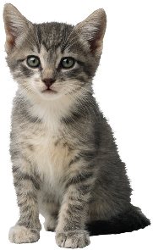
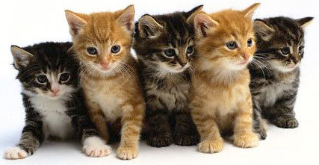
What Group am I?
Help the animals find there group words.
Kitten
Litter

Slide 4
Formal Vs. Informal Create an Invitation for a Party
Informal:
Formal:
Introduce what the event is
Describe the activities that will be happening.
Include: date, time, location.
Introduce what the event is and who it is for.
Describe the activities and events that will take place.
Have an invitation sentence: We are inviting you to…..
Include: Date, time, location, RSVP information.

Slide 5
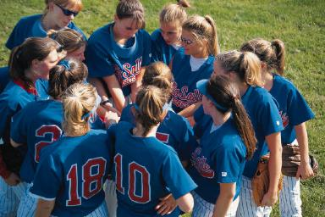
Collective Nouns
Collective Nouns are words that are use about groups of things, people, and animals
A team of players. Team is a collective noun, and it is a singular representing one group.

Slide 6
Lesson Assignment
In this assignment, you will research a specific organization they wish to join and create an introduction letter. You should include: information about experiences, skills, and why you want to be a part of the organization.
Remember to include:
Include all sections of the letter: greeting, closing, body.
Include your skills, experiences, and other important details.
Use 1-2 collective nouns correctly to express ideas.

Slide 7
Rubrics
Category | Level 4 | Level 3 | Level 2 | Level 1
Thinking | Had a very specific organization that I would like to join. Had 4 or more details expressing my skills, experience and why I would like to join the organization. | Had a organization that I would like to join. Had 3 or more details expressing my skills, experience and why I would like to join the organization. | Had a general organization that I would like to join. Had 2- 3 details expressing my skills, experience and why I would like to join the organization. | Had multiple organization that I would like to join. Had 1-2 details expressing my skills, experience and why I would like to join the organization.
Communication | Included 2 or more collective nouns. Used specific word choices to express my ideas, and no spelling mistakes | Included 1-2 collective nouns. Used good word choices to express my ideas, and no spelling mistakes | Included 1 collective noun. Used few word choices to express my ideas, and some spelling mistakes | Included no collective nouns Used none or one word choice to express my ideas, and many spelling mistakes

Slide 8
Coming Up Next!

Slide 11
