Slide 1
Out of the House
Unit 3: Lesson 1

Slide 2

What’s in the bag?
How did you get there?
Giving directions activity
/st/ swap!
Next lesson

Slide 3



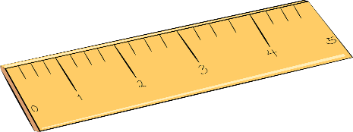

Conversation
Listen and share
What’s in the teacher’s backpack?
What did they bring?
Calculator
Ruler
Pens
Pencil
Computer
Notebook
Textbook
Food (Lunch)
Other?

Slide 4

What’s in the bag?
What does the teacher have in their bag?
I think you have (a) _____________ in your bag.

Slide 5

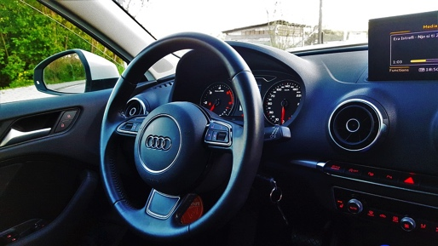
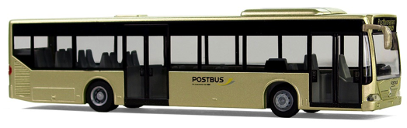
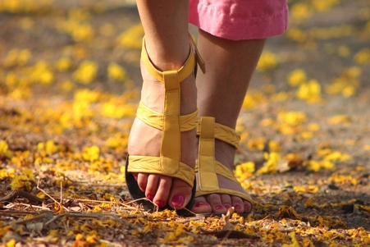
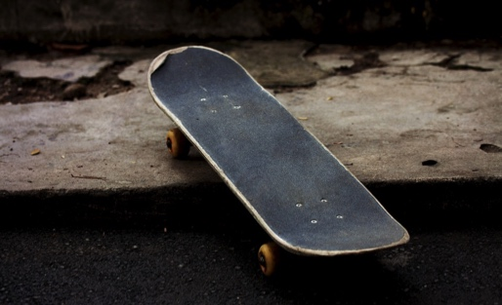

Work in pairs to choose the best way to get here.
Q:
How | did | you he/she | get | here?
A:
I | took the bus.
From the school to the hospital
From the school to my house
From Beijing to Dalian
From Egypt to France
From my house to my friend’s house
From the school to the playground
From the library to the grocery store
From the Hong Kong to Guangzhou
took the bus
rode my bike
drove a car
flew in an airplane
walked
skateboarded

Slide 6

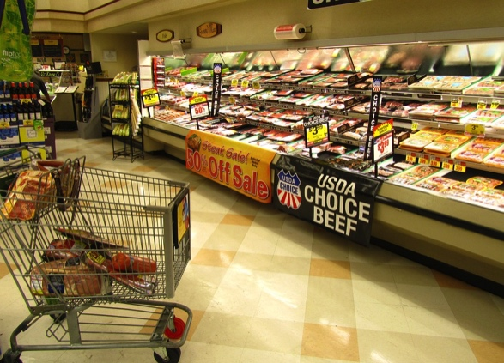
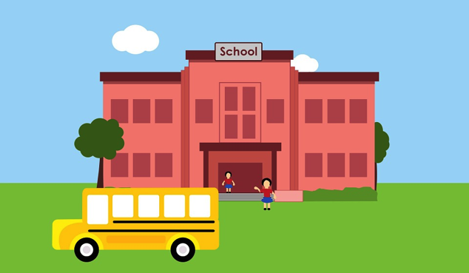
Directions!
Practice Giving and
Listening to Directions.
Q:
How | do | I | get | to | the mall?
A:
Go | right | then | left.
Shopping Mall
Grocery Store
School

Slide 7



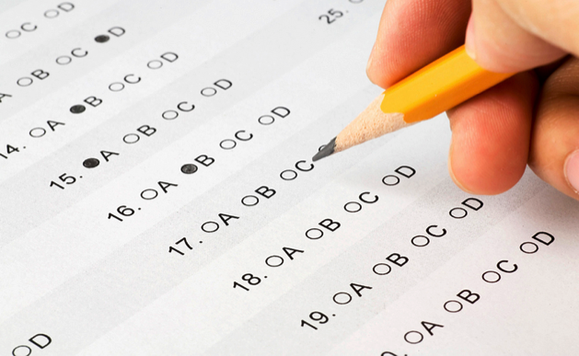

/st/ sound
Review
street
strong
student
test
star
nest

Slide 8
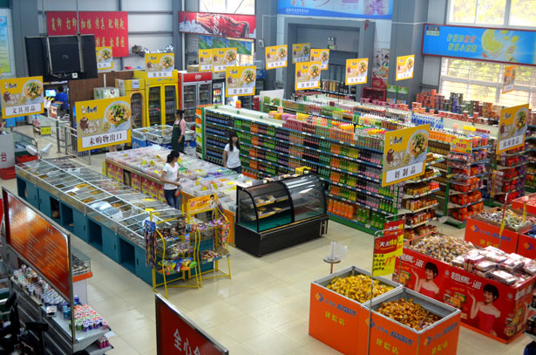





/st/ sound
Review
stool
store
stop
stone
stick
storm

Slide 9
Lesson 2, Unit 3
What day is it today?
List the days of the week as a class. Practice pronouncing them together.
Tuesday
Monday
Thursday
Friday
Saturday
Sunday
Wednesday

