Slide 1
Out of the House
Unit 3: Lesson 2

Slide 2
Review
Days of the week
Events
/sh/ sound

Slide 3
Conversation
When is yearbook club?
What day is it today?
It’s on Tuesday.
It is Friday.
Tomorrow is the weekend.

Slide 4
Lesson Activities
Days of the week circle
Partner Listening – What’s on your schedule?
Scheduling Activity Dictation or Spot the Difference
/sh/ /st/ sound review
Lesson Preview

Slide 5
Days of the Week Circle
Review
Week |  |  |  |  | Weekend
Monday | Tuesday | Wednesday | Thursday | Friday | Saturday | Sunday
Yesterday
Today
Tomorrow
Today is Tuesday.
Yesterday was Monday.
Tomorrow is Wednesday.

Slide 6
What’s on your schedule? Partner listening activity
Week |  |  |  |  | Weekend
Monday | Tuesday | Wednesday | Thursday | Friday | Saturday | Sunday
Fill in your schedule. Don’t show your partner. Read your schedule to your partner while they fill in their blank schedule. Use the following sentence pattern to help you.
I He/she | have has | soccer practice | on | Thursday and Friday.
on | the weekend.
all week.

Slide 7
Schedule Dictation/Spot the Difference
Week |  |  |  |  | Weekend
Monday | Tuesday | Wednesday | Thursday | Friday | Saturday | Sunday
I He/she | have has | soccer practice | on | Thursday and Friday.
on | the weekend.
all week.

Slide 8
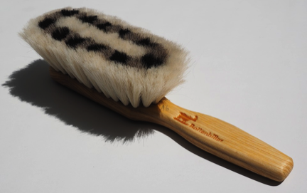
/sh/ sound
Review
trash
dish
shell
shirt
brush
ship

Slide 9
/sh/ sound
Review
shark
shoe
shin
sheet
bush
shape

Slide 10
Look around the class-
What’s he/she wearing?
She/he’s wearing a -------.

