Slide 1
Out of the House
Unit 3: Lesson 3

Slide 2
Change places – What are you wearing?
Partner Worksheet – What’s the Weather?
What to wear - Handbooks
Flashcard Memory
Lesson 4 Preview (Review)

Slide 3
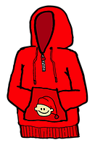
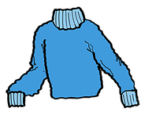
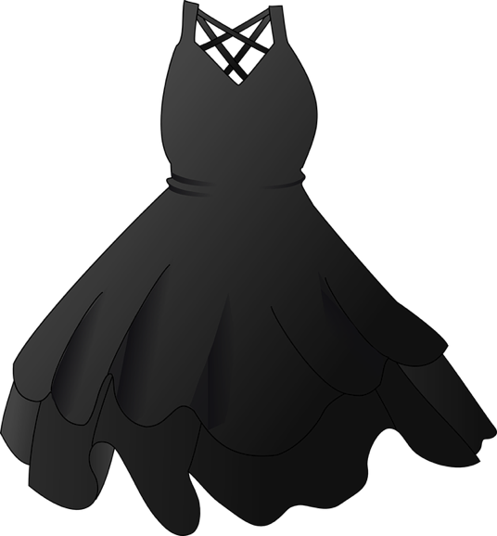
Listen to your teacher. Be ready to change places.
Q:
Who | is | wearing | a yellow t-shirt?
shorts
gloves
pants
T-shirt
sweater
hoodie
Dress
hat
swimsuit
scarf
boots

Slide 4
Weekly Weather Worksheet – Partner Activity
Monday | Tuesday | Wednesday | Thursday | Friday | Saturday | Sunday
Hot

Slide 5
Handbooks
Share your book and ask your classmates about theirs.
Q:
What | is | the | weather | like | in the winter?
A:
It | is | snowy | and | cold.
What | will | you | wear | in the winter?
A:
I | will | wear | (a) coat.
Winter
Spring
Summer
Fall

Slide 6
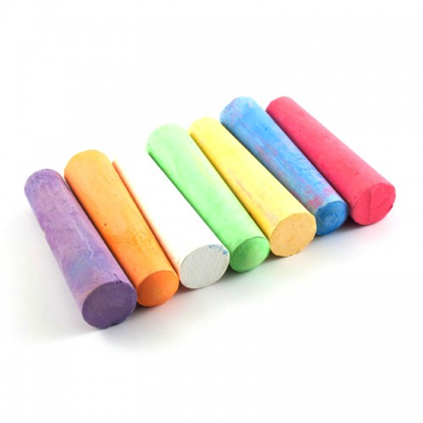
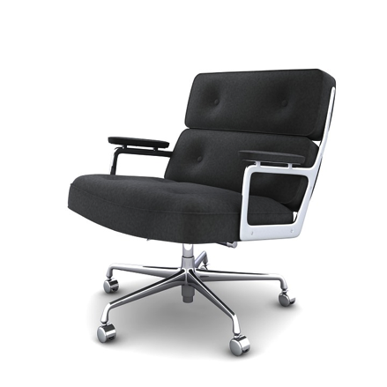
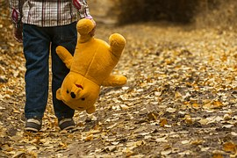
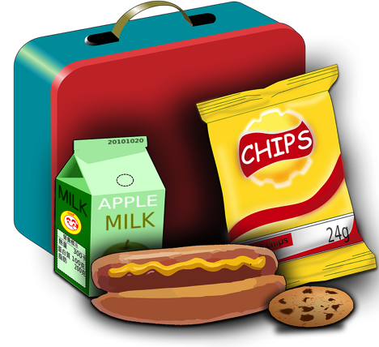
Short /ch/ sound
Flashcard Recall
chess
chalk
chair
child
cheese
lunch

Slide 7
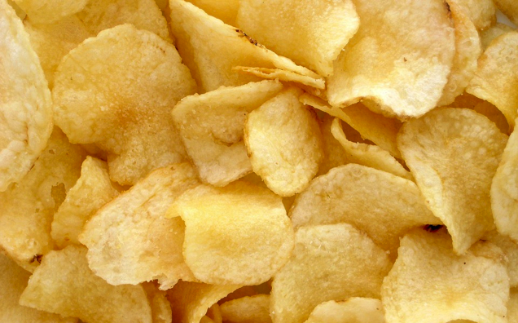
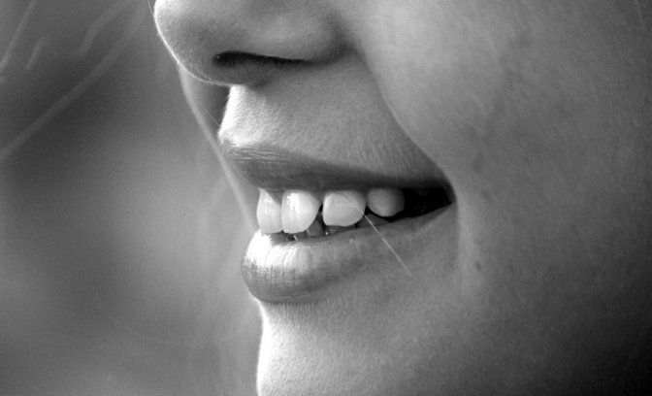
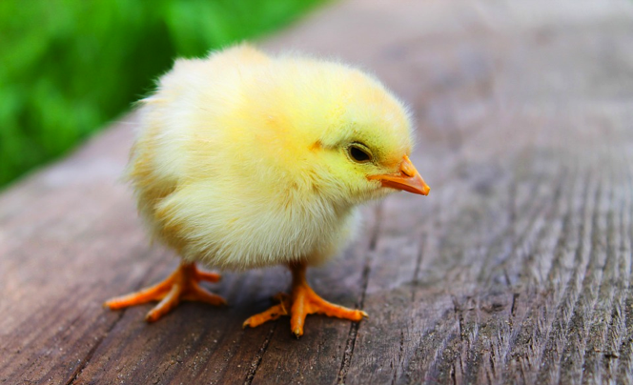
Short /ch/ sound
Flashcard Recall
chips
cheek
chain
chin
chick
beach

Slide 8
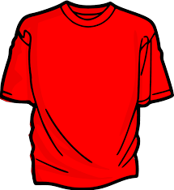
Lesson 4 Preview (Review)
Think of all of the vocabulary words from the last three lessons.
Name some for your teacher.
Group these words together under headings.

