Slide 1
Out of the House
Unit 3: Lesson 4

Slide 2
Your Schedule – Listening Activity
What’s missing? Vocabulary Review
My Weekly Diary…
/st/ /sh/ /ch/ Drawing Race
Giving Directions - Review

Slide 3
Your Schedule
Monday | Tuesday | Wednesday | Thursday | Friday | Saturday | Sunday

Slide 4
Unit Vocabulary – What’s missing from the board?
Brainstorm – What are some words you can remember from the last three lessons?
Types of Travel
Weather
Clothing
Days of the week
Weekly Schedule
Seasons

Slide 5
My Weekly Diary – In Pictures
What will you do this week? What will the weather be like? What will you wear?
Answer these questions in your weekly diary.
Share your diary with a classmate.
Discuss similarities and differences.

Slide 6
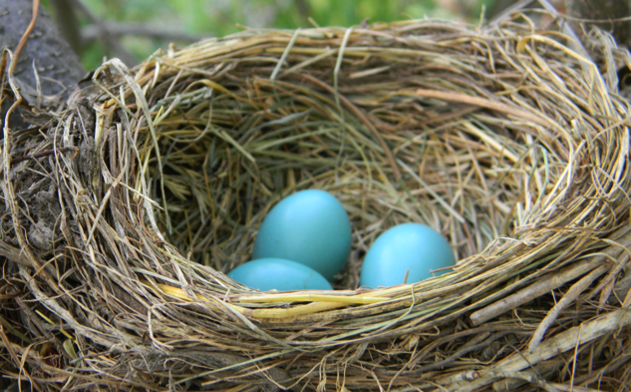
Phonics Drawing Race
Listen and Draw
Line up in four lines by the board.
Your teacher will say your phonics words to you.
Draw the picture of the word they say.
The first one done wins!
/sh/ /ch/ /st/

Slide 7
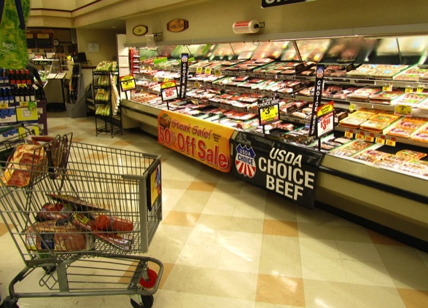
Class directions
Tell your partner how to get to the:
Q:
How | do | I | get | to | the mall?
A:
Go | right | then | left.
Library
Shopping Mall
Grocery Store
School

