Slide 1
Lesson 1
Family and Work

Slide 2

Your Family True and False
Family Stories
Describing People
/ck/
Preview Lesson 2

Slide 3

Your Family – True or False?
Write down five to ten sentences about your family.
Half of the sentences should be false and half should be true.
Work with a partner – have them guess which ones are true and which are false.
Guess theirs too!

Slide 4
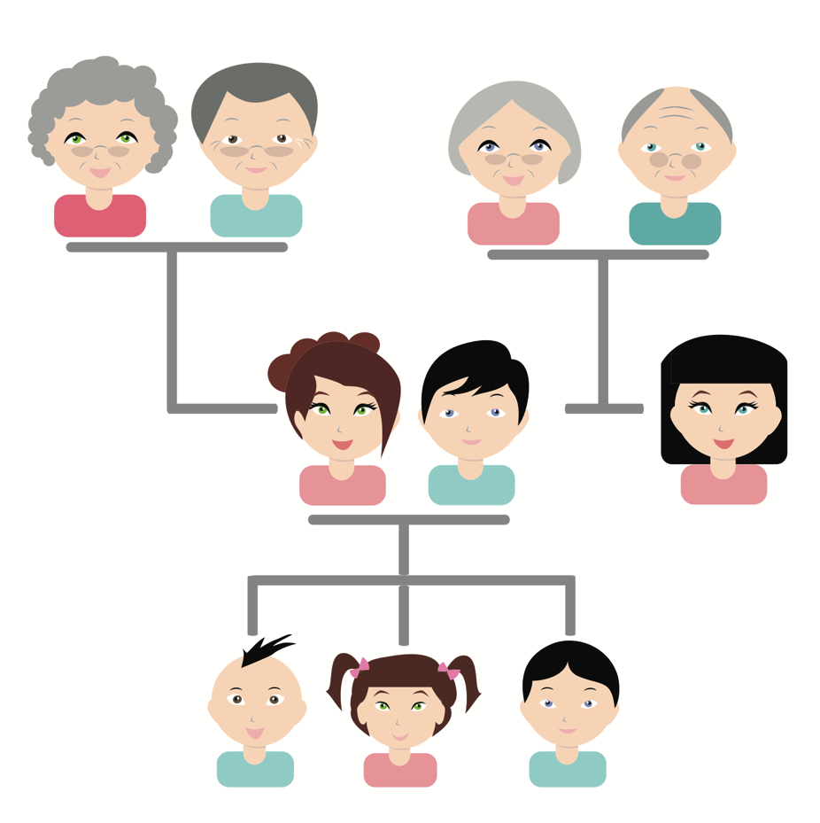
Your Family – Family Stories
Work with your partner to read and complete their family stories.

Slide 5

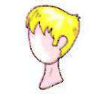
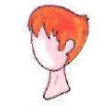
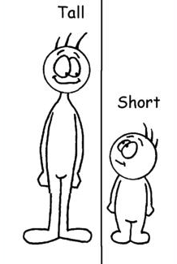
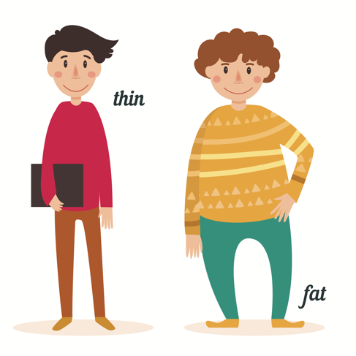
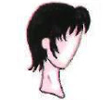
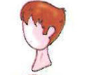
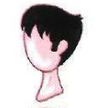
Vocabulary Review
tall
thin
fat
short
long
blonde
red
short
brown
black

Slide 6
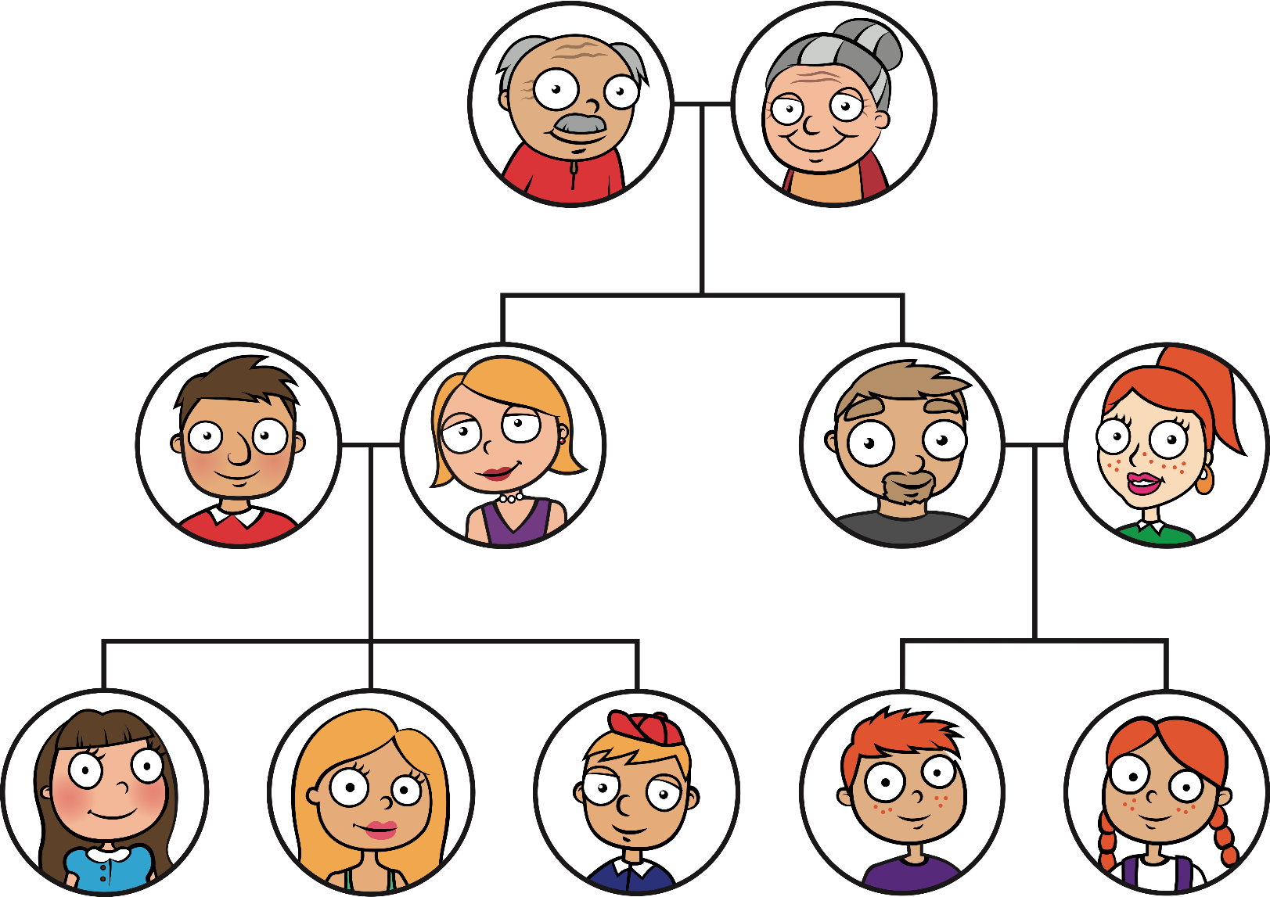
Create a Family Tree or Story
grandfather
grandmother
father
mother
uncle
aunt
you
sister
brother
cousin
cousin

Slide 7


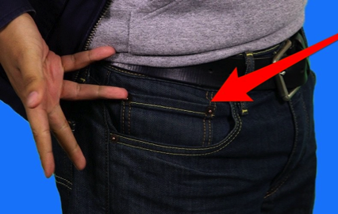
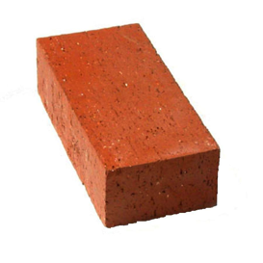

Short /ck/ sound
Listen and Repeat
lock
black
clock
pocket
brick
sock

Slide 8

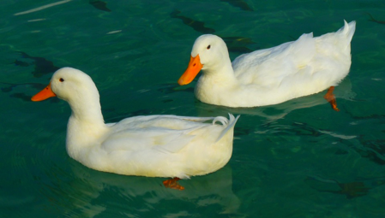



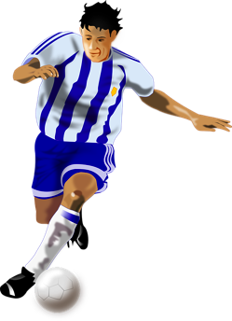

Short /ck/ sound
duck
click
back
sack
kick
truck

Slide 9
What do you want to do when you grow up?
What jobs do you know of? What do you want to do when you grow up?
List them on the board with your teacher.
$

