Slide 1
Lesson 4
Family and Work

Slide 2

Class Story
All About You - Partner interviews
Storyboard
Phonics Dash
ABCs of Jobs

Slide 3
Class Story
Topics:
Family
Appearance
Jobs
Places where people work
Rooms in a house
Furniture
Where is it?

Slide 4

All about you- Partner Interviews
Who is in your family?
What do they look like?
Do you live in an apartment or a house?
What job is the best?
What job is the worst?
What place to work is the best?
What place to work is the worst?
Ask you partner these questions!
Write down their answers.

Slide 5
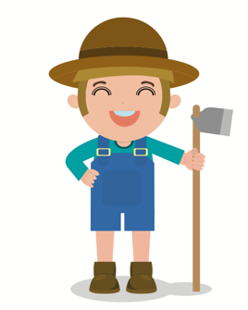
Storyboard
Job He is a farmer. He grows fruits and vegetables.
farmer

Slide 6
Phonics Dash
/ou/
/er/
/ck/
Listen carefully to your teacher. They will say a word and you should run to the correct phonics picture.

Slide 7
ABCs Job Review
A G M S Y
B H N T Z
C I O U
D J P V
E K Q W
F L R X

