Slide 1
Lesson 2
Family and Work

Slide 2

Best and Worst Jobs – Place Change
My Future Job
Job Summaries or Who am I?
/er/ sentence practice
Lesson 4-3 Preview - Prepositions

Slide 3


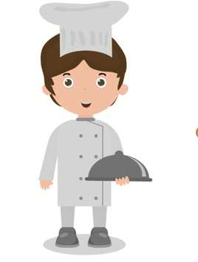
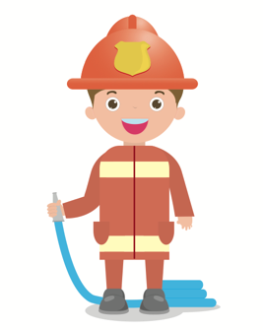



Best or Worst? Listen and move
Q:
What | do does | you he/she | do?
A:
I He/She | am is | a | scientist.
Which is the best job?
businessman
doctor
chef
firefighter
construction worker
police
officer
scientist

Slide 4

My Future Job – Conversation Example
A: | What do you want to be?
B: | I want to be a doctor. It’s the best job.
A: | Why do you want to be a doctor?
B: | Doctors help people feel better. They help people.
A: | That sounds like a good job.
B: | Yes. What do you want to be?

Slide 5





Job Summaries
Write about the jobs with a partner
Q:
What | do does | you he/she | do?
A:
I He/She | is | a | businessman.
I fly airplanes.
I grow food.
I make music.
I make art.
I protect countries.
pilot
farmer
soldier
musician
artist

Slide 6
Who am I?
Guess which job your partner does.
scientist
doctor
businessman
firefighter
chef
police officer
Construction worker

Slide 7

/er/ practice
With a partner, please write five sentences using these /er/ words. Say the sentences out loud with another group.
water
mother
summer
teacher
computer

Slide 8


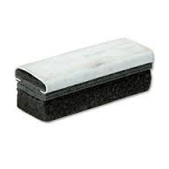

Lesson 4-3 Preview
Look around the classroom. Using prepositions, describe where things are in the classroom.

