Slide 1
Lesson 2
Family and Work

Slide 2

Lesson Activities
Prepositions Practice
Gap-fill
My House Map
/ou/ Sentence Practice
Lesson 4 – 4 Preview

Slide 3


Prepositions of Place
on
above
under
behind
beside

Slide 4







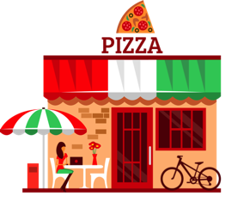
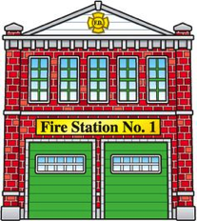





Gap-Fill: Listen to the Story and fill in the blanks
hospital
police station
airport
office building
restaurant
fire station
farm

Slide 5

Map My House - Vocabulary Review
bedroom
bathroom
kitchen
living room

Slide 6








Map My House - Vocabulary Review
dresser
chairs
bed
desk
stools
bookshelf
couch
side tables

Slide 7

Map My House - Vocabulary Review
cupboards
plant
dishes
knives
kettle
sink
pot
mug
pan
oven

Slide 8

/ou/ practice
With a partner, please write five sentences using these /ou/ words. Say the sentences out loud with another group.
hour
found
account
trout
shout

Slide 9

Lesson 4: Review
  Study for your quiz!
  Review vocabulary
  Watch Lesson 4

