Slide 1
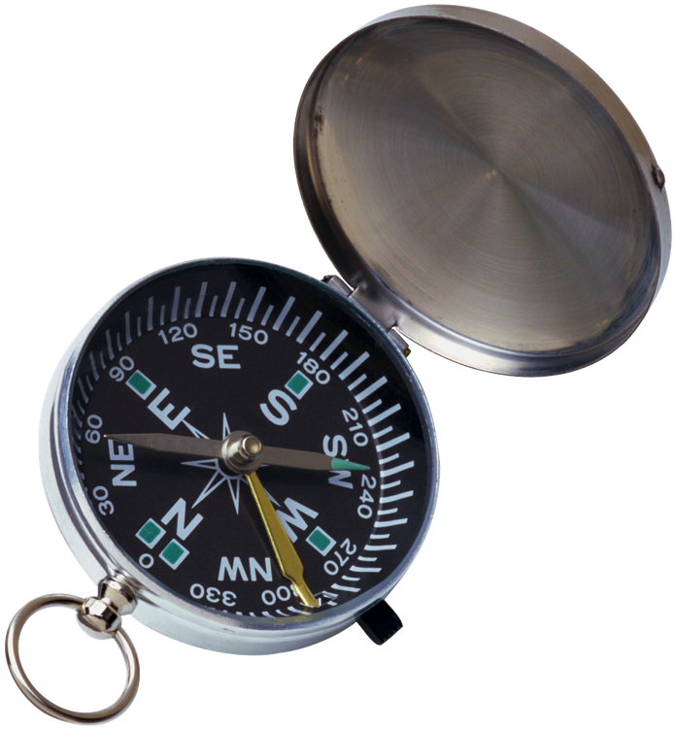
Unit 3:
Lesson One

Slide 2
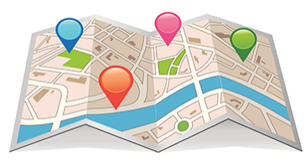
Read a map by combining text and images
Use maps to help us navigate
Use schedules to plan a trip
Use direction words

Slide 3
Amusement Park Directions
Use the Amusement Park map to answer your question.
Use direction words:
By, North, Across
Use different parts of the
Map for information

Slide 4
Plan you Fun!
Pick 3 rides, and 1 restaurant you want to go to at the Amusement park.
Include in Plan:
3 rides
1 restaurant
Where will you go first.
What time will I get to each ride
What places will I pass on the way
Make it Clear with
Directions words
Time information
Locations for reference
Location names.

Slide 5
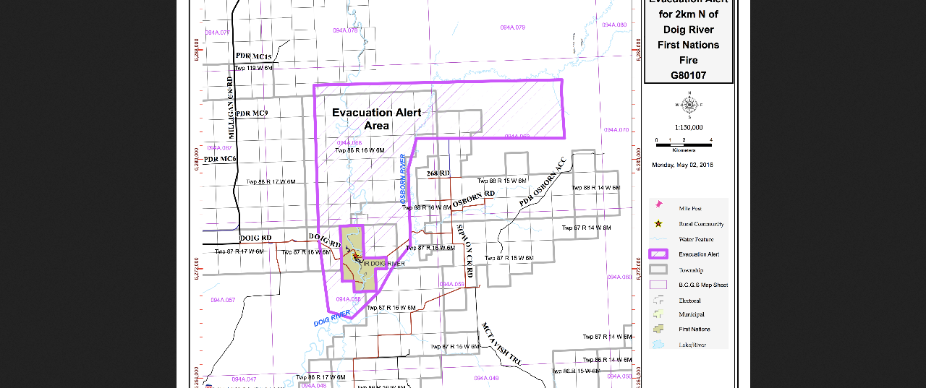
Mapping Parts
Title
Compass Rose
Labels
Scale
Location Names
Legend/Key
Notes:
Reference: http://energeticcity.ca/wp-content/uploads/2016/05/Evacuation-Alert-May-2-2016-2-km-north-of-Doig-River.png/evacuation-alert-may-2-2016-2-km-north-of-doig-river-2/

Slide 6
Lesson Assignment
In this assignment, you will brainstorm about important locations in your school. You will create a map of your school, and include two sentences that give directions to a location on the map.
Remember to include:
Include all sections of the map: title, scale , compass, labels
Make sure picture information is clear and neat.
Use 2-3 directions words in sentences to give directions.

Slide 7
Rubrics
Category | Level 4 | Level 3 | Level 2 | Level 1
Thinking | Had a very specific information about locations in my school on my map. I included all parts of the map, and used correct language to create labels for them | Had a accurate information about locations in my school on my map. I included most parts of the map, and used correct language to create labels for them | Had a general information about locations in my school on my map. I included some parts of the map, and used correct language to create labels for them | Had a little information about locations in my school on my map. I included few parts of the map, and used correct language to create labels for them
Communication | Included 3 or more directions words that were used with purpose My sentences were full and I had no spelling mistakes | Included 2-3 directions words that were used with purpose Most sentences were full, and I had no spelling mistakes | Included 1-2 directions words that were used with purpose Some sentences were full, and some spelling mistakes | Included 1 or no directions words that were used with purpose No sentences were full, and many spelling mistakes

Slide 8
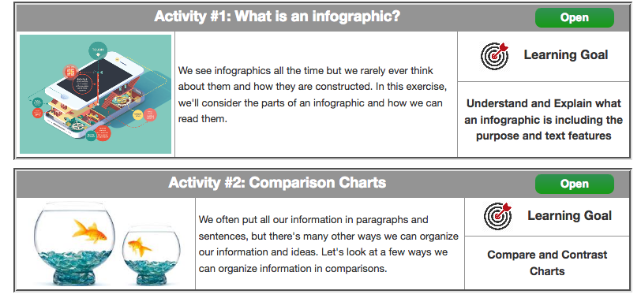
Coming Up Next!

Slide 9
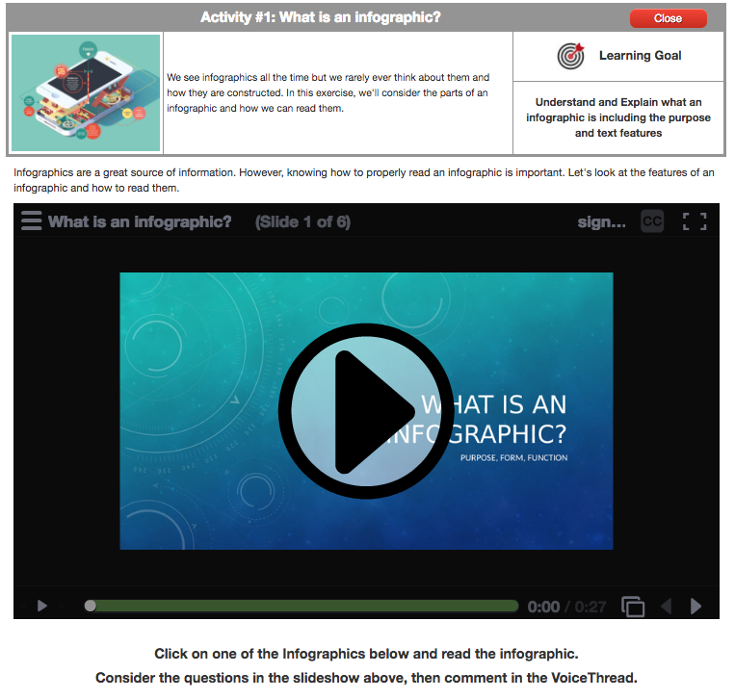

Slide 10
