Slide 1
Unit 3:
Lesson Two

Slide 2
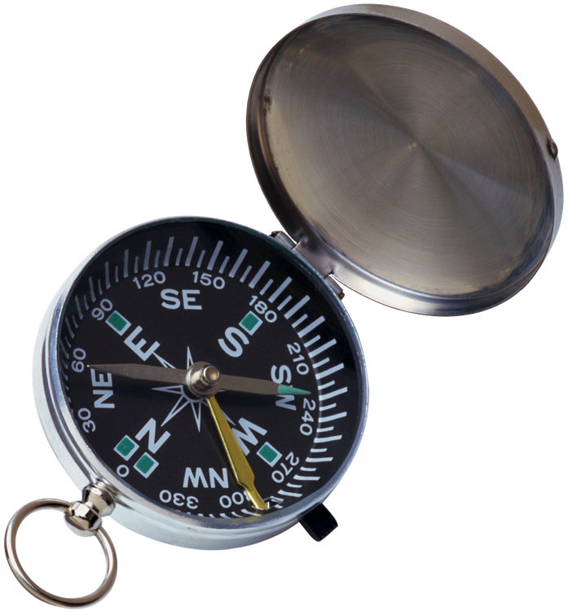
Read infographics by choosing the most important things
Determine the purpose of the infographic or graphic text
Explain orally some of the key features of an infographic
Create an infographic
Use superlatives and more/less than constructions

Slide 3
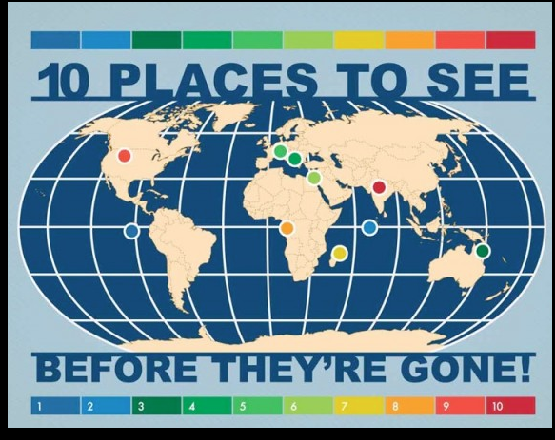
Infographic sort
Sort the infographic into the right group
Think about :
What is the topic?
How does the information connect?
What is the important information?

Slide 4
Expressing Differences!
Comparison Sentences and More or less sentences express differences.
Lets take a look!
Comparison Sentences
More or Less Sentences
Adjective Comparative Superlative
Good Better Best
Small Smaller Smallest
Important More Important Most Important
It was a good movie.
It was a better movie.
It was the best movie.
When two things are the same we use this type of comparison sentence.
(object) is as (adjective) as (object).
The pen is as small as the pencil.
More or less sentences work like this:
There are more/less (object)(+where) than (object)(+where)
There are more fish in the ocean than fish in my fish tank.
There are fewer people in a building than people in city.

Slide 5
Fill in the Sentences
1. The turtle is the animal.
2. There are cars on the highway than cars in the parking lot.
3. The cheetah is as as a car.
4. The movie was than I thought.
5. The glass cup is as as the plastic cup.
6. There are people in Canada than people in China.
Notes:
Reference: http://energeticcity.ca/wp-content/uploads/2016/05/Evacuation-Alert-May-2-2016-2-km-north-of-Doig-River.png/evacuation-alert-may-2-2016-2-km-north-of-doig-river-2/

Slide 6
Lesson Assignment
In this assignment, you will brainstorm a topic for which you would like to make an infographic. You will: pick a topic to express an idea about, include pictures to help develop the idea, and include text that develop your idea.
Remember to include:
Include all elements of an infographic: title, text , pictures.
Make sure picture information is clear and neat.
Use 2-3 comparison and more/less sentences in your text information.

Slide 7
Rubrics
Category | Level 4 | Level 3 | Level 2 | Level 1
Thinking | Had a very specific idea I am communicating about my topic . I included all parts of the infographic, and they connect well to develop my idea | Had a solid idea I am communicating about my topic I included most parts of the infographic, and they connect to develop my idea | Had a general idea I am communicating about my topic I included some parts of the infographic, and they have some connect to develop my idea | Had a vague idea I am communicating about my topic I included few parts of the infographic, and they do not connect to develop my idea
Communication | Included 3 or more comparison or more/less sentences. My sentences were full and I had no spelling mistakes | Included 2-3 comparison or more/less sentences. Most sentences were full, and I had no spelling mistakes | Included 1-2 comparison or more/less sentences. Some sentences were full, and some spelling mistakes | Included 1 or no comparison or more/less sentences. No sentences were full, and many spelling mistakes

Slide 8
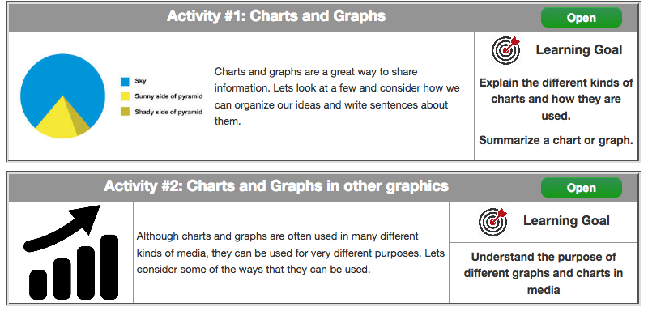
Coming Up Next!

Slide 9
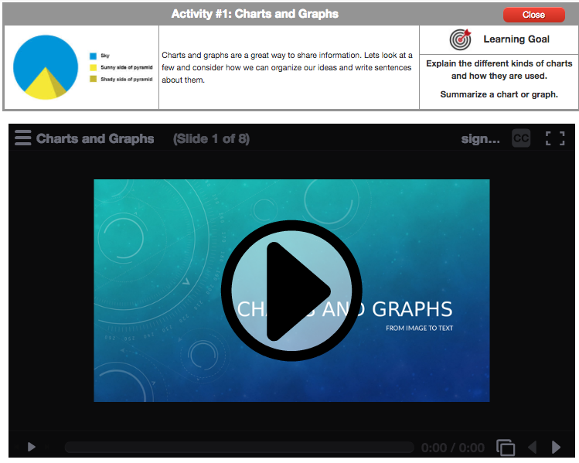

Slide 10
