Slide 1
Unit 3
Lesson Three

Slide 2
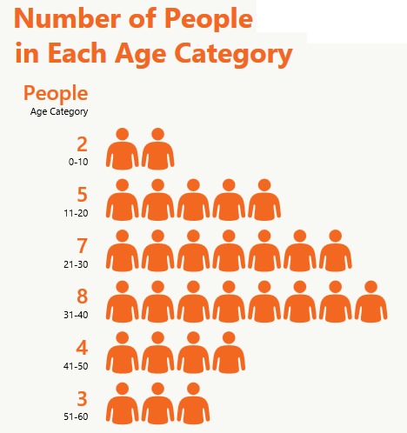
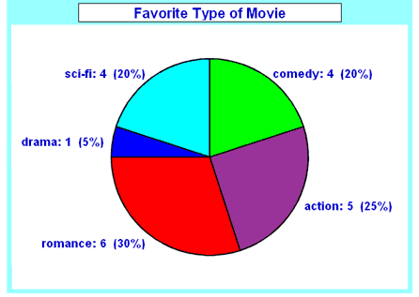
Write a short summary of an infographic
Explain different charts and graphs and how they are used.
Create your own chart or graph

Slide 3
Favourite Colour Chart
What is your favourite colour?
Think about :
What kind of charts do you know of?
What would be the best chart to show the information?

Slide 4
Reading A Chart!
Read the chart, and create a 2-3 sentence summary!
Think About:
What is the topic of the graph?
What information does it tell me?
Why is this information important?
Is the chart misleading in any way?

Slide 5
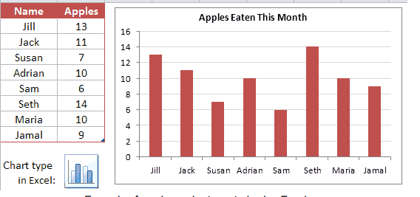
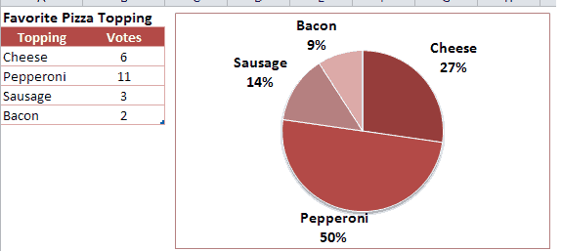
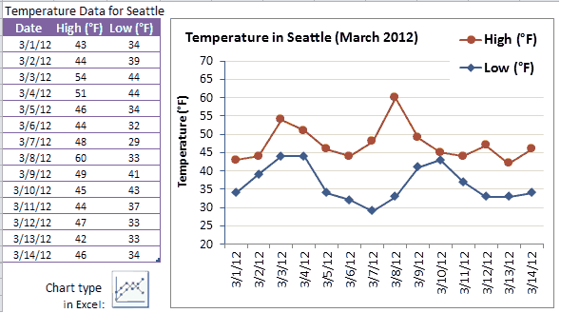
Different Types of Charts and Graphs
Notes:
Reference: Chart Graph Excel. http://www.vertex42.com/edu/charts-and-graphs-in-excel.html
Airplane diagram. https://hannahphang.wordpress.com/2011/02/21/instructions/
Granny Smith Apple recipe. cookingwithmunira.com

Slide 6
Lesson Assignment
In this assignment, you will brainstorm a topic for which you would like to make a chart. You will: pick a topic to express facts about, include all elements of your type of chart, and include two sentences explaining if your chart is misleading in anyway.
Remember to include:
Include all elements need for the chart: title, label , table with data collected .
Make sure to research all data needed, and pick a chart type that will show information well.
Make sure to reflect on your chart, and explain if it is misleading.

Slide 7
Rubrics
Category | Level 4 | Level 3 | Level 2 | Level 1
Thinking | Had a very specific idea I am communicating about my topic . I included all parts needed in my chart type, and have researched data. | Had a solid idea I am communicating about my topic I included most parts needed in my chart type, and have researched data | Had a general idea I am communicating about my topic I included some parts needed in my chart type, and have researched data | Had a vague idea I am communicating about my topic I included few parts needed in my chart type, and have researched data
Communication | Included 3 or more sentences reflecting on my chart. My sentences were full and I had no spelling mistakes | Included 2-3 sentences reflecting on my chart. Most sentences were full, and I had no spelling mistakes | Included 1-2 sentences reflecting on my chart. Some sentences were full, and some spelling mistakes | Included 1 or no sentences reflecting on my chart. No sentences were full, and many spelling mistakes

Slide 8
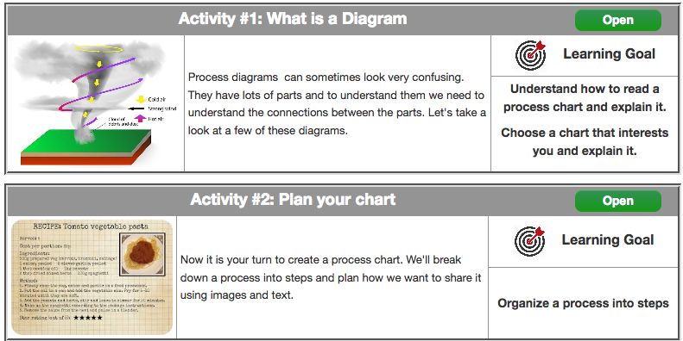
Coming Up Next!

Slide 9
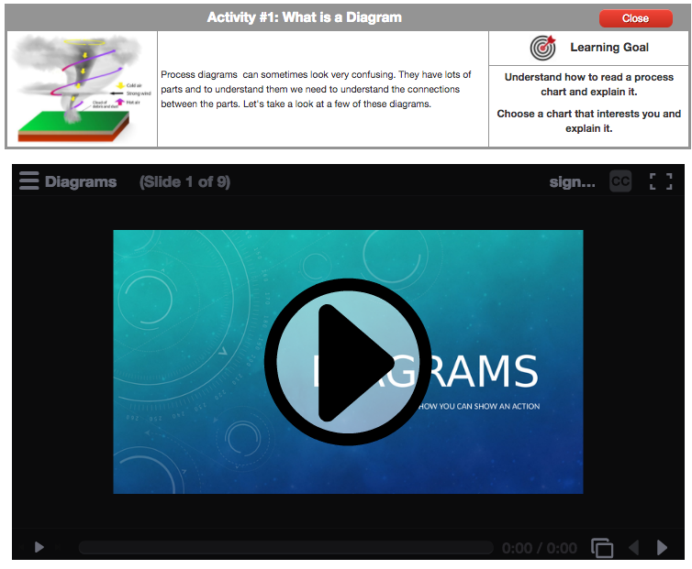

Slide 10
